Slide 1
ABB SACE Emax 2
Monday, November 18, 2019
Concept
Global Product Management Breakers & Enclosure, EPSP

Slide 2
SACE Emax 2
The mission
Design and Planning
Startup and Commissioning
Operation and Service
Reduce design time and prospective cost of the system
Minimize manhours and space
Keep systems reliable, safe and adaptive to constantly evolving needs
Deliver value through the entire customer journey

Slide 3
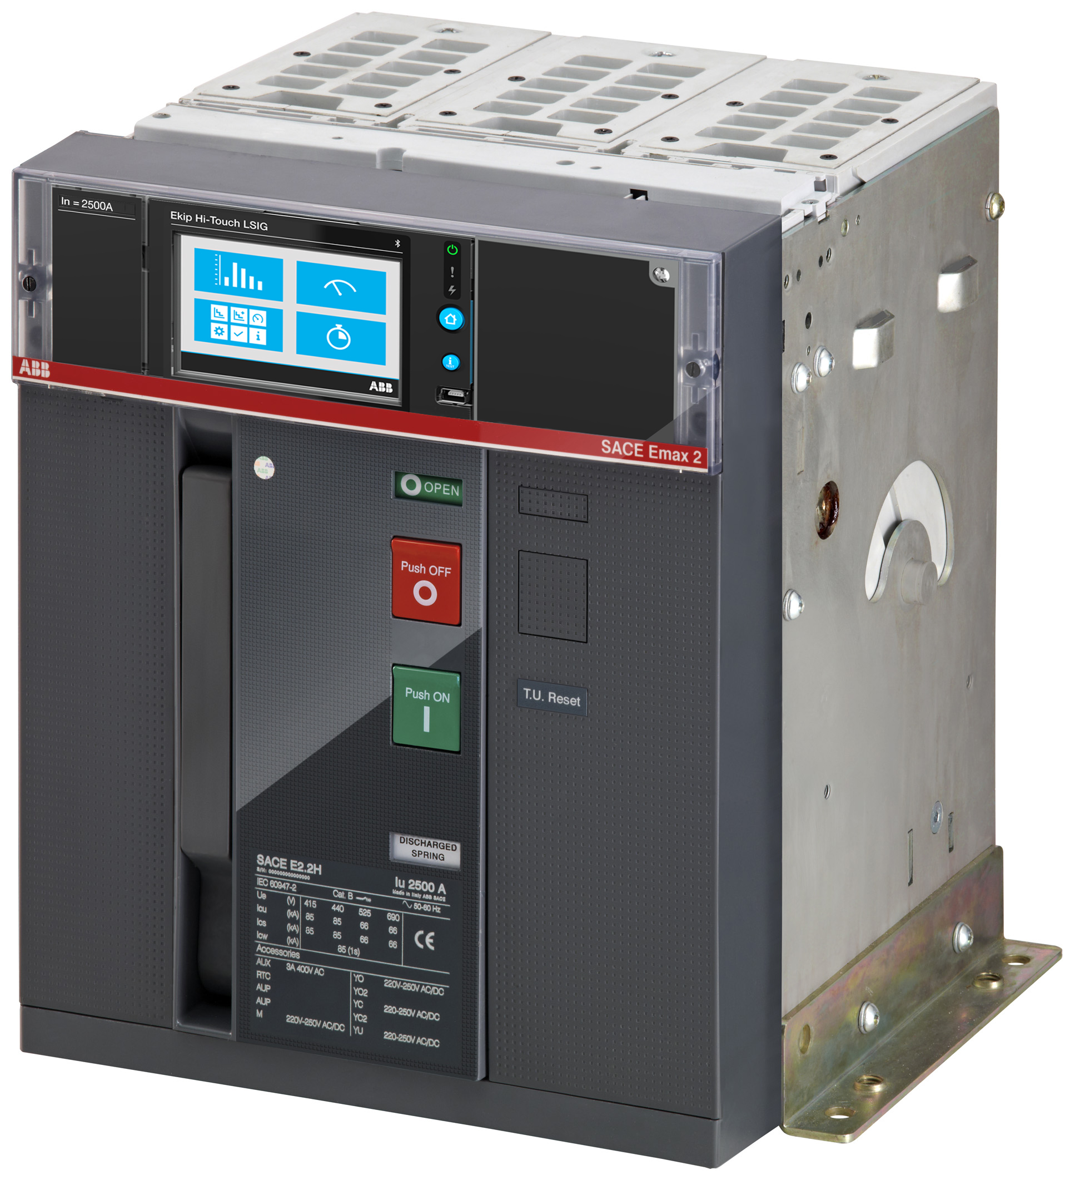
SACE Emax 2
Concept
SACE Emax 2 improves the efficiency of electrical systems, creating the new standard in:
Performance
Satisfying all requirements at the right size
1
Control
Optimization of power flow even in emerging microgrid application
2
Connectivity
Integration into any digital system
3
Ease of use
Simplified user experience; at all customer interactions during the product’s lifecycle
4
SACE Emax 2 is far more than a Circuit Breaker…

Slide 4
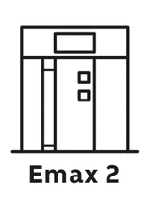
SACE Emax 2
Concept
More than traditional circuit breakers:
Measurement
Solutions to understand power consumption
Protection
Advanced functions for microgrids and distribution systems
Logics
Ensure continuous power supply and system operation
Connectivity
Integration into all automation and energy management systems
Everything is Embedded into Emax 2…All-In-One Innovation Concept

Slide 5
SACE Emax 2
Performance

Slide 6
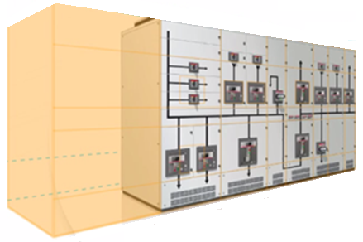
SACE Emax 2
Performance
More efficiency in switchgear:
Four construction sizes
High short circuit rating in a compact size
Optimized design for higher current–carrying capacity
Embedded functionalities, avoiding external devices, cables and extra space
Benefits:
Reduce equipment footprint
Reduced busbar length, saving copper
Reduce panel surface, saving metal sheet
30%
footprint reduction
Less System Cost and More Usable Space for End User
Discover your saving with Emax 2 switchboard calculator >>

Slide 7
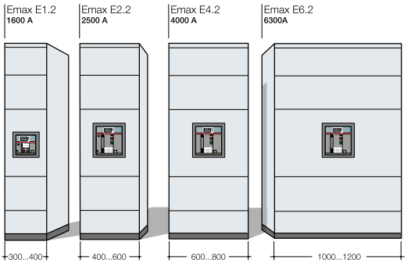
SACE Emax 2
Up to 30% saving on footprint reduction
Performance
More efficiency in switchgear:
Four construction sizes
High short circuit rating in a compact size
Optimized design for higher current–carrying capacity
Embedded functionalities, avoiding external devices, cables and extra space
Benefits:
Reduce equipment footprint
Reduced busbar length, saving copper
Reduce panel surface, saving metal sheet
Less system cost and more usable space for end user

Slide 8
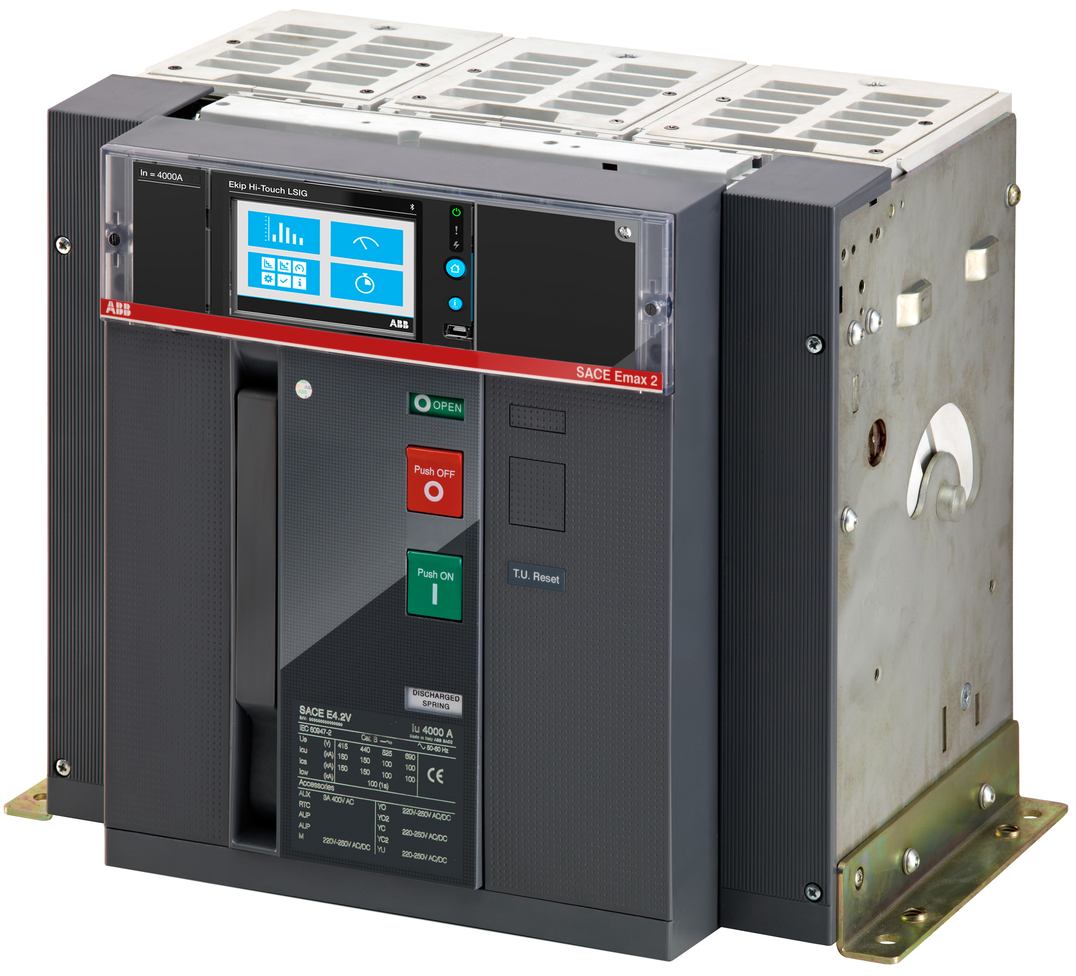
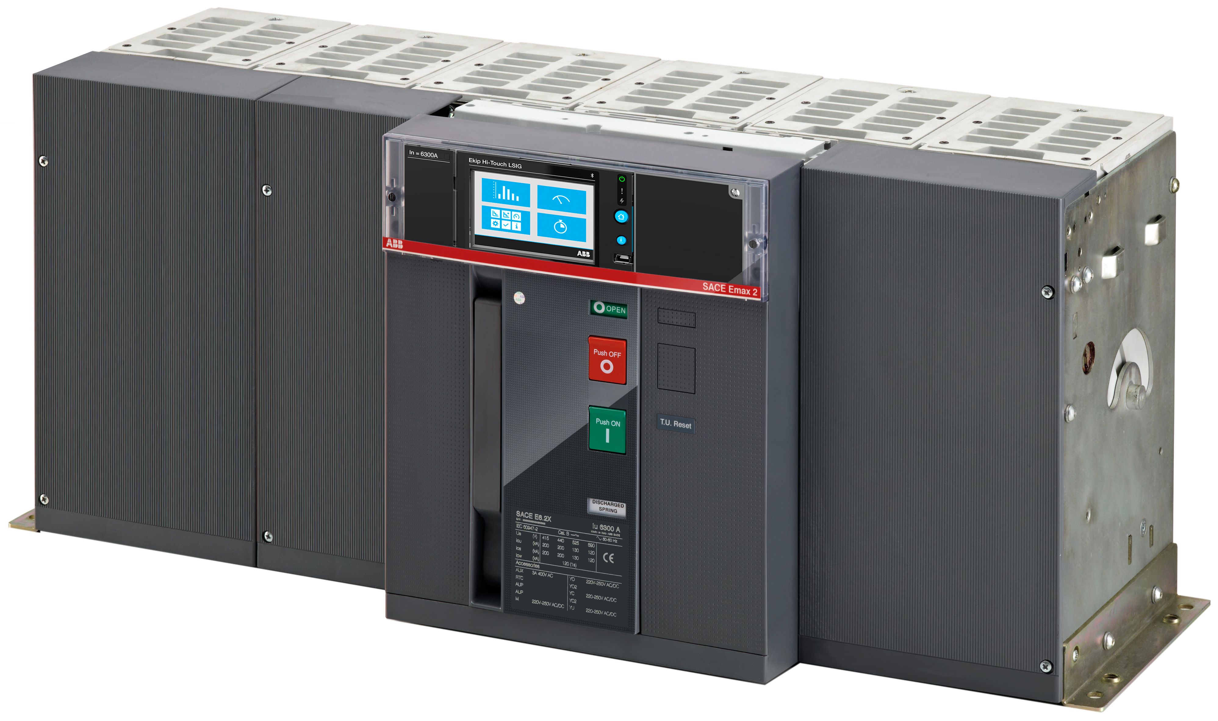
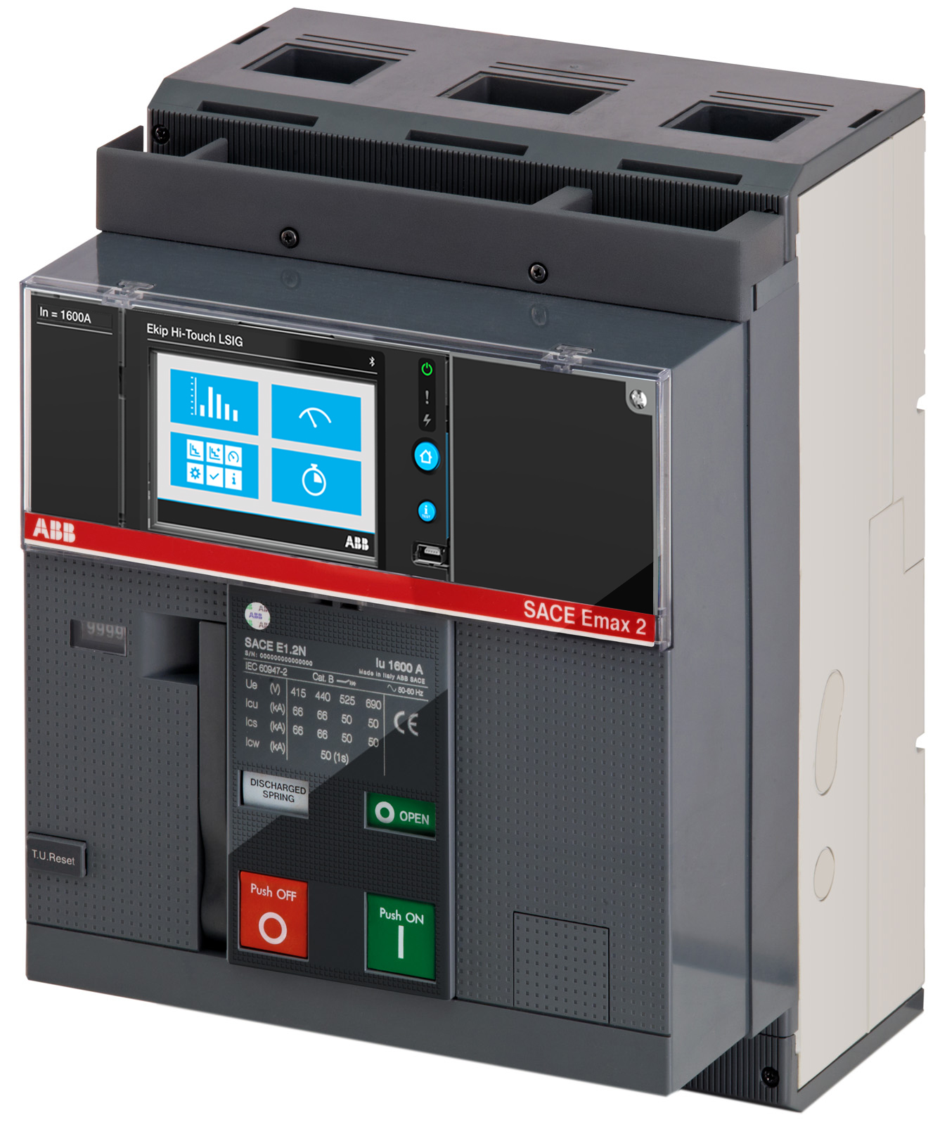
SACE Emax 2
Performance
The range:
Fixed and withdrawable versions
Same electronic trip across the family
Same auxiliary terminal box
Same height and depth from E2.2 to E6.2
E1.2
E2.2
E4.2
E6.2
A global platform:
Emax 2 IEC
A complete family from 250 A to 6300 A for applications in accordance to IEC 60947 standards
Emax 2 UL1066
A complete portfolio of breakers from 800 A to 6000 A for applications in accordance to ANSI C37/UL1066 standards
Emax 2 Multilisting
Offering dedicated to global OEMs that desire standardized solutions. These devices include IEC , UL and CCC markings on one device.
Emax 2 High Voltage
Market leading high voltage performance for renewable customers up to 900Vac.

Slide 9
SACE Emax 2
Performance
E1.2 - The most compact frame
Icu= 42, 50, 66kA@440V; 42, 50kA@690V
Icw= 42, 50kA (1s)
20.000 mechanical operations
Installation in vertical and horizontal
1.600A switchboards with a 400mm width
E2.2 - The new reference up to 2.500A
Icu= 42, 50, 65, 85, 100kA@440V; 42, 66, 85kA@690V
Icw= 42, 66, 85kA (1s)
2.500A switchboards with 400 mm(3p) or 600mm (4p) in width
2.500A available in IP31@35/45°C switchboards

Slide 10
SACE Emax 2
Performance
E4.2 - The ultimate performance
Icu=66, 85, 100, 150kA@440V; 66, 85, 100kA@690V
Icw= 42, 66, 85, 100kA (1s)
4.000A switchboards with 600 mm(3p) or 800mm (4p) in width
Fully rated neutral in 4p
E6.2 - Efficiency up to 6.300 A
Icu=100, 150kA@440V; 100, 120kA@690V
Icw=100, 120kA(1s)
Iu=6.300A in switchboard
Doubled 4.000A pole structure
50% and 100% rated neutral

Slide 11
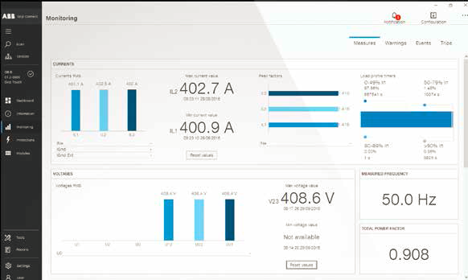
SACE Emax 2
Performance
Measures
All the electrical parameters at your disposal without any additional components
Current, Voltage, Phase sequence, Frequency, Power, Energy, Power factor, Peak factor
Accuracy
Class 1 in Energy and Power according to IEC 61557-12
Accuracy: Current 0.5%, Voltage 0.5%, Power 1%, Energy 1%
Availability
Data available at any time
Instantaneous values
Historical measurement
A complete, accurate and easily accessible solution

Slide 12
SACE Emax 2
Performance
Certified for IEC 61557-12
A rigorous and reliable standard
Certified Class 1 Energy and Power
Analysis of energy demand
Energy analysis

Slide 13
SACE Emax 2
Control

Slide 14
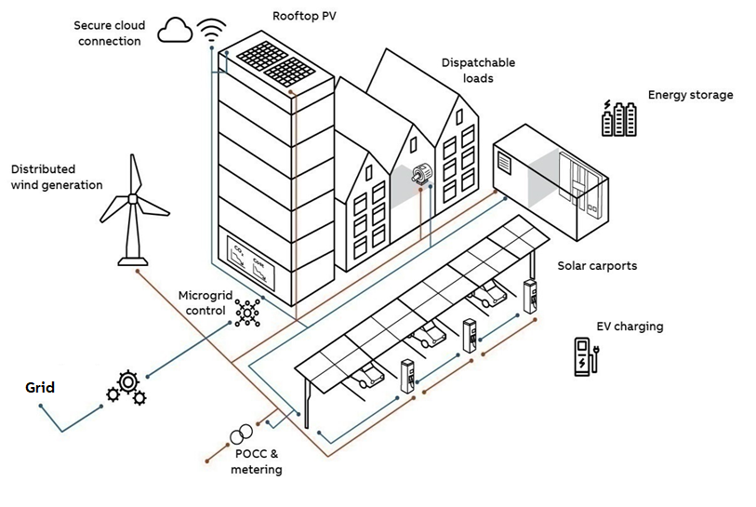
SACE Emax 2
Control
Optimization of power flow, for example a microgrid:
Ensure and adapt protection under any condition
Manage different energy sources
Interact with the main grid
Manage power consumption
Minimize down-time
Benefits:
Higher reliability
Service continuity
Optimization of power
Savings in space, time and system costs
1
2
3
4
5
Discover your saving with Emax 2
Power controller >>

Slide 15
SACE Emax 2
Control
Adaptive protections:
Ensure and adapt protection under any condition
Manage different energy source
Interact with the main grid
Manage power absorption
Minimize down-time
To guarantee selectivity, it is important to take into account the variation of the short circuit power when moving from on-grid to off-grid operation. The fault current differs when supplied by Utility or local generation. Emax 2 adapts automatically the protection thresholds ensuring protection under any condition.
Benefits: Service continuity
1
2
3
4
5
1
Discover your saving with Emax 2
Power controller >>

Slide 16
SACE Emax 2
Control
Transfer Switch:
Ensure and adapt protection in any condition
Manage different energy sources
Interact with the main grid
Manage power absorption
Minimize down-time
Includes an embedded solution to switch from the main power circuit to another power source ensuring service continuity and source optimization. Emax 2, via digital communication, ensures an ultra fast data exchange between the devices and the network.
Benefits: Service continuity, ready-to-go programming
1
2
2
3
2
4
5
2
Discover your saving with Emax 2
Power controller >>

Slide 17
SACE Emax 2
Control
Interface protection and Synchro-reclosing:
Ensure and adapt protection in any condition
Manage different energy source
Interact with the main grid
Manage power absorption
Minimize down-time
Interface protection, based on voltage and frequency, are required to disconnect the microgrid from the main grid.
When conditions allow, the Emax 2 has the capability to automatically re-close the microgrid to the main grid by leveraging synchrocheck and switching logics.
Benefits: Space savings inside switchgear​, solution cost, and service continuity
1
2
3
4
5
3
3
Discover your saving with Emax 2
Power controller >>

Slide 18
SACE Emax 2
Control
Power controller:
Ensure and adapt protection in any condition
Manage different energy source
Interact with the main grid
Manage power consumption
Minimize down-time
Ekip Power Controller works by managing user ranked non-priority loads to limit the average power consumption of the system (i.e. thermal and refrigerating loads, lighting apparatus, delayed start loads, charging systems for electric vehicles, generators)
Benefits: Ready to use, engineering free, lower energy cost
1
4
2
3
4
5
4
Discover your saving with Emax 2
Power controller >>

Slide 19
SACE Emax 2
Control
Load Shedding:
Ensure and adapt protection in any condition
Manage different energy source
Interact with the main grid
Manage power absorption
Minimize down-time
When the main grid is disconnected, the Emax 2 avoids microgrid blackouts by quickly disconnecting the non-priority loads thus preventing a frequency drop and delivering continuity for the priority loads.
Benefits: Service continuity, no downtime costs
1
2
3
4
5
5
Discover your saving with Emax 2
Power controller >>

Slide 20
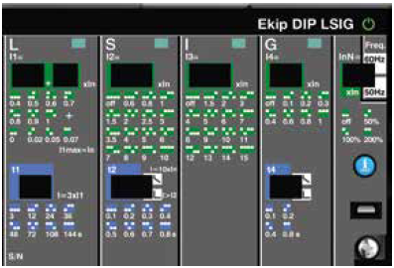
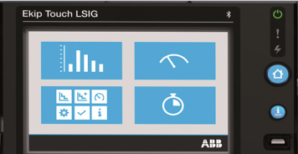
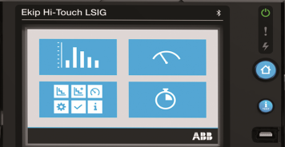
SACE Emax 2
Control
Ekip Dip: The standard trip unit
Ekip Touch: The smart trip unit
Ekip Hi-Touch: The ultimate trip unit
Current protection for basic distribution
Thermal memory, separate settings for neutral
LED signals trip cause; time and date of last trip available
More than Ekip Dip:
Ready to be upgraded and customized
Advanced protection set for more sophisticated systems (GFext + 2I)
Ready for measuring
Embedded Bluetooth
More than Ekip Touch:
Advanced preloaded feature set
Class 1 accuracy
Exclusive directional protection for complex grids
Dual setting for smart grids and arc-flash
Self-power

Slide 21
SACE Emax 2
Connectivity

Slide 22
SACE Emax 2
Connectivity
Key features
Plug & play communication cartridge modules avoiding external gateway and other interfaces
A wide selection of field bus protocols to simplify integration to any system and network
First circuit breaker with IEC61850 communication, avoiding external relays and complex integration
Multi-protocol platform ensuring different protocols work together
Direct cloud connectivity to ABB Ability for valued added services
Wide set of analog and digital interfaces to interact with any ecosystem
Embedded Bluetooth connectivity
Gateway free
Maximum reliability
Zero space
Multi protocols
Universal interface
External relay free
Fully integrated; just one single product can replicate the functionality of many

Slide 23
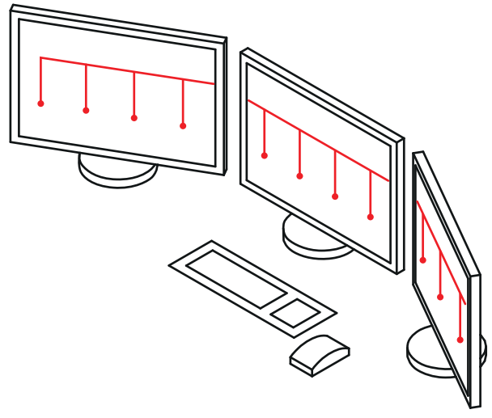
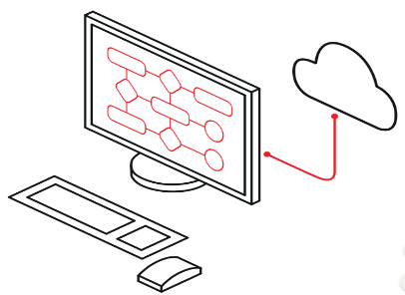
SACE Emax 2
Connectivity
A full range of possibilities
Remote Communication
Embedded Bluetooth technology
ABB AbilityTM EDCS

Slide 24
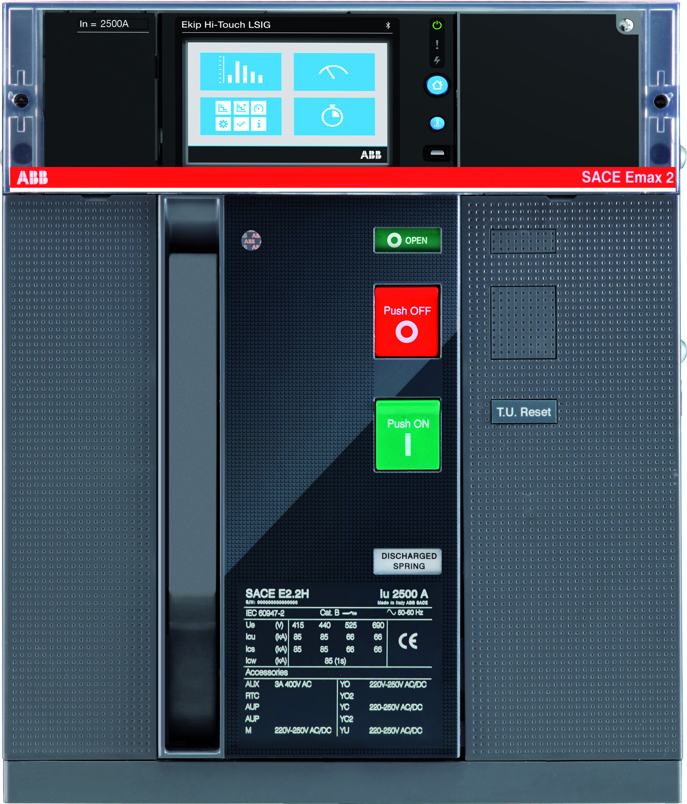
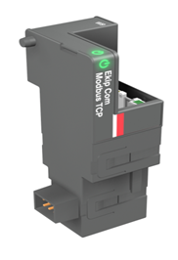
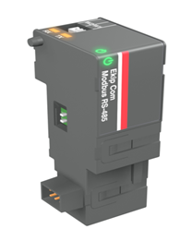
SACE Emax 2
Connectivity
Plug & Play modules
Plug&play communication cartridge modules enable direct communication with the seven most common industrial communication protocols and the cloud:
Modbus RTU, Modbus TCP, Profibus DP, DeviceNet, ProfiNet, Ethernet/IP, IEC 61850, Com Hub
Multiple modules can be used simultaneously.
Additionally, Emax 2 offers a wide range of analog and digital I/O to acquire external measurement (i.e temperature) and signals.
The most flexible and comprehensive connectivity offering

Slide 25
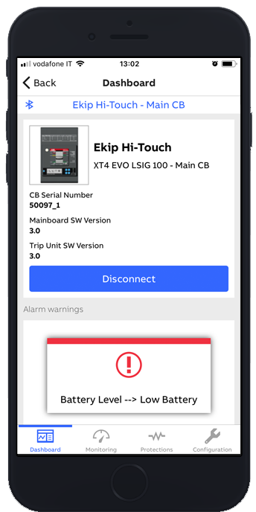
SACE Emax 2
Connectivity
Embedded Bluetooth
Easy protection setting and information access
Possibility to upgrade the circuit breaker through SW packages available on ABB Ability Marketplace™
Safe commissioning of the device
Import and export settings
Always connected and up to date

Slide 26
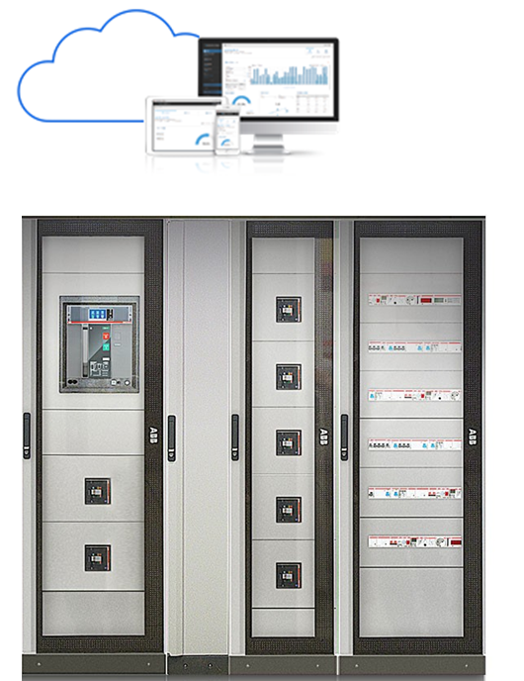
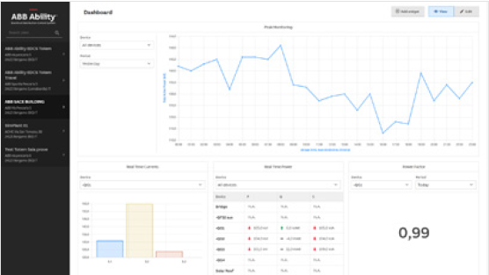
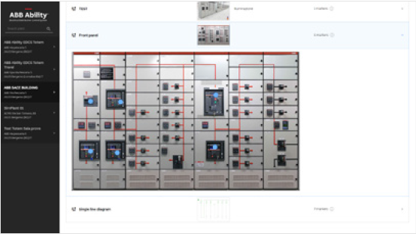
SACE Emax 2
Connectivity
ABB AbilityTM EDCS: Cloud-based Energy and Asset Management
Monitor
Discover plant performance, monitor the electrical system, and allocate costs
Optimize
Analyze the relevant information, improve the use of your assets, and make the right business decisions
Predict
Supervise the system health conditions and predict the next maintenance
Control
Remotely implement an effective power management strategy to save on energy cost
Maintenance costs reduced up to 30%

Slide 27
SACE Emax 2
Ease of use

Slide 28
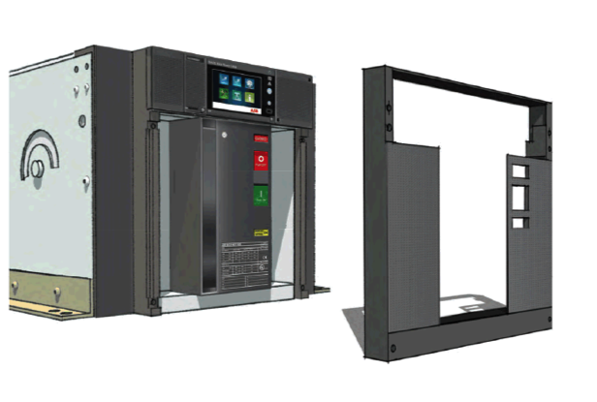
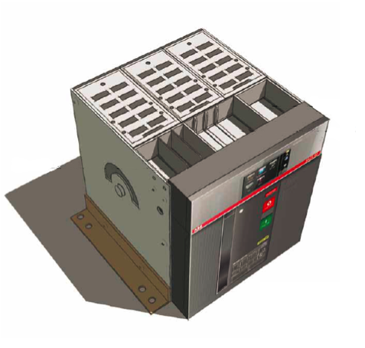
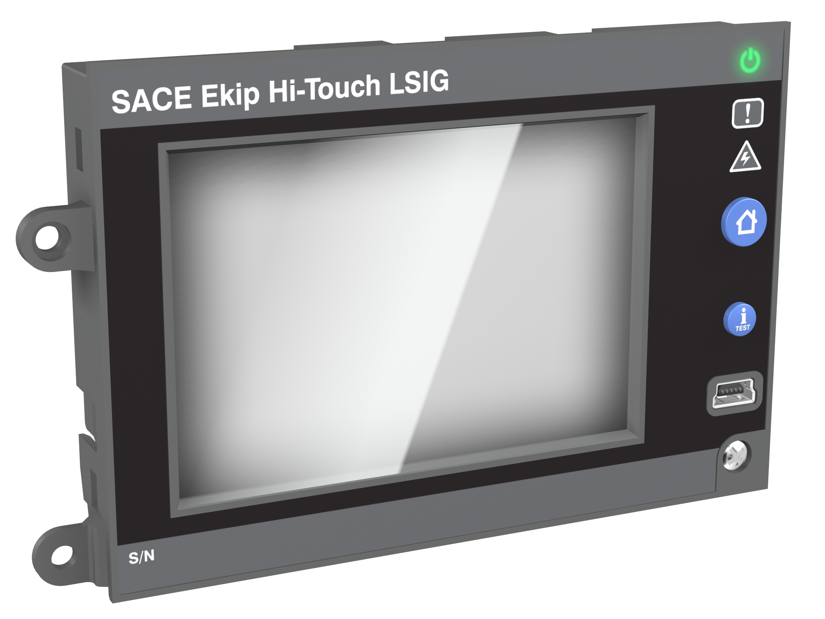
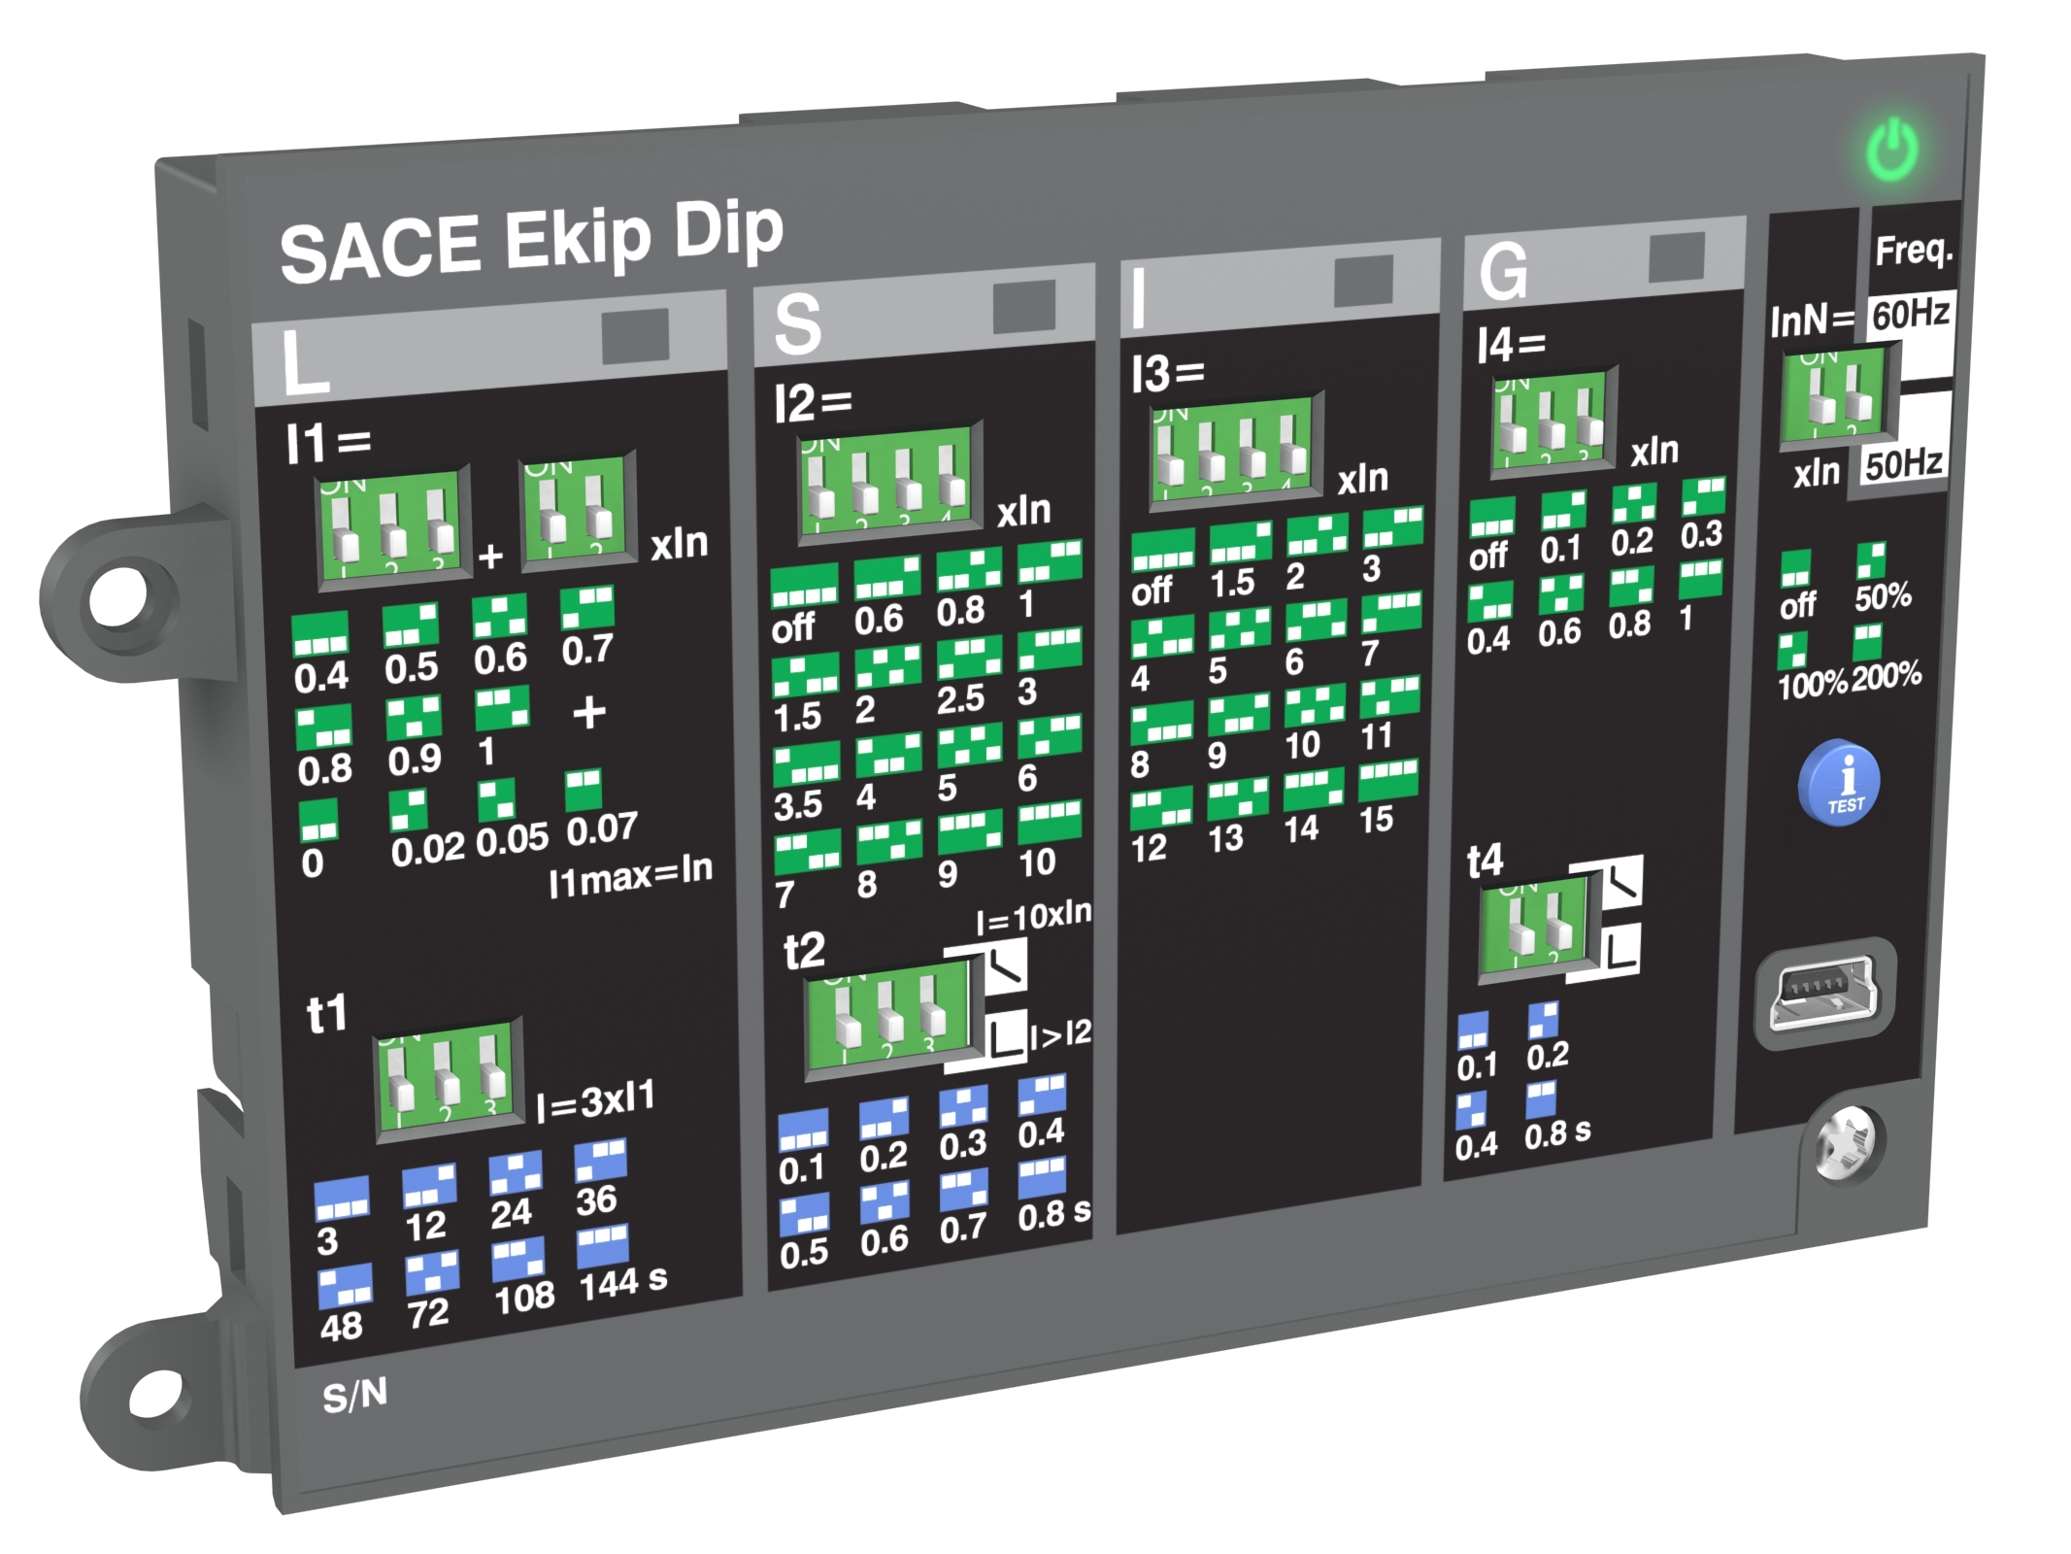
SACE Emax 2
Ease of use - Architecture
Auxiliary terminals
Trip Units
Cartridge modules
Accessories
Safety area
25% less time installing accessories compared to the previous ACB series

Slide 29
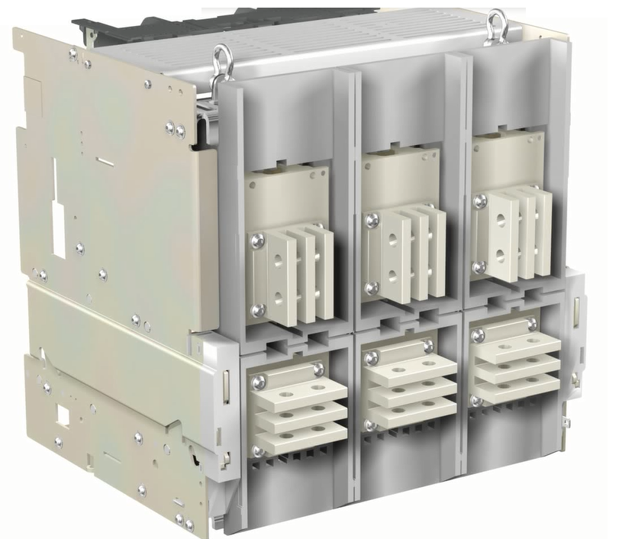
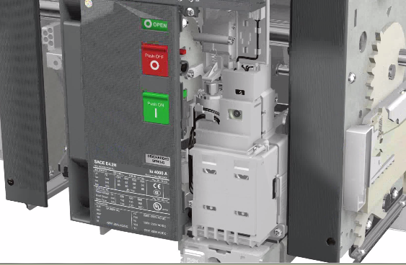
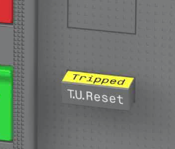
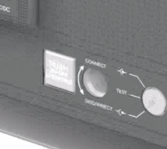
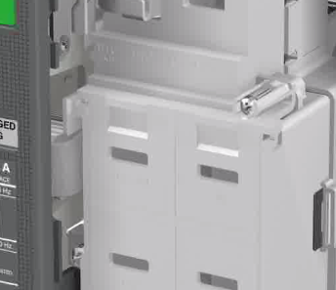
SACE Emax 2
Ease of use - Accessories
Adjustable terminals
Pre-wired accessories
Intuitive Indicators
25% less time installing accessories compared to the previous ACB series

Slide 30
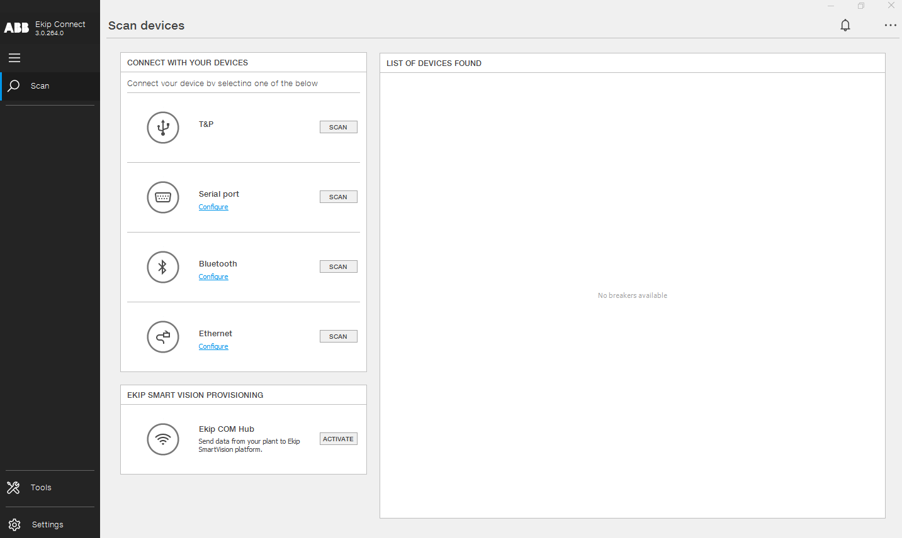
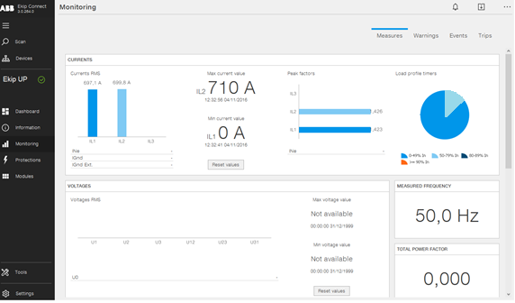
SACE Emax 2
Ease of use - Commissioning
Easy and fast commissioning by Ekip Connect:
Device setting
Protection setting
Diagnostics
Reporting
Testing
Versions:
Laptop
EPiC Mobile app
50% time saved during trip units commissioning

Slide 31
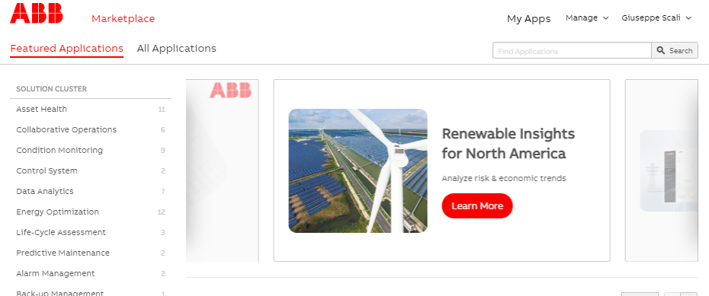
SACE Emax 2
Ease of use - Evolution
Emax 2 is able to evolve during its lifecycle
Thanks to the ABB Ability MarketplaceTM and dedicated software packages, Emax 2 can be fully customized at any point in its lifecycle.
Measurements
Protection functions
Network Analyzer
Data Logger
Buy
Upgrade
100% device upgradability, if new capabilities needed once installed

