Slide 1
UniPack Compact Substation
Optimized solution for Data Centers

Slide 2
Data Centers
UniPack Compact Secondary Substation (CSS)

Slide 3
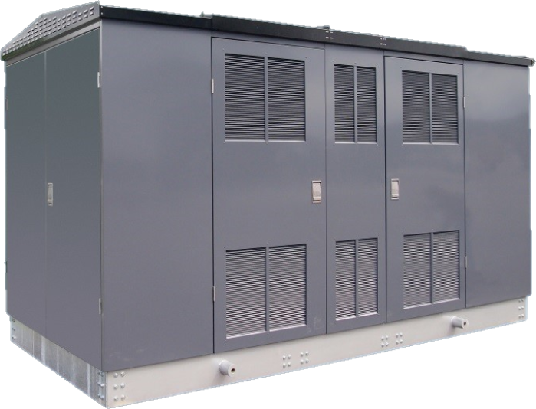
Data Centers
Compact Secondary Substation
ABB UniPack
Values
High level of safety for equipment and personnel
Type tested per the latest international standard IEC 62271-202
Internal arc tested for public and service personnel safety
Compact solution with a small footprint
Design optimized for optimal footprint utilization
Faster delivery
Reliability
Plug and play solution including medium voltage switchgear, transformer and low voltage switchboard
Easy and fast installation, commissioning and relocation
Natural cooling of transformer to reduce risk of failure

Slide 4
Data Centers
Values
1. High safety
Internal arc fault tested
Type tested per IEC62271-202
2. Reliability
Plug and play solution including MV/LV SWG and transformer
Easy and fast installation, commissioning and relocation
Natural cooling of transformer to reduce risk of failure
3. Compact solution with a small footprint
Design optimized for optimal footprint utilization
Fast delivery
4. Eco-friendly
Low environmental impact
Transformer oil containment bund or dry type
Low global warming potential MV switchgear as an option
Energy efficient with low losses transformer

Slide 5
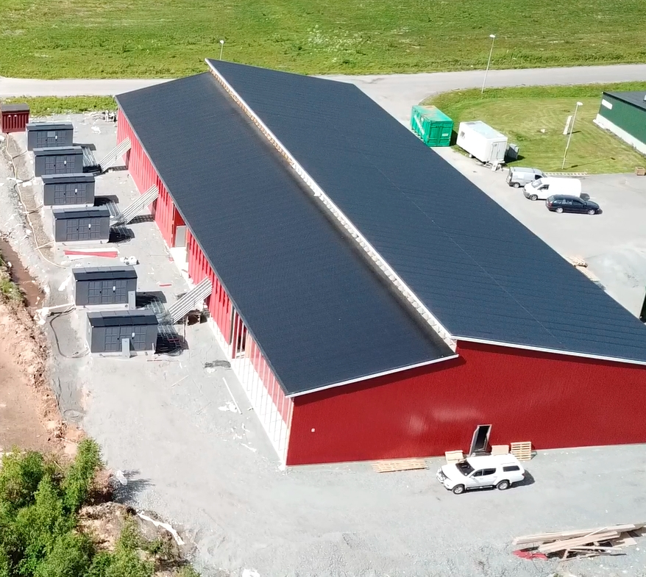
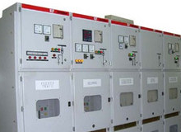
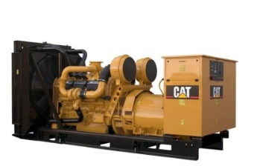
Data Centers
Plant layout case study
MV Distribution
Plant Layout
Primary MV SWG
Connected to Power Supply/Sub Station
11-33 kV
CSS
MV distribution
Ring or Radial configuration
Up-to 5000A

Slide 6
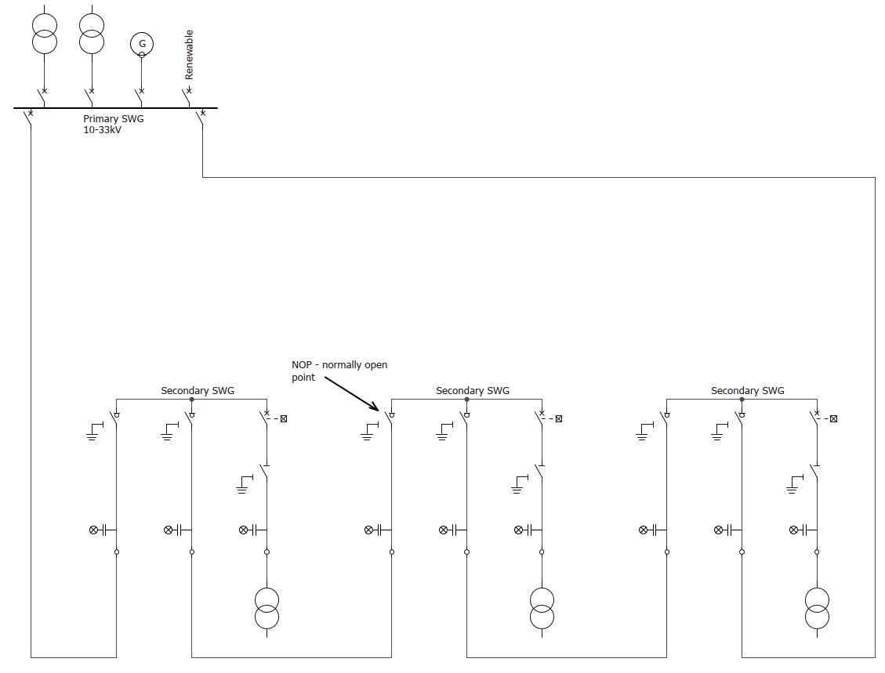
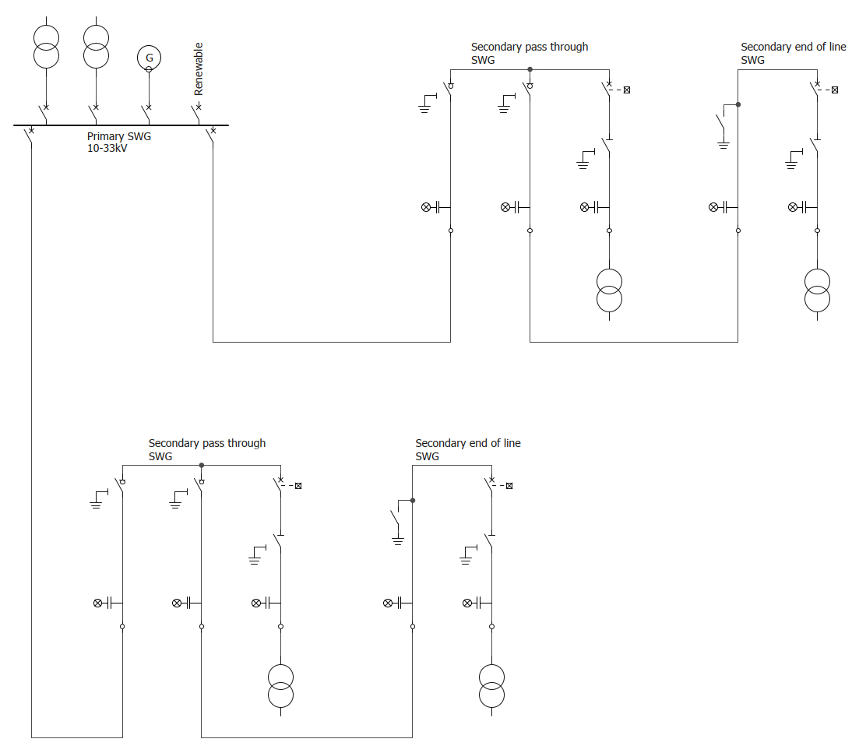
Data Centers
MV grid topology
MV ring connection grid
MV radial connection grid

Slide 7
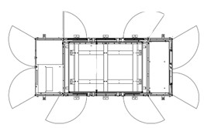
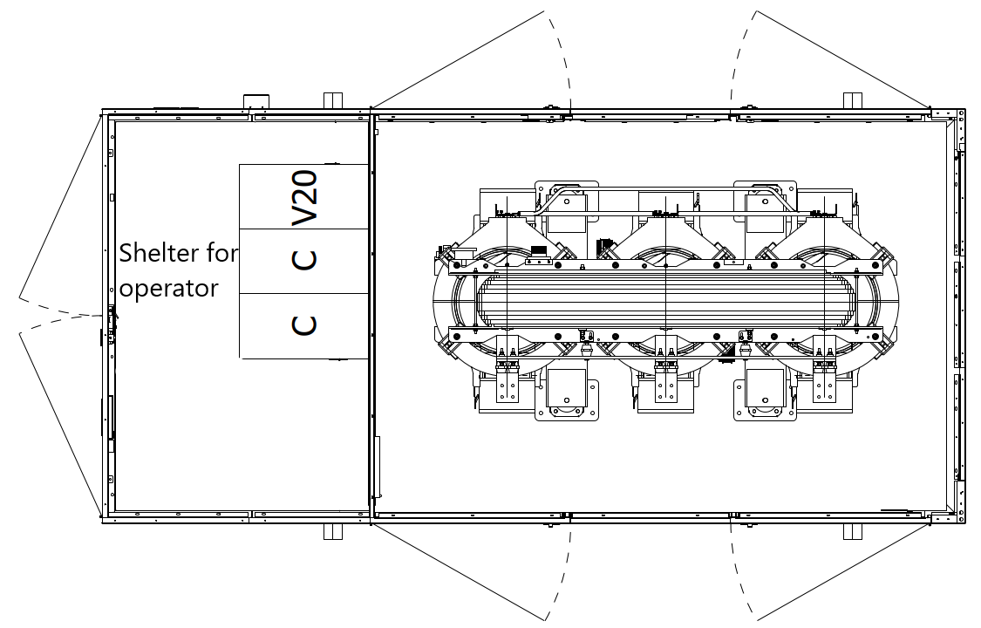
Data Centers
CSS operation
Non walk in
Walk in
CSS
CSS
Grid
MV SWG
TR
LV
Grid
MV SWG
TR
LV
Equipment is operated from outside
Equipment is operated by entering a CSS

Slide 8
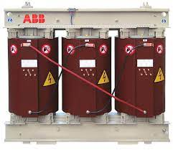
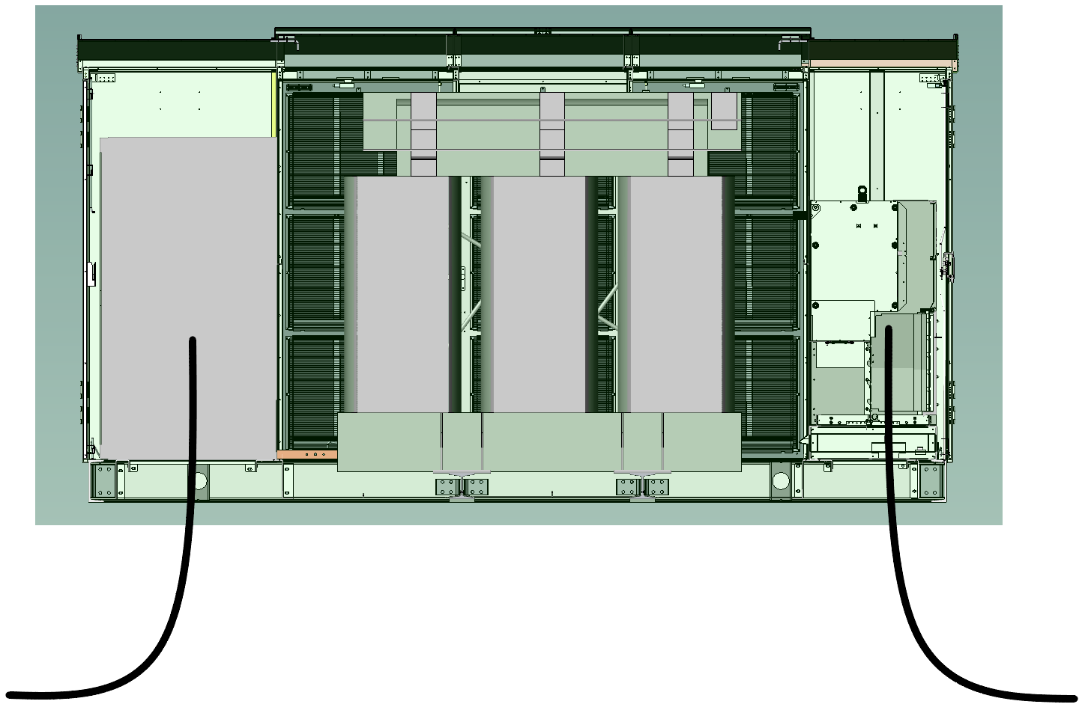
Data Centers
UniPack Mercury
Oil TR
Dry TR
Main equipment
Designed and manufactured to install dry or oil transformers up to 3.5 MVA
In case of oil transformer there is integrated oil pit in TR compartment
Designed to accommodate medium voltage secondary switchgear up to 40.5 kV
ABB gas insulated secondary switchgear (SafeRing/SafePlus)
ABB ecoGIS secondary switchgear (SafeRing Air, AirPlus)
Low voltage switchboard dimensioned according to transformer ratings
Breaker (ACB) capable of disconnecting the transformer and LV busbar
Designed for continuous operation
Remote control and monitoring of CSS and internal components
Compartment design to ensure safety and segregated access areas
LVS
MV SWG
LV outgoing cables
MV incoming cables

Slide 9
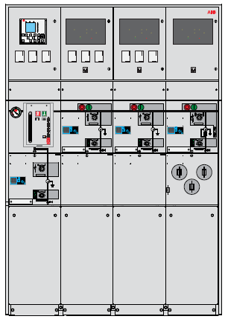
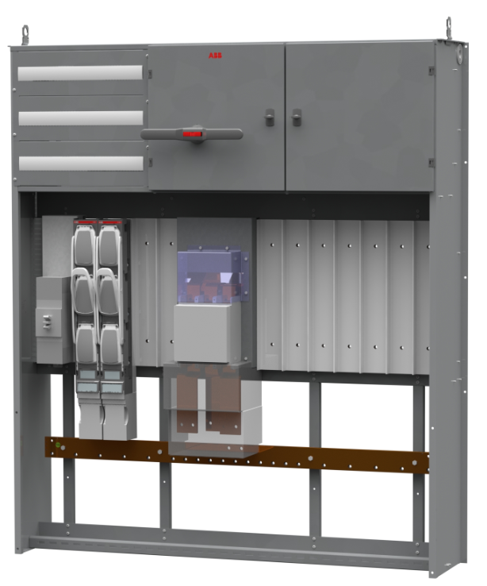
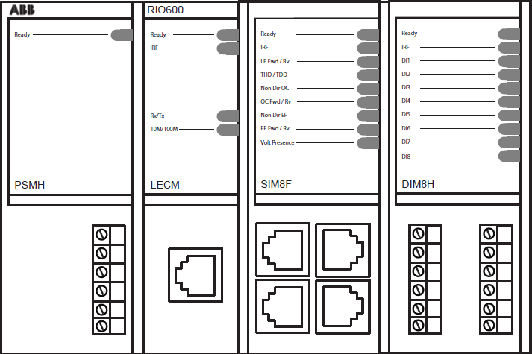
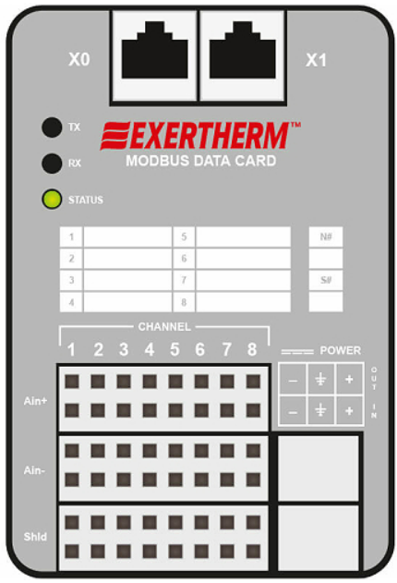
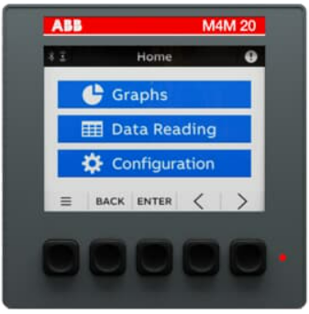
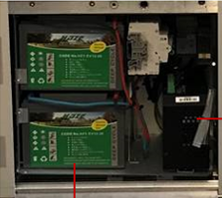
Data Centers
SCADA
Backup power
AC supply alarm
Charger alarm
Battery alarm
DC backup supply
Power circuit
DC backup supply
Battery and charger for backup power supply
Power circuit
AC supply

Slide 10
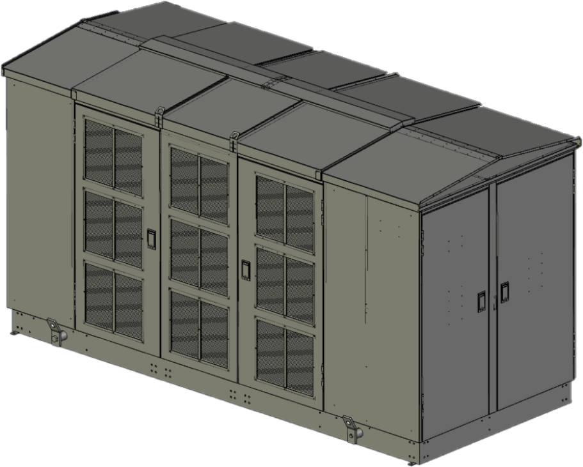
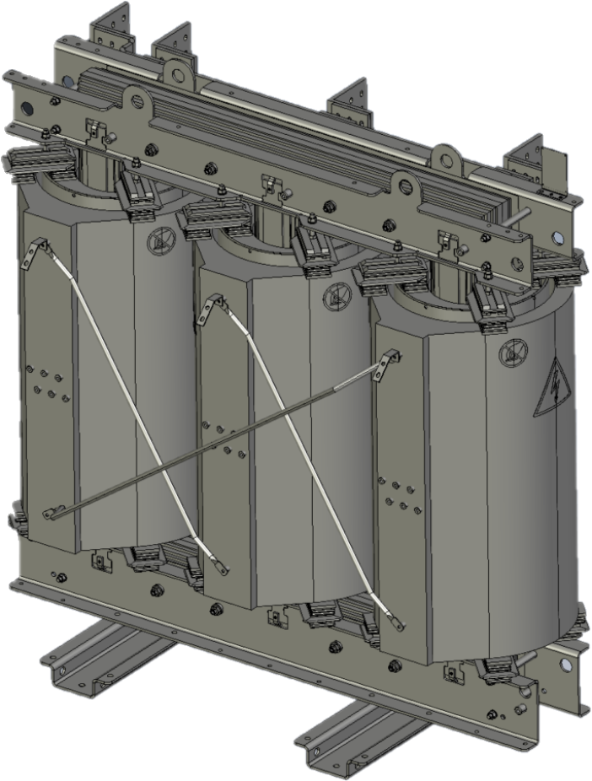
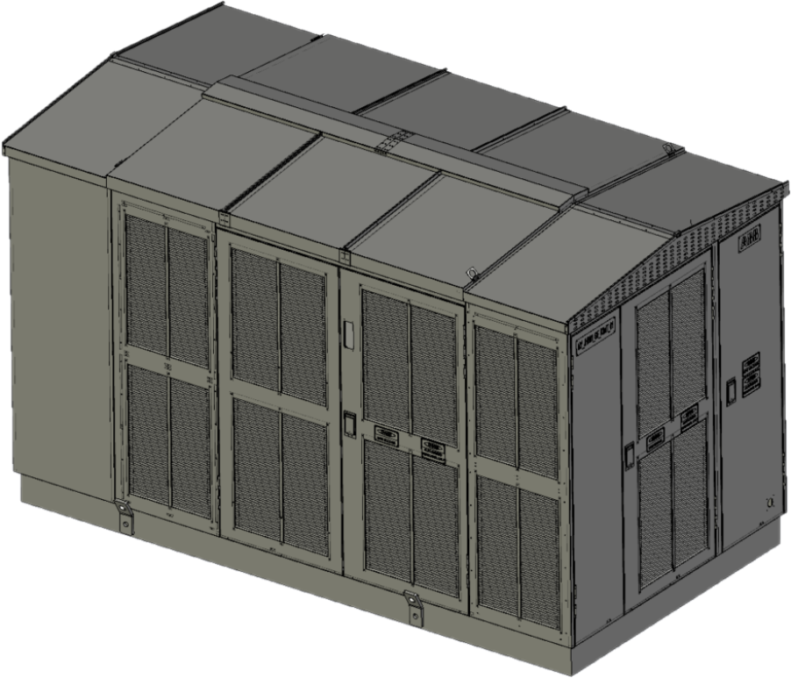
Data Centers
Transformer replacement
TR replacement through the roof
TR replacement through the door
TR replacement through the door

Slide 11
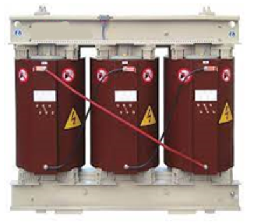
Data Centers
Suitable for use in fire hazardous areas
Safety
CSS for Datacenter
CSS enclosure material is nonflammable and self extinguishing
Dry transformer is F1 fire class:
Comply to IEC 60076-11 Ed.2 2018-08 paragraph 12.3
suitability to install in places subject to a fire hazard
restricted flammability, minimized emission of toxic substances and opaque smoke
Transformer do not contribute significantly to the thermal energy of an external fire

Slide 12
Data Centers
Flexible to meet specific requirements
Optional requirements
Weather/rain protection for MV SWG operator
Smoke detection in selected compartments
UPS/backup power may be included in CSS, be external or shared (included in some CSS)
TR room door key interlock
Compliance to IEEE693 seismic requirements
Emergency mode when TR cooling is boosted by forced ventilation
For this case AN and AF ratings may need to be agreed between manufacturer and user

Slide 13
Data Centers
UniPack-S
Technical parameters for a typical data center application
Parameter | Value
Max transformer power | Up to 3500KVA (oil or dry type)
Max rated voltage | 40.5kV
Short circuit withstand current of internal earthing network | 20kA/1s
Max overall dimensions (LxWxH) | 5212 X 2250 X 3038 mm
Transformer compartment IP protection degree | IP23D (Optional IP35 or 45)
MV/LV compartment IP protection degree | IP43 (Optional 54)
CSS enclosure thermal class | K10 / K15 depending on IP class
MV compartment | ABB SafePlus secondary switchgear family
LV compartment | ABB low voltage switchboard or direct connection to Transformer Main breaker: Air circuit breaker
Max rated current of LV panel | Up to 5000A
Rated short circuit withstand capacity of LV switchboard | Up to 66kA/1s

Slide 14
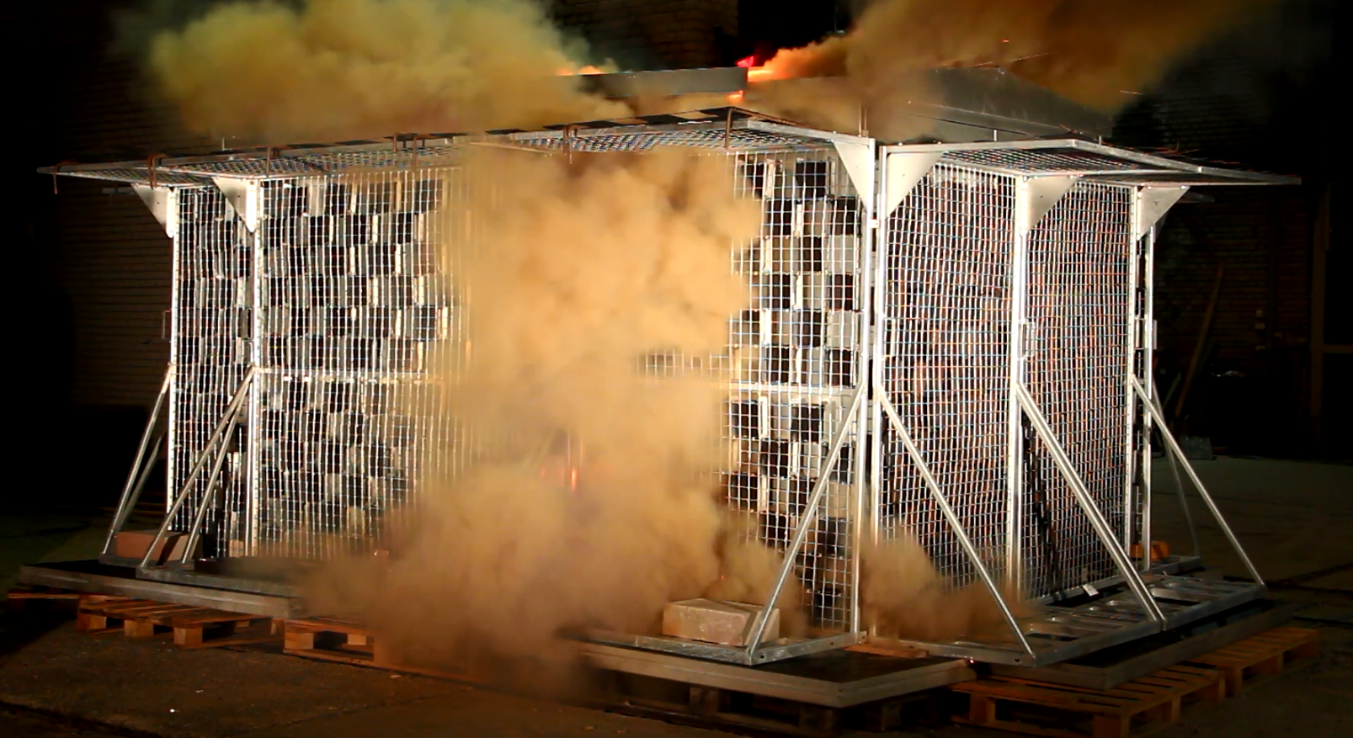
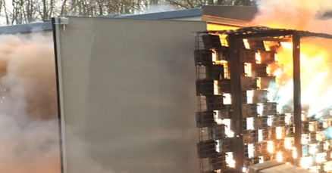
Data Centers
Internal Arc Classification (IAC)
Safety
Internal arc proof
Non-arc proof
Internal arc classified substation
According to IEC62271-202
IAC-AB 20kA 1 sec
Protection to both operators and general public
Gases directed
LV
T
MV
LV
T
MV
Gases directed

Slide 15
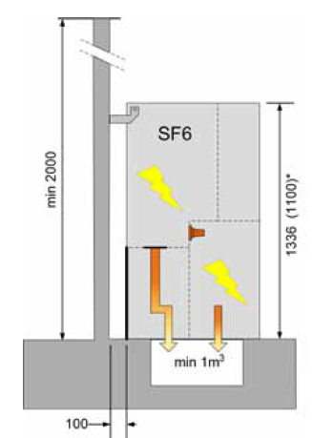
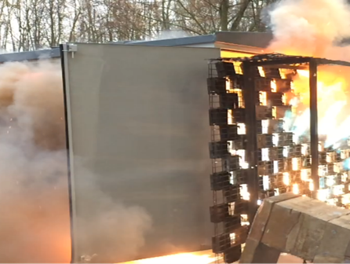
Data Centers
Internal Arc Classification (IAC)
Safety
Non-arc proof CSS
Arc proof SWG
Arc proof MV switchgear inside CSS does not mean that CSS is arc tested
Compact substation needs to be tested with medium voltage switchgear due to following cases:
Overpressure inside CSS
Overpressure on RMU covers
Hot gases routing inside substation
Important to manage hot gases for safety

Slide 16
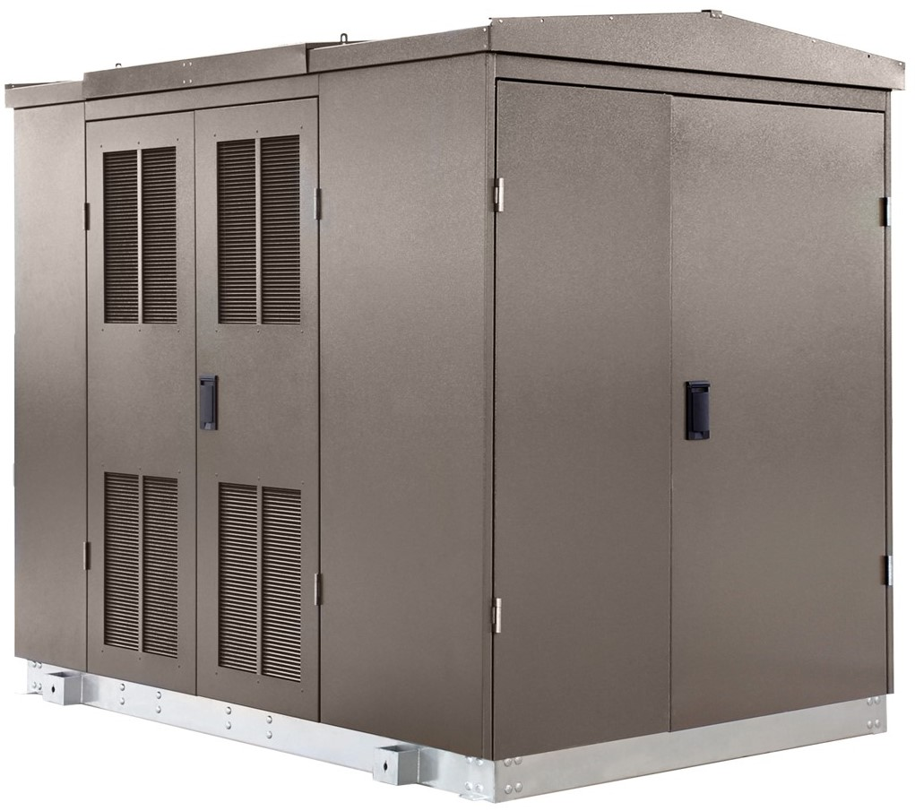
Data Centers
Control and monitoring functional packages
Function
1 - Temperature Monitoring
2 - Status Monitoring
3 - Control Package
4 - Protection Package
Including:
Event recorder
DC Backup power with long lifetime
Dry TR
Oil TR
1 - Oil temperature alarm/trip
Pressure alarm/trip
2 - Gas formation alarm/trip
Oil level alarm/trip
1 - PT100 oil temperature
analog value
CSS enclosure
1 - Temperature alarm/trip
1 - PT100 oil temperature
analog value
2 - Door open signal
2 - Smoke signal
2 - External trip of MV and LV
breakers
LV Switchboard
MV Switchgear
2 - Environment temperature monitoring
2 - Gas density monitoring
2 - Fault indicator
1 – Incoming cable temperature monitoring
4 - Relion relay
2 - Position indication
3 - Remote control
2 - Fuse blown
indication
2 – Power flow
monitoring
2 - Position indication
3 - Motor control
4 - Arc detection
2 - Power flow
Measurements (U, I, THD)
1 - Temperature
monitoring of
conductors
2 - Fuse blown indication

Slide 17
Data Centers
Case studies

Slide 18
Case study
Powering crypto mining
Location: Sweden
Installed base: UniPack-S CSS
Challenge:
Tight requirements to comply with customer site layout and footprint
Monitoring, remote control and integration solution into customer system
Modular solution also for next phases
Outcome:
Fast delivery
Ability to meet client demands
Maintain profitable business operations
Solution:
Reliable, pre-fabricated, customized solutions for grid integration
Fully type tested product to guarantee safety and reliability
Expansion capabilities with modular solution
A total of 11 containerized substations including:
Dry transformers
Secondary MV switchgear SafeRing AirPlus™
LVS3 with low-voltage breakers

Slide 19
Case study
Powering a cryptocurrency data center
Location: Australia
Installed base: UniPack-S CSS
Challenge:
Robust and reliable electrical power supply of cryptocurrency data center
Fast delivery
Ability to expand in line with future developments
Outcome:
CSS integrated in customer SCADA providing monitoring for both low- and medium-voltage side
Layout is standardized for next phases of the projects
Small footprint compared to a traditional solution with very short installation time on site
Solution:
UniPack-S Mercury35 compact secondary substation with additional monitoring and control compartment
Remote control, status and fault monitoring with SCADA integration
Dry type transformer
Fully type tested solution allowing safe operation for service personnel

Slide 20
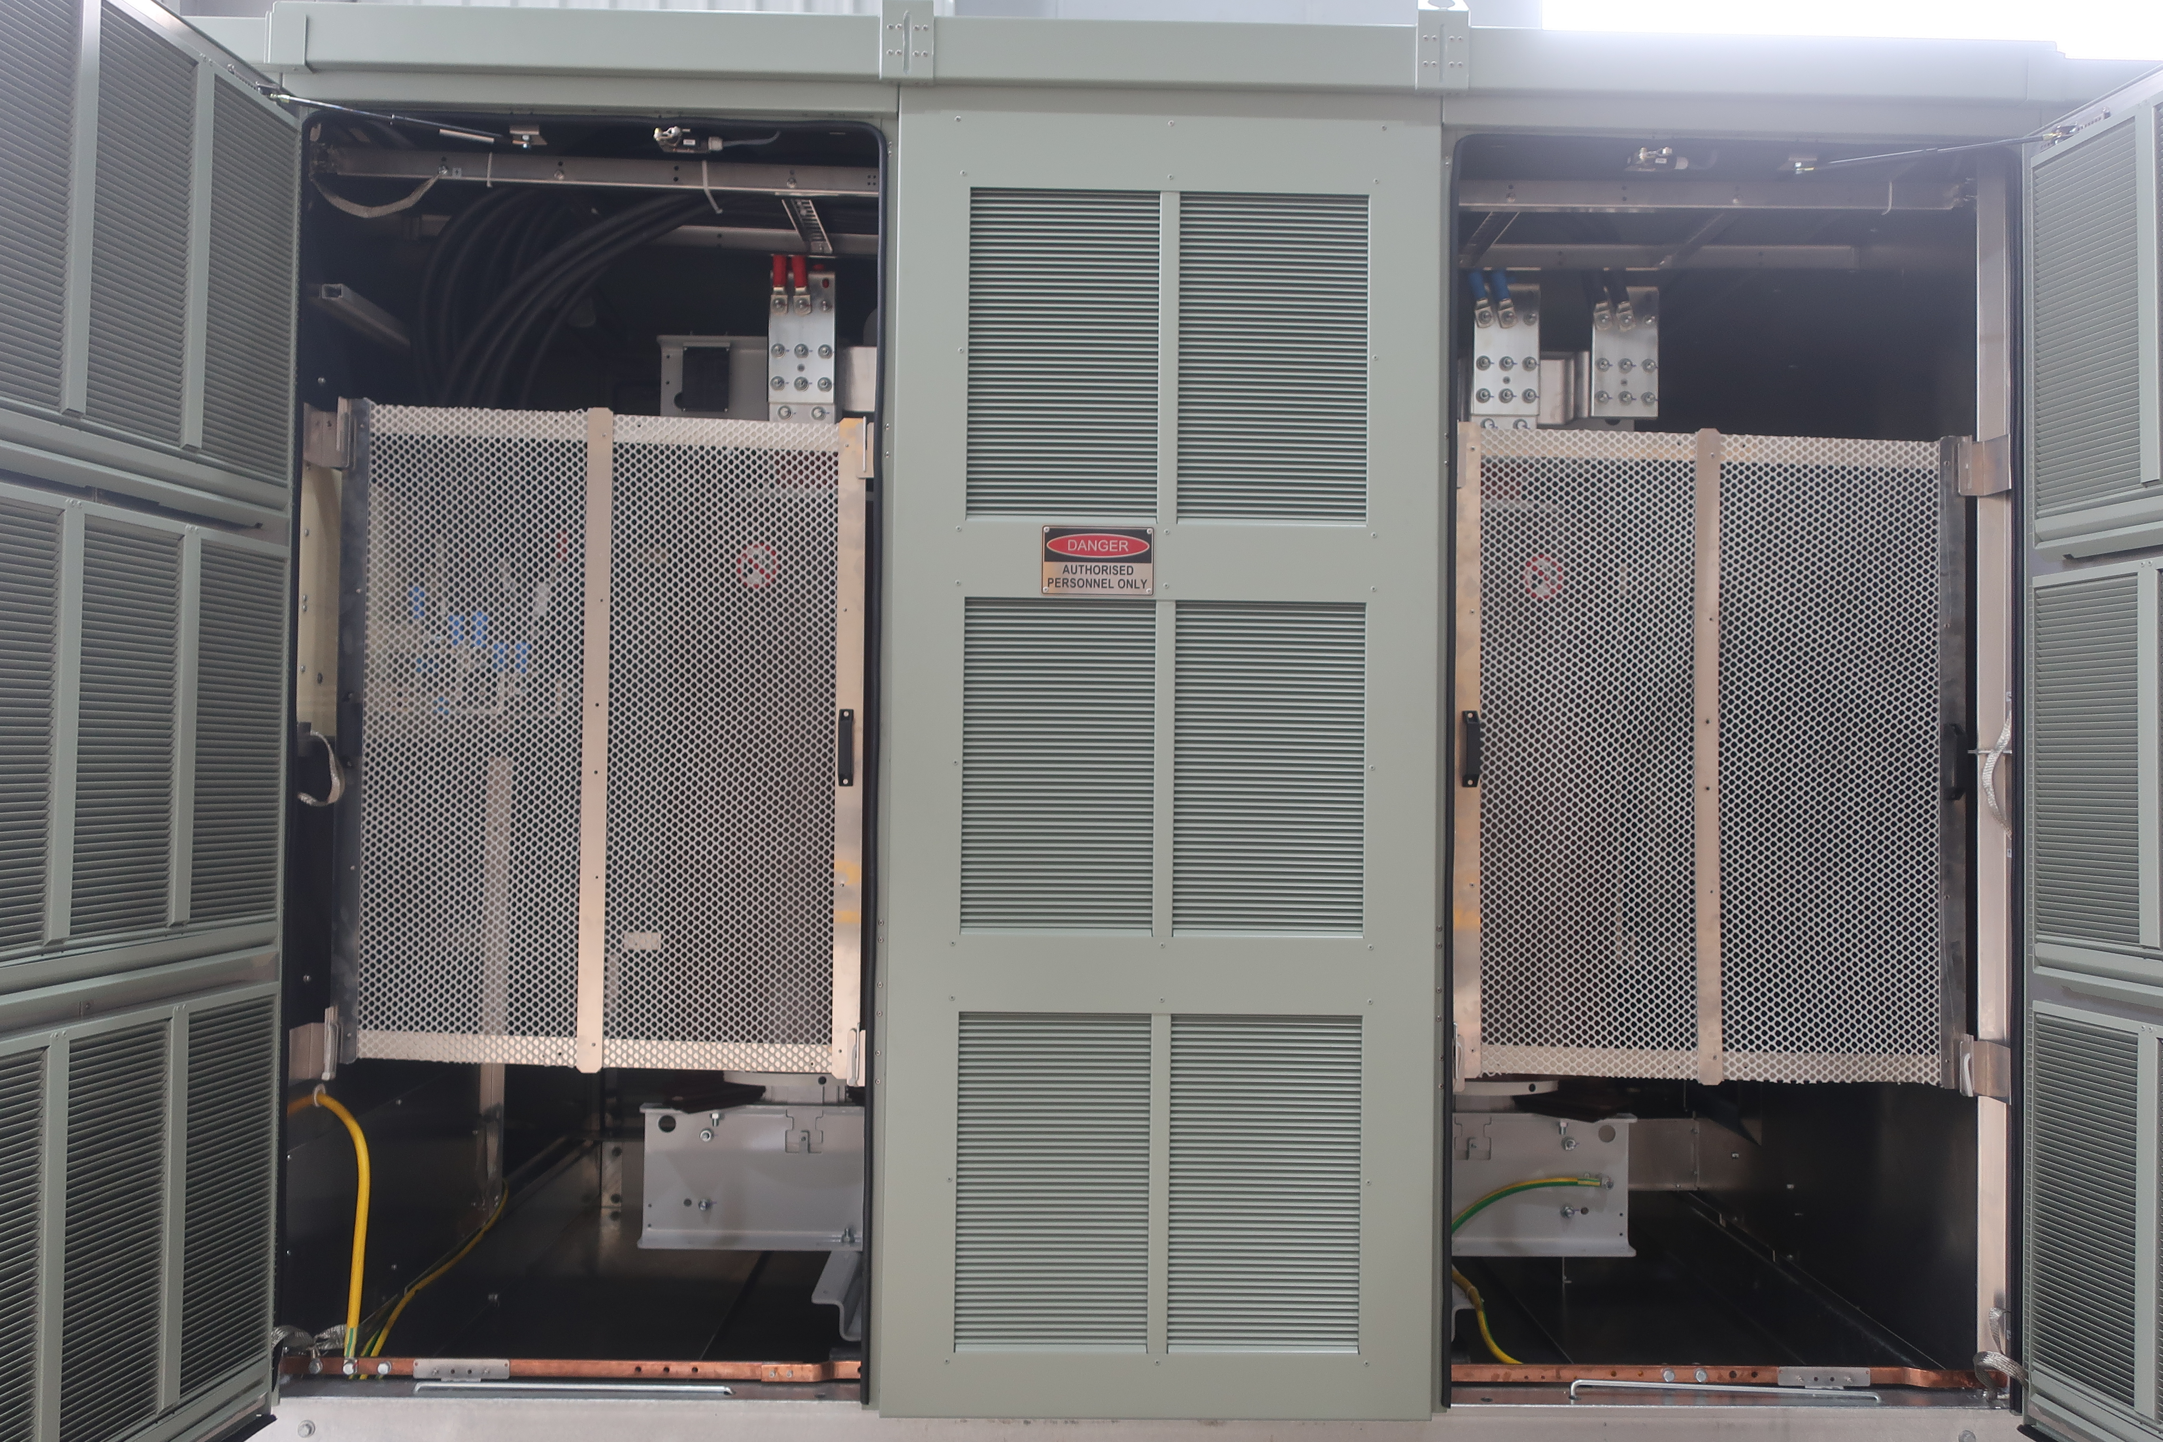
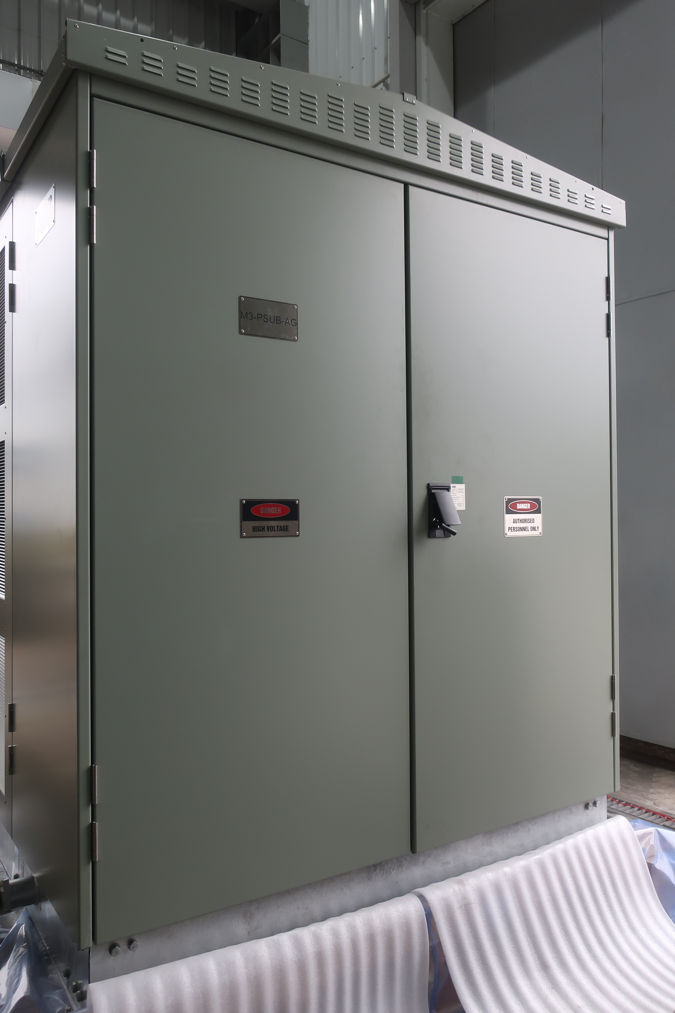
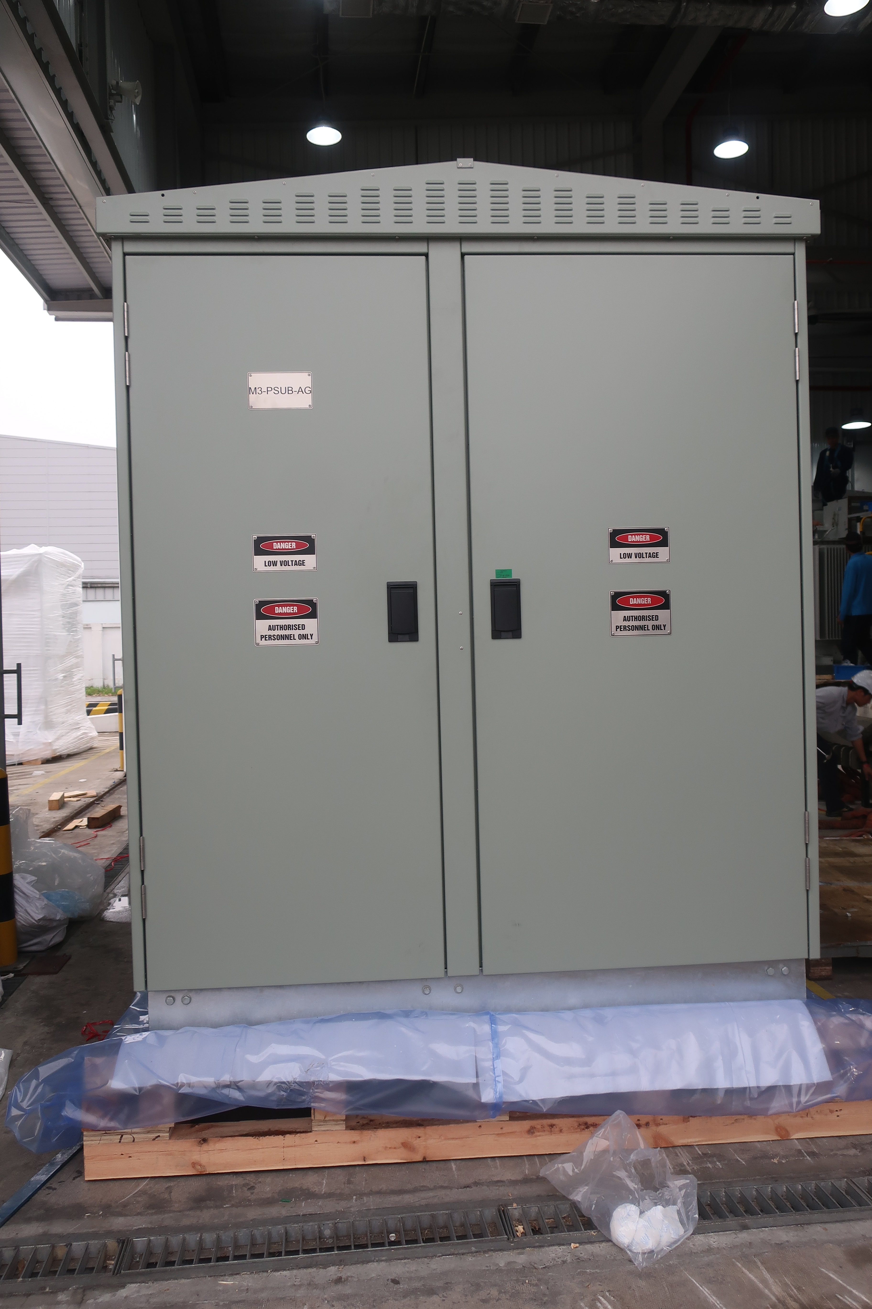
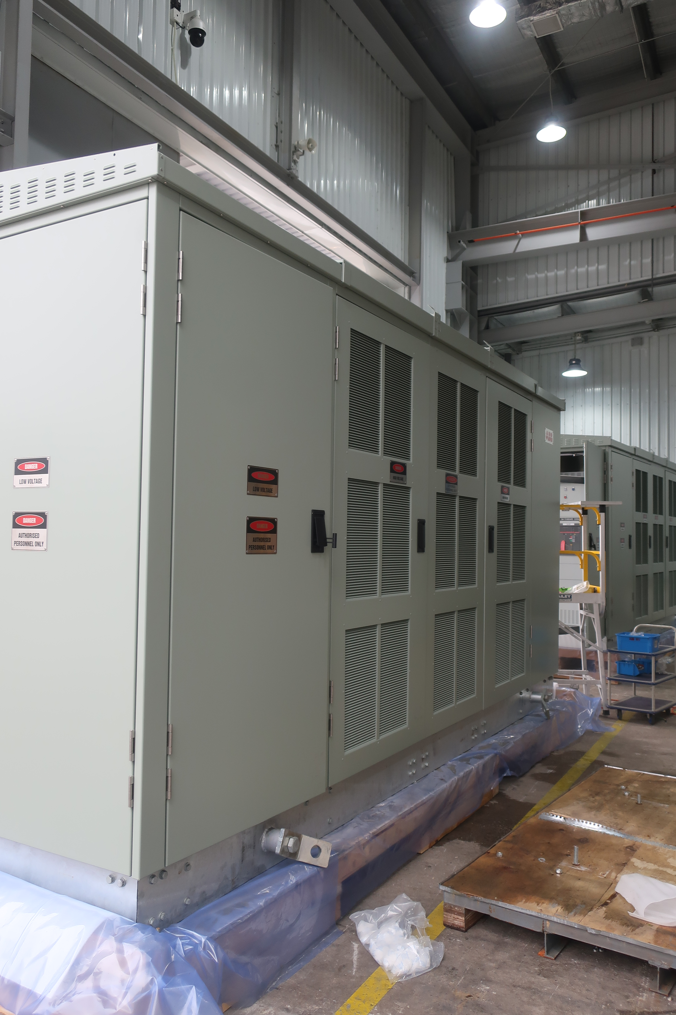
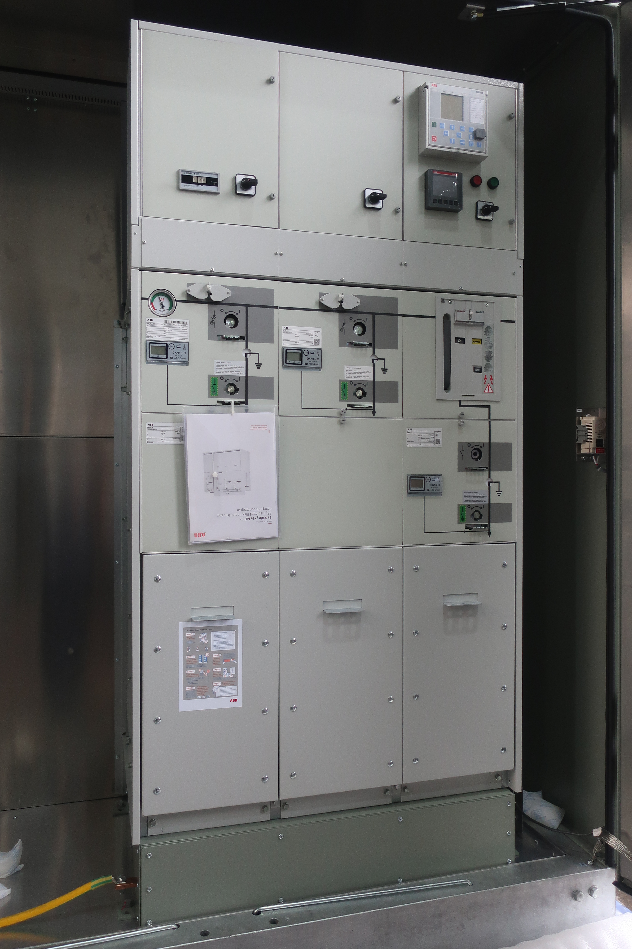
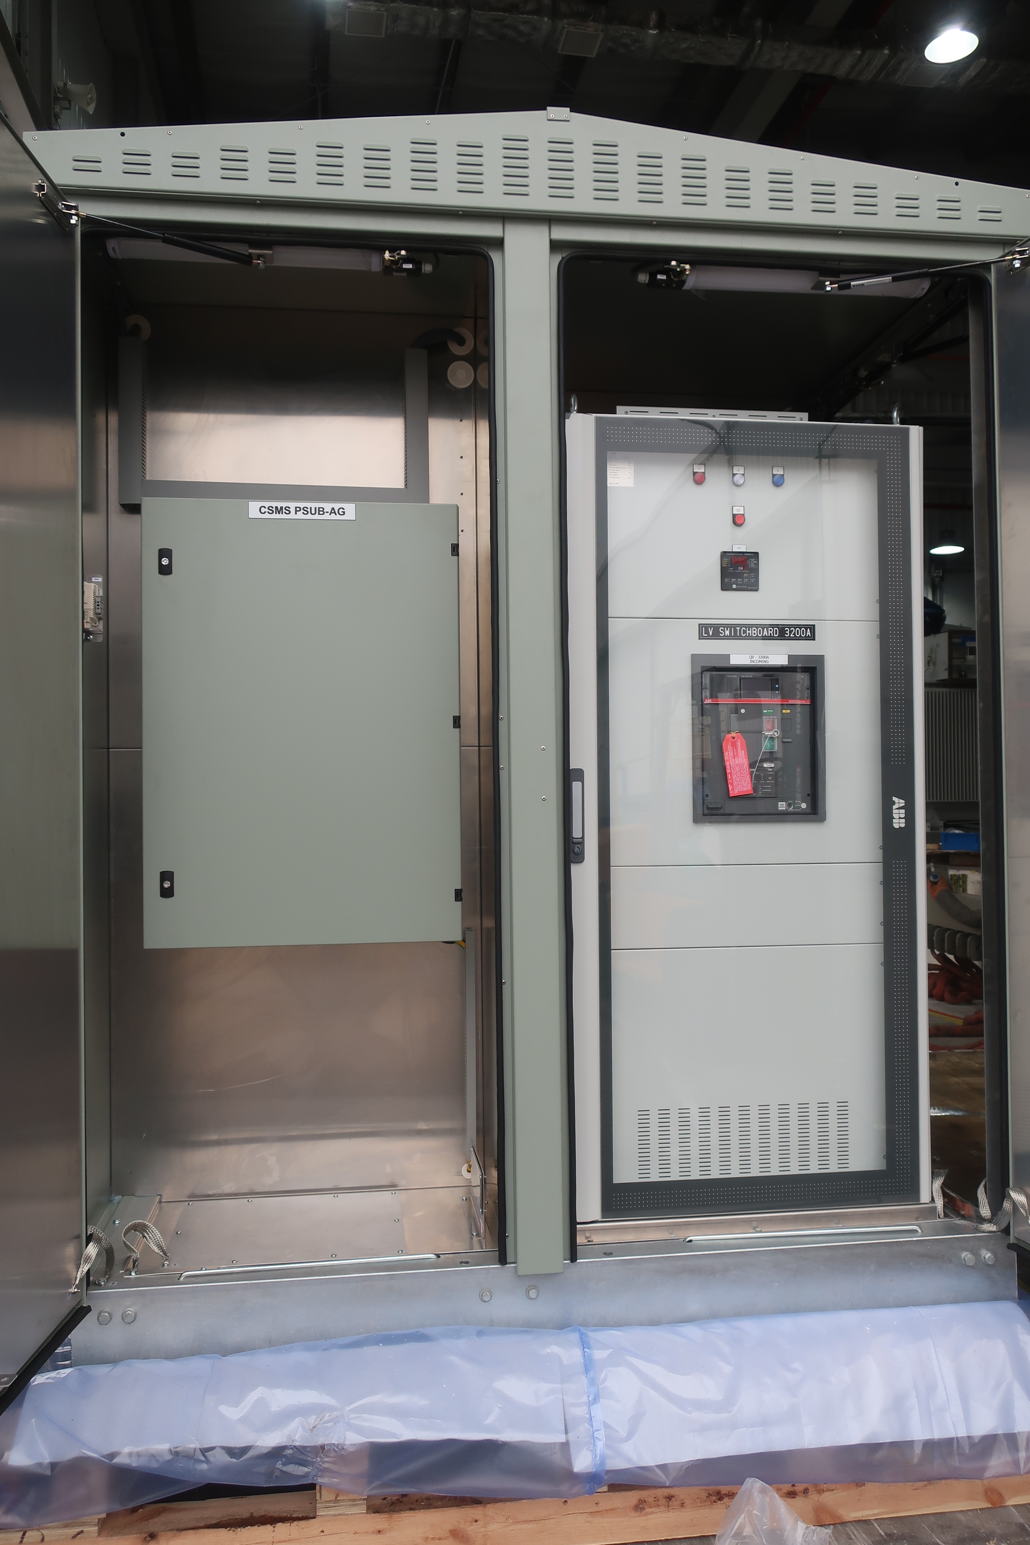
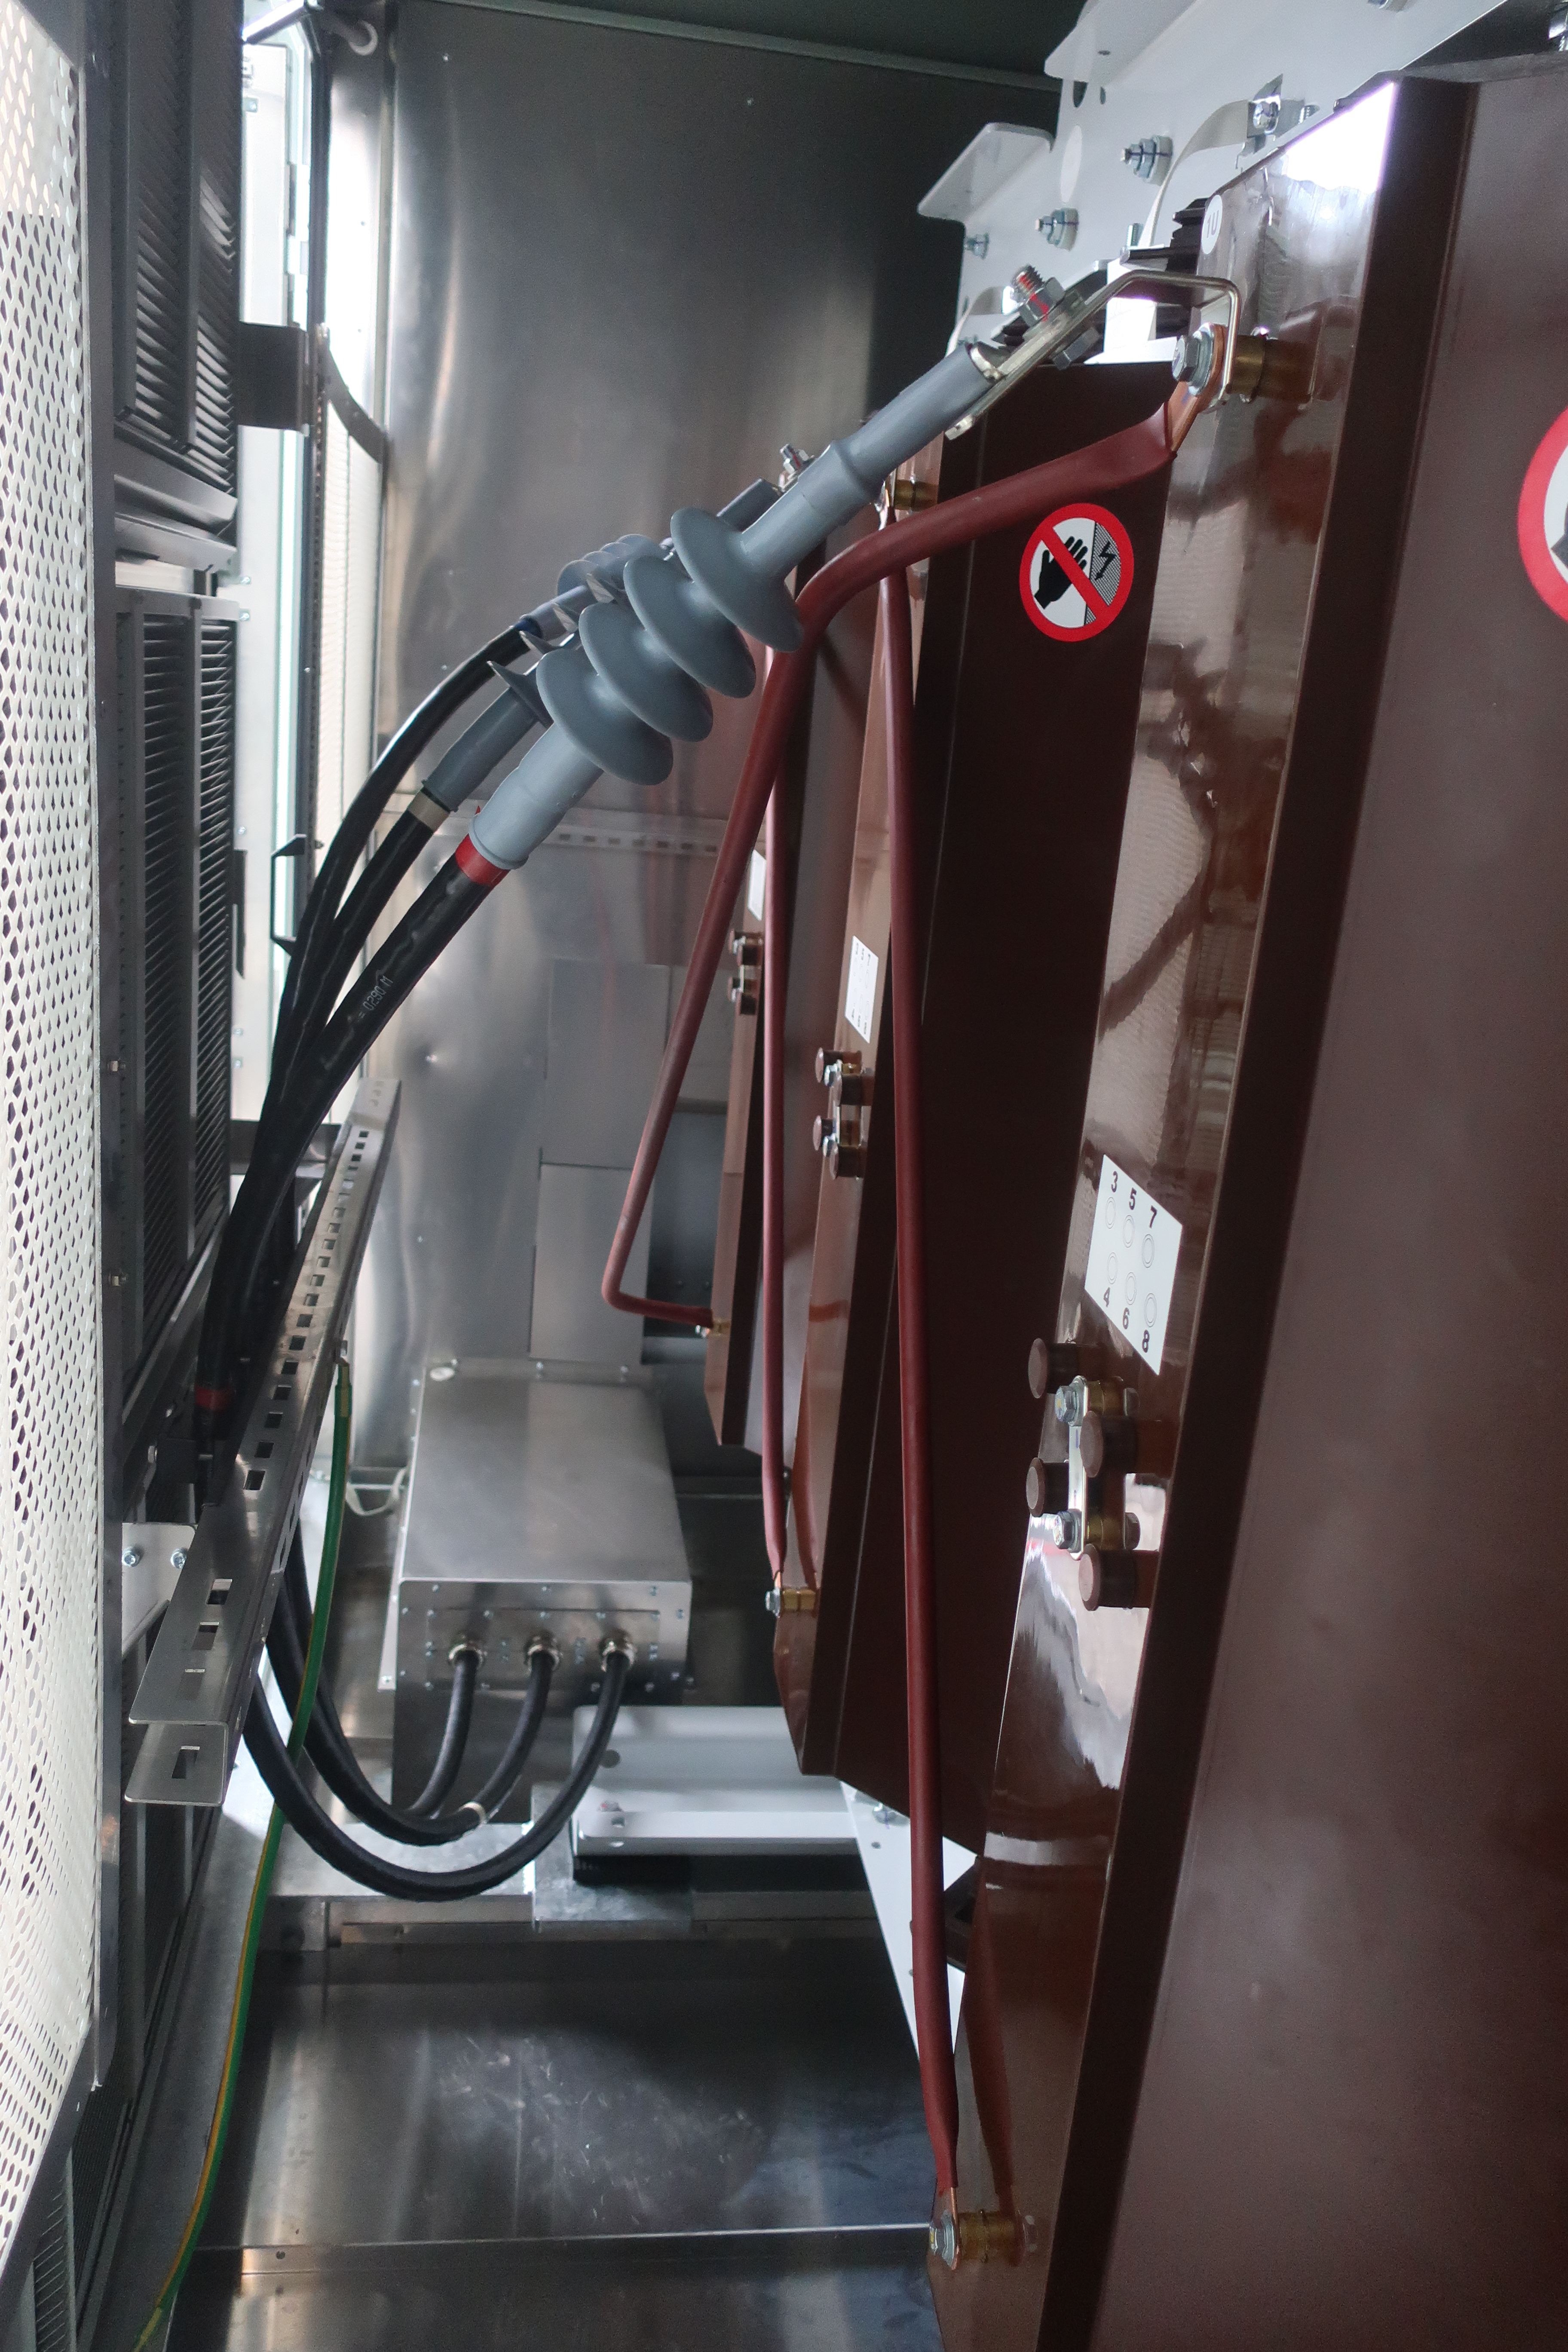
Case study
Australia - Cryptocurrency data center
Overall Layout
MV Compartment
Transformer compartment
LV & Aux Compartment

Slide 21
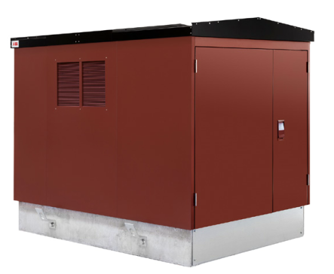
Case study
Powering a cryptocurrency data center
Location: Estonia
Installed base: UniPack-S CSS
Challenge:
Fast delivery time
Customer required a scalable, modular solution
Outcome:
Project finalized within a short delivery period
Solution:
Standard unit with quick delivery
12 units of Mercury 16 with 1250kVA transformer
UniPack low-voltage switchboard for power distribution with fuse switch protection for outgoing cables

Slide 22
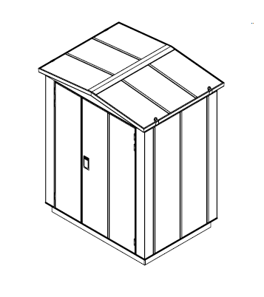
Case study
Powering a Colo data center
Location: EU
Installed base: UniPack-G CSS
Challenge:
Robust and reliable electrical power supply of Colo data center
Fast delivery and easy installation.
Ability to expand in line with future developments
Outcome:
CSS easily integrated in customer designed system
Layout is standardized for next phases of the projects
Small footprint compared to a traditional solution with very short installation time on site
Solution:
UniPack-S Antares 2x3 compact secondary substation with additional equipment in order to safely and reliably monitor and service the RMU.
Having a walk-in solution for RMU maintenance and operation. Provides shelter in even harsh weather condition for operation.
Our GRP design provides the optimal conditions for the best possible operating condition for the RMU
Flexible Steel foundation allows easy installation and fast cabling

Slide 23
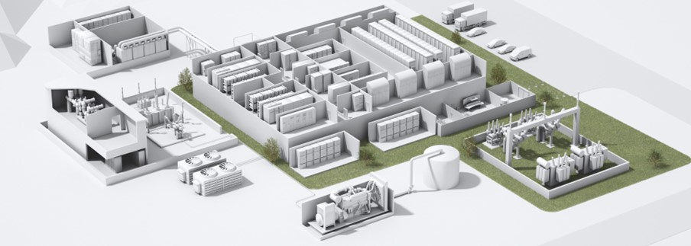
Case study
Colo in Europe
Standard solution
Modular solution with 2500 kVA net power
CSS concept integrated in overall DtC design
Benefits:
Small footprint, fast delivery,
Outdoor solution reducing Capex for building & site installation
Improved PUE
No fire hazard
steel enclosure
F1 rated Dry type transformer
MV RMU 24 kV
2800 Dry type transformer
No Lo Voltage, but direct cable connection

Slide 24
CSS Solutions for Data Centers
Value proposition vs Standalone products

Slide 25
Data Centers
CSS Value Proposition Vs. Standalone products (MV switchgear, transformers, LV cabinet)
Low Cost of ownership
Fast delivery
Space saving
Safe
Reduction in project management, installation and commissioning
CSS is delivered as one piece; pretested unit with premade internal interconnections
CSS footprint is approximately 30% smaller than eHouse
Internal Arc tested to guarantee safety for Operation personnel and Public

Slide 26
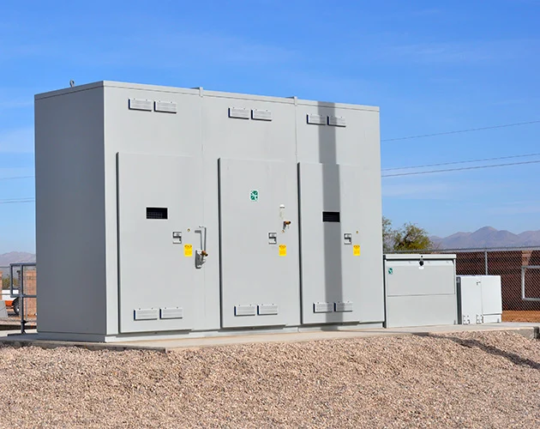
Data Center
Value proposition CSS vs. Standalone products (MV switchgear, transformers, LV cabinet)
CSS footprint
Compact solution with a small footprint
CSS footprint is approximately 30% smaller than standalone components
Standalone components footprint

Slide 27
Data Center
Value proposition CSS vs. Standalone products (MV switchgear, transformers, LV cabinet)
Item | CSS | Standalone components
MV Switchgear | Included | Included
Transformer | Included | Included
Low voltage switchboard | Included | Included
Interconnections | Included | Not included
Automation and monitoring | Inside CSS enclosure | Standalone box
Tested as a package | Included | Not included
Compact solution for fast delivery
CSS is delivered as one piece; tested unit with premade internal interconnections

Slide 28
Data Center
Value proposition CSS vs. Standalone products (MV switchgear, transformers, LV cabinet)
Scope of works with CSS | Scope of works with standalone components
CSS foundation | MV Foundation
CSS foundation | TR foundation
 | LV foundation
Incoming MV and LV cables | MV cable MV SWG-TR
Incoming MV and LV cables | LV cable TR-LVS
 | Incoming MV and LV cables
PRJ Mngmt CSS | PRJ Mngmt MV SWG
PRJ Mngmt CSS | PRJ Mngmt TR
 | PRJ Mngmt LVS
 | PRJ Mngmt Cable supplier
Test at factory | Test at site
Transportation of one unit | Transportation of components
Low cost of ownership
CSS reduce project management, installation and commissioning cost

Slide 29
Data Center
Value proposition CSS vs. Standalone products (MV switchgear, transformers, LV cabinet)
DESIGN
BUILD
INSTALLATION
Permitting
Final commissioning (L5)
1
Approvals & purchasing
Sit prep.
Structure
Connection & testing (L3)
Traditional on-site build “stick built”
Fast delivery
Engineering
Bid evaluation
Equip mfg
FAT¹ (L1) – multiple factories
Transport & inspect (L2)
Debugging & load testing (L4)
CSS is delivered as one piece; pretested unit with premade internal interconnections
Approvals & purchasing
Permitting
Connection & testing (L3)
2
Sit prep.
Final commissioning (L5)
Predesigned, prefabricated off-site eHouse or skid
50% improvement over traditional
Equip mfg + integration
Debugging & load testing (L4)
Bid evaluation
Transport & inspect (L2)
Engineering
FAT¹ (L1) – one factories
Notes:
As

Slide 30
CSS Solutions for Data Centers
Value proposition vs. eHouse

Slide 31
Data Centers
CSS Value Proposition Vs. eHouse
Continuous operation
Energy efficient
Space saving
Safe
Type Tested for 'the' most demanding reliability and availability levels
No use of HVAC and integrated metering to efficiently measure PUE levels
CSS footprint is approximately 30% smaller than eHouse
Internal Arc tested to guarantee safety for Operation personnel and Public

Slide 32
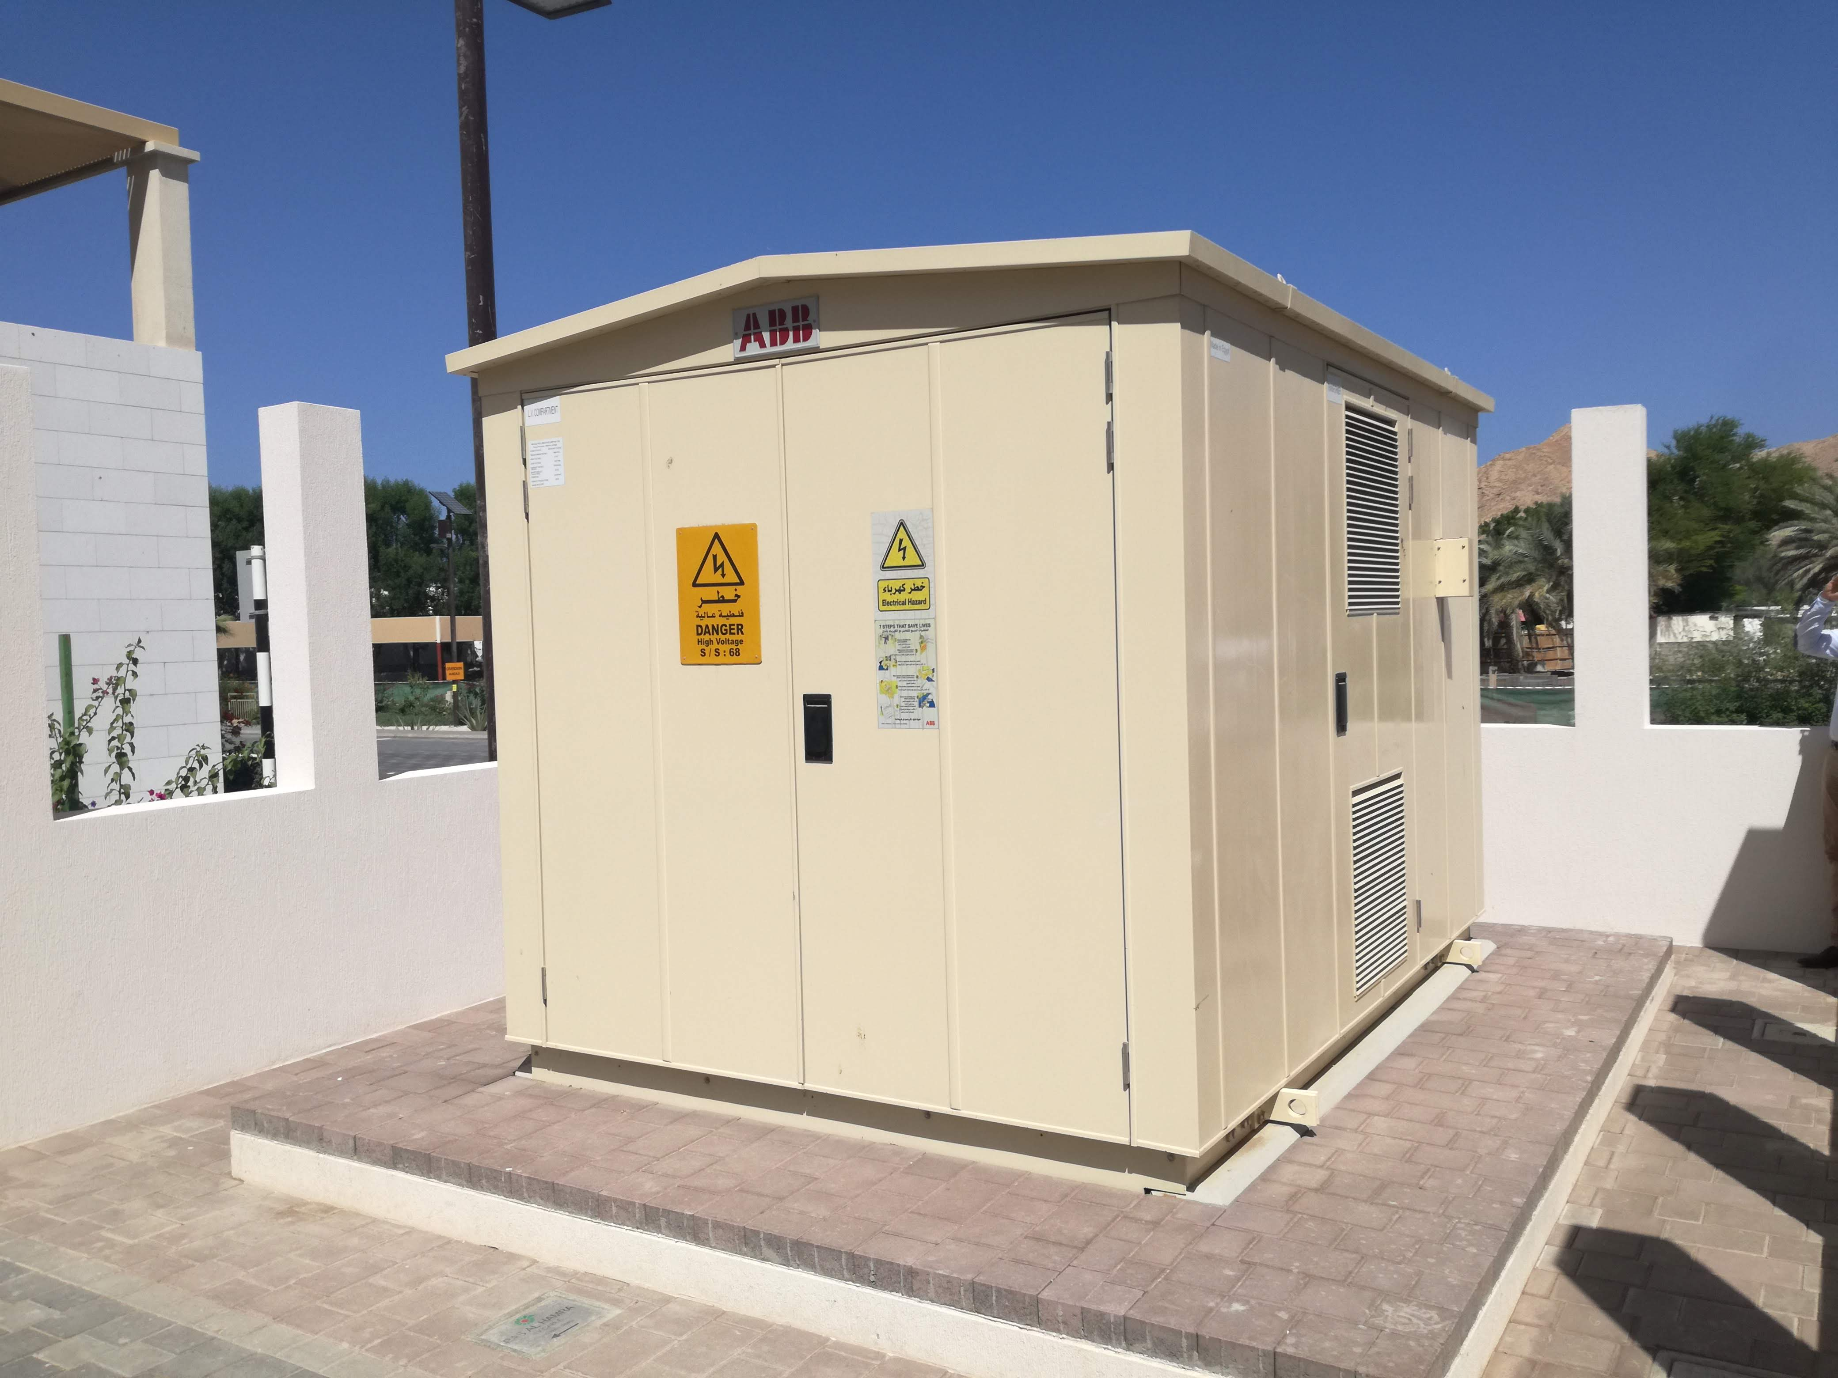
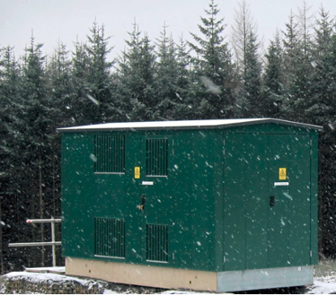
Data Centers
CSS Value Proposition Vs. eHouse
Continuous operation
Type Tested for 'the' most demanding reliability and availability levels

Slide 33
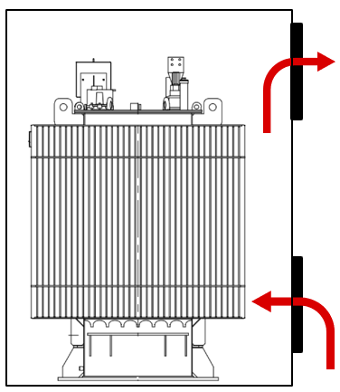
Data Centers
CSS Value Proposition Vs. eHouse
Energy efficient
Improved PUE due to no need of HVAC thanks to natural cooling

Slide 34
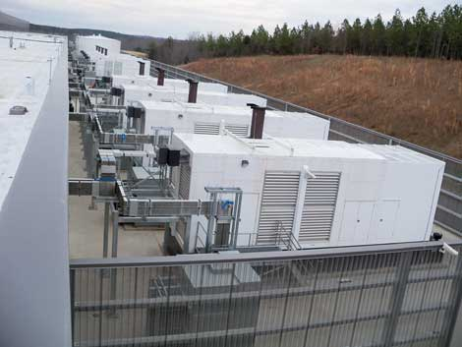
Data Center
Value proposition CSS vs. eHouse
Compact solution with a small footprint
CSS footprint is approximately 40% smaller than eHouse
CSS footprint
eHouse

Slide 35
Data Centers
CSS Value Proposition Vs. eHouse
Safe
Internal Arc tested to guarantee safety for Operation personnel and Public

Slide 36
CSS Solutions for Data Centers
Value proposition vs. Outdoor Skid

Slide 37
Data Centers
CSS Value Proposition Vs. Outdoor Skid
Continuous operation
Safe
Type Tested for 'the' most demanding reliability and availability levels
Internal Arc tested to guarantee safety for Operation personnel and Public

