Slide 1
Direct Replacement Emax & New Emax to Emax 2
2020
Advanced retrofitting kit solutions
EPSP Global Product Service Management

Slide 2
ELSP Global Service
Service Product Portfolio
1-Installation and commissioning An investment in long-term equipment’s reliability
6-Engineering and consulting Application recommendations and environmental best practices.
2-Training The best way to teach how to respond efficiently in different critical situations
7-Extensions, upgrades and retrofits Enhance existing equipment with the latest technologies.
8-End of life services Equipment’s recycling in line with environmental requirements
3-Spares and consumables All original and genuine spare parts and upgrade kits.
9-Replacements Replacing old equipment can dramatically increase performance and reduce costs.
4-Maintenance Maintenance to guarantee the system’s continuous operation
10-Advanced services Predictive Maintenance into ABB Ability EDCS Ekip Up to upgrade your installations
5-Repairs Workshop and on site repairs by our service engineers
11-Service agreements Customer support agreements for low voltage equipments

Slide 3
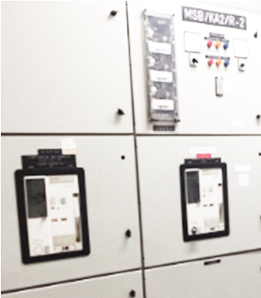
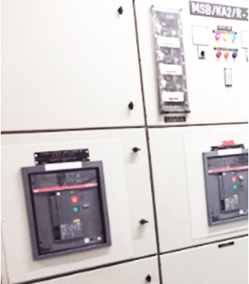
Extension, upgrades and retrofits
Time to upgrade?
Modernize by Retrofit kits
Modernize
Safety
Technology
Service years
Saving in Maintenance
Environment-friendly
Equipment health
Retrofit kit
Modern Circuit Breaker
Low cost solution
Profitable investment

Slide 4
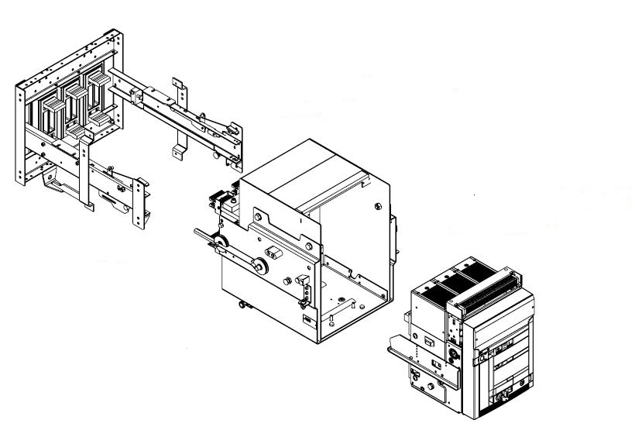
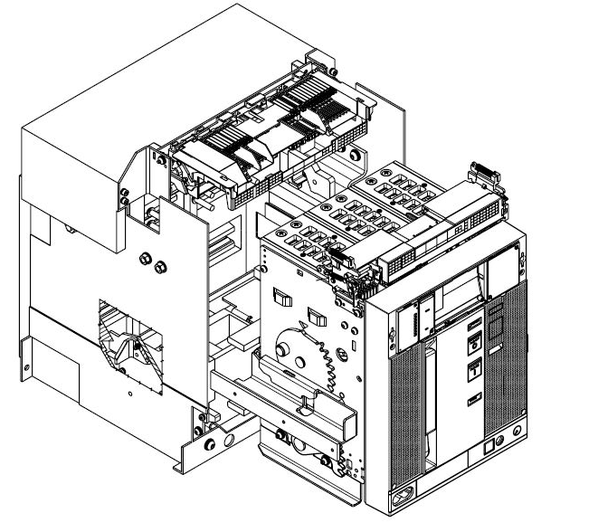
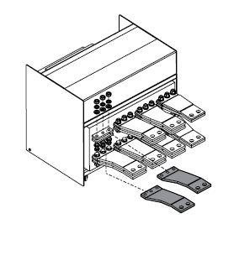
Product Portfolio - Retrofitting Kit Solutions
How to upgrade your installations
1. Hard Bus Retrofill (RF)
2. Cradle in Cradle (CiC)
3. Direct Replacement (DR)
The existing fixed part is removed from the switchboard and the new one is installed using a pre-designed bus bar connection and protection shields.
The fixed part of the new CB is modified to be inserted in the old fixed part.
The moving part of the new CB has to be modified to simulate the moving part of the old CB.
Portfolio
ABB: New Emax, Emax, Megamax, Novomax, Otomax, Isomax
Competitors: Schneider, Siemens, Terasaki, AEG H&W, Mitsubishi
Portfolio
ABB: Isol, Fusol, Otomax, BBC K-Line, Megamax
Competitors: GE, Federal Pacific, Allis Chalmers
Portfolio
ABB: Emax, New Emax, Megamax, Novomax, Modul, ASEA ALG
Competitors: Masterpact M (Schneider)

Slide 5
Product Portfolio - Retrofitting Kit Solutions
How to upgrade your installations
Hard Bus Retrofill (RF)
What?
Hard bus retrofill consists of:
Pre-designed and cut bus bars to link new terminals to existing copper busbars.
Insulating shields prevent live parts from being exposed
Sticker drilling template to cut the door
Mounting instructions
When?
Fixed and withdrawable circuit breakers when the mounted fixed part of the old breaker is in bad conditions
How?
The chassis of the old breaker has to be removed
Who?
Anyone can do it (also customers)
Why?
Easy installation allows to replace the complete product

Slide 6
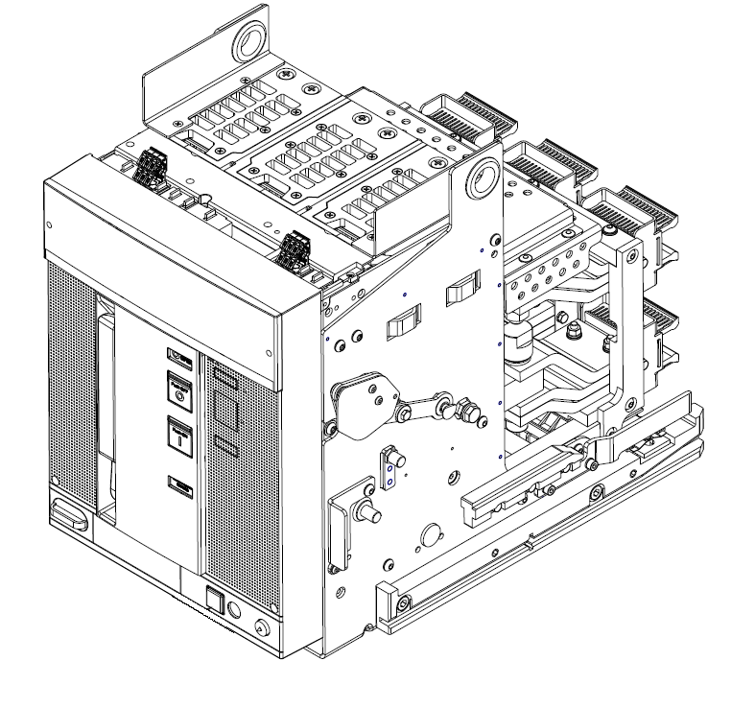
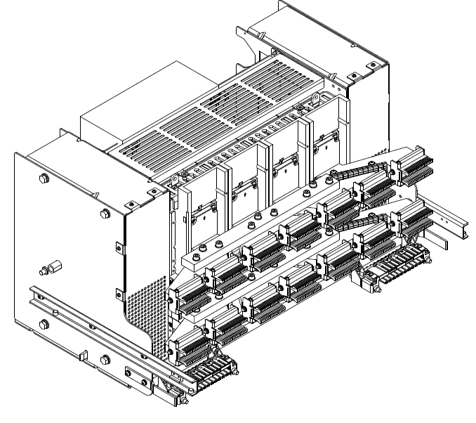
Product Portfolio - Retrofitting Kit Solutions
How to upgrade your installations
Direct Replacement (DR) – Cradle in Cradle (CiC)
Who?
Anyone can do it (also customers)
What?
New circuit breaker already modified in order to be racked in/out the existing fixed part.
Accessories and connections are already pre-cabled.
Installation instructions
When?
Withdrawable version
The old fixed part still in good conditions
How?
Replacing only the moving part of the old circuit breaker
Why?
Easy to install
Short down-time due to installation

Slide 7
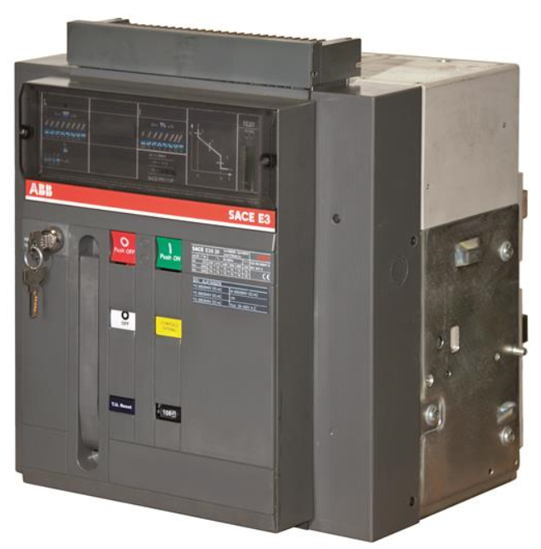
Direct Replacement Emax & New Emax to Emax 2
Advanced retrofitting solutions
Emax
Emax devices, automatic circuit breakers and switch disconnectors, are used to protect and control low voltage distribution systems.
Emax is a complete range offering a large selection of performance levels:
Rating currents I_{u} from 800 to 6300A
Breaking capacity I_{cu} up to 150kA at 415V
Operational voltage U_{e} up to 1000 V
Emax Life Cycle
Launch: 1996
End of sales: 2015 (Emax/ML 2018)
Life cycle status: Obsolete

Slide 8
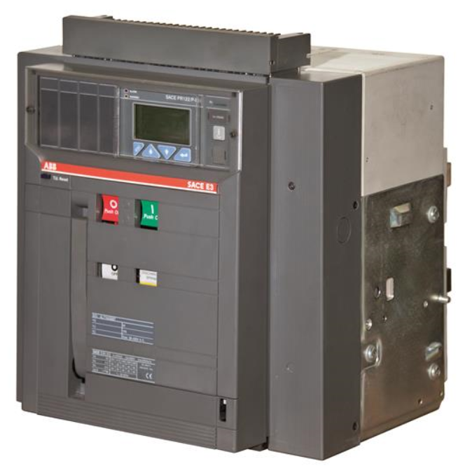
Direct Replacement Emax & New Emax to Emax 2
Advanced retrofitting solutions
New Emax
New Emax devices, automatic circuit breakers and switch disconnectors, are used to protect and control low voltage distribution systems.
New Emax is a complete range offering a large selection of performance levels:
Rating currents I_{u} from 800 to 6300A
Breaking capacity I_{cu} up to 150kA at 415V
Operational voltage U_{e} up to 1150 V
Emax Life Cycle
Launch: 2003
Life cycle status: Classic

Slide 9
Direct Replacement Emax & New Emax to Emax 2
Retrofitting kits solutions available
Emax/New Emax to Emax 2
 |  | Versions
 |  | FIXED | WITHDRAWABLE
Emax / New Emax | Performance Level | HR Terminals | HR Terminals | VR Terminals
X1* | B | RF | RF | RF
 | N | RF | RF | RF
E1 | B | RF | DR -RF | DR
 | N | RF | DR -RF | DR
E2 | B | RF | DR -RF | DR -RF
 | N | RF | DR -RF | DR -RF
 | S | RF | DR -RF | DR -RF
E3 | N | RF | DR -RF | DR -RF
 | S | RF | DR -RF | DR -RF
 | H | RF | DR -RF | DR -RF
 | V* | RF | DR -RF | DR -RF
E4 | S | RF⁽¹⁾ | DR -RF | DR - RF⁽¹⁾
 | H | RF⁽¹⁾ | DR -RF | DR - RF⁽¹⁾
 | V* | RF⁽¹⁾ | DR -RF | DR - RF⁽¹⁾
E6 | H | - | DR -RF | DR - RF⁽²⁾
 | V | - | DR -RF | DR - RF⁽²⁾
* Version available only for New Emax; (1) Available only for 3p versions; (2) Available also for 4p/f versions

Slide 10
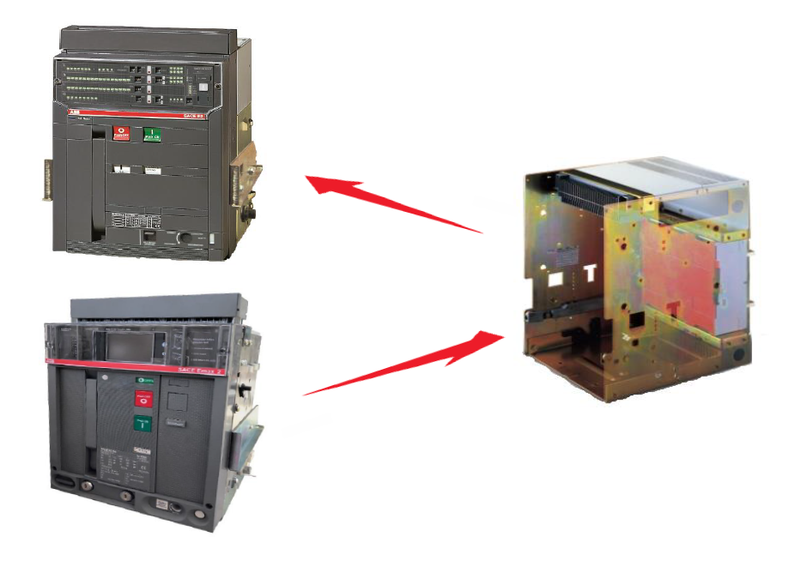
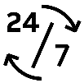
Direct Replacement Emax & New Emax to Emax 2
Advanced retrofitting kit solutions
Value propositions
Safety & Protection
High quality level confirmed by certified products.
ABB brand is associated with buying products with robust design.
Easy to install Fast and easy installation without dismantle the existing cradle.
Reduction of the downtine due to the installation in less than 1 hour
Continuous operation PREDICT feature in ABB Ability™ EDCS for Predictive Maintenance
Ekip power controller to improve energy efficiency
Sustainability Extend the lifespan of an electrical system keeping it live and efficient as long as possible.
Minimization of CO₂ emissions and raw materials usage

Slide 11
Direct Replacement Emax & New Emax to Emax 2
Direct Replacement solutions - Correspondence table
Automatic circuit breakers
Emax/New Emax | Iu [A] | Poles | Emax 2 | Emax 2 Performance Level | Iu [A] | Iu (Rating Plug) [A] | Icu/Ics 415V [kA] | Icu/Ics 440V [kA] | Icu/Ics 690V [kA] | Icw (1s) [kA]
E1B | 800 | 3p/4p | E2.2 | B | 1600 | 800 | 42 | 42 | 42 | 42
 | 1000* | 3p/4p | E2.2 | B | 1600 | 1000 | 42 | 42 | 42 | 42
 | 1250 | 3p/4p | E2.2 | B | 1600 | 1250 | 42 | 42 | 42 | 42
 | 1600* | 3p/4p | E2.2 | B | 1600 | - | 42 | 42 | 42 | 42
E1N | 800 | 3p/4p | E2.2 | N | 800 | - | 50 | 50 | 50 | 50
 | 1000* | 3p/4p | E2.2 | N | 1000 | - | 50 | 50 | 50 | 50
 | 1250 | 3p/4p | E2.2 | N | 1250 | - | 50 | 50 | 50 | 50
 | 1600* | 3p/4p | E2.2 | N | 1600 | - | 50 | 50 | 50 | 50
E2B | 1600 | 3p/4p | E2.2 | B | 1600 | - | 42 | 42 | 42 | 42
 | 2000 | 3p/4p | E2.2 | B | 2000 | - | 42 | 42 | 42 | 42
E2N | 1000* | 3p/4p | E2.2 | N | 1000 | - | 65 | 65 | 55 | 55
 | 1250 | 3p/4p | E2.2 | N | 1250 | - | 65 | 65 | 55 | 55
 | 1600 | 3p/4p | E2.2 | N | 1600 | - | 65 | 65 | 55 | 55
 | 2000 | 3p/4p | E2.2 | N | 2000 | - | 65 | 65 | 55 | 55
E2S | 800* | 3p/4p | E2.2 | S | 800 | - | 85 | 85 | 65 | 65
 | 1000* | 3p/4p | E2.2 | S | 1000 | - | 85 | 85 | 65 | 65
 | 1250* | 3p/4p | E2.2 | S | 1250 | - | 85 | 85 | 65 | 65
 | 1600* | 3p/4p | E2.2 | S | 1600 | - | 85 | 85 | 65 | 65
 | 2000* | 3p/4p | E2.2 | S | 2000 | - | 85 | 85 | 65 | 65
* Version available only for New Emax; (1) Ics =85kA; (2) Ics =100kA; (3) Ics =85kA

Slide 12
Direct Replacement Emax & New Emax to Emax 2
Direct Replacement solutions - Correspondence table
Automatic circuit breakers
Emax/New Emax | Iu [A] | Poles | Emax 2 | Emax 2 Performance Level | Iu [A] | Iu (Rating Plug) [A] | Icu/Ics 415V [kA] | Icu/Ics 440V [kA] | Icu/Ics 690V [kA] | Icw (1s) [kA]
E3N | 2500 | 3p/4p | E4.2 | N | 3200 | 2500 | 65 | 65 | 65 | 65
 | 3200 | 3p/4p | E4.2 | N | 3200 | - | 65 | 65 | 65 | 65
E3S | 1000* | 3p/4p | E4.2 | H | 3200 | 1000 | 75 | 75 | 75 | 75
 | 1250 | 3p/4p | E4.2 | H | 3200 | 1250 | 75 | 75 | 75 | 75
 | 1600 | 3p/4p | E4.2 | H | 3200 | 1600 | 75 | 75 | 75 | 75
 | 2000 | 3p/4p | E4.2 | H | 3200 | 2000 | 75 | 75 | 75 | 75
 | 2500 | 3p/4p | E4.2 | H | 3200 | 2500 | 75 | 75 | 75 | 75
 | 3200 | 3p/4p | E4.2 | H | 3200 | - | 75 | 75 | 75 | 75
E3H | 800* | 3p/4p | E4.2 | V | 2000 | 800 | 100⁽¹⁾ | 100⁽¹⁾ | 85 | 85
 | 1000* | 3p/4p | E4.2 | V | 2000 | 1000 | 100⁽¹⁾ | 100⁽¹⁾ | 85 | 85
 | 1250 | 3p/4p | E4.2 | V | 2000 | 1250 | 100⁽¹⁾ | 100⁽¹⁾ | 85 | 85
 | 1600 | 3p/4p | E4.2 | V | 2000 | 1600 | 100⁽¹⁾ | 100⁽¹⁾ | 85 | 85
 | 2000 | 3p/4p | E4.2 | V | 2000 | - | 100⁽¹⁾ | 100⁽¹⁾ | 85 | 85
 | 2500 | 3p/4p | E4.2 | V | 2500 | - | 100⁽¹⁾ | 100⁽¹⁾ | 85 | 85
 | 3200 | 3p/4p | E4.2 | V | 3200 | - | 100⁽¹⁾ | 100⁽¹⁾ | 85 | 85
E3V | 800* | 3p/4p | E4.2 | V | 2000 | 800 | 130⁽²⁾ | 130⁽²⁾ | 130⁽³⁾ | 85
 | 1250* | 3p/4p | E4.2 | V | 2000 | 1250 | 130⁽²⁾ | 130⁽²⁾ | 130⁽³⁾ | 85
 | 1600* | 3p/4p | E4.2 | V | 2000 | 1600 | 130⁽²⁾ | 130⁽²⁾ | 130⁽³⁾ | 85
 | 2000* | 3p/4p | E4.2 | V | 2000 | - | 130⁽²⁾ | 130⁽²⁾ | 130⁽³⁾ | 85
 | 2500* | 3p/4p | E4.2 | V | 2500 | - | 130⁽²⁾ | 130⁽²⁾ | 130⁽³⁾ | 85
 | 3200* | 3p/4p | E4.2 | V | 3200 | - | 130⁽²⁾ | 130⁽²⁾ | 130⁽³⁾ | 85
* Version available only for New Emax; (1) Ics =85kA; (2) Ics =100kA; (3) Ics =85kA

Slide 13
Direct Replacement Emax & New Emax to Emax 2
Direct Replacement solutions - Correspondence table
Automatic circuit breakers
Emax/New Emax | Iu [A] | Poles | Emax 2 | Emax 2 Performance Level | Iu [A] | Iu (Rating Plug) [A] | Icu/Ics 415V [kA] | Icu/Ics 440V [kA] | Icu/Ics 690V [kA] | Icw (1s) [kA]
E4H | 3200 | 3p/4p | E4.2 | V | 3200 | - | 100 | 100 | 85 | 100
 | 4000 | 3p/4p | E4.2 | V | 4000⁽⁴⁾ | - | 100 | 100 | 85 | 100
E6H | 4000* | 3p/4p | E6.2 | H | 4000 | - | 100 | 100 | 100 | 100
 | 5000 | 3p/4p | E6.2 | H | 5000 | - | 100 | 100 | 100 | 100
 | 6300 | 3p/4p | E6.2 | H | 6300 | - | 100 | 100 | 100 | 100
E6V | 3200** | 3p/4p | E6.2 | V | 4000 | 3200 | 125 | 125 | 100 | 100
 | 4000 | 3p/4p | E6.2 | V | 4000 | - | 125 | 125 | 100 | 100
 | 5000 | 3p/4p | E6.2 | V | 5000 | - | 125 | 125 | 100 | 100
 | 6300 | 3p/4p | E6.2 | V | 6300 | - | 125 | 125 | 100 | 100
* Version available only for New Emax; ** Version available only for Emax (old); (1) Ics =85kA; (2) Ics =100kA; (3) Ics =85kA; (4) Derating to 3800A

Slide 14
Direct Replacement Emax & New Emax to Emax 2
Direct Replacement solutions - Correspondence table
Switch disconnectors
Emax/New Emax | Iu [A] | Poles | Emax 2 | Emax 2 Performance Level | Iu [A] | Icw (1s) [kA]
E1B/MS | 800...1600 | 3p/4p | E2.2/MS | B | 1600 | 42
E1N/MS | 800 | 3p/4p | E2.2/MS | N | 800 | 50
 | 1000* | 3p/4p | E2.2/MS | N | 1000 | 50
 | 1250 | 3p/4p | E2.2/MS | N | 1250 | 50
 | 1600* | 3p/4p | E2.2/MS | N | 1600 | 50
E2B/MS | 1600 | 3p/4p | E2.2/MS | B | 1600 | 42
 | 2000 | 3p/4p | E2.2/MS | B | 2000 | 42
E2N/MS | 1000* | 3p/4p | E2.2/MS | N | 1000 | 55
 | 1250 | 3p/4p | E2.2/MS | N | 1250 | 55
 | 1600 | 3p/4p | E2.2/MS | N | 1600 | 55
 | 2000 | 3p/4p | E2.2/MS | N | 2000 | 55
E2S/MS | 800* | 3p/4p | E2.2/MS | N | 800 | 65
 | 1000* | 3p/4p | E2.2/MS | N | 1000 | 65
 | 1250* | 3p/4p | E2.2/MS | N | 1250 | 65
 | 1600* | 3p/4p | E2.2/MS | N | 1600 | 65
 | 2000* | 3p/4p | E2.2/MS | N | 2000 | 65
* Version available only for New Emax

Slide 15
Direct Replacement Emax/New Emax to Emax 2
Direct Replacement solutions - Correspondence table
Switch disconnectors
Emax/New Emax | Iu [A] | Poles | Emax 2 | Emax 2 Performance Level | Iu [A] | Icw (1s) [kA]
E3S/MS | 2500...3200 | 3p/4p | E4.2/MS | N | 3200 | 65
E3H/MS | 1000...3200 | 3p/4p | E4.2/MS | H | 3200 | 75
E3V/MS | 800...2000* | 3p/4p | E4.2/MS | V | 2000 | 85
 | 2500* | 3p/4p | E4.2/MS | V | 2500 | 85
 | 3200* | 3p/4p | E4.2/MS | V | 3200 | 85
E4S/MS | 4000 | 3p/4p | E4.2/MS | H | 4000⁽¹⁾ | 75
E4H/MS | 3200 | 3p/4p | E4.2/MS | V | 3200 | 100
 | 4000 | 3p/4p | E4.2/MS | V | 4000⁽¹⁾ | 100
E6H/MS | 4000* | 3p/4p | E6.2/MS | H | 4000 | 100
 | 5000 | 3p/4p | E6.2/MS | H | 5000 | 100
 | 6300 | 3p/4p | E6.2/MS | H | 6300 | 100
* Version available only for New Emax; (1) Derating to 3800A

Slide 16
Direct Replacement Emax & New Emax to Emax 2
Product details
DR retrofitting kit
Dedicated Emax 2 moving part 3p/4p
The kit consists:
Special mobile part developed and tested in the ABB service factory and ready to racked-in into the old fixed part. It includes:
Sliding contacts
Mechanical signaling
Anti-insertion locks
Racking in/out lever
Kit for the door’s adaption
It is always necessary to verify that the Emax/New Emax fixed part is in good conditions according to the document 1SDH001279R0002.
DR for 3p versions
DR for 4p versions

Slide 17
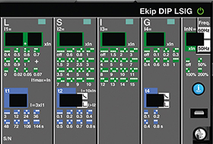
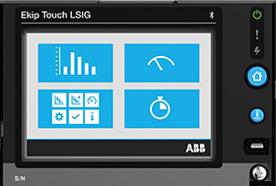
Direct Replacement Emax & New Emax to Emax 2
Trip Units features
Functions in Emax/New Emax and Emax 2 Trip Units
 | PR111/P | PR112/P | PR113/P | PR121/P | PR122/P | PR123/P | Ekip DIP | Ekip Touch | Ekip Hi-Touch
Protection functions | LI/LSI/LSIG | LSI/LSIG | LSI/LSIG | LI/LSI/LSIG | LSI/LSIG | LSI/LSIG | LI/LSI/LSIG | LI/LSI/LSIG | LI/LSI/LSIG
Overload - L
Inverse long-time delayed trip | ● | ● | ● | ● | ● | ● | ● | ● | ●
Thermal memory | - | ● | ● | - | ● | ● | ● | ● | ●
Time-delayed overcurrent - S
Constant tripping time (t=k) | ● | ● | ● | ● | ● | ● | ● | ● | ●
Constant specific let-through energy (t=k/l^2) | ● | ● | ● | ● | ● | ● | ● | ● | ●
Thermal memory | - | ● | ● | - | ● | ● | ● | ● | ●
Start-up function | - | - | ● | - | ● | ● | - | ● | ●
Zone selectivity | - | ● | ● | - | ● | ● | - | ● | ●
Instantaneous overcurrents - I
Constant tripping time (t=k) | ● | ● | ● | ● | ● | ● | ● | ● | ●
Start-up function | - | - | ● | - | ● | ● | - | ● | ●
Ground fault - G
Constant tripping time (t=k) | - | ● | ● | ● | ● | ● | ● | ● | ●
Constant specific let-through energy (t=k/l^2) | ● | ● | ● | ● | ● | ● | ● | ● | ●
Start up function | - | - | ● | - | ● | ● | - | ● | ●
Zone selectivity | - | ● | ● | - | ● | ● | - | ● | ●
Grand fault on toroid (Gext) | - | ● | ● | - | ● | ● | - | ● | ●
Directional protection - D | - | - | ○ | - | - | ● | - | - | ●
Current imbalance | - | ● | ● | - | ● | ● | - | ● | ●
Power Control | - | - | - | - | - | - | - | ○ | ○
Network analyzer | - | - | - | - | - | - | - | - | ●
Real-time monitoring and protection |  |  |  |  |  | -
Current | - | ● | ● | - | ● | ● | ○ | ● | ●
Voltage - Power - Energy - Frequency | - | - | ○ | - | ○ | ● | - | ○ | ●
Maintenance indicators and records | - | ○ | ● | - | ● | ● | ● | ● | ●
Communication capability | - | ○ | ○ | - | ○ | ○ | - | ○ | ○
● Standard features ○ Features available as optional or installing additional devices

Slide 18
Direct Replacement Emax & New Emax to Emax 2
Trip Units features
Additional features in Trip Units
Ekip DIP
Real time monitoring and protection of current with Ekip Multimeter
Ekip Touch
Real time monitoring and protection of Voltage - Power - Energy - Frequency with software packages
Power Control with Ekip Power Controller
Ekip Hi-Touch
Power Control with Ekip Power Controller
PR112/P
Maintenance indicators and record using the release PR112/PDL or PR112/PDM
Communication capability usisng the release PR112/PDL (LonTalk Protocol) or PR112/PDM (Modbus Protocol)
PR113/P
Directional protection D with the installation of a set of three external voltage transformers
Real time monitoring and protection of Voltage, Power, Energy, Frequency with with the installation of a set of three external voltage transformers
Communication capability usisng the release PR113/PDM (Modbus Protocol)
PR122/P
Real time monitoring and protection of Voltage, Power, Energy, Frequency with PR120/V
Communication capability with PR120/D-M (Modubus) EP010-FBP (Profibus/DeviceNet)
PR123/P
Communication capability with PR120/D-M (Modubus) EP010-FBP (Profibus/DeviceNet)

Slide 19
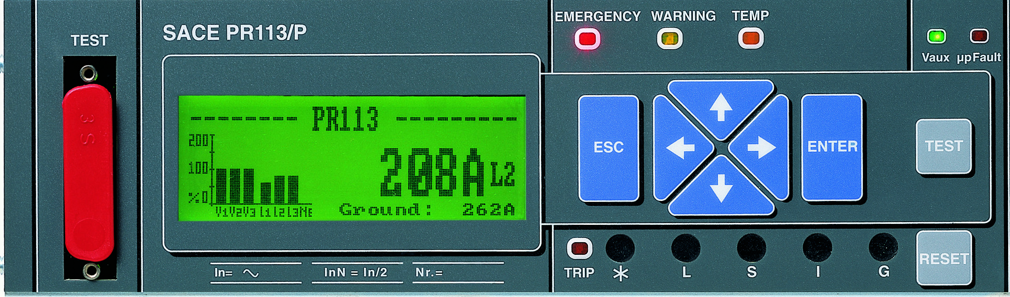
Direct Replacement Emax & New Emax to Emax 2
Trip Units comparison
Correspondence Emax/Emax 2 Trip Units
Correspondence New Emax /Emax 2 Trip Units
Emax |  | Emax 2
PR111/P |  | Ekip DIP *
PR112/P |  | Ekip Touch **
PR113/P |  | Ekip Hi-Touch
Emax |  | Emax 2
PR121/P |  | Ekip DIP *
PR122/P |  | Ekip Touch **
PR123/P |  | Ekip Hi-Touch
* Ekip Touch and Ekip Hi-Touch can also replace PR111/P Emax Trip Unit
** Ekip Hi-Touch can also replace PR112/P EmaxTrip Unit
* Ekip Touch and Ekip Hi-Touch can also replace PR121/P Emax Trip Unit
** Ekip Hi-Touch can also replace PR122/P EmaxTrip Unit

Slide 20
Direct Replacement Emax & New Emax to Emax 2
Advanced retrofitting kit solution
Accessories compatibility
SACE Emax/New Emax |  | DR Emax/New Emax vs Emax 2
YO (shunt opening release) | → | Emax 2 standard YO
YO2 (second shunt opening release) | → | Emax 2 standard YO2 (alternative YU)
YC (shunt closing release) | → | Emax 2 standard YC
YU (undervoltage release) | → | Emax 2 standard YU
Time-delay device D | → | Emax 2 UVD - cubicle's rewiring is required
M (motor for charging springs) | → | Emax 2 standard M (spring charge motor)
SOR Test Unit | → | Emax 2 YO/YU Test Unit - rewiring is required
Electrical signalling of electronic releases tripped S51 | → | Emax 2 contact signalling tripping of Ekip protection TU S51/1
Current sensor for neutral conductor outside circuit-breaker | → | Emax 2 Current sensor for neutral conductor outside CB - cubicle's rewiring is required
Homopolar toroid for the main power supply earthing conductor | → | Emax 2 Homopolar toroid for the main power supply earthing conductor - cubicle’s rewiring is required
Toroid for residual current protection * | → | Emax 2 Toroid for residual current protection - cubicle's rewiring is required
Mechanical operation counter | → | Emax 2 standard MOC
Key lock in open position | → | Emax 2 standard KLC
Padlocks in open position | → | Emax 2 standard PLC
Lock in racked-in/test isolated/racked-out position | → | Emax 2 standard KLP
IP54 door protection | → | Emax 2 standard IP54
AUX Q1…Q10 (O/C auxiliary contacts) | → | AUX Q4 (O/C - standard supply) + AUX Q6 (O/C)
AUX Q11...Q25 (O/C auxiliary contacts for installation outside the CB) | → | Re-use the ones of Emax/New Emax fixed part (adaptation kit for 15 AUX is required)
AUX spring charged (S33M/2) | → | Emax 2 standard S33M/2
AUX S75I-S75T-S75E CB racked-in/test isolated/racked-out | → | Re-use the ones of Emax/New Emax fixed part
AUX YU (YU energized) | → | Emax 2 RTC - check compatibility before ordering
PR120/K Electrical signalling contacts for TU * | → | Emax 2 Ekip Signalling 2K - 4K - 10K (10K to install outside the circuit breaker)
PR020/K Electrical signalling contacts for TU ** | → | Emax 2 Ekip Signalling 2K - 4K - 10K (10K to install outside the circuit breaker)
PR120/V Measurament module for PR122/P * | → | Emax 2 Feature available with Emax 2 Emax 2 Ekip Hi-Touch or Ekip Touch + measuring package
PR120/D Communication modules * | → | Emax 2 Ekip Com modules - cubicle's rewiring is required to install Ekip Cartridge
* Accessory available only for New Emax; ** Accessory available only for Emax;

Slide 21
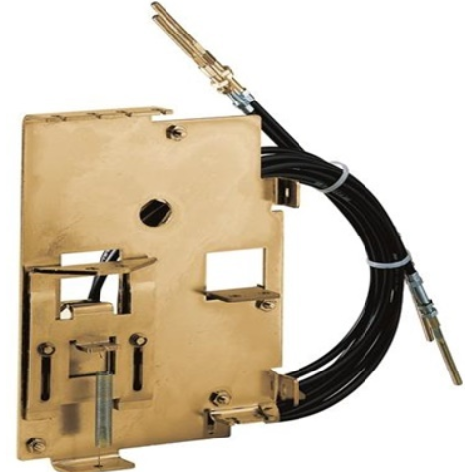
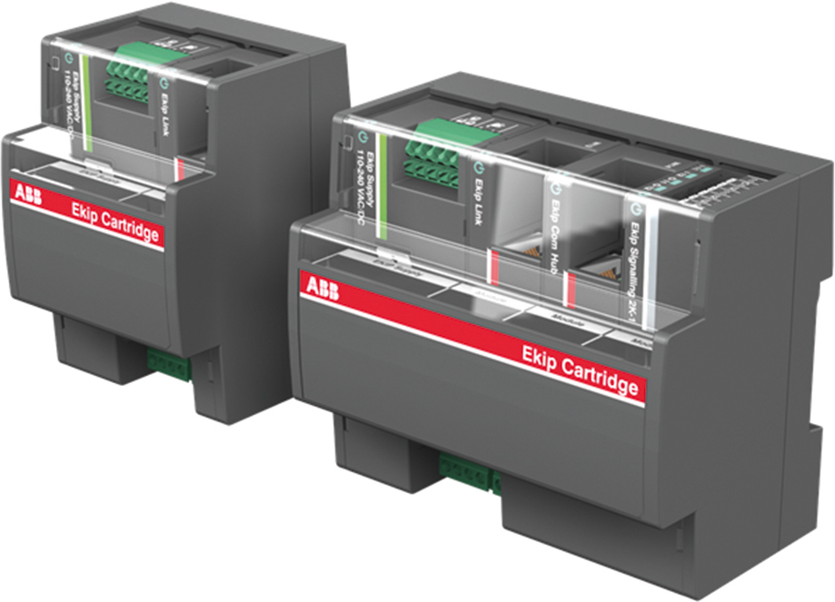
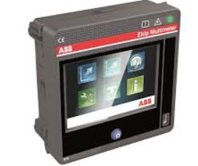
Direct Replacement Emax & New Emax to Emax 2
Advanced retrofitting kit solutions
Accessories and compatibility
Ekip Cartridge
The following accessories are not compatible with these retrofit kit solutions
Mechanical lock for compartment door;
Mechanical interlock system with other CBs;
All accessories of the Emax 2 fixed part
This external device is connected directly to the Ekip Touch/Ekip Hi-Touch Trip Unit and allows to use most of the connectivity modules:
- Ekip Supply
Ekip Com
Ekip Link
Ekip Signalling
Ekip Synchro check
Ekip AUP
The following Emax 2 accessories can be installed with an external re-wiring with local adaptation:
Ekip Multimeter;
Ekip Control Panel;
Ekip View;
Remote reset YR

Slide 22
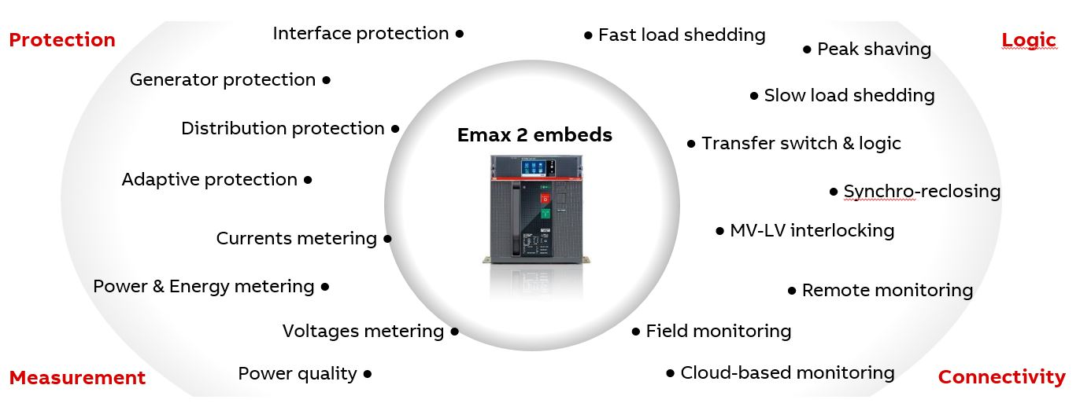
Retrofit kits
Why would you choose our retrofit kits?
Introduce easily new technologies in old systems – Emax 2: all in one innovation

Slide 23
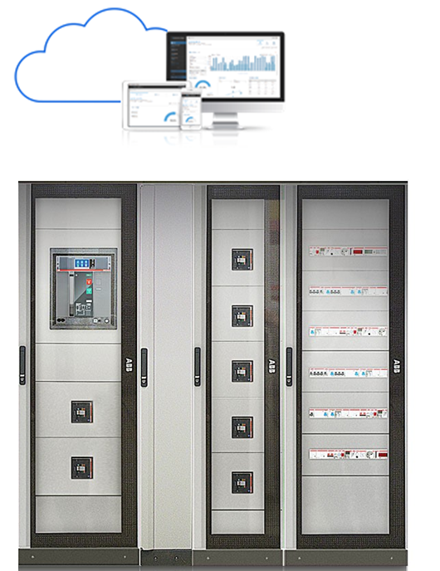
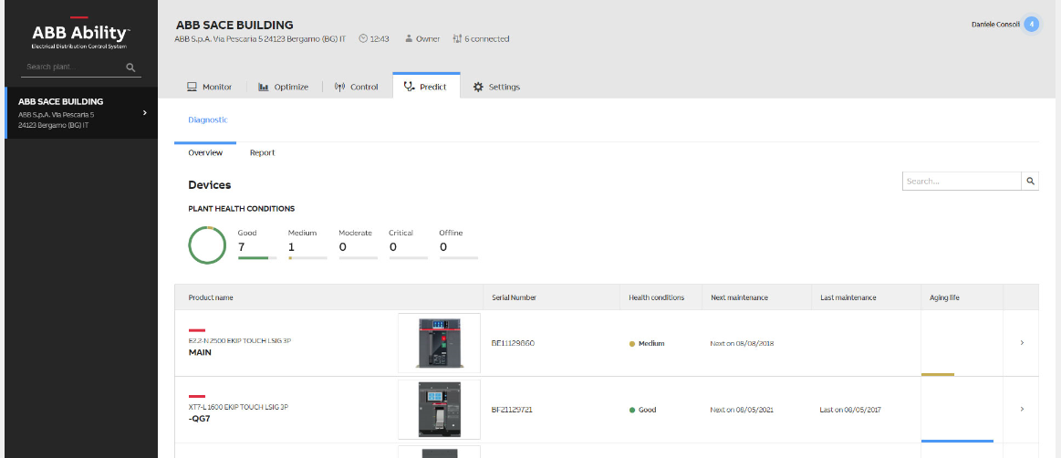
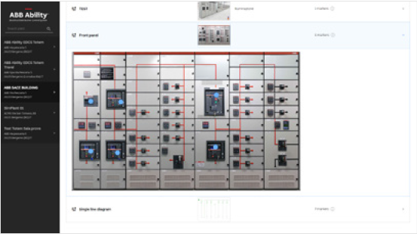
Retrofit kits
Why would you choose our retrofit kits?
Introduce easily new technologies in old systems – Emax 2: cloud-based Energy and Asset Management
Monitor
Optimize
Discover plant performance, supervise the electrical system and allocate costs
Analyze the relevant information, improve the use of your assets and take the right business decision
Predict
Control
Supervise the system health conditions and predict next maintenance actions
Remotely implement an effective power management strategy to simply achieve energy savings
Notes:
24k€ Energy efficiency certificates → no need for expensive and time consuming audits by 3rd parties, automatic reports via EDCS!
30% savings on operational costs → Thanks to remote supervision and alerting, reduction of time and costs for commuting around the different sites and intervene proactively and quickly to restore normal condition avoiding faults, perform maintenance, or fix downtimes + avoiding downtimes and penalties due to bad power quality

Slide 24
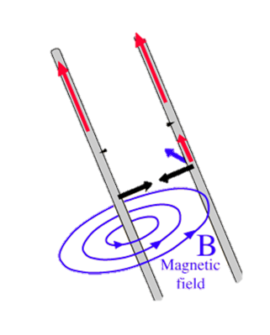
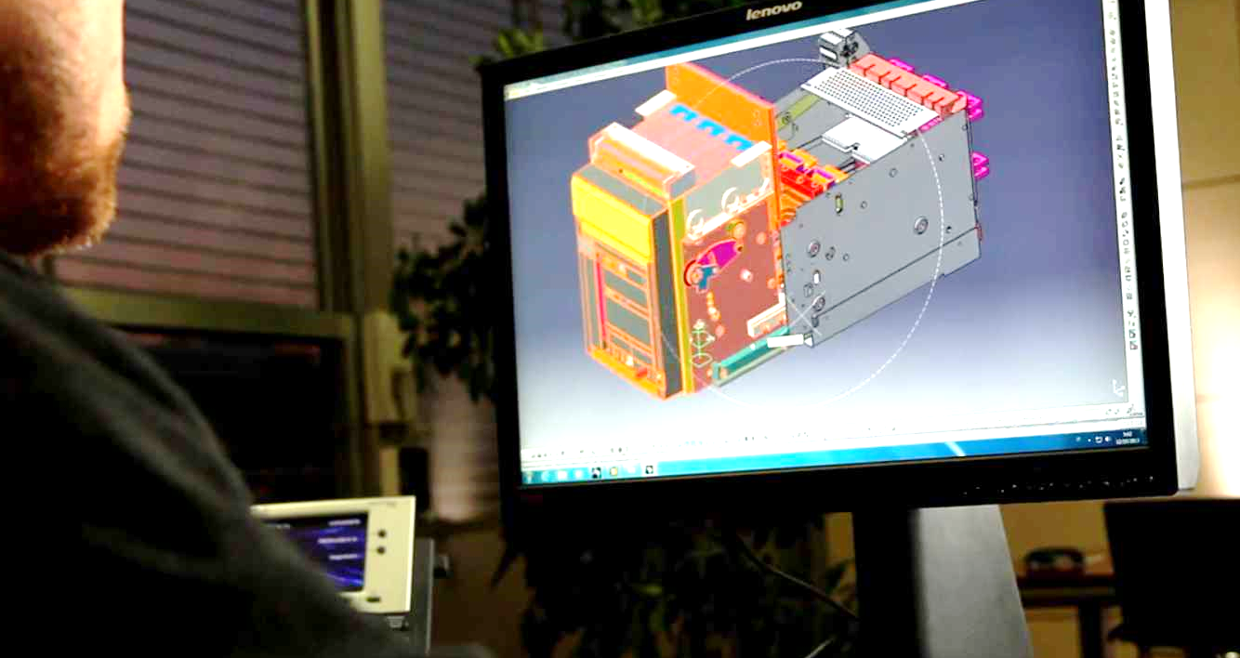
Retrofit kits
Why would you choose our retrofit kits?
Introduce easily new technologies in old systems– High quality and easy installation
ABB Retrofit kits have high quality as:
Tested in accredited laboratory and completed with compatibility declarations
Developed by the same R&D team that has developed both old and new circuit breakers
Behind the kits there are studies to respect the Driving factors:
Thermal behavior
Short circuit withstand current
Dielectric properties
Mechanical fits: installation, compatibility, auxiliary connections
Easy installation
Equipped with clear mounting instruction/video tutorials

