Slide 1
LWT series – A renewed GWR offering

Slide 2
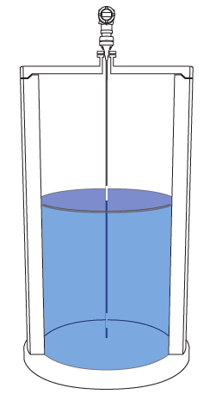
Why do you need guided wave radar?
Reliable level measurement, even in difficult conditions
Radar wave confined by probe, so energy is stays high, providing reliable measurements
Suitable for high pressures and high temperatures
Can be made in materials resisting hash conditions

Slide 3
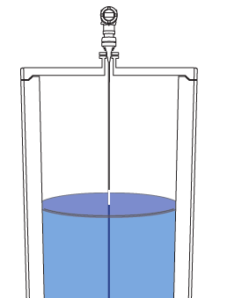
How does GWR work?
A radar wave is generated by the transmitter and guided by the probe
Advantage: The energy is always high providing good signals
When the wave touches an interface, liquid or solid, it reflects back to the transmitter
The time of flight of the wave is measured, providing a measurement of distance
The dielectric constant of the materials indicates how strong the reflection will be
Water has a high DC, reflects strongly
Oils have a low DC, reflect weakly
Low density solids have a low DC
Plastics have a low DC

Slide 4
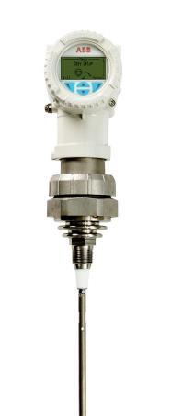
The LWT300 series
The LWT series is based on
The common ABB platform
The MT5000 coupler designs
This leads to
A renewed, state of the art, guided-wave radar electronics
The common ABB look and feel
The heritage of the MT5000 couplers
The new LevelExpert algorithm, making setup faster and the measurement more reliable
Painted aluminum or
Stainless steel enclosure
Common ABB menu layout
TTG or pushbutton display
Head can be rotated
Threaded or flanged interface
Cable probe
Rod probe
Segmented rod probe
Coaxial probe

Slide 5
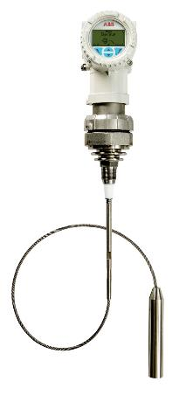
LWT Models and specifications
GWR provides high accuracy and excellent reliability in harsh conditions
 |  | LWT310 | LWT320
Recommended applications |  | Liquids | Solids
Coupler diameter, NPT version |  | 3/4 in. |  | 1-1/2 in.
Process temperature |  | -50C to 204°C (-58°F to 400°F)
Process pressure |  | up to 200 bar (2900 psi)
Minimum DC |  | 1.4
Update rate |  | 5 Hz
Accuracy |  | 2 mm (5/64 in.)
Resolution |  | 1 mm (3/64 in.)
Protection class |  | IP68 /NEMA 6P
Probes |  | Cable Rigid rod Segmented rod (connected segments of 1 m) Coaxial
Maximum pull force |  | 450 kg (1000 lb.) | 635 kg (1400 lb.)

Slide 6
Different probes can be used in different contexts
Cable probe
Rod, segmented or continuous
Coaxial probe
Up to 60 m long (200 ft.)
Very convenient for shipping and handling
A weight is placed at the bottom to keep cable straight
Cable can be cut and weight reattached
Up to 6 m long (20 ft.)
Segmented rod are very convenient for shipping and handling
Segments of 1 m (3 ft.) long
Up to 6 m long (20 ft.)
Used for special applications
Keeps radar pulse inside coaxial tube, high intensity
Relevant for low dielectrics (DC < 2)
No dead zone (5 cm (2 in.) for others)

Slide 7
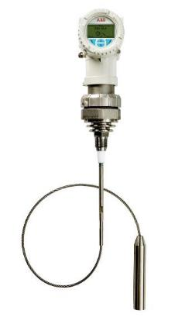
The LevelExpert™
A GWR that anyone can use
A guided wave radar that anyone can use. No need to be an expert anymore.
GWR is often considered difficult to setup
LWT series benefits from powerful and user-friendly way of configuring a GWR
LWT series guided-wave radar
With LevelExpert™: The expert inside
The LevelExpert™ concentrates 20 years of industrial level measurement experience into an intelligent algorithm made to accurately detect the level even in the most demanding conditions. Forget baseline mapping and echo selection, LevelExpert™ knows how to find the right level through the clutter. The expert is now inside your guided-wave radar.

Slide 8
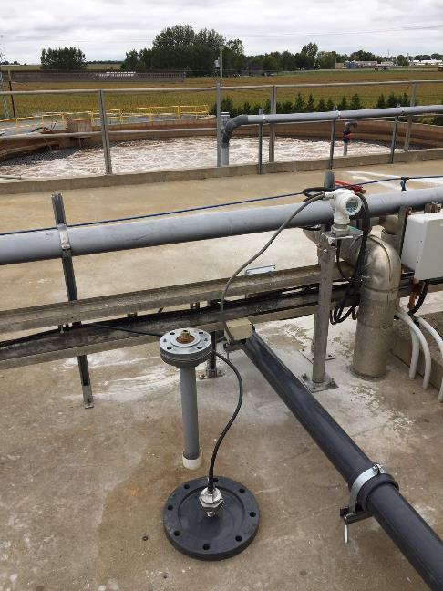
Remote head with long cable
Placing head away from coupler
Remote head with long cable, as much as 60 m (200 ft.)
The remote head option can be very convenient, for instance when
The coupler is hard to reach
The coupler is in a warm place, where uncomfortable to work
The coupler is on top of the vessel but the display needs to be at a lower level
The head is separated from the coupler and probe by a coaxial cable
The coaxial cable is rated for outdoor use and shielded

Slide 9
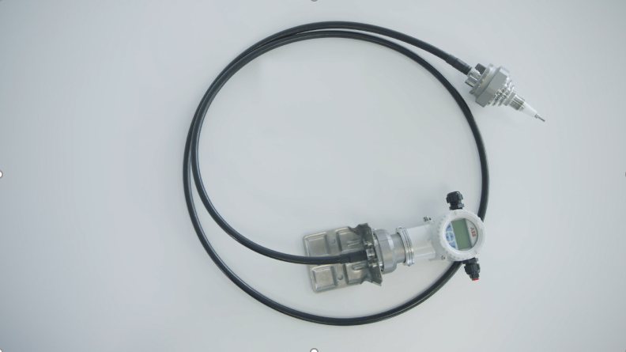
Remote head with long cable
Placing head away from coupler
Remote head with long cable, as much as 60 m (200 ft.)
The remote head option can be very convenient, for instance when
The coupler is hard to reach
The coupler is in a warm place, where uncomfortable to work
The coupler is on top of the vessel but the display needs to be at a lower level
The head is separated from the coupler and probe by a coaxial cable
The coaxial cable is rated for outdoor use and shielded

Slide 10
Very low temperature drift possible
LWT series specification:
Temperature drift (digital): ±0.2 mm/10 K (max ± 2.5 mm)
This is 15 to 50 times better than usually seen on the market
Accuracy is defined at a constant temperature, it doesn’t account for drift.
You must have a low temperature drift in order to benefit from high accuracy in real world applications.
When is it important?
When you expect high accuracy at all times, even during temperature changes
Also relevant for redundant applications: when using several units, they will all drift, but they need to remain within a given range otherwise it will trigger an alarm. Low drift means efficient redundancy.

Slide 11
Faster step response for measuring fast changes
Step response defines the time it takes to see 90% of an immediate change
It is a better definition of instrument response time than update rate – you could update the output very fast with constant values
The LWT series has a fast update rate of 5 Hz, leading to a step response time of 400 ms
A step response time of 1 – 3 is usually seen on the market
When is it important?
A fast update rate is important for measuring rapidly filling vessel.
Small vessel can fill up fast
Spherical or cylindrical vessel fill up fast near the top, since the vessel diameter gets smaller near the top
Fast response time is safer: less chances of overfilling

Slide 12
Probe type and length can easily be changed on site
Change without having to recalibrate
You can stock electronics heads separately from probes and assemble probes as needed, without recalibration
You can keep, on site:
Electronics heads and couplers together
Cables and weights
Segments of rods
All you need to do it tell the LWT which type of probe is used, and its length

Slide 13
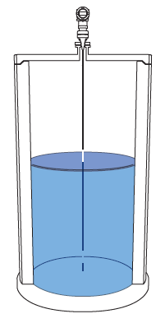
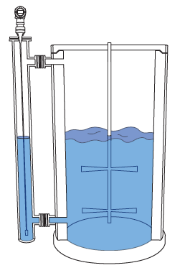
Applications
Storage vessel
External chamber/bridle/MagWave™
Storage vessels are one of the most common applications for guided wave radar.
Instrument signal is not affected by steam, vapor, mist, spray, turbulence, flashing, changing pressures or temperatures, or changing dielectrics.
Foam generally does not affect signal, but excessive foam can cause a negative offset.
Light buildup can be managed, but heavy buildup should be avoided.
Boiler drums, feedwater heaters, compressed hydrocarbons and process vessels with multiple obstructions require external chambers.
LWT310 is the best measurement choice for such installations
Chamber concentrates signal if chamber is 100 mm (4 in) or smaller providing excellent measurements

Slide 14
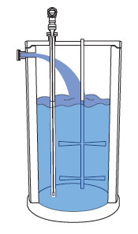
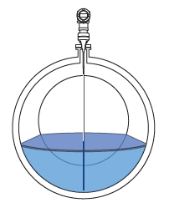
Applications
Stilling wells / co-axial probe
Horizontal cylinder
Stilling wells are used if
the probe must be installed in the process fill stream
Stilling well or co-axial probe are used:
to avoid obstructions and agitators
to retain signal strength in applications with very low dielectric fluids and long measuring lengths
Used as settling tanks, separation vessels, and storage tanks.
LWT310 not affected by the internal geometry of horizontal cylinders.
No false level reflections created by the cylinder walls
LWT310 is able to measure close top the end of the probe, allowing measurement until the vessel is near empty.

Slide 15
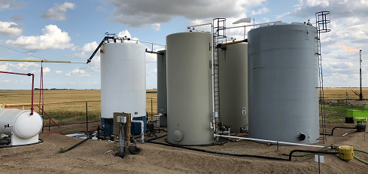
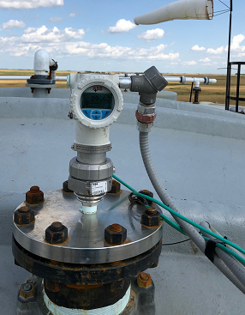
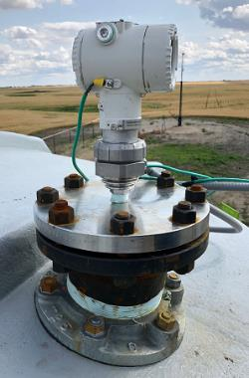
Typical tank level measurement
Oil with H2S
Customer needs
Configuration
Feedback
Reliable level measurement on oil with H2S and wax build up in fiberglass tank.
LWT310
25 foot long cable probe
Threaded in flange, flat metal surface provide great radar pulse launch
Easy setup menu allowed full configuration through integrated HMI
LevelExpert allowed setup either using traditional threshold or Movement based level detetcion
Great measurement stability over time

Slide 16
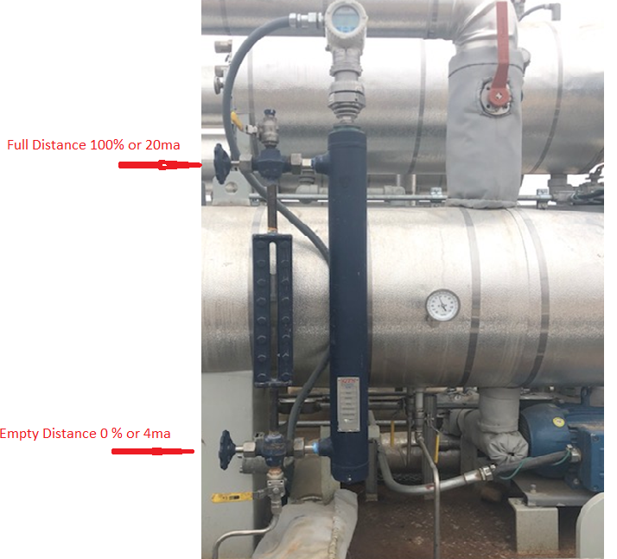
Typical external chamber installation
LWT310 on LNG tank
Configuration:
LWT310
Segmented rigid rod probe
External chamber
Made of metal, contains radar pulse like a coaxial probe.
High intensity provide very reliable measurement
External chamber protects probe from potential interference from inside the main tank

Slide 17
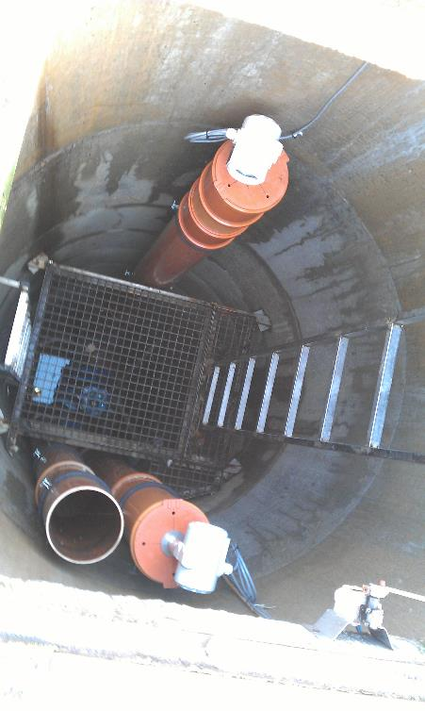
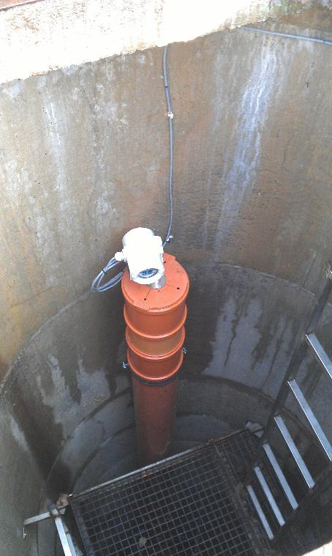
ABB’s LWT310 to secure tunnel from being flooded in Warsaw in Poland
ABB’s client was faced with problem to choose right measuring method to prevent tunnel from being flooded.
In 2013, after grand opening of a new tunnel in Warsaw there was a short but very intensive storm.
False echoes of ultrasonic transmitter led to wrong valve behavior and tunnel was flooded.
Customer then wanted a device immune to such false echoes which can appear in narrow well. He choose the LWT310.
Because of new LevelExpert™ algorithm the customer was able to configure the device by himself and whole commissioning only took minutes.

Slide 18
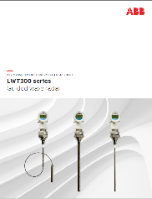
Find more information on our web site
Web page: http://bit.ly/LWTseries
Technical presentation
Ppt presentations
Videos

Slide 19
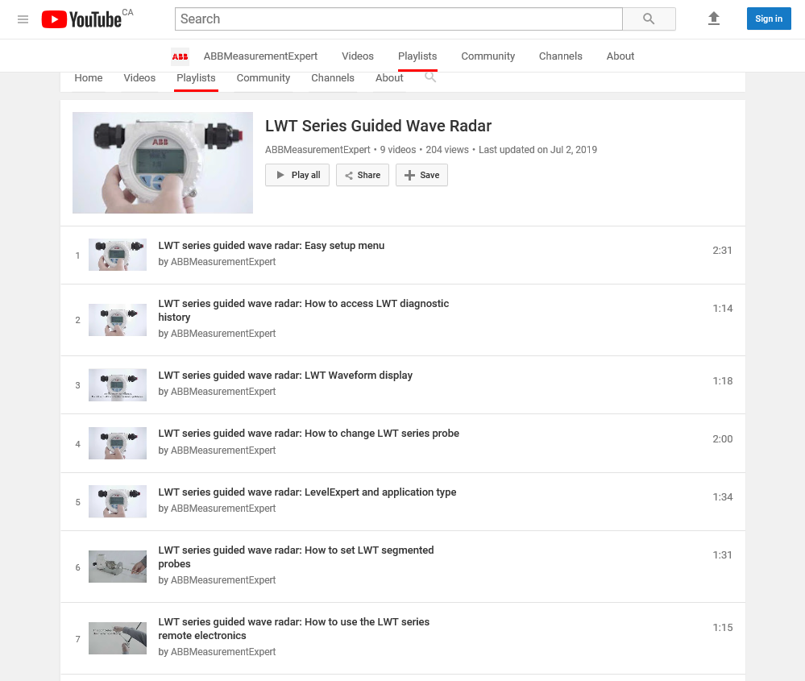
How-to videos
Playlist of 9 LWT series videos:
https://www.youtube.com/playlist?list=PLiDMHZk-KA7aj17ZpFP5W8PozbGlCwNNk

Slide 20
Summary
Guided wave radars provide
high accuracy (2 mm)
Reliable measurement in harsh conditions (vapors, dust do not affect it, wetted materials can be selected appropriately)
due to the high radar pulse intensity maintained by the probe
GWR can be used widely in the industry
The LWT300 series, with the new LevelExpert algorithm, is very easy to use, making it possible for almost anyone to install one

Slide 21
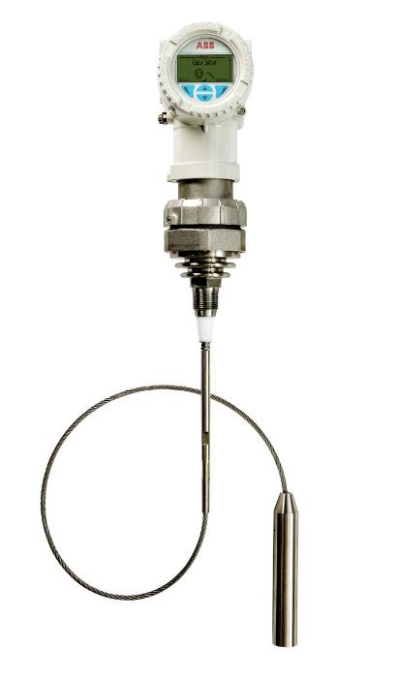
Contact information
For more information about the products
radars@ca.abb.com

