Slide 1
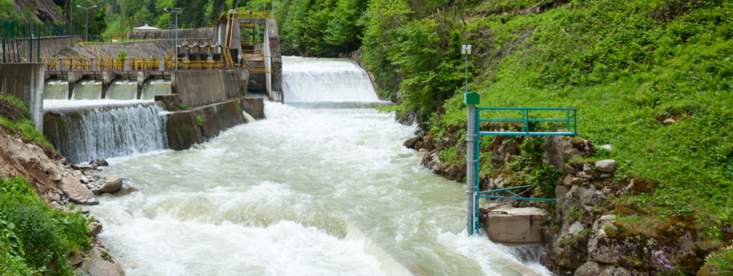
ABB Hydropack
Modernization solution for mini hydro power plants
Roger Lladó/Albert Martí, ABB Motion Services
2020
9AKK108466A8417

Slide 2
Content
ABB Hydropack
Efficiency improvement
Benefits
Additional benefits
Service journey
Technical description
Key components
Products selection
References in operation
Case studies
Slide 2

Slide 3
ABB Hydropack
ABB Hydropack is a modernization solution that increases the efficiency and performance of mini hydro plants. It consists mainly of a regenerative drive with an embedded specific control system, that allows the turbine to operate from fixed to variable speed and enables it to generate a wider range of flow rates, hence increasing the profitability of the installation.

Slide 4
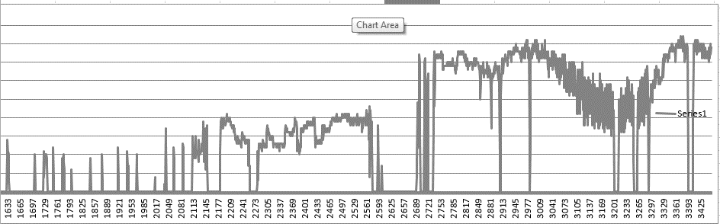
— How do we improve the efficiency of a mini hydro power plant?
The traditional system needs a minimum water flow to maintain the turbine nominal speed, and at the same time, it’s needed to maintain the synchronous speed to achieve 50Hz for energy evacuation to the network.
With the implementation of the ABB Hydropack variable speed solution, the system can generate at extremely low water flow rates and the equivalent hours of the plant are increased.
Power
Time
Slide 4

Slide 5
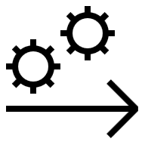
Benefits
Adapted proposals
Multiple advantages
Maximize profit
The simple integration of a drive allows
increasing the production of energy
through a greater range of speeds and
turbinable flow rates. At the same time,
the control software always finds the
An optimal working point that allows an
increased performance throughout all
speed ranges and flow rates.
The option that best serves your needs
will be offered through the power plant
assessment. You choose among various
options: commissioning, optimization
and annual monitoring.
The ABB Hydropack solution improves
efficiency by reducing mechanical losses
and decreasing maintenance needs.
Compensatory elements are not required
for the existing reactive energy, which
leads to significant savings. Improving
the range of production (even at very low
flow rates) and the operating point are
also valuable advantages.

Slide 6
Additional benefits
Generator directly coupled to shaft turbine:
Less maintenance (gearbox, oil, etc.)
Efficiency improvement (reduction of mechanical losses)
Wide speed ranges
Drive controls and protects the generator:
There is no external synchronization, protection or separate excitation devices
Reactive control: no compensation elements required, generation at low harmonics level
Increase of turbinable flows, improves energy production margin
Improvement of the nominal working point

Slide 7
— ABB Hydropack solution. How do we do it?
Service journey
On-site assessment
Compilation of historical production and plant technical data
Visit the plant and technical assessment
Technical & economic feasibility study
Implementation
Verification at ABB of the converter-generator set (when possible)
Site installation and commissioning
Remote monitoring
Follow up and settings optimization
Predictive Maintenance (Condition Based Maintenance)

Slide 8
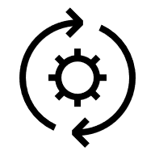
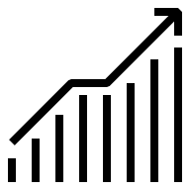
Service journey
ABB Hydropack. Modernization solution for mini hydro power plants
Life-cycle management. Digital services
ABB Expertise. 1-year remote follow-up
ABB Expertise. Power plant optimization
Getting right solution
ABB Hydropack Installation and commissioning
Assessment
Compilation of historical production and plant technical data provided by the customer in order to perform a technical & economical study to check if modernization is feasible and ROI acceptable.
Suitable drive and generator selection (if needed) according to power plant characteristics.
Products & Services installed and commissioned for turbine speed control, operating as a follower of main power plant control.
Enhanced plant productivity with better efficiency and higher annual equivalent hours of production, generating in wider flow rates ranges increasing profitability, especially at low flow rates.
Monthly report for a period of one year delivered to the customer including ABB Expert analysis with recommendations for improvements when needed.
ABB Hydropack can be maintained and serviced based on the recommendations provided by ABB Ability™ digital solutions (Condition Monitoring for drives, smart sensors, generators, etc.)
Slide 8

Slide 9
— ABB Hydropack Technical description
We add a frequency converter between Generator and Transformer
In some cases, replacement or overhauling of Generator is needed
Embedded control system. Turbine speed control software optimises operation and maximizes production
Integration with main power plant control system
Remote monitoring for follow up and custom settings optimization
Implementation of preventive maintenance package (alarm management, remote access, condition based maintenance, etc.)
Remote Connection
Ethernet
Drive Bus
Control panel CP6xx
Unit Control AC5xx
Power supply to grid
400/690V
10-70Hz
*PMG/IMG
ACS880-17
Station Transformer
Turbine
Slide 9
*PMG (Permanent Magnet Generator), IG (Induction Generator)

Slide 10
— ABB Hydropack Key components (1/2)
Transformer
In case of need to adapt to the existing voltage of the installation (MV Generator)
Regenerative Drive ACS880-11/17
High power ranges (4–5.600 kW)
Voltage ranges (400–690 V)
MV Drives to be studied case by case
Generator
In case of replacement, it is recommended to have:
PMG (Permanent Magnet Generator)
IG (Induction Generator)

Slide 11
— ABB Hydropack Key components (2/2)
Control System
It is the embedded software inside ABB Hydropack PLC that integrates an algorithm that is always looking for the most optimal working point in the speed of the turbine. An integrated HMI touch panel allows easy operation of the system.
Never Alone
ABB is always close to the customer. In-person, remotely, by telephone or through the ABB AbilityTM Condition Monitoring portal, where the customer can monitor the real status of the machine online, depending on its condition.
Follow up and optimization
Throughout the first year, the machine will be monitored and optimized, always seeking greater efficiency in power generation, delivering monthly reports to the customer with the improvements made, the results of previous modifications and the planning of future improvements.

Slide 12
ABB Hydropack
Products selection
Scope
ABB Hydropack
Generator (*New or Refurbished)
Transformer
ABB Hydropack
Generator
(*New or Refurbished)
ABB Hydropack
Basic
Powertrain
Premium/Complete
Notes:
Position of ATV600 series which is competing with ACS580-07 and ATV900 competing with ACS880. The main message of ATV600 is the energy efficiency where as ATV900 is about the performance.
Price-Performance positioning.
ATV61,71 are the legacy products with more power rating options. However, they are discontinuing those legacy products.

Slide 13
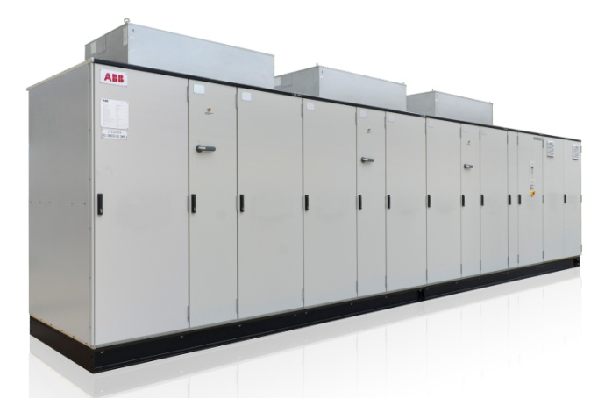
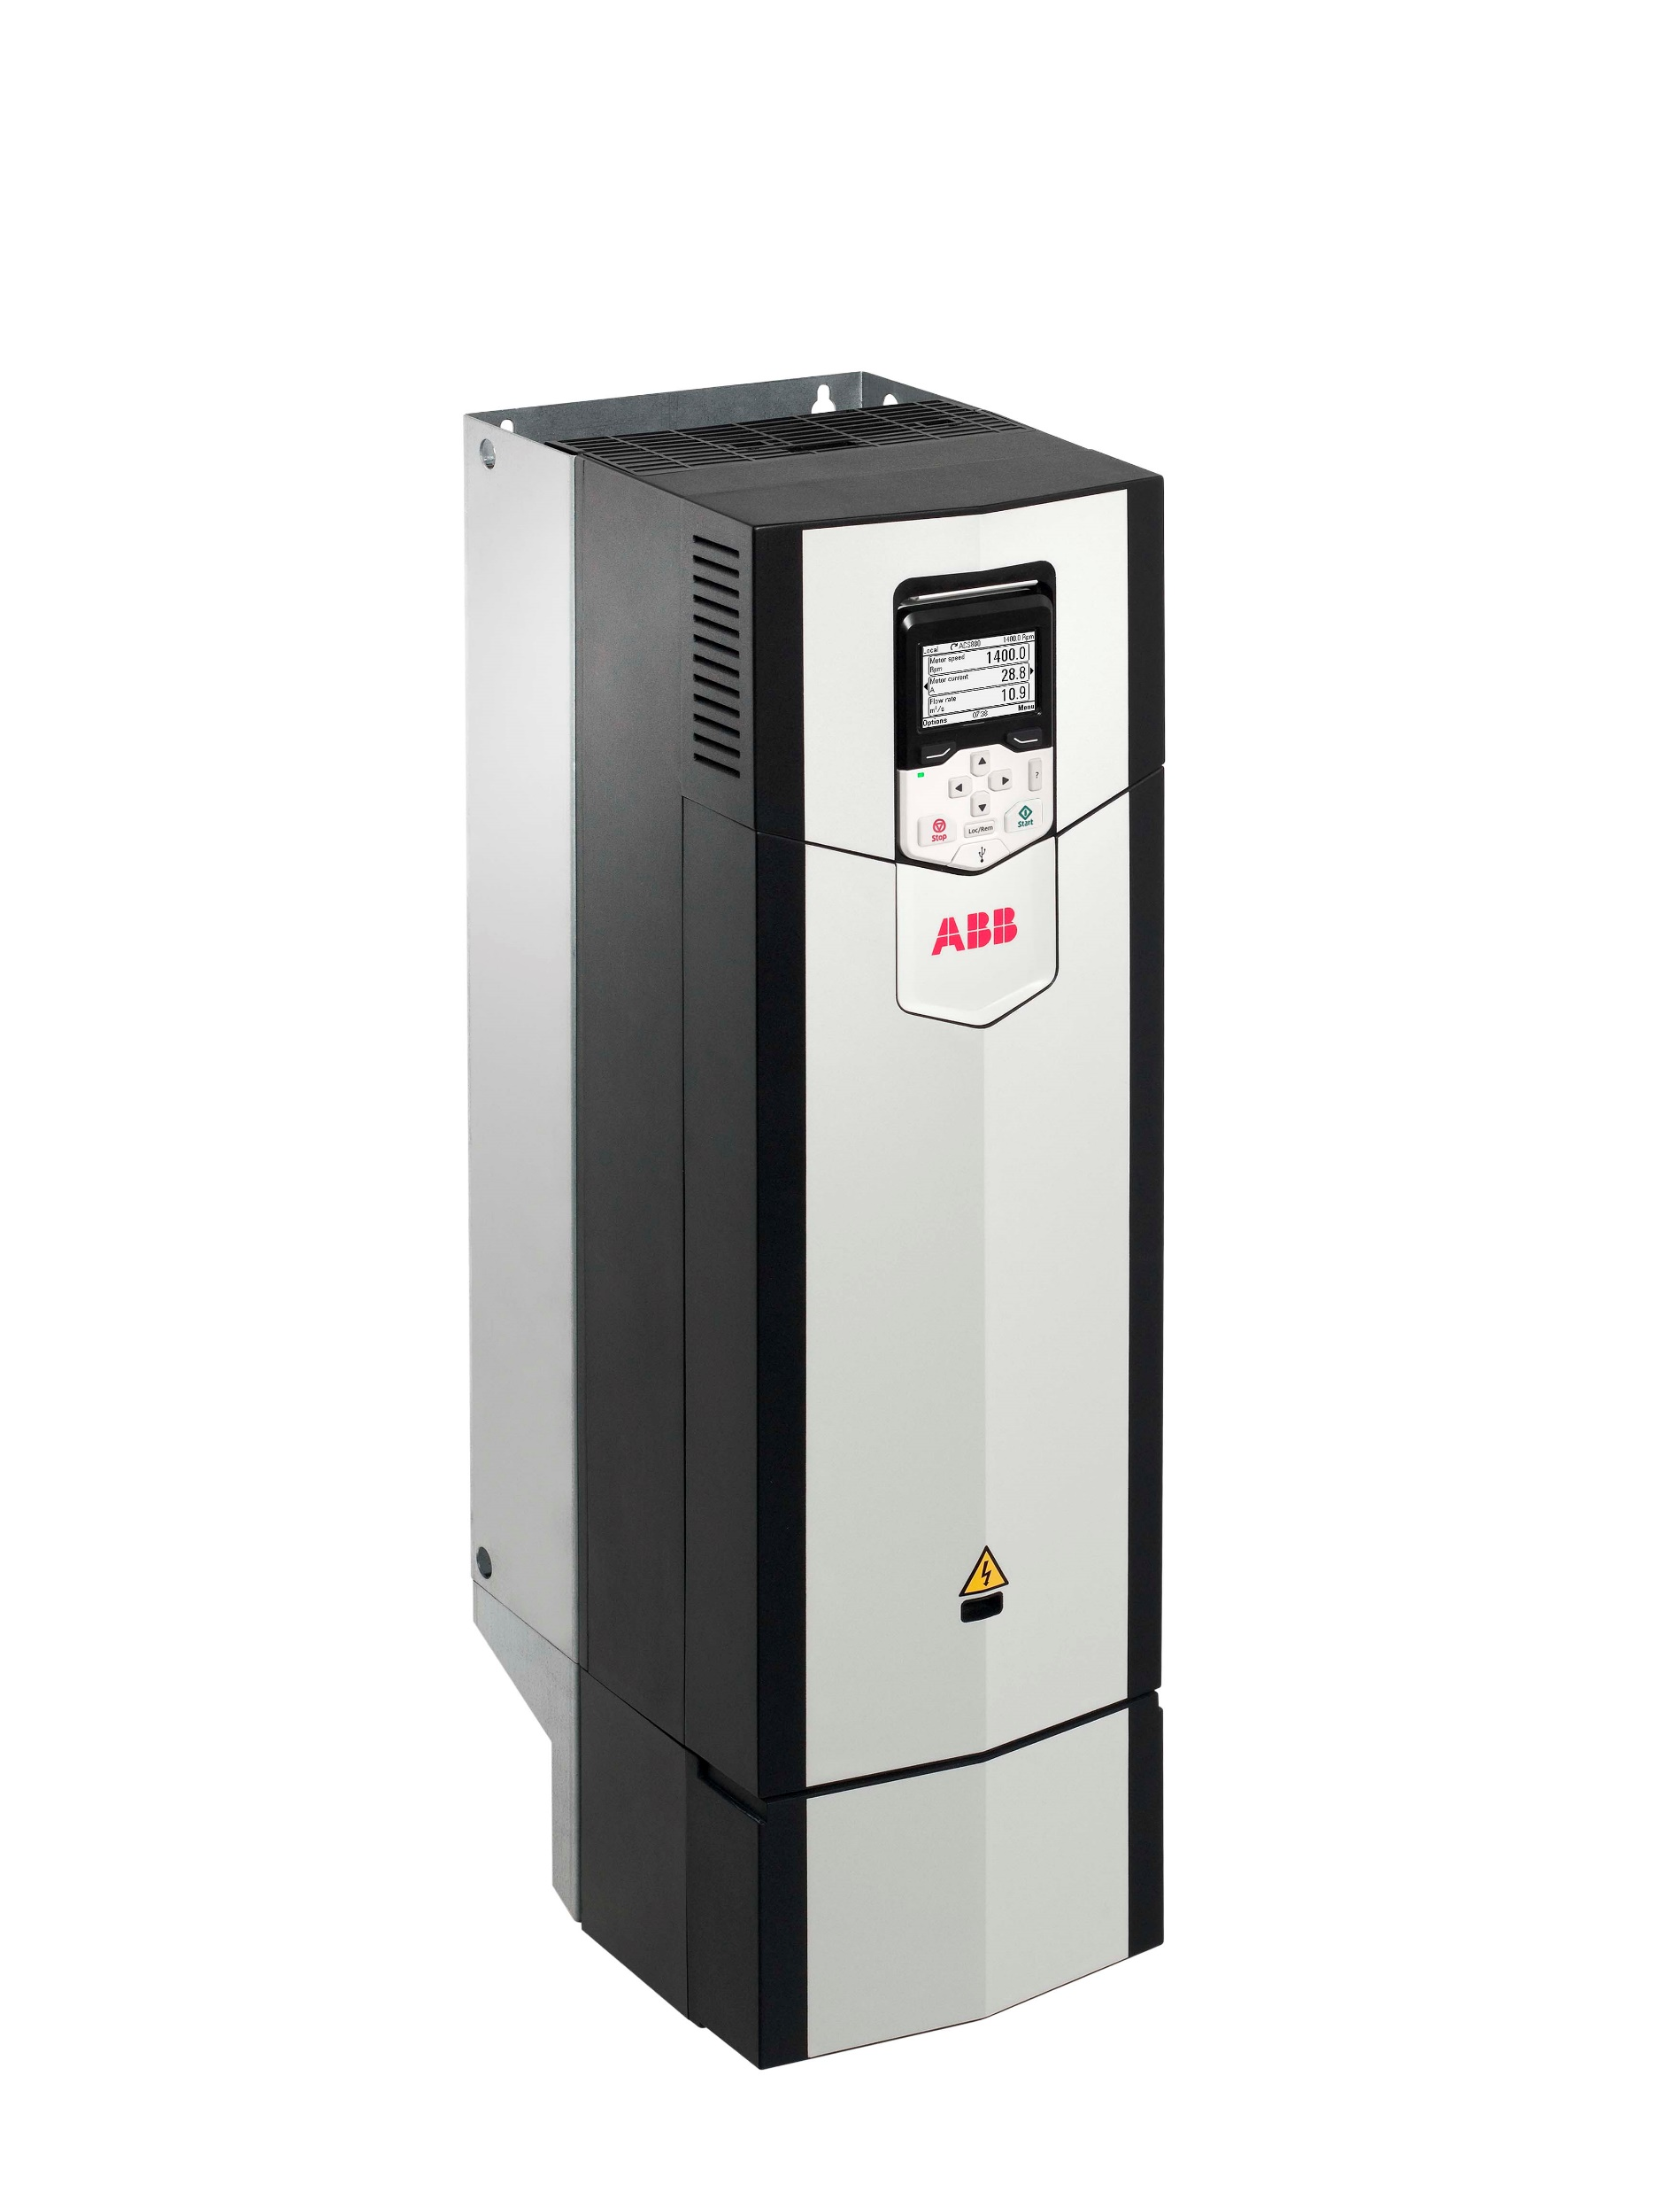
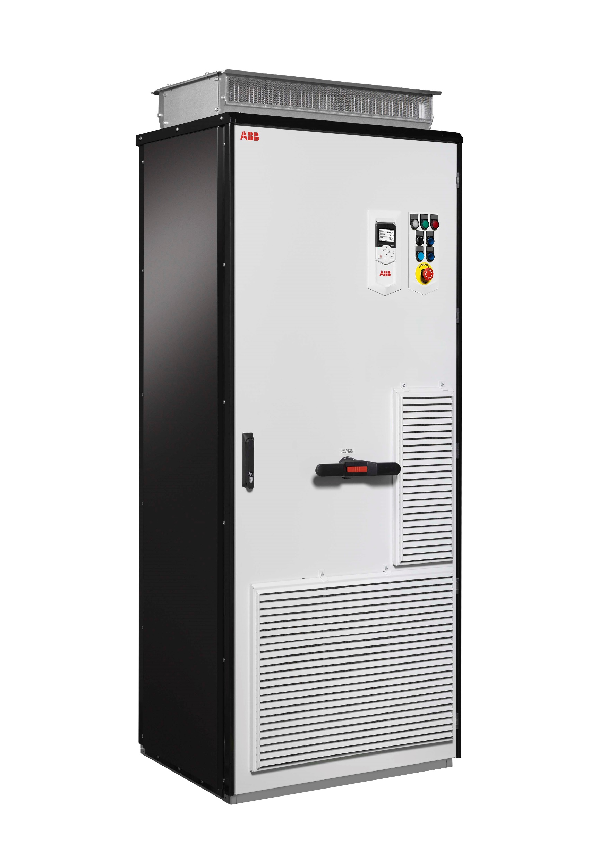
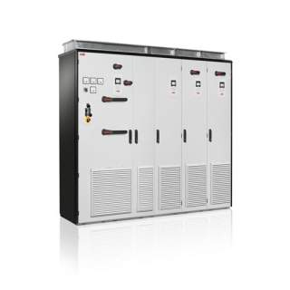
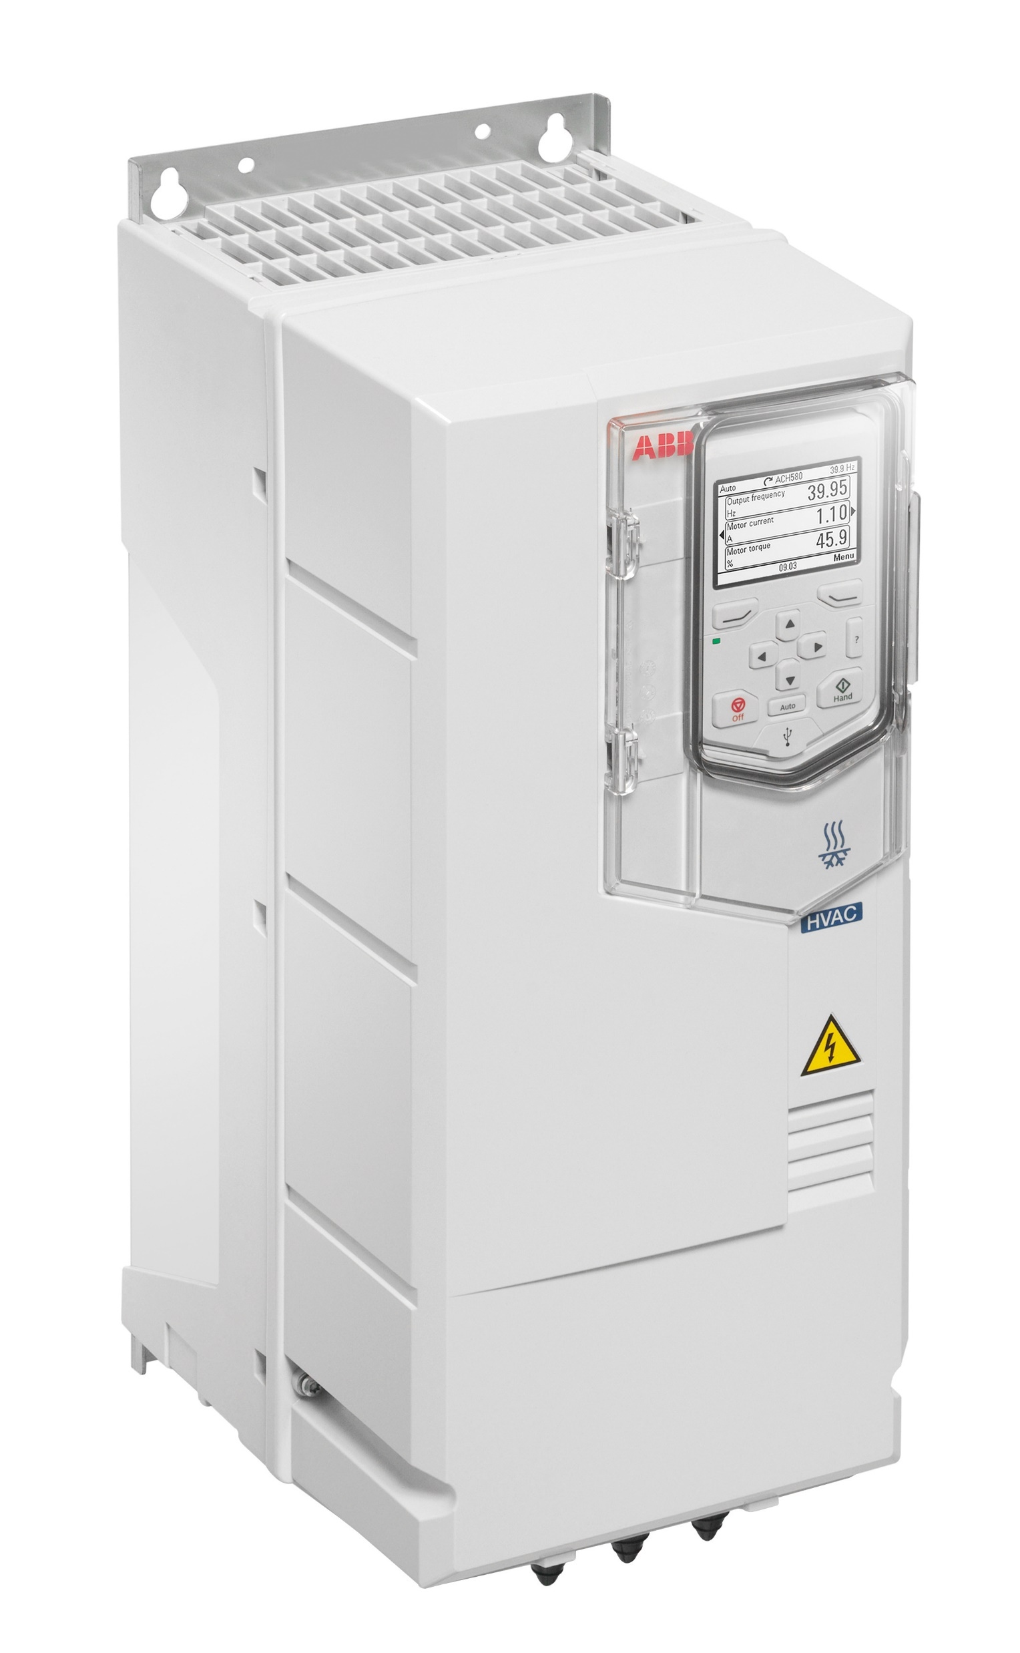
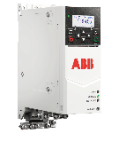
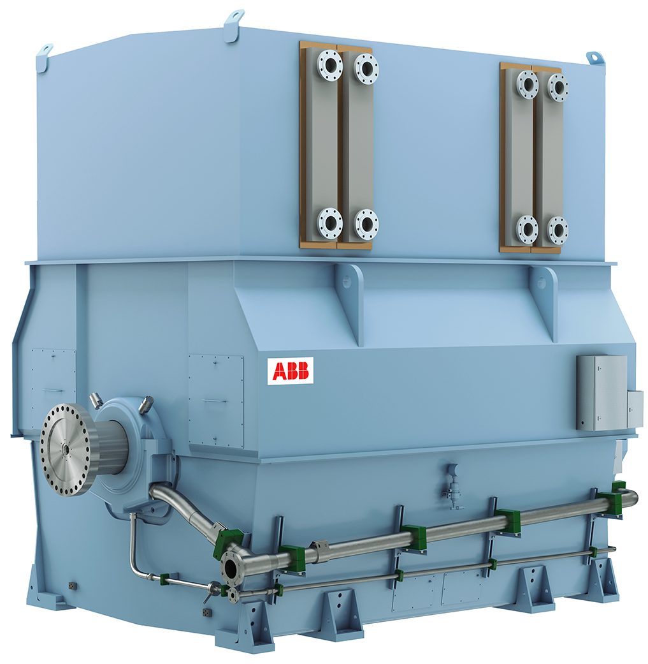
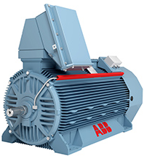
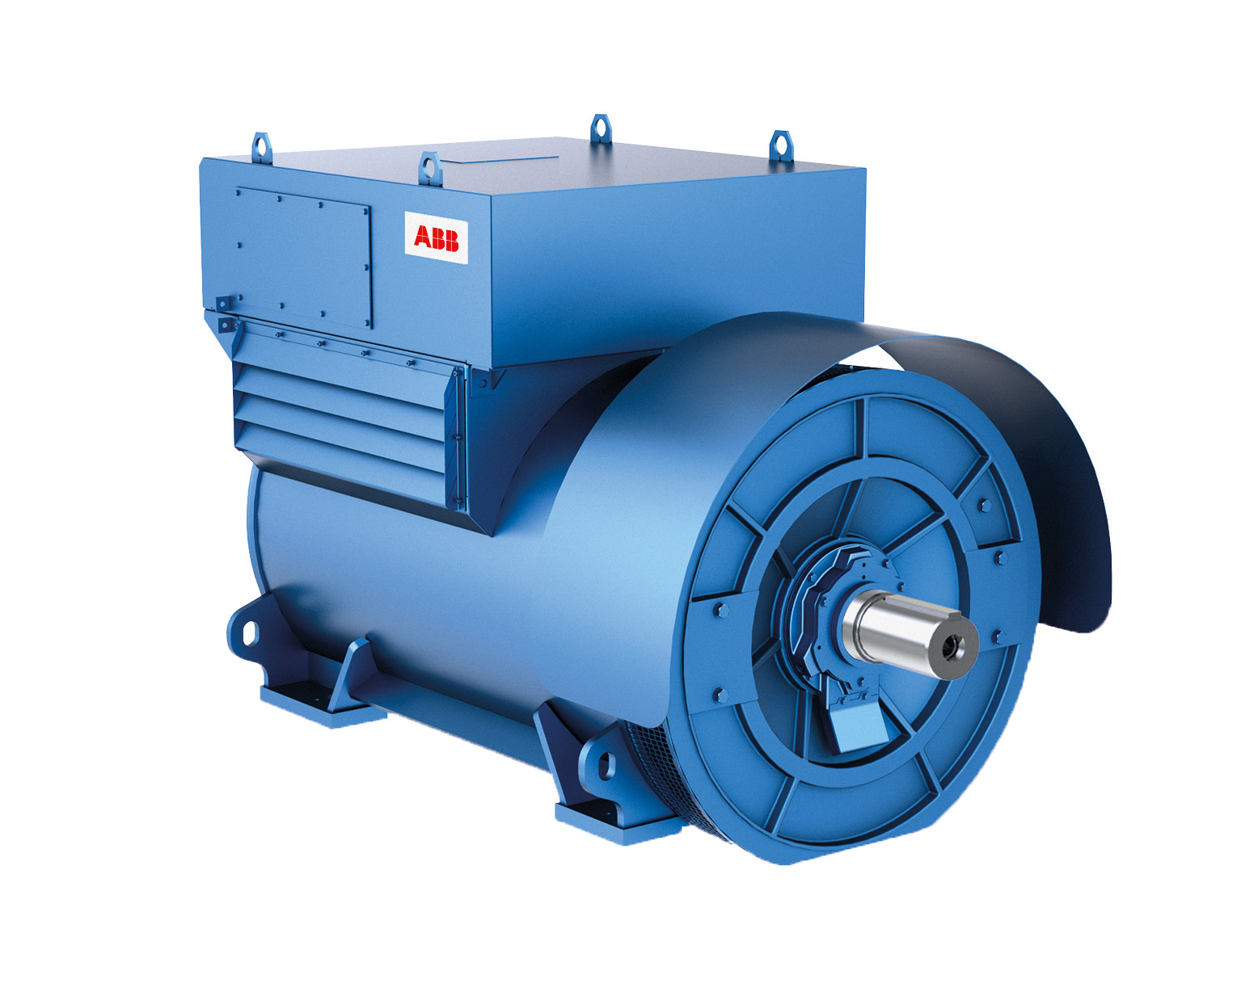
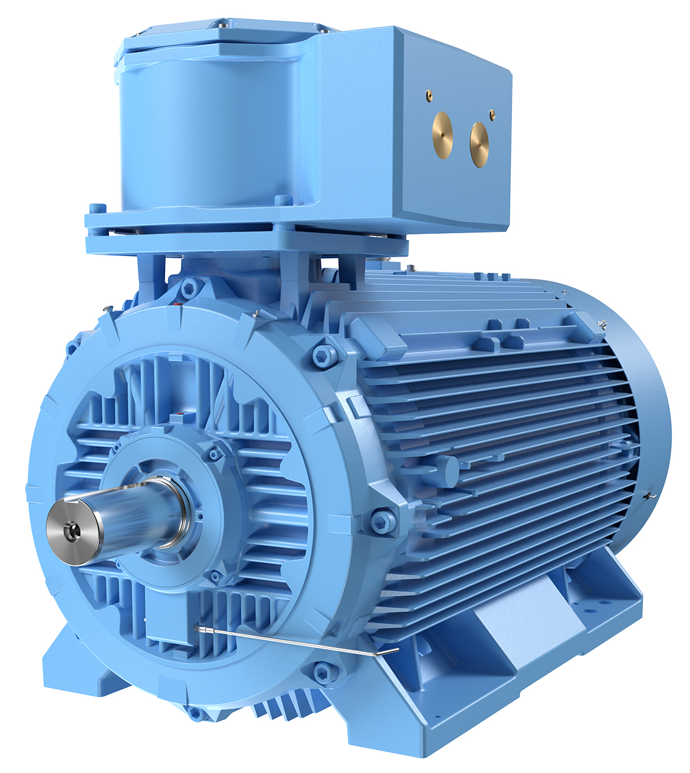
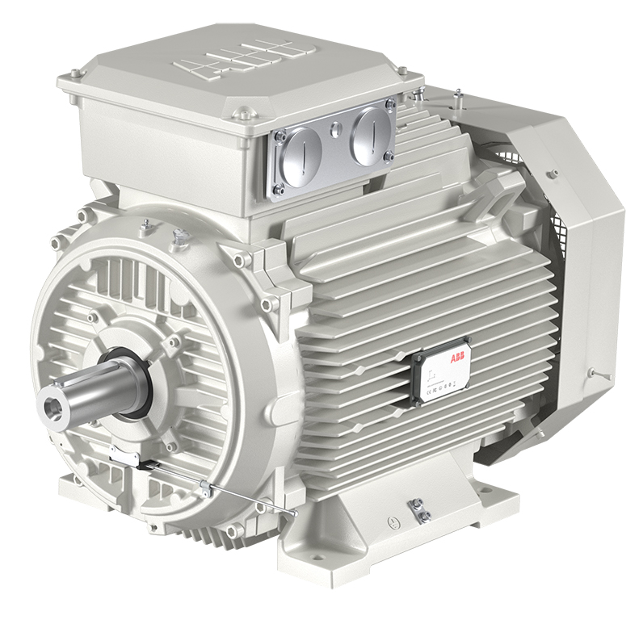
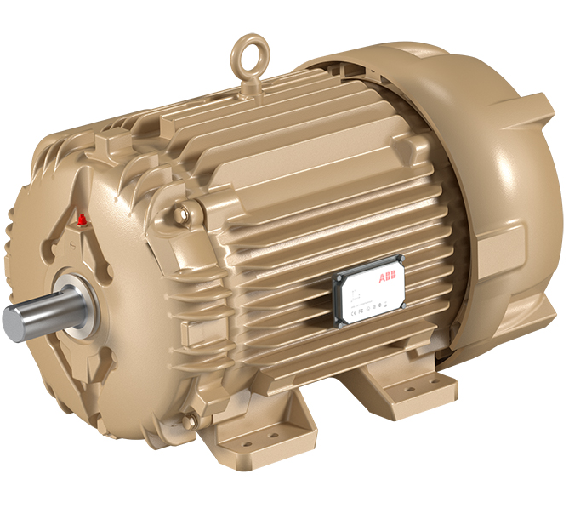
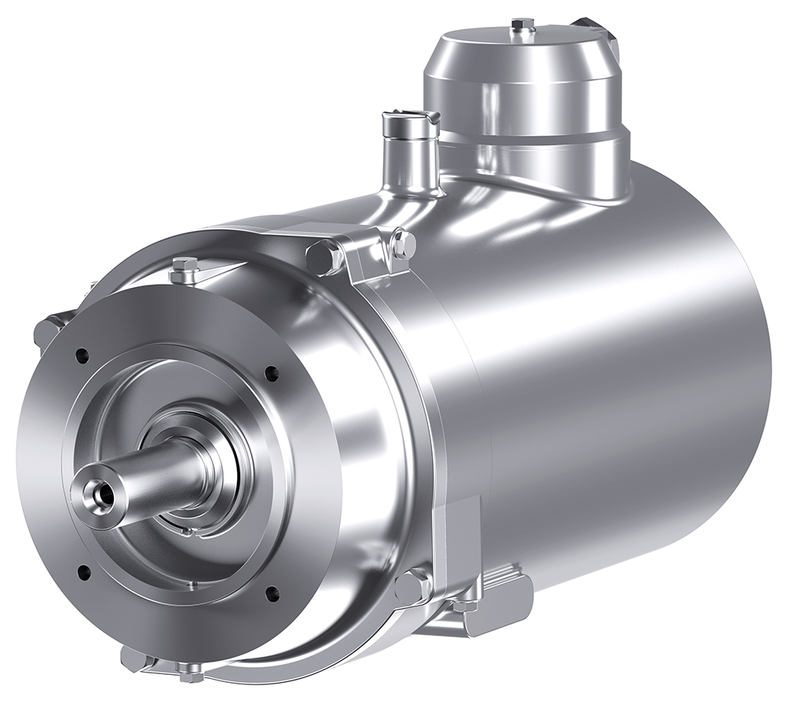
ABB Hydropack
Products selection
Special products – high power in MV
Industrial products – from low power to high power in LV
Mass products – not applicable
<1 kW
4 kW
ABB and NON ABB generators
6000 Kw
36,000 kW
February 28, 2019

Slide 14
References in operation
10 installations operating in Spain with customers like Utilities, small producers and turbine manufacturers, mainly with Francis and Kaplan turbines.
The first installation performed in 2013
Power Ranges from performed installations between 140kW to 710kW (1 MW in 2022; solution available up to 6MW) and voltage range of 400 to 690V (Medium Voltage plants to be studied case by case).
Performance improvement range of 20-50% from executed installations up to date.
Average of Return Of Investment (ROI) time between 18 months to 5 years
Note: the average power plants age is around 100 years and life expectancy is between 30 and 60 years more of operation, depending on power plant water rights.
Other indirect savings: less mechanical maintenance and smooth and efficient mechanics.
Power ranges
140kW to 1000kW
Voltage
400 to 690V
+ Performance
20-50%
Return of Investment (ROI)
18 months to 5 years

Slide 15
Summary of references operation (Spain)
Plant | Year | Customer | Power | Voltage | Turbine Type | Remarks
1 | 2013 | Utility | 685kW | 1500/690V | Flight | Voltage adaptation to the existing generator and drive at 690V implementation through step-up and step-down transformers
2 | 2014 | Turbine manufacturer | 230kW | 400V | Kaplan | New PM Gen coupled directly to the turbine. Under the same flow conditions, an extra 37,4% of performance is obtained
3 | 2015 | Service provider | 140kW | 400V | Flight | The customer will no longer have to change blades angle depending on the flow. 48,9% of better performance is obtained
4 | 2014 | Service provider | 500kW | 400V | Kaplan | With the drive, we minimize the malfunction of the turbine due to being originally miscalculated. Production has improved by 18-20%
5 | 2015 | End user | 350kW | 400V | Crossflow | Greenfield installation

Slide 16
Summary of references in operation (Spain)
Plant | Year | Customer | Power | Voltage | Turbine Type | Remarks
6 | 2018 | End user | 675kW | 690V | Kaplan | Existing separately excited synchronous generator working perfectly with the drive. Sinus filter equipped drive
7 | 2019 | End user | 132kW | 400V | Francis | Before drive implementation, blades opening at low flow levels couldn’t be lower than 17%, since the turbine would start cavitating. Now we can reach 2% without any problem
8 | 2020 | End user | 250kW | 690V | Francis | The existing generator has been rewound, providing it with reinforced insulation to operate with a variable speed drive. An increase of 25% in production has been obtained
9 | 2021 | End user | 50+50kW | 400V | Archimedes screws | Greenfield installation. With drive, 17kW more are obtained
10 | 2022 | Utility | 1.010kW | 690V | 2 x Francis | Ongoing. Changed the original design of the plant, from the medium voltage (6kV) to low voltage (690V). A previous study indicates a theoretical return on investment of 1,7 years

Slide 17
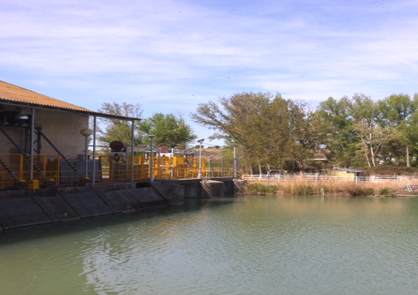
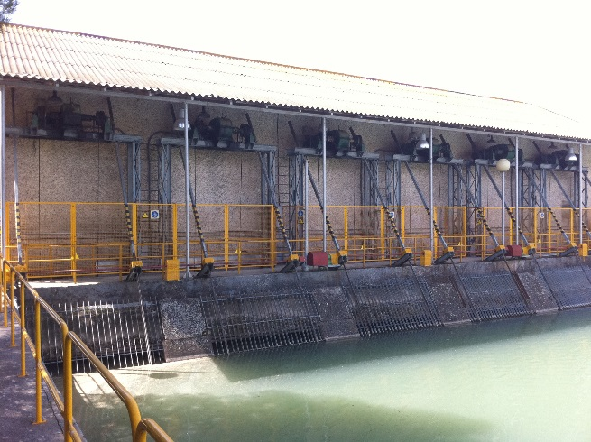
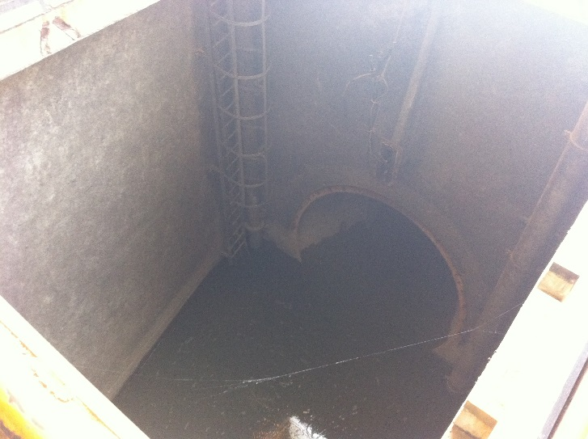
1.Community of Madrid (Utility)
The river’s water flow decrease resulted in the customer’s power plant stoppage, owing to traditional control alongside the low water flow, interruption of the ecologic flow took place, which led to strict fines by the local hydric control agency. The performance is superior under the same flow conditions, the system has been simplified and, alongside the maintenance and its use, the customer is greatly satisfied with the system.
1500V
690V
690V
15kV
Customer G 685kW nominal
Trafo Step Up
ACS800-17-0870-7
Trafo Step Down
Slide 17

Slide 18
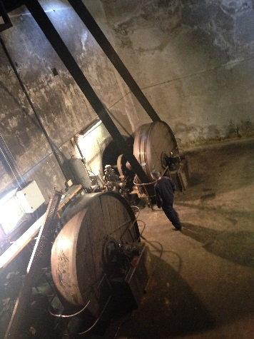
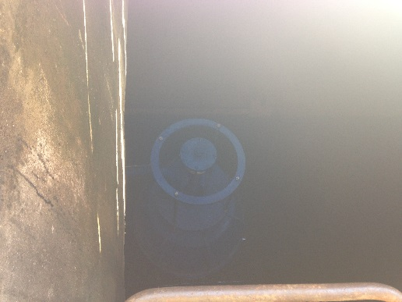
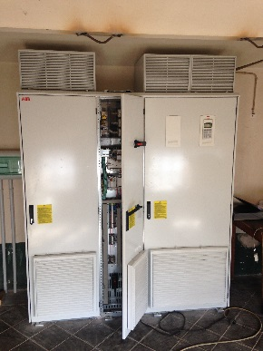
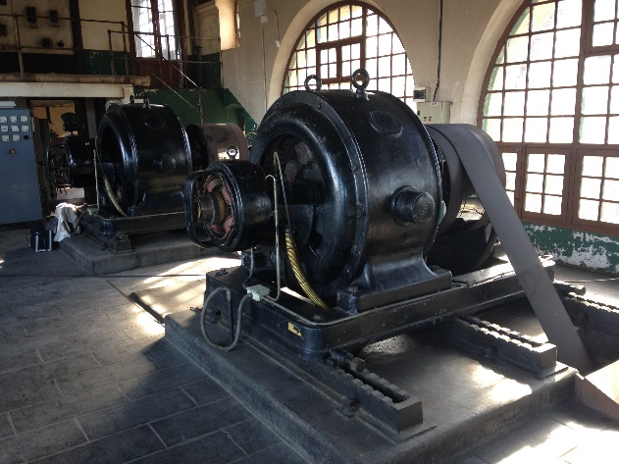
2.Catalunya (Turbine manufacturer)
The customer replaced a generation system by belts with a generator directly coupled to the turbine, a drive and adapting customer plant control to the new system.
Under the same flow conditions, an extra 37,4% of performance is obtained.
400V
400V
Customer PMG 230kW
ACS800-17-0870-7
Slide 18

Slide 19
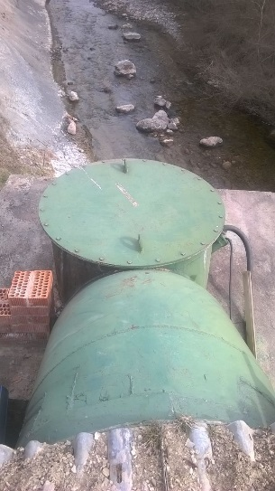
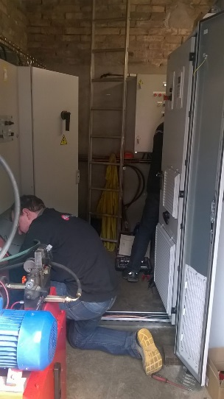
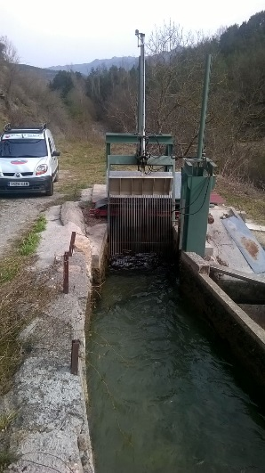
3.Catalunya (Service Supplier)
Since manually changing the blades’ position depending on the water flow can be difficult, a PID control of the water duct level has been made by the drive, regulating its speed. A continuous system and reliability are obtained, which improves performance by 48,9% (see plot).
400V
400V
Customer G EAML 140kW
ACS800-17-0170-3
Slide 19

Slide 20
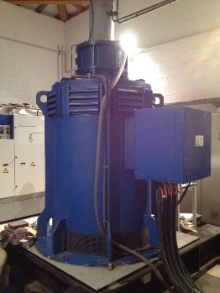
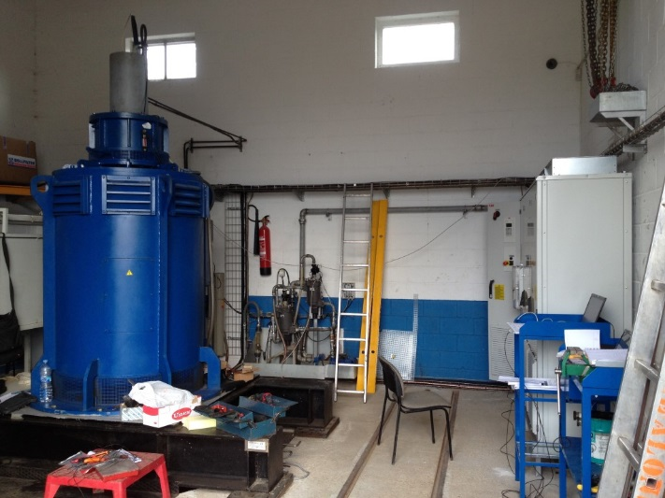
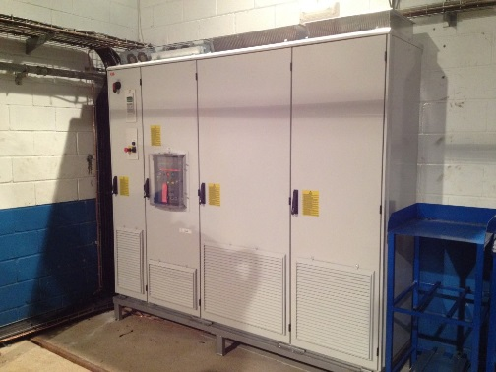
4.Asturias (Turbine Manufacturer / Service Supplier)
On this occasion, the turbine is brought to slightly superior working speeds to improve efficiency, thanks to the drive the motor torque on the generator axis is controlled. Performance is improved and so is the power plant’s productive time.
According to the customer, production has improved by 18-20% approximately.
400V
400V
Customer G Marelli 500kW
ACS800-17-0770-3
Slide 20

Slide 21
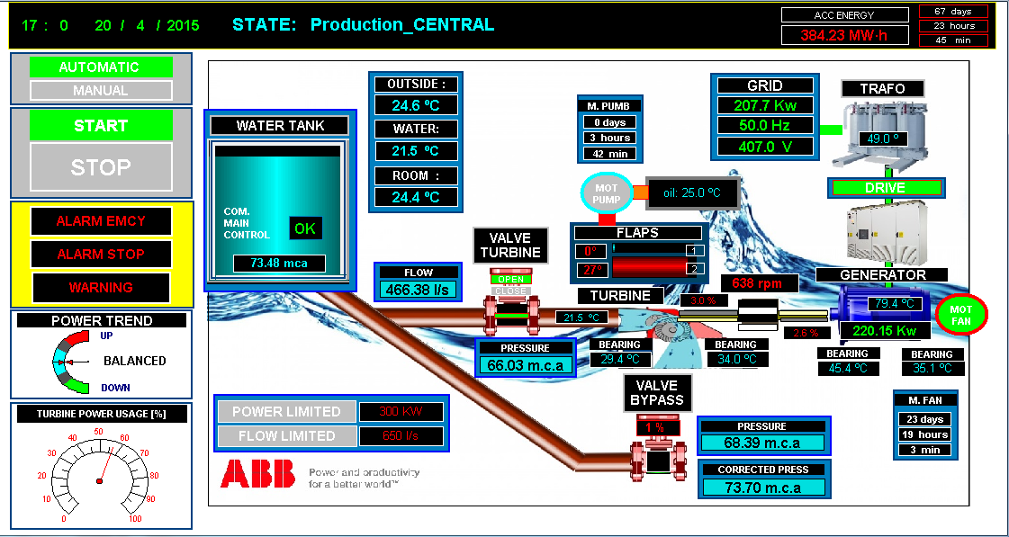
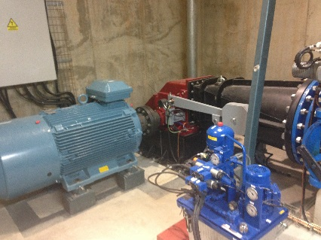
5.Catalunya (Owner)
New facility. An irrigation canal in La Sénia (Tarragona) is used. This case includes generator, drive, cabin and control elements sales, as well as coding the control system and its commissioning.
The turbine is manufactured by Cink, known for selling a Siemens turbine pack, multiplier and generator, so the manufacturer’s facilities were visited, and ABB propose a new way of control with a generator directly coupled to a turbine that was presented.
The customer’s comments are very satisfactory. According to the data, the real curve is almost identical to the theoretical power curve calculated by the customer.
AC500
CP640
ABB PM G 350kW
ACS800-77
Slide 21

Slide 22
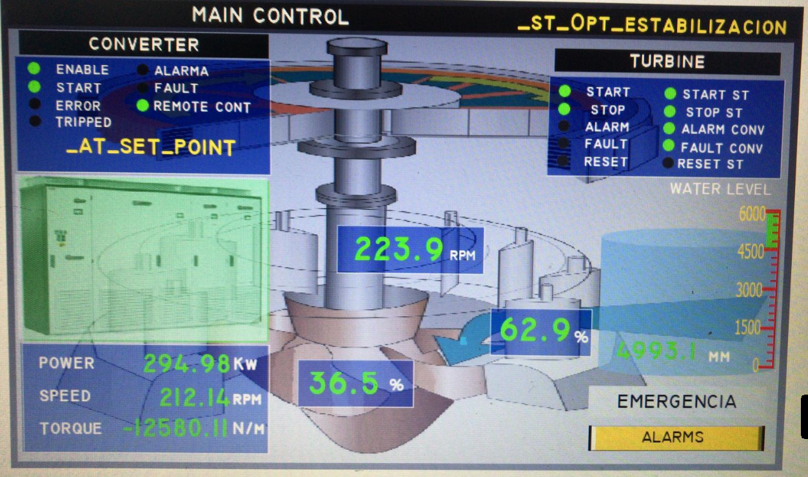
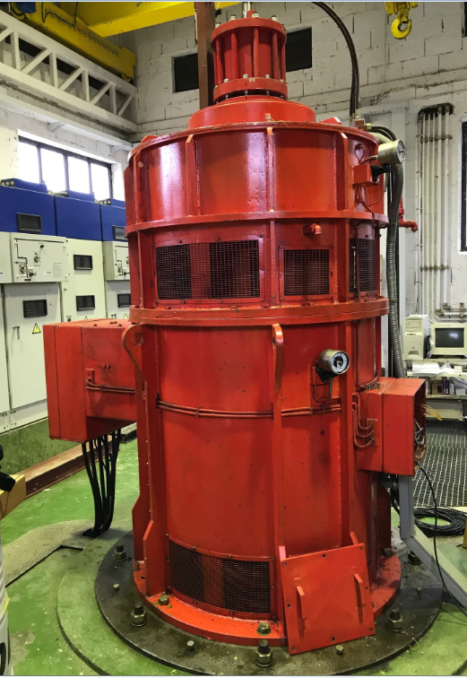
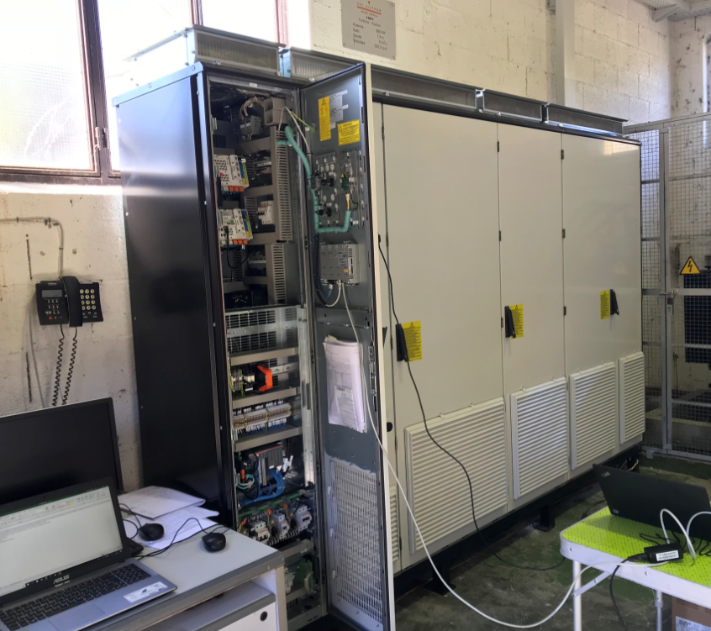
6.Huesca (Owner)
Small hydropower plant optimization, adding an ACS880-17-0770A-7 drive. A current generator is a synchronous machine with separate voltage excitation.
The same generator characteristics are kept after driver installation.
Optimization of the power plant’s power curve is done with a follow-up during one year.
AC500
CP635
ALCONZA 675kW
ACS880-17-0770A-7
Slide 22

Slide 23
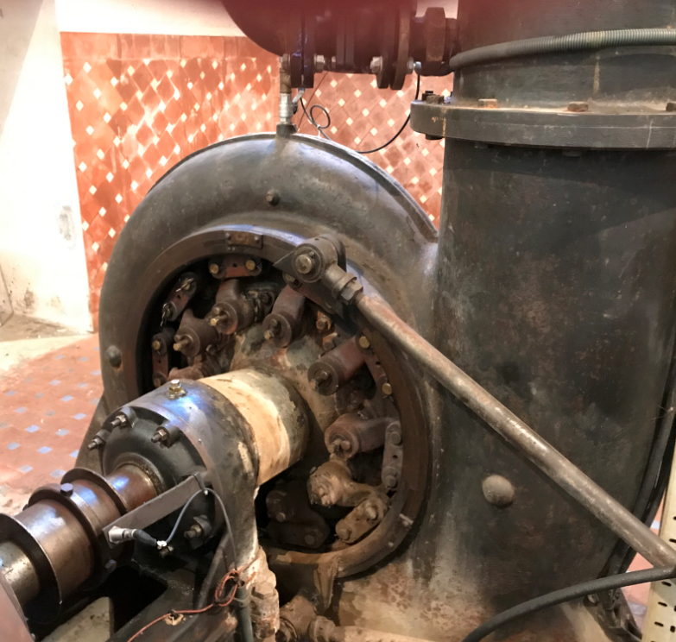
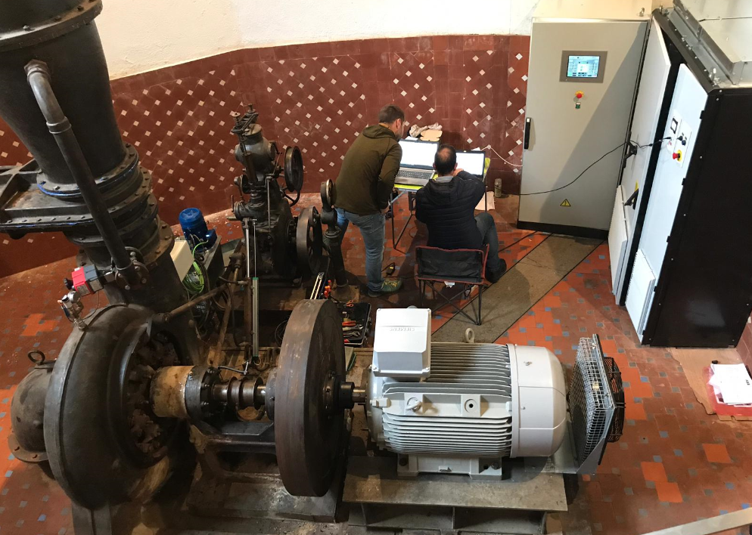
7.Catalunya (Owner)
Before drive implementation, the impeller opening at low flow levels couldn’t be lower than 17%, since the turbine would start cavitating.
Currently, with the new drive fully installed, an impeller opening of 2% can be reached and the turbine keeps working properly, which leads to a considerable increase in production since working at lower water flow levels is now allowed.
SIEMENS 132kW
ACS880-17-0293A-3
Slide 23

Slide 24
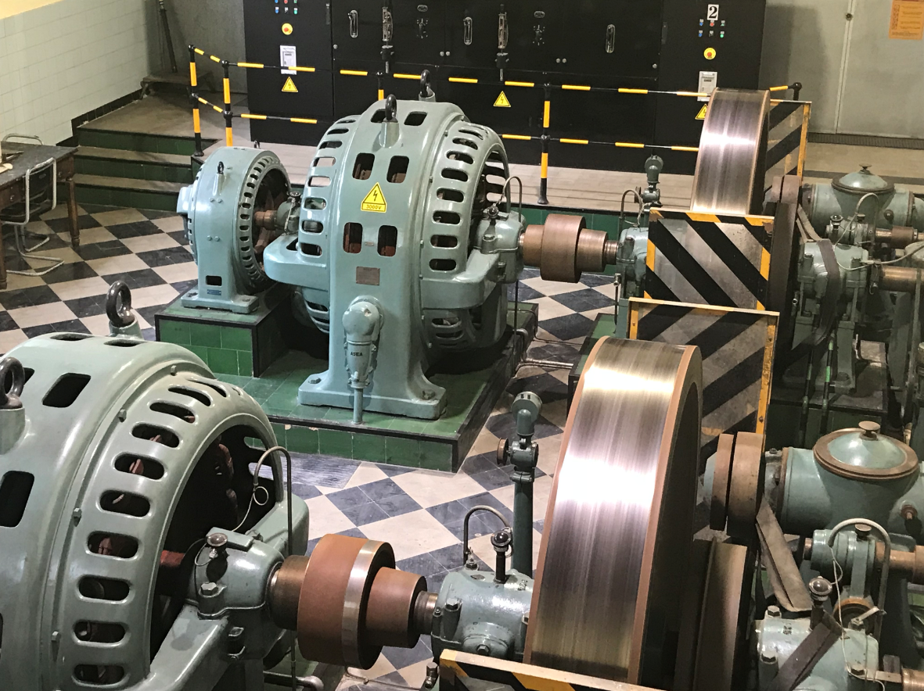
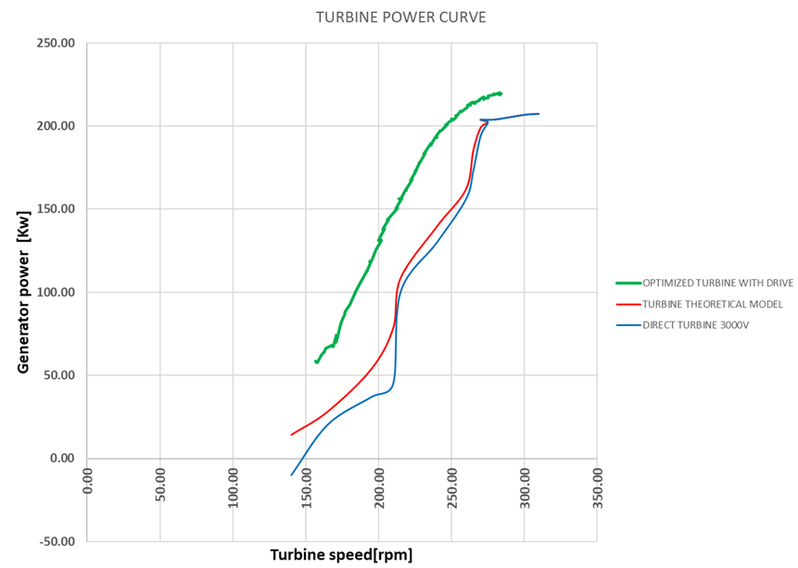
8.Catalunya (Particular owner)
Optimization of the small hydropower plant, adding an ACS880-17-0271A-7 drive.
The existing generator has been rewound, providing it with reinforced insulation to operate with a variable speed drive.
Optimization of the power plant’s power curve is done, with a follow-up during one year.
An increase of 25% in production has been obtained.
AC500
CP635
Asea 250kW
ACS880-17-0271A-7
Slide 24

Slide 25
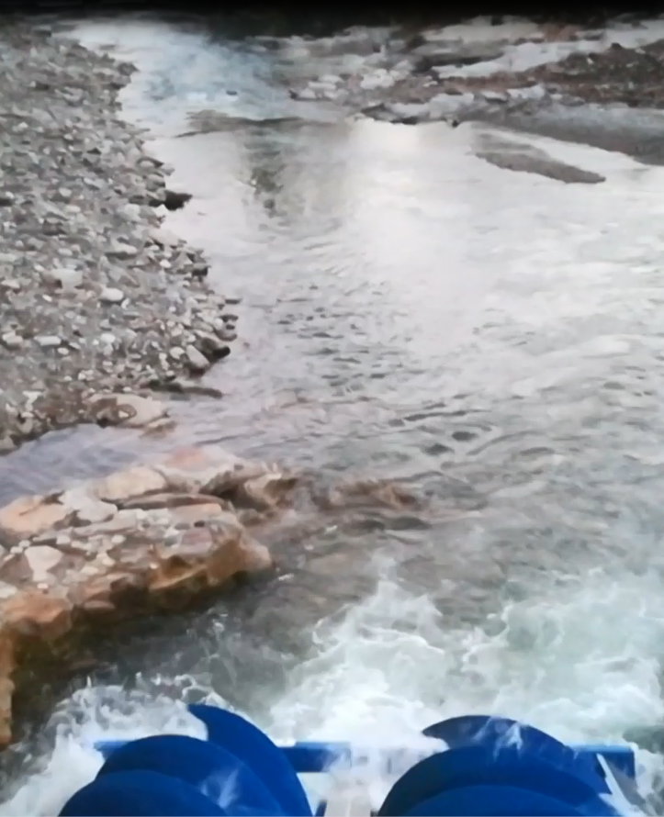
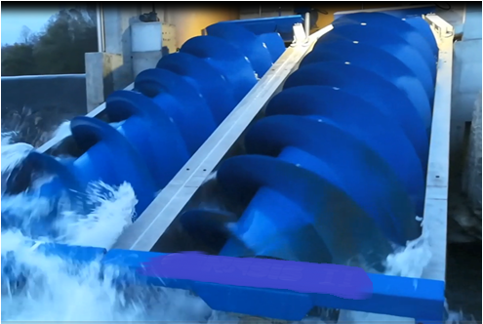
9.Catalunya (Owner)/ Archimedes’ screw/ Fish ladder
Supply of 2 x 50kW ABB generators and 2 x ACS-800-11-060-7 drives in an Archimedes’ screws facility used as a fish ladder.
According to the customer, there’s been an increase of 17kW in expected production due to variable speed implementation.
Due to existing norms, it must be limited to 50kW, each.
ABB 50kW
ACS800-11-060-7
ACS800-11-060-7
Slide 25

Slide 26
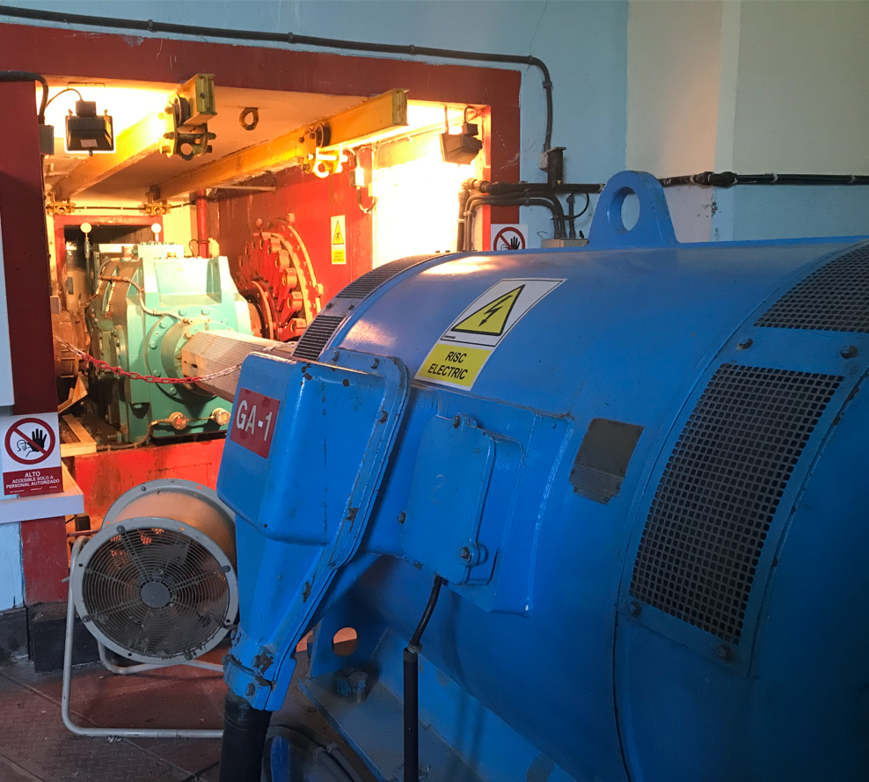
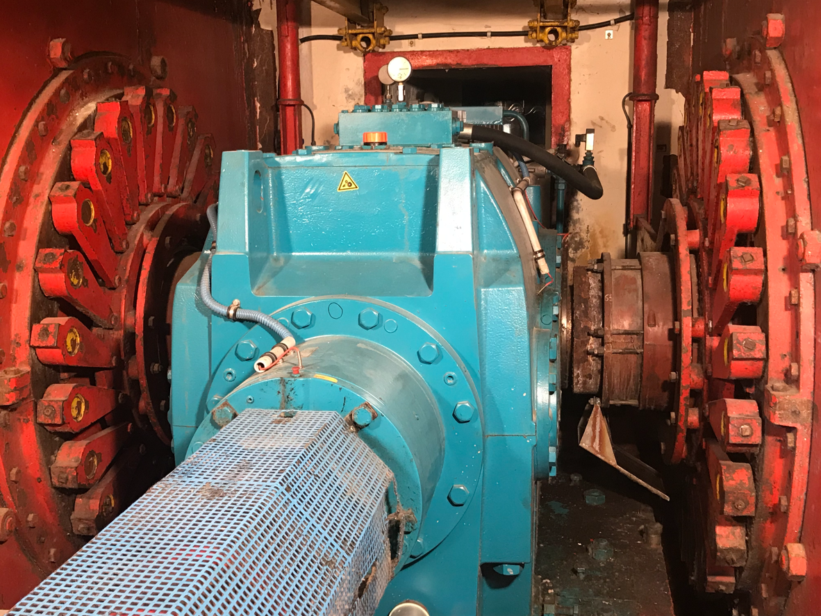
10.Catalunya (Utility, ongoing)
Hydropower plant optimization by adding a set consisting of a frequency converter, generator and transformer.
The original design of the plant was in medium voltage (6kV), and it has been converted to low voltage (690V).
It is planned to optimize the power curve of the plant with a follow-up for one year.
In the previous study carried out, it indicates a theoretical return on investment of 1.7 years.
We are currently analyzing other existing plants in other basins with this customer.
AC500
CP635
690V
25kV
ABB 1010kW
ACS880-17-1130A-7 (1100kW)
Trafo
Slide 26

Slide 27
Utility calculations
Annual Real Average Data | CH 1 | CH 2 | CH 3 | CH 4 | CH 5
2008 | 82 | 414 | 2.356 | 2.468 | 1.173
2009 | 2.064 | 1.273 | 2.833 | 2.975 | 1.184
2010 | 710 | 302 | 3.556 | 3.928 | 1.703
2011 | 5.025 | 1.083 | 2.777 | 2.184 | 1.432
2012 | 2.527 | 461 | 1.896 | 1.700 | 785
2013 | 4.670 | 1.112 | 2.884 | 3.311 | 1.478
2014 | 2.255 | 993 | 3.828 | 4.040 | 2.156
2015 | 3.585 | 1.024 | 3.400 | 3.150 | 1.607
2016 | 2.327 | 474 | 2.210 | 2.202 | 683
2017 | 2.464 | 609 | 2.064 | 1.855 | 405
2018 | 2.069 | 1.141 | 3.582 | 3.674 | 1.256
Avg. MWh/year | 2.525 | 808 | 2.853 | 2.862 | 1.260
Theoretical Avg. (ABB) | 9.882 | 1.670 | 5.466 | 4.872 | 1,200
Difference | -7.357 | -862 | -2.613 | -2.010 | 60
Improvement (%) | 74 | 52 | 48 | 41 | -5
At ABB, having available production data of several power plants, we can help customers to decide which plant is best to start the implementation of the ABB Hydropack solution, based on our previous study and the resulting Return On Investment (ROI) derived from this study.

