Slide 1
ABB Field Indicators
LAUNCH PRESENTATION
JDFx00 Models

Slide 2
What does the customer needs?
JDFx00 Field Indicators
Voice of the Customer
I need to check on variables from a remote location, cannot keep going back to the control room
I need to have access to measurement points that are difficult to reach
I need a device reliable and simple to control
I work with an analog device or a FOUNDATION™ Fieldbus and I have devices of different brands in my system / plant
I need to operate / configure FF devices from the field in case of necessity
I need to set process controls when in front of measurement points
Customer Needs
Remote Visibility
Delocalization of process control and indicator configuration in the field
Fitting into the existing network

Slide 3
Target Markets and Potential Applications
JDFx00 Field Indicators
Indicators must be designed for all-weather performances are needed.
Indicators must be vibration and corrosion-resistant, as well as certified for use in hazardous areas
Potential applications/plants can be:
Steel plants
Oil and gas refining
Transportation
Storage tank indication
Chemical processing
Storage stations
Ideally any process that requires remote measures visibility

Slide 4
JDF300 – Foundation Fieldbus indicator

Slide 5
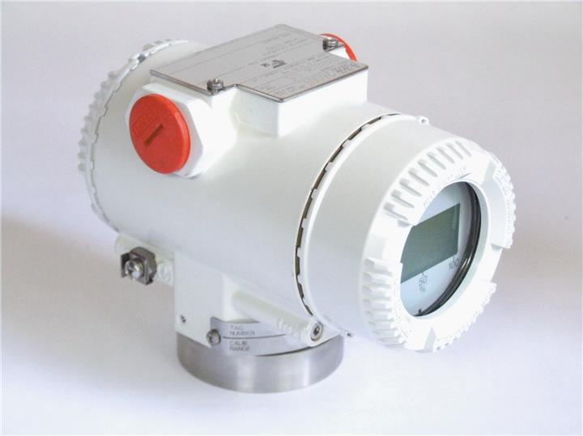
Introduction
JDF300 – Multivariable FOUNDATION™ Fieldbus Field Indicator
Business Context
ABB offering in FOUNDATION™ Fieldbus frameworks has been historically composed by FF-based field measurement devices plus an indicator, the former code named 264IB.
As 264IB has been discontinued, the current solution in case of projects was to mitigate the absence of a true indicator via the delivery of a full FF pressure transmitter “downgraded” to serve the purpose.
In order to close the above range gap, ensure coherence with the global ABB FID platform and provide a common ITK registered version across FF offering, the project of JDF300 has been initiated.
264IB FF Indicator

Slide 6
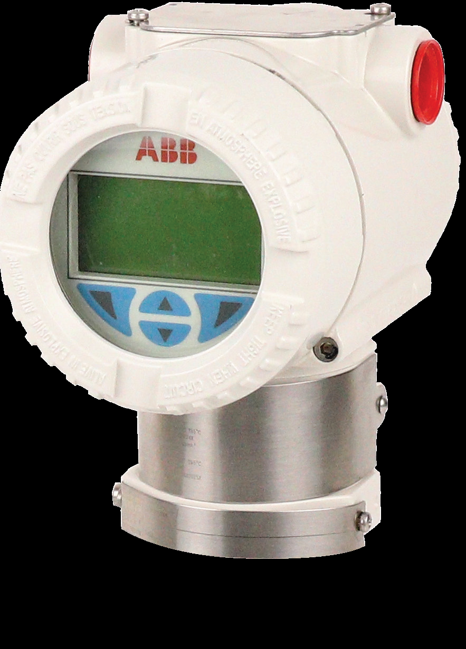
Product Look and Feel
JDF300 – Multivariable FOUNDATION™ Fieldbus Field Indicator
Macro specs
2600T family look and feel
L1 display with common HMI operational logics, including Easy Setup
Hazardous Area Certified
ATEX
IECEx
FM
IP67 protection
C5 corrosion protection painting
Additional external push-button for haz-loc configuration

Slide 7
How do we answer the call?
JDF300 – Multivariable FOUNDATION™ Fieldbus Field Indicator
Remote Visibility
Delocalized Control
FF Network Fit
Multivariable display visibility
Up to 8 variables, including measure goodness
Single variable (P) displayed multiple times
Set of variables (P, T, flow) displayed in sequence
Local display configuration
Tailored for specific visualization
Multipurpose bracket system
One bracket for wall & pipe installation
Library of function block available
1 Arithmetic (+, -, average, etc)
1 Input selector (returns output based on rules on input received)
1 Control selector (as ‘input selector’ but with input from control blocks)
2 PID (Proportional, integral, derivative)
Backup LAS capability (Link Active Scheduler)
JDF300 is able to auto-activate schedule of the planned activities on the network
FOUNDATION™ Fieldbus architecture allows JDF300 to process/receive any variable from existing FF network devices including:
Pressure
Temperature
Flow
Setpoint
PID output (control variable %)
From both ABB and competitors’ products
Notes:
FEATURES TO ANSWER TO REMOTE VISIBILITY DEMAND
The device can show up to 8 process variables that come from different connected devices, plus the indication about the goodness of the measure (good, uncertain, bad).
Also a single variable can be displayed multiple times with a defined refresh time (interval of 1 sec – preset).
In case of multiple variables, the sequence is defined by the ranking through which devices are connected to FF block (MAO).
The local display can be configured to ensure the proper setting of the incoming variables is correct.
In fact user can set in the position from 1 to 8 (max number of variables) each and every UOM coherent with the relevant analog input (connected device)
The Easy Set up and the Device Set Up functions are also active on the JDF300 allowing the following settings:
EASY SETUP:
Language -> select the preferred language among the supported languages
Contrast -> Set the desired contrast for a better visualization
Auto Scrolling -> ON/OFF
Input Selection Select the MAO_input to be displayed
DEVICE SETUP:
Language
Contrast
Auto Scrolling -> ON/OFF
Input selection -> Select the MAO_input to be displayed
Inputs enable -> Enable which of the 8 MAO inputs are used
Quality Status format -> Text or Number
Another element to be considered in the visibility context is the installation easiness.
JDF300 can be ordered with a multipurpose bracket that can be either used for wall or pipe installation freely.
No need for a specific ordering code on the part while having the opportunity to flexibly manage stock regardless off the application installation.
FEATURES TO ANSWER TO DELOCALIZED CONTROL DEMAND
JDF300 is featuring 5 specific blocks on top of the MAO one. These blocks are to be configured at DCS level so as to be exploited at their maximum potential.
The available function blocks are the following one:
arithmetic: this block allows to perform the arithmetic functions like sum, difference, average, compensated volume, etc.
Input selector: this block returns a specific output based on a set of rules to be applied on the input. For example it can return the “First Good” among the variables linked to the block.
Control selector: this block behaves in the same way input selector does, returning a specific output based on a set of rules that applies to a control block input. It is a more sophisticate way to define a control system: for example it could be used in systems where two controllers are used in parallel.
2 PID function blocks. PID stands for Proportional, integral, derivative and it’s a controlling block:
Proportional means that input is related to output through a coefficient that defines how the output needs to vary (i.e. 10% error means 10% opening of a valve for a tank filling system). This condition implies the presence of a minimum error that cannot be zeroed.
Integral means that the effect defined based on the input is related to the integral of the error, which means that the action will normalize the system behavior once the error is brought back to zero. Using this method aims at reducing to zero the error.
Derivative means that the effect defined is based on the derivative of the error (i.e. inclination of the curve of the error). This allows to anticipate the effect of the error in case the error increases fast.
The LAS (or link active scheduler) is a function that activates autonomously in case of issues on the network.
It basically replaces the scheduler defined by the DCS, allowing the control loop to be kept alive.
This function is a way to ensure no losses are there in case of unexpected malfunctions of the control room.
As well, it could be used in order to maintain efficiency in case of maintenance of DCS itself.
FEATURES TO ANSWER TO FF NETWORK KIT DEMAND
Last but not least it is important to mention that JDF300 will fit into any FF network thanks to the intrinsic FF architecture on which it is built .
This means that JDF300 can be connected to any existing network easily, no matter if the network is composed by ABBs or competitors products.
When connected to a FF network, JDF300 can receive different types of inputs, as seen in the MAO section, including also the Setpoints that could be defined at DCS level or from other loop elements.

Slide 8
What are the benefits for the customer?
JDF300 – Multivariable FOUNDATION™ Fieldbus Field Indicator
Cost Saving
Improved Control
Enhanced Productivity
Lower operating cost: monitoring system can be designed in a simpler way
Lower installation cost: store one bracket code for pipe and wall installation
Lower cost of ownership: combined certification and modular spare parts reduce immobilized capital
Faster in field diagnostic improved by multiple simultaneously available data
System failure recovery and stops avoidance through LAS capability
No operators running around: more data in the same place
No costs for training: operating the devices is the same as ABB 266 models
Improved operators’ safety level due to elimination of need to reach difficult measurement points
Notes:
COST SAVING
Lower operating cost: monitoring system can be designed in a simpler way to leverage all the internal functions in the JDF300 function blocks library
Lower installation cost: store one bracket code for pipe and wall installation
Lower cost of ownership: combined certification and modular spare parts reduce immobilized capital
IMPROVED CONTROL
Faster in field diagnostic improved by multiple simultaneously available data
System failure recovery and stops avoidance through LAS capability
ENHANCED PRODUCTIVITY
No operators running around: by leveraging the sequence of variables, it is possible to observe more data in the same place and relevant to different devices across the plant.
No costs for training: operating the devices is the same as ABB 266 models. The simplicity of the JDF300 withstands in the common practices that are consolidated in the 266 range since years.
Improved operators’ safety level due to elimination of need to reach difficult measurement points. No more climbing or having to adjust using ladders and or other specific tools. Once installed, operators can safely monitor devices data avoiding any proximity or position-related risks.

Slide 9
In a nutshell…4 things to remember
JDF300 – Multivariable FOUNDATION™ Fieldbus Field Indicator
Less operating cost: more data in the same place at the same time
Less installation cost: a simpler system with a simple device
Perfect fit in any FF network, no matter the devices brands
Improved diagnostics and control (LAS)

Slide 10
JDF200 – Analog indicator

Slide 11
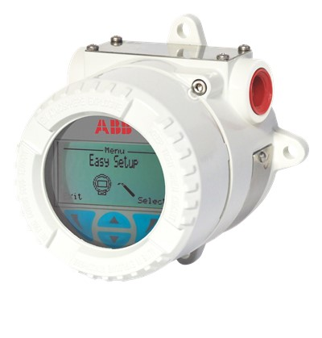
Introduction
JDF200 – Analog Field Indicator
Context
JDF200 has been conceived to replace the former 695FI
JDF200 is featuring the ABB common, menu-controlled HMI

Slide 12
Product Look and Feel
JDF200 – Analog Field Indicator
Key Features
Loop-powered device
4…20 mA signal not to be interrupted in case of failure
The menu-controlled LCD will allow intuitive configuration
Square root and most common transfer functions are available
Alarm on failure notified by flashing icon on display
Compatible with all 4 to 20 mA, 2-wire systems
Rugged, compact, lightweight, enclosure compliant to IP67 and NEMA 4x
Corrosion resistant painting (C5 level)

Slide 13
Performance Overview
JDF200 – Analog Field Indicator
Key Features
Potential
Indication accuracy
Digital: ±0,10% of span (16 mA) ± 1 digit
Bar graph: ±1%
Resolution
16-bit conversion
Ambient temperature effect
±0,15% of span (16 mA)
By applying an appropriate input scaling, JDF200 shows:
Current
Pressure
Temperature
Level
Mass and Volume Flow
Heat Transfer Rate
Custom variable
Since JDF200 is compatible with all 4 to 20 mA, 2-wire systems and allows visualization of different variable types, it can be coupled to all field devices where indication at eye-level is required.

Slide 14
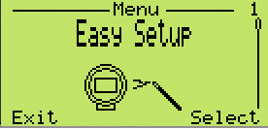
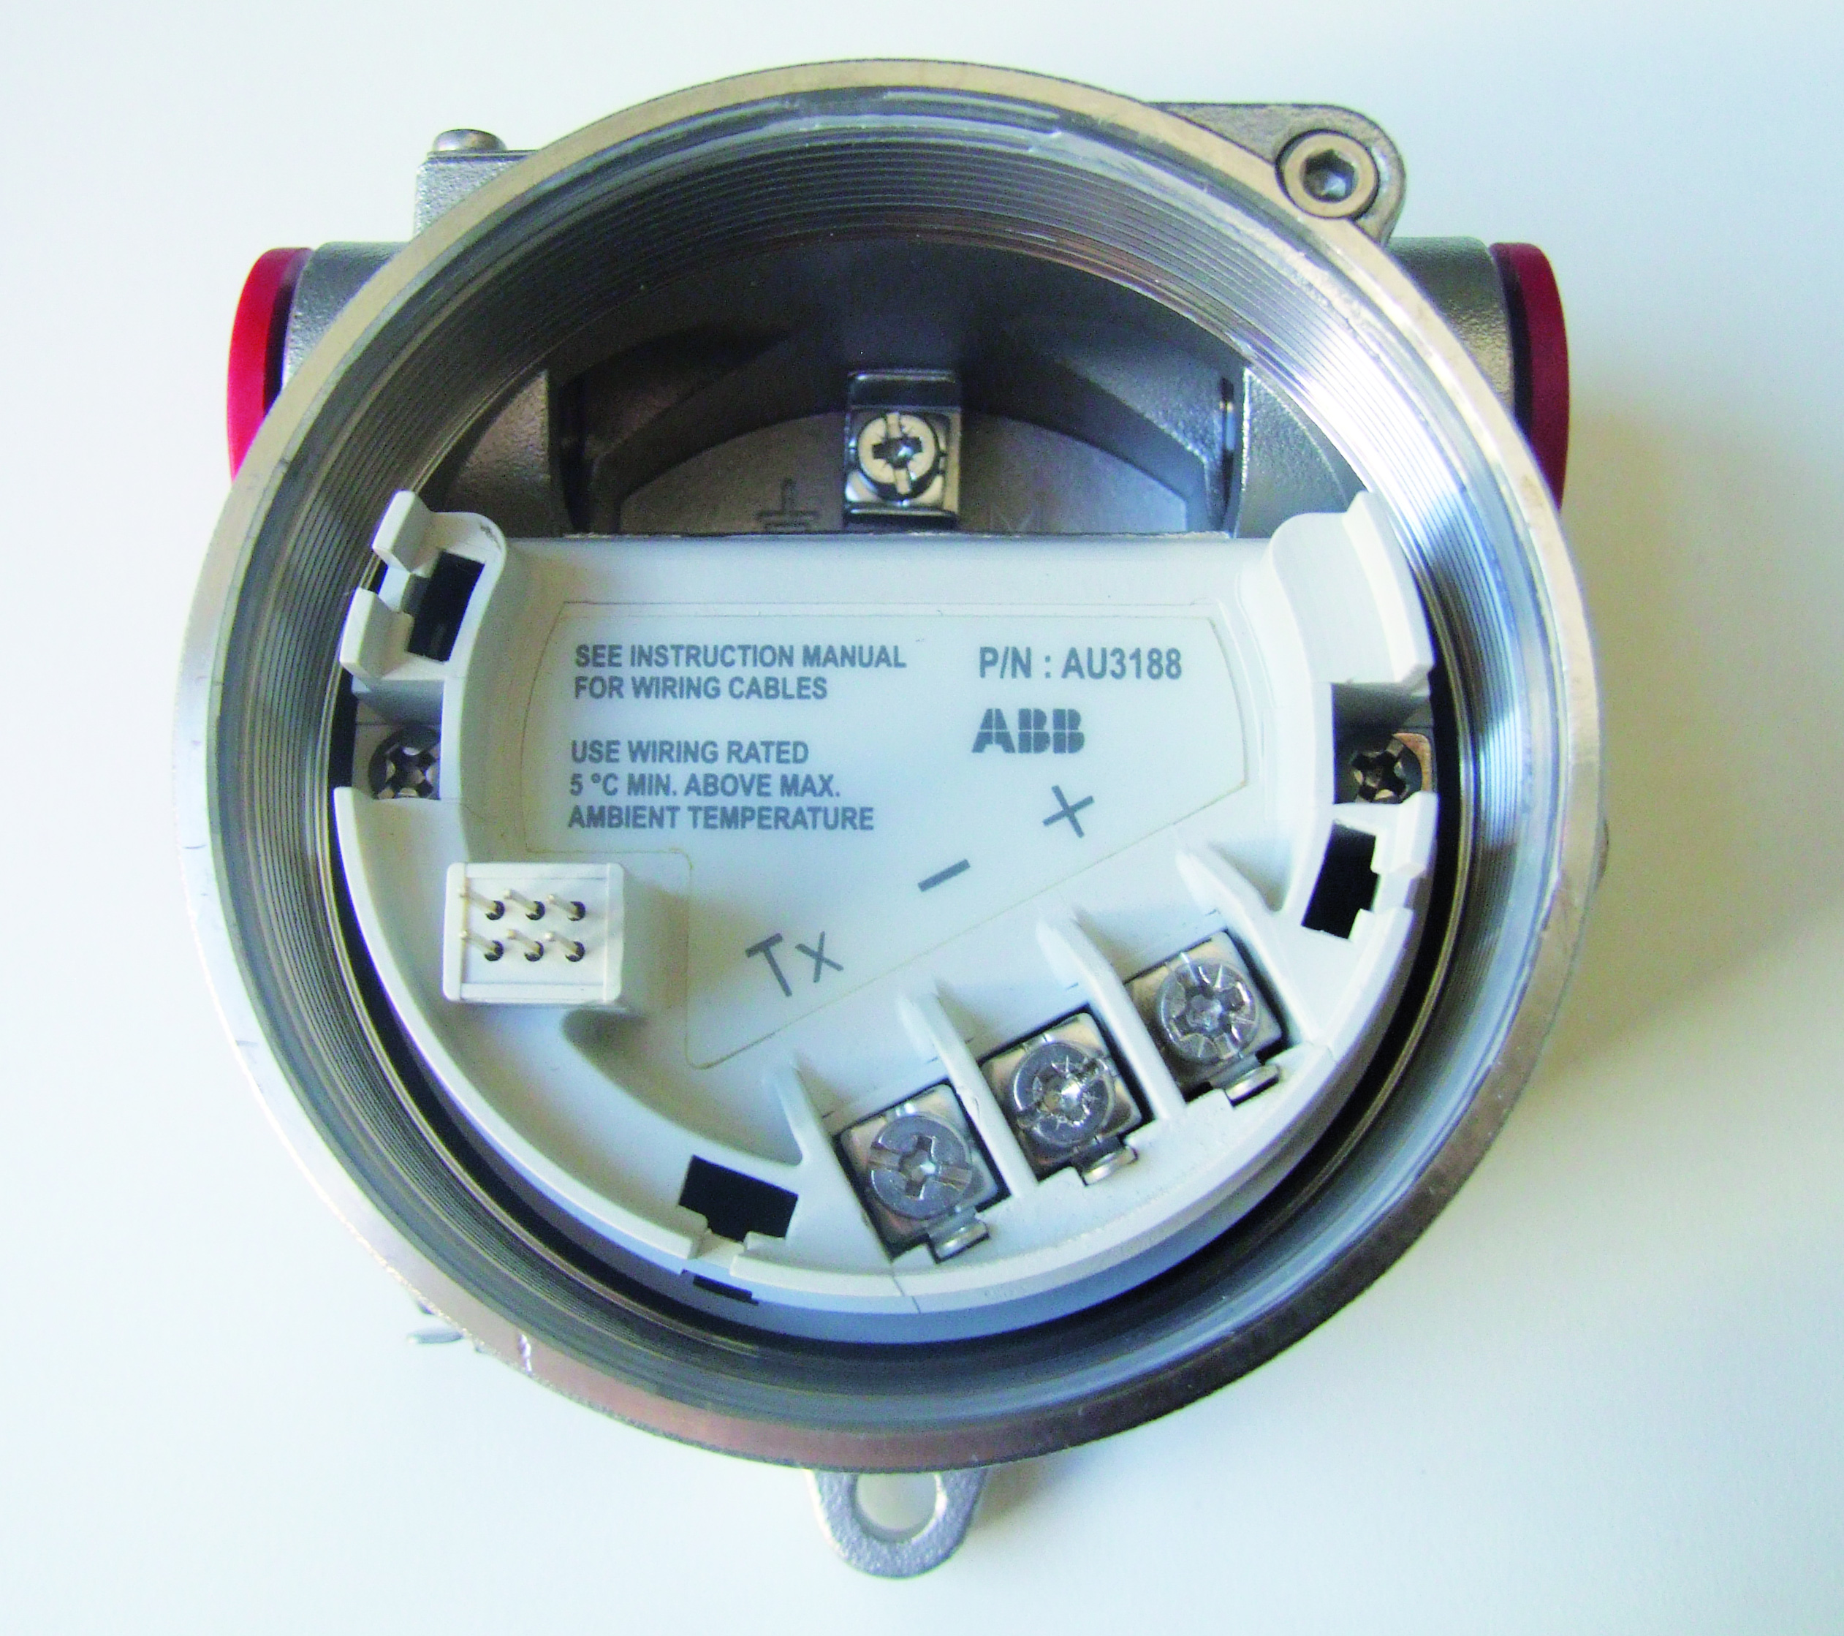
HMI and Board Overview
JDF200 – Analog Field Indicator
Modularity
Common HMI for better usability
In-field replaceable conversion board
In case of failure, it can be replaced in seconds without removing the field indicator from the process
Part number printed on the terminal block for quicker reference.
Easy setup
Allows easy and quick installation and startup without the need to use complicated additional tools.
Multilanguage menu
Wherever the transmitter will end up, thanks to its multi-language interface, the user will be able to navigate in English, German, Italian, French and Spanish

Slide 15
What are the benefits for the customer (1 of 2)?
JDF200 – Analog Field Indicator
Installation
Installation Benefits
Installation is easy thanks to the V-Bolt supplied as standard.
In case of wall mounting, four, casted, accessible holes will grant total ease of installation
Optimal flexibility
No need of over-specifying
Ease of operation
Operation
Operation Benefits
Wide, easy-to-read display with 90° step rotation possibility
Multilingual, intuitive, guided device configuration menu
Compatible with all 4-20mA devices (P, T, flow, level, current or heat transfer rate)
The measure you need where you need
JDF200 set-up in a minute
Minimal need of referring to documentation
Perfect match regardless from the measurement type
Enhanced flexibility
Notes:
COST SAVING
Lower operating cost: monitoring system can be designed in a simpler way to leverage all the internal functions in the JDF300 function blocks library
Lower installation cost: store one bracket code for pipe and wall installation
Lower cost of ownership: combined certification and modular spare parts reduce immobilized capital
IMPROVED CONTROL
Faster in field diagnostic improved by multiple simultaneously available data
System failure recovery and stops avoidance through LAS capability
ENHANCED PRODUCTIVITY
No operators running around: by leveraging the sequence of variables, it is possible to observe more data in the same place and relevant to different devices across the plant.
No costs for training: operating the devices is the same as ABB 266 models. The simplicity of the JDF300 withstands in the common practices that are consolidated in the 266 range since years.
Improved operators’ safety level due to elimination of need to reach difficult measurement points. No more climbing or having to adjust using ladders and or other specific tools. Once installed, operators can safely monitor devices data avoiding any proximity or position-related risks.

Slide 16
What are the benefits for the customer (2 of 2)?
JDF200 – Analog Field Indicator
Diagnostics
Diagnostics Benefits
Flashing icons and error codes according to NAMUR standard
Customizable alarm messages acc.to input signal thresholds (saturation and fail)
Clear indication with relevant troubleshooting
Field issues can be approached easily with meaningful alarm strings
Maintenance
Maintenance Benefits
4…20 mA will not be interrupted in case of failure
Conversion board easily accessible
Comprehensive asset protection
Fast operations on the field reduce maintenance costs
Notes:
COST SAVING
Lower operating cost: monitoring system can be designed in a simpler way to leverage all the internal functions in the JDF300 function blocks library
Lower installation cost: store one bracket code for pipe and wall installation
Lower cost of ownership: combined certification and modular spare parts reduce immobilized capital
IMPROVED CONTROL
Faster in field diagnostic improved by multiple simultaneously available data
System failure recovery and stops avoidance through LAS capability
ENHANCED PRODUCTIVITY
No operators running around: by leveraging the sequence of variables, it is possible to observe more data in the same place and relevant to different devices across the plant.
No costs for training: operating the devices is the same as ABB 266 models. The simplicity of the JDF300 withstands in the common practices that are consolidated in the 266 range since years.
Improved operators’ safety level due to elimination of need to reach difficult measurement points. No more climbing or having to adjust using ladders and or other specific tools. Once installed, operators can safely monitor devices data avoiding any proximity or position-related risks.

