Slide 1
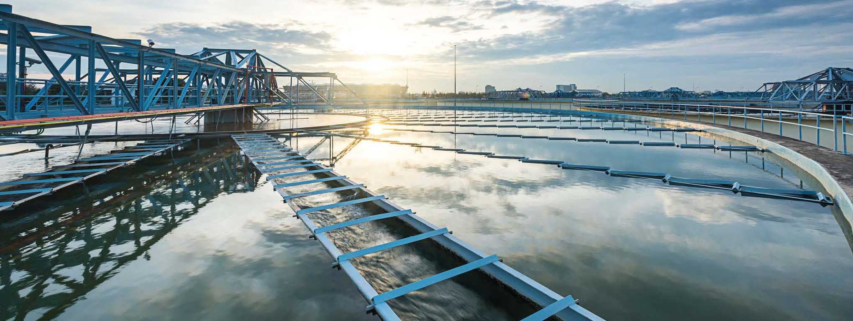
Water and Wastewater Treatment Industry
Industry brochure
Installation Products Division
July 2022
2020

Slide 2
— Thomas & Betts is now part of ABB’s Installation Products Division, but our long legacy of quality products and innovation remains the same. From connectors that support wire buildings on Earth to cable ties that help put machines in space, we continue to work every day to make, market, design and sell products that provide a smarter, safer and more reliable flow of electricity, from source to socket.

Slide 3
Contents
04 Designed to perform
05 Challenge and commitment
08 Corrosive & harsh environment protection
09 Power quality, efficiency & reliability
12 Continuous operation & sustainability
13 Hazardous location protection
16 Grounding & bonding
17 Liquid ingress protection
Safety
Extreme temperature protection
24 Services & training
25 Product selection guide

Slide 4
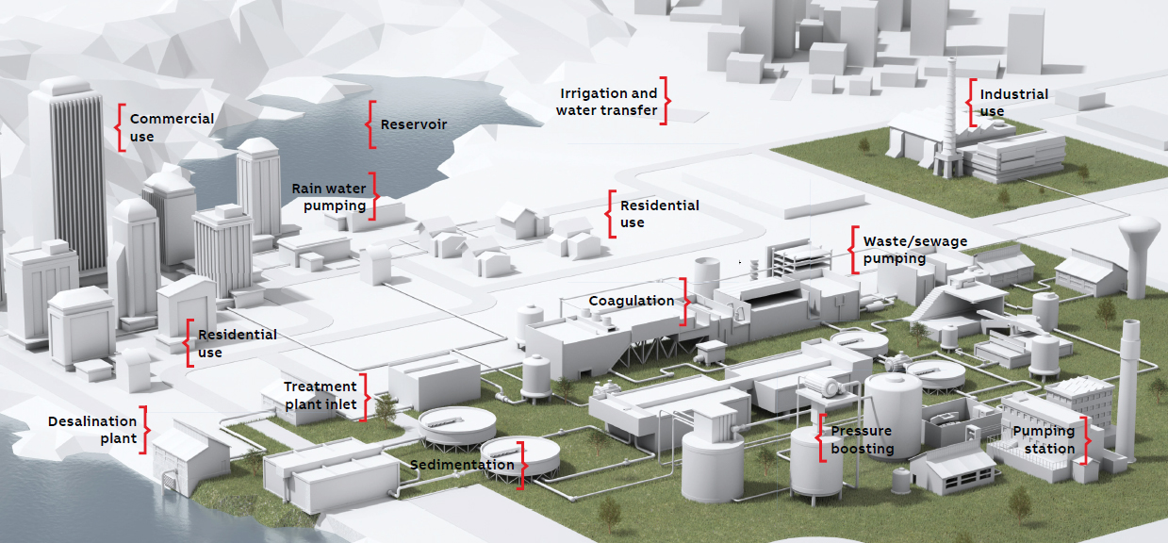
Designed to perform
Renewable energy industry
ABB understands the challenges faced in water and wastewater treatment facilities and is committed to providing innovative electrical solutions that not only reduce overall project costs, but also increase safety, promote sustainability and even improve cash flow.
Whether it’s labor-saving rough-in components, custom-designed electrical prefabrication systems, online cloud-based design tools or even our world-class logistics, ABB can help bring water and wastewater treatment projects in on time, within budget and profitably.

Slide 5
Challenge and commitment
The world has plenty of fresh water – just not in the right place or at the right price. In the decades to follow, water, along with energy, will become one of the most sought after basic commodities.
Water industry applications

Slide 6
— In 2002 the EPA reported that mechanical
and electrical systems for facility components such as treatment plants and pumping stations need to be replaced every 15-25 years. Are you making choices that will help extend the life of your electrical systems?

Slide 7
— Does corrosion cause your plant to operate ineffectively or inefficiently? The proper conduit and fitting system solution
can extend the life of your electrical
system by up to 300%.

Slide 8
Corrosive & harsh environment protection
Corrosion is the enemy of electrical systems. According to NACE International, corrosion costs the U.S. water/wastewater processing industry an estimated $1.3 billion annually.
Problems caused by corrosion include:
Equipment failure and shortened life
Poor electrical system reliability caused by high-resistance connections
Long maintenance repair time due to corroded parts
Safety hazards at the grounding level and from product contamination
Added labor expenses
Ocal® – OCAL-BLUE® PVC-coated conduit
and fittings
PVC-coated, hot-dipped galvanized conduit and threads
Provides superior corrosion protection against many harmful elements
Interior blue urethane provides corrosion protection around cables
Kindorf® – Stainless steel and non-metallic
modular framing system
Modularity reduces installation time
Available in Type 316 stainless steel or non-metallic for the most corrosive environments
Trapnut® strut fastener features a unique scissor action that closes at any point on the threaded rod, taking up to 43% less time to install than standard nuts and bolts
Adaptaflex®
Stainless steel flexible conduit systems
T&B® Cable Tray – Stainless steel, aluminum and non-metallic cable tray
Available in stainless steel, aluminum and non-metallic materials
Alternating “strut” rungs allow for supported mounting
T&B® Fittings – Stainless steel liquidtight
conduit and cord fittings
Continuous sealing ring ensures a liquidtight seal
Gland nut deflects water away from connector
PMA®
Flexible nylon cable protection systems
Red•Dot®
Code Keeper® weatherproof while-in-use covers
Russellstoll®
MaxGard® and DuraGard® pin-and-sleeve Connectors

Slide 9
Power quality, efficiency & reliability
Electrical equipment must be reliable and operational 24 hours a day, seven days a week, with protection from surges, line surges, voltage spikes and power interruption.
For water treatment, maintaining service to motors, pumps and monitoring equipment is the difference between a smooth operation and a visit from the EPA. In this critical industry, the need for stable power is paramount. ABB products and systems maximize uptime and control by:
Detecting faults and protecting against overcurrent and voltage drops
Preventing damage due to power quality disturbances
Eliminating underperformance, minimizing system losses and increasing usable power
Joslyn Hi-Voltage® – VBM Switching Systems
Vacuum interruption and solid dielectric insulation for gas-free, oil-free operation
Provides up to 100,000 maintenance-free operations, depending on operating mechanism and control voltage selection
Elastimold® – Distribution switchgear
Solid EPDM insulating media makes it maintenance free and environmentally friendly – no oil, no gas
Compact, modular, field-upgradable design enables smaller footprint and field assembly inside tight vaults
Fisher Pierce®
Capacitor controls and relays
Faulted circuit indicators
Current sensors
Homac®
Substation connectors

Slide 10
— Power quality determines the fitness of electrical power to various devices. Selecting the appropriate devices allows electrical systems to function in their intended manner without significant loss of performance or life.

Slide 11
— ABB products are designed
to perform consistently
and withstand the
forces of nature, requiring
less field service.

Slide 12
Continuous operation & sustainability
The production and fines associated with downtime in water/wastewater operations can be substantial. Lost power can mean overflows and contaminated water released into the environment.
To prevent such problems, plants need solutions that ensure:
Superior product engineering
Quality product construction
Accurate product selection
Availability on demand
Proper installation
In the single most demanding, non-stop operating environments, one single point of failure can lead to costly – or even disastrous – results.
Color-Keyed® compression
Motor lead disconnects
Minimize motor downtime by eliminating the need for bolting and taping during motor change-out
Offer a quick, snap-together assembly that is insulated with a slide-on cover
Featuring the Color-Keyed® compression system that ensures proper connections
Compression connectors
Boost efficiency with fewer crimps that yield superior terminations
Featuring the Color-Keyed® compression system that ensures proper connections
Ocal®
PVC-coated conduit, fittings and accessories
PVC-coated XJG expansion couplings
PVC-coated XD expansion/deflection couplings
Sta-Kon® – Crimped wire termination systems
Complete line of rings, forks, splices, disconnects, pin terminals and wire ferrules, built with materials for high-performance applications
Longer, selectively annealed barrel for increased pull-out strength and lowered crimping force, with funneled terminal barrel entry for faster installation
Nylon terminals feature metal insulation grip sleeve for strain relief
All Sta-Kon® terminals are UL® Listed and CSA certified
Shrink-Kon® wire insulation products provide superior conductor, connection and termination protection, thus helping to ensure reliable, continuous operations

Slide 13
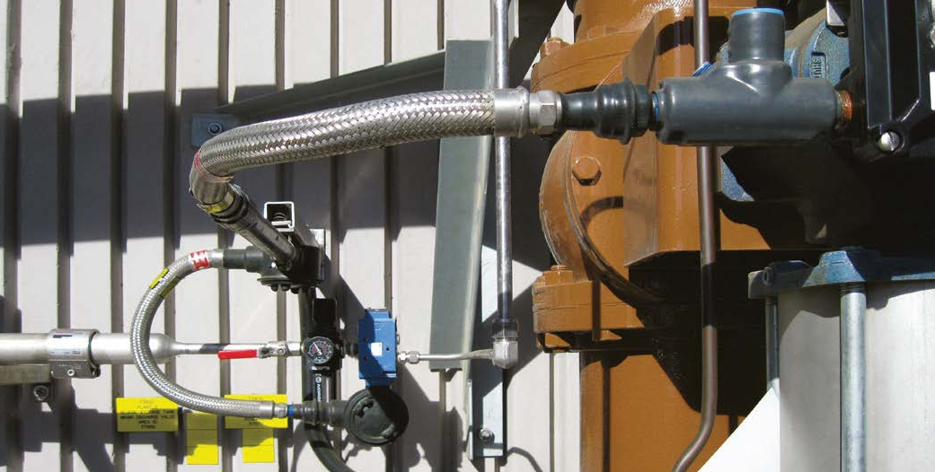
Hazardous location protection
There is always a concern at water/wastewater treatment facilities about the significant presence of gases and vapors in certain areas.
Typical hazardous locations include:
Water/wastewater plant process areas
Booster stations and valve areas along pipelines
Loading and unloading areas in terminals
Storage areas for tanks, barrels and trucks
Russellstoll® – MaxGard® explosion-proof interlocked receptacles
Copper-free, cast-aluminum, epoxy-coated housing
O-ring-sealed interior components ensure watertight protection whether connections are mated or not
Explosion-proof systems for 30A, 60A and 100A
T&B® Fittings – STAR TECK XP® stainless steel and aluminum fittings
High-quality fittings for jacketed metal-clad and teck cables
Suitable for use in hazardous locations
Class I Division 2, Class II Division 2 and Class III
Kopex-Ex™ – Flame-proof cable protection
systems for IEC applications
Designed to meet UL®, CSA, IECEx and ATEX standards for hazardous environments
Approved for use in Zones 1, 2, 21, 22, Class I Division 1 and Class II Division 2 hazardous locations
Complete system includes conduit, fittings, stopping plugs, thread converters and accessories
Ocal®
PVC-coated conduit and fittings for hazardous areas
PMA®
ATEX flexible non-metallic cable protection systems

Slide 14
— Do you have explosion risks from chemicals used or gas being produced? Count on ABB to provide electrical solutions designed to satisfy your facility’s needs for protection in hazardous areas.

Slide 15
— Reducing the potential for electric shock and equipment failure results from following the National Electrical Code®. Turn to ABB for the grounding and bonding solutions to meet NEC® requirements.

Slide 16
Grounding & bonding
Grounding the electrical system provides a means in which conductive equipment is connected to an earth potential via the grounding electrode.
This prevents potential differences and sparking between conductive equipment and grounded structures. Together, proper grounding and bonding will:
Ensure personnel safety
Eliminate lighting interruptions
Protect critical equipment
Meet IEEE, UL® and CSA requirements
Provide electrical continuity and reliability
ABB durable, code-compliant systems, onsite grounding and bonding training and installation support are designed to ensure the safe and reliable operation of your plant’s electrical systems and increase overall equipment effectiveness.
Blackburn® grounding
EZGround™ compression and mechanical grounding systems
EZGround™ connectors use standard compression installation tools and techniques
Full range of mechanical grounding components also available
High-quality flexible braid connectors
Extra-flexible links for heavy-duty applications up to 3,600A
Standard flexible links for medium-duty applications up to 2,350A
Sta-Kon® – Dragon Tooth® insulation-piercing
wire connectors
Provide continuity without the need to remove insulation
Designed to splice, tap and terminate magnet wire
Steel City® – Grounding pigtails, clips and mud rings
Solid and stranded grounding pigtails and grounding clips for easy attachment of ground wires to electrical boxes
Steel City® Adjustable Mud Rings pass the standard UL® Grounding Continuity test
T&B® Fittings
Revolver® liquidtight grounding fittings
Designed for use where an external bonding jumper is required for liquidtight flexible metal conduit
Revolving grounding ring provides flexibility in positioning for ease of installation
Blackjack® grounding bushings
Dual rated for grounding and bonding of threaded and unthreaded conduit, aluminum and copper wire
Speeds installation and improves aesthetics
Elastimold®
Molded separable connectors and solid-dielectric switchgear
EZCODE®
Danger/warning labels and signs, industrial/wire markers and barricade/burial tapes

Slide 17
Liquid ingress protection
A single drop of oil seeping into an electrical control box is all it takes to knock out your production line for days. And a faulty fitting can be the culprit causing that failure.
At ABB, we realize that while most of our products are small, the jobs they do are big. And big jobs demand the right product engineering, testing and quality control. That’s what you get with ABB.
Selecting proper equipment to battle liquid ingress helps to:
Ensure electrical safety
Prevent corrosion
Avoid system degradation
Minimize costly downtime
Homac® – Flood-Seal® products
Make water-tight connections quickly and easily with Homac® Flood-Seal® splice kits and multi-tap connectors
Flood-Seal® technology eliminates the need for time-consuming tapes and shrinks – no heat guns or pull cords
Range-taking designs provide flexibility in the field and minimize the number of SKUs you have to manage
T&B® Fittings – Stainless steel liquidtight conduit and cord fittings
Continuous sealing ring ensures a liquidtight seal
Gland nut deflects water away from connector
Ocal®
OCAL-BLUE® PVC-coated type 4X form 8 conduit bodies
PVC-coated liquidtight conduit fittings
PMA® – Flexible nylon cable protection systems
Ingress protection conforms to recognized test methods
Connectors are commonly rated IP66, IP68 or IP69K
Offer excellent resistance to lubricants and highly corrosive chemicals; also resistant to weather
Sta-Kon® – Shrink-Kon® self-fusing
insulation tape
Easy-to-install insulation for harnesses, wires or cables – no heat or adhesive required
Just two layers form a moisture-proof, abrasion-resistant dielectric seal for low- or high-voltage applications (600V max.)
Red•Dot® – Code Keeper® weatherproof
while-in-use covers
Alloy A380 aluminum construction and stainless steel springs provide increased corrosion resistance
Complies with National Electrical Code® Extra-Duty requirements

Slide 18
— Water, water everywhere, except in your connections.
ABB solutions provide superior liquid ingress protection.
Our products help to keep your electrical equipment –
and those who use it – safe.

Slide 19
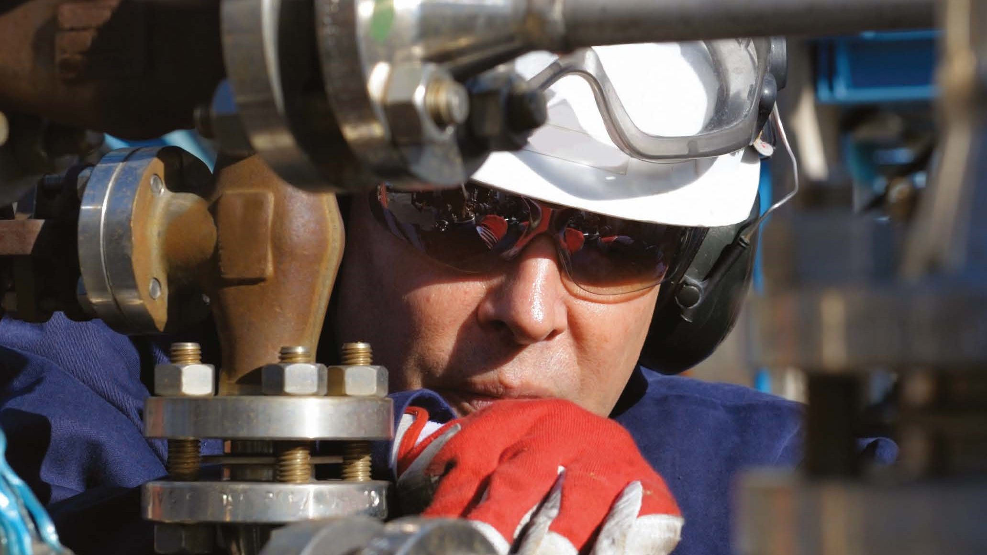
— Safety failures bring increased scrutiny in an already strictly regulated industry. Have you implemented both active and passive safety measures to ensure the safety of your plant and personnel?

Slide 20
Safety
The goal of safety practices is zero accidents, zero injuries and zero deaths.
The major stakeholders in safety solutions are:
The community
The state
The business/organization
The employee(s)
The environment/society
No one is immune to safety and contamination concerns. Contamination and safety concerns are not market specific. They affect workers, production schedules and the bottom line across a broad spectrum of industries.
EZCODE® – Safety labels, tags, signs and barricade tapes
Help to ensure personnel and workplace safety, as well as regulatory compliance
Visible and long-lasting materials
Custom labels, tags and signs available
Barricade and burial marking tapes in a variety of materials and colors
Elastimold®
High-voltage separable connectors
High-voltage solid-dielectric switchgear
Fused loadbreak elbows
Molded canister fuses
Molded current-limiting fuses
Ty-Rap®
Extra-high temperature and flame-retardant UL94V-0 nylon cable ties
Ty-Rap Tote® cable tie dispensers and ergonomic installation tools
Kindorf®
Seismic bracing system

Slide 21
Extreme temperature protection
Electrical systems need to perform consistently in boiler rooms and around furnaces and evaporators. Many of these processes require heat tracing to maintain elevated temperatures throughout water/wastewater processing systems.
Excessive heat or cold can wreak havoc on an electrical system, potentially causing critical components to fail. Operations are challenged to:
Prevent premature material aging due to prolonged heat
Avoid material contraction and expansion due to ground frost
Protect against physical damage from hail
ABB offers numerous electrical systems and devices that are designed to withstand and insulate against severe temperatures.
T&B® Fittings
52® Series high-temperature flexible metal liquidtight fittings
Handle temperatures up to 150°C
Steel or malleable iron construction, electro-zinc plated and chromate coated for corrosion protection
Available in 45°, 90° and straight versions
ATX Liquidtight flexible metal conduit
Performs in extreme temperature environments up to 150°C
Conduit sizes from 3/8" to 4"
Ty-Rap®
Extra-high temperature nylon cable ties
For use in temperatures from -40°C to 150°C
Smooth body sheds contaminants
Heavy-duty stainless steel cable ties
For use in temperatures from -80°C to 538°C
Available in both Type 304 and Type 316 stainless steel
Adaptaflex® – Stainless steel flexible
conduit systems
Supports temperatures of -50°C to 350°C for static applications and -45°C to 250°C for moving applications
Corrosion-resistant stainless steel construction
Offers high flexibility and fatigue life
Sta-Kon® – High-temperature wire joints and terminals
Wire joints and fluoropolymer-insulated terminals rated for temperatures up to 150°C, 600V maximum
Wire joints include a molded, one-piece nylon insulator, rated UL94V-2
Wire joints feature brazed copper sleeves that prevent separation of connection during crimping
Wire joints’ internal serrations enable cold flow for increased conductivity and pull-out strength
PMA®
Flexible nylon cable protection systems

Slide 22
— Water treatment is sometimes performed at extreme temperatures in terms of both equipment and environment.
Selecting the correct ABB temperature solution system
and components will extend the life of your electrical
system and reduce the frequency of corrective maintenance.

Slide 23
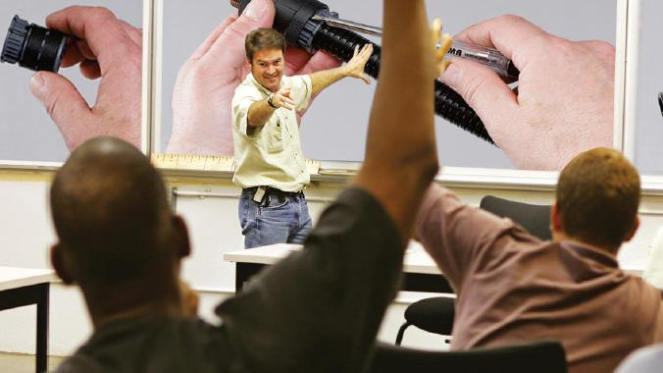
—
ABB provides training for many of our products. We make sure that our clients understand how our versatile solutions will work with their electrical systems.

Slide 24
Services & training
ABB has more than 200 direct representatives in the field, ready to instruct and train you on the proper use of products, tools and recommended installation practices.
—
Our services
As a full-service provider, ABB offers product training, installation training and certification, application support, technical support, field engineering and onsite troubleshooting to ensure successful plant operation and maintenance.
Blackburn® grounding systems
The QTP program provides a guaranteed two-week shipment of select Blackburn® products
Cloud-based Product Configurator enables online design of custom connectors
Product specification specialists available nationwide to train in the proper use and installation of Blackburn® products
Inside Tech Support group provides 24/7/365 expertise for Blackburn® compression, mechanical and grounding products
Full tool service, plus loaner and tool rental programs
Ocal®
Onsite installation training provides hands-on practice of clamping, cutting, threading, assembling and repairing the Ocal® PVC-coated conduit system and extends warranty from 2 to 5 years on a system installed by a certified contractor
Additional services & training
Online CAD Library
Tool services
Tool rental programs
Mobile solutions team
Onsite NEC® update training
Onsite grounding & bonding training
BIM-compatible floor box and poke through system data
Regional product specification specialist teams

Slide 25
Product selection guide
Water & wastewater industry
Product description | Corrosive & harsh environment protection | Power quality, efficiency & reliability | Continuous operation & sustainability | Hazardous location protection | Grounding & bonding | Liquid ingress protection | Safety | Extreme temperature protection | Services & training
Kopex-Ex™
Flame-proof cable protection systems for IEC applications |  |  |  | • | •
Ocal®
Ocal-Blue® PVC-coated conduit and fittings | • |  | • | • |  |  |  |  | •
Ocal-Blue® PVC-coated type 4X form 8 conduit bodies and liquidtight conduit fittings |  |  |  |  |  | •
PVC-coated XJG expansion couplings and XD expansion/deflection couplings |  |  | •
PMA®
Flexible nylon cable protection systems | • |  | • | • |  | • |  | •
Red•Dot®
Code Keeper® weatherproof while-in-use covers | • |  |  |  |  | • | •
Russellstoll®
MaxGard® and DuraGard® pin-and-sleeve connectors | • |  | • |  |  | •
MaxGard® explosion-proof interlocked receptacles |  |  |  | •
Sta-Kon®
Corrosion-resistant, nickel-plated wire terminals | •
Crimped wire termination systems |  |  | •
High-temperature wire joints and terminals |  |  |  |  |  |  |  | •
Luminaire disconnects |  |  |  |  |  |  | •
Dragon Tooth® insulation-piercing wire connectors |  |  |  |  | •
Shield-Kon® coaxial grounding connectors |  |  |  |  | •
Shrink-Kon® heat-shrink insulation and self-fusing insulation tape |  |  |  |  |  | • |  | •
Steel City®
Grounding pigtails, clips and mud rings |  |  |  |  | •
T&B® Cable Tray
Cable support systems | • |  | •

Slide 26
Product selection guide
Water & wastewater industry
Product description | Corrosive & harsh environment protection | Power quality, efficiency & reliability | Continuous operation & sustainability | Hazardous location protection | Grounding & bonding | Liquid ingress protection | Safety | Extreme temperature protection | Services & training
T&B® Fittings
ATX high-/low-temperature liquidtight conduit and fittings |  |  |  |  |  | • |  | •
Bluekote® LU® universal conduit elbow |  |  | • |  |  |  |  | •
Wire-mesh strain-relief cord and conduit grips |  |  | • |  |  |  |  | •
Corrostall® aluminum conduit boxes, Silver Grip® stainless steel tray cord fittings, stainless steel and aluminum hubs | •
Liquidtight cord and conduit fittings | • |  | • |  |  | •
Revolver® grounding fittings, Blackjack® grounding bushings and bonding locknuts |  |  |  |  | •
Star Teck XP® fittings and XP explosion-proof flexible couplings |  |  |  | • | •
Type A liquidtight flexible conduit and fittings |  |  |  |  |  | •
Xtra Flex® non-metallic liquidtight conduit, tubing and Bullet® fittings | • |  |  |  |  | •
XD expansion/deflection couplings for rigid conduit |  |  |  |  | •
Bonding and grounding wedges and grounding hubs |  |  |  |  | •
XJG expansion couplings with internal bonding jumper |  |  |  |  | •
Ty-Rap®
Stainless steel cable ties and Deltec® outdoor fastening system |  |  |  |  |  |  |  | •
Extra-high temperature and flame-retardant UL94V-0 nylon cable ties |  |  |  |  |  |  | • | •
Ty-Rap Tote® cable tie dispensers and ergonomic installation tools |  |  |  |  |  |  | •

Slide 27
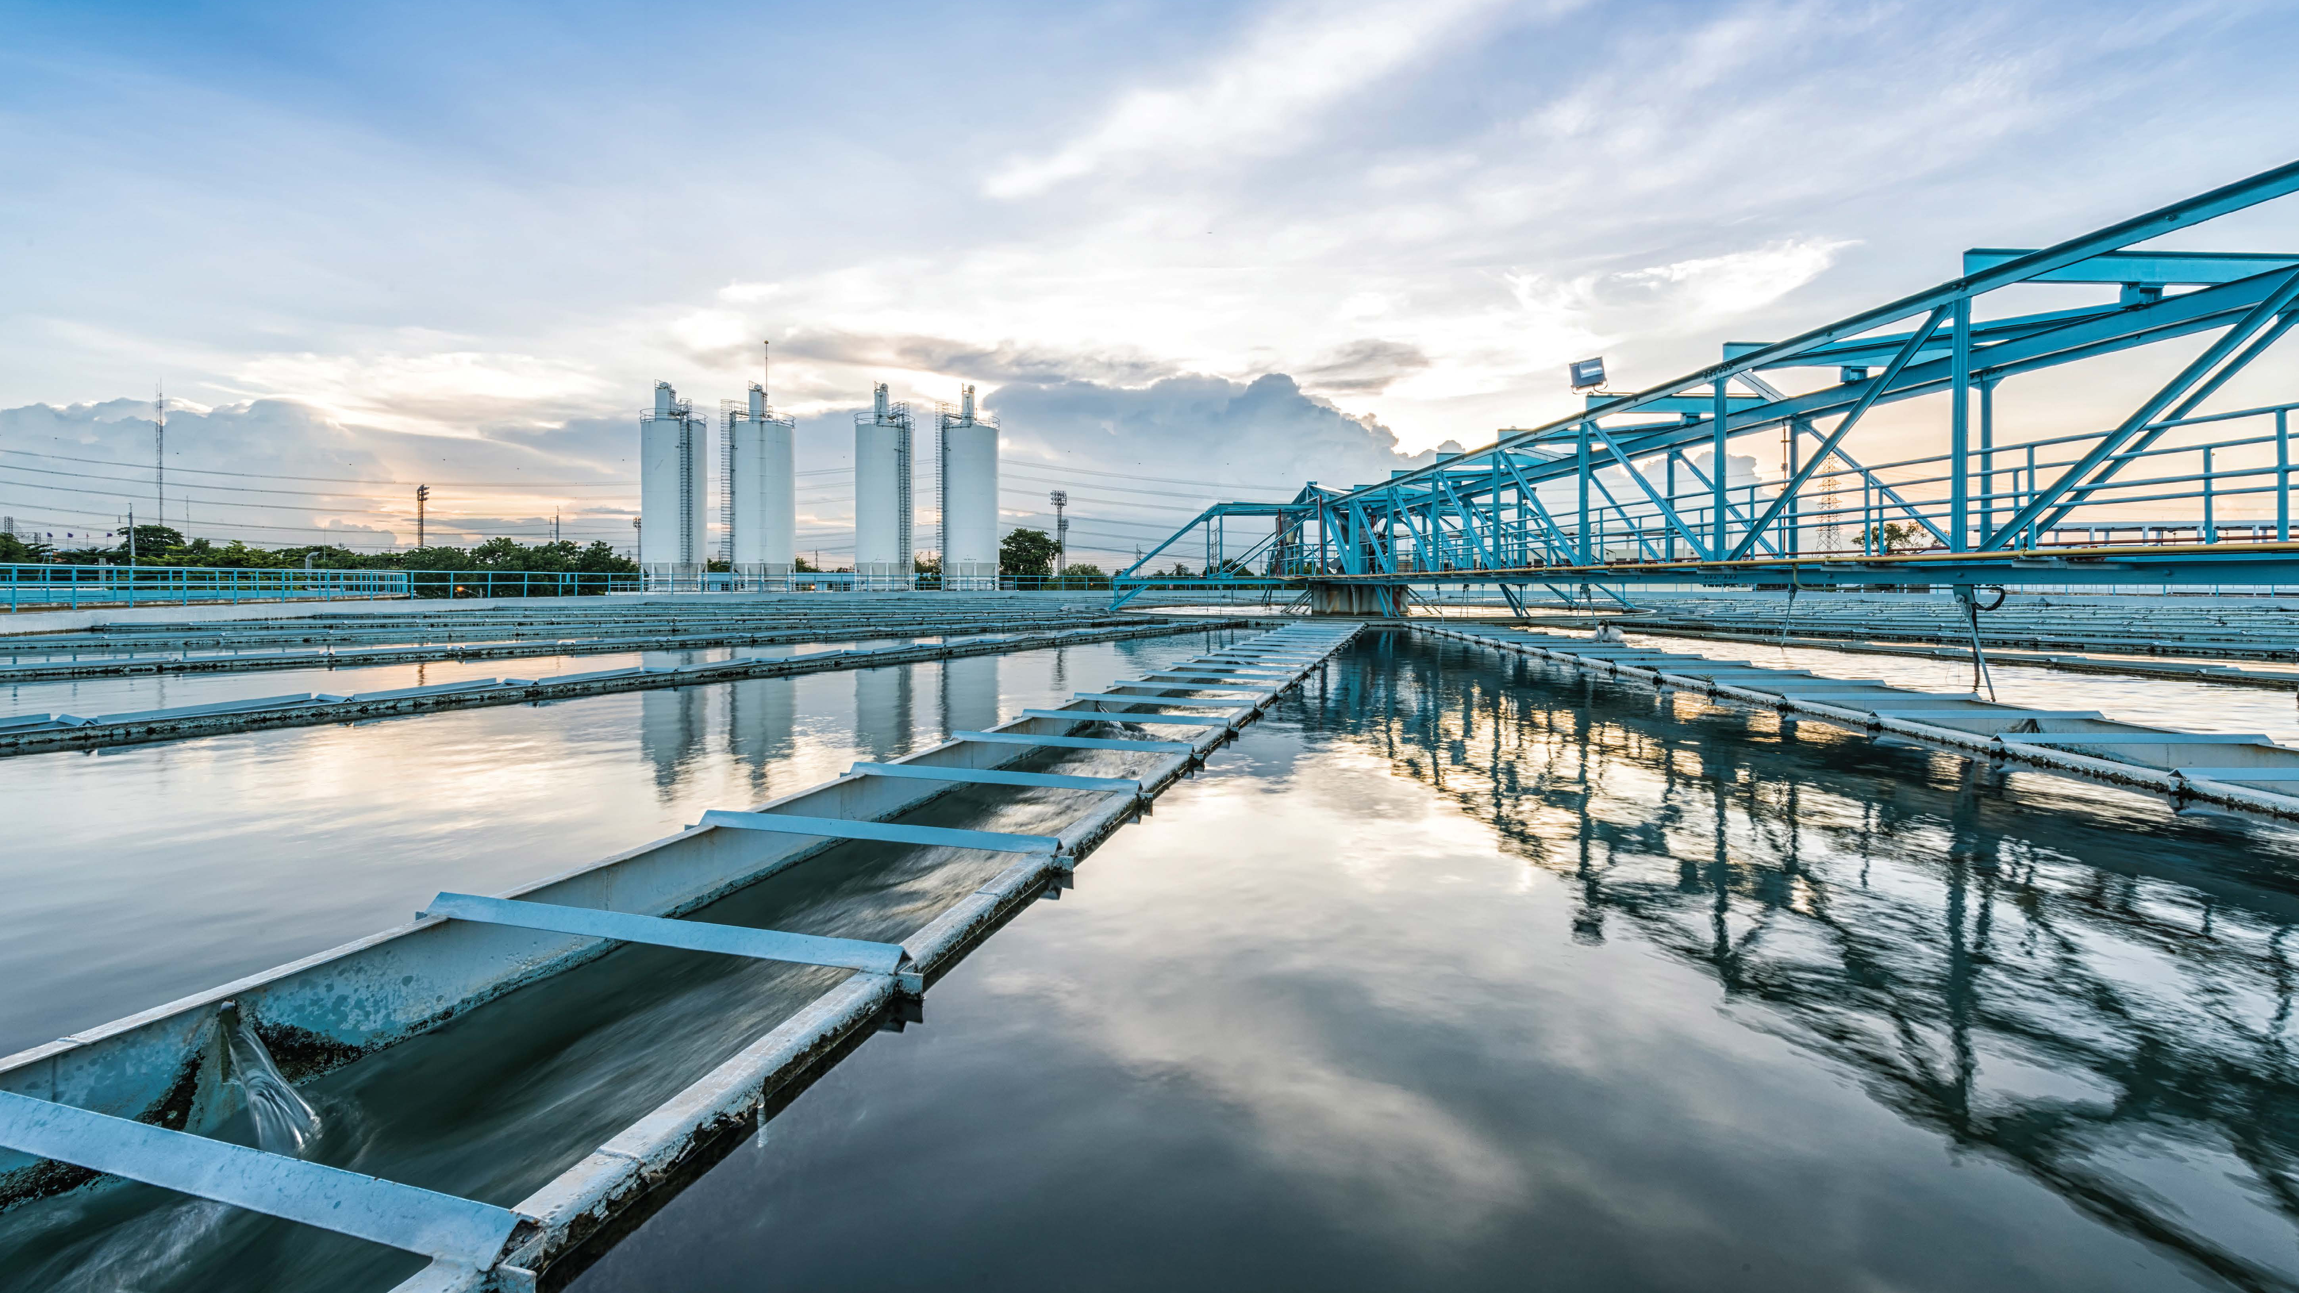
—
ABB understands the challenges and provides a set of solutions to be used in the water/wastewater industry. When you need to connect, terminate, fasten or protect, plug into the power and innovation of ABB.

