Slide 1
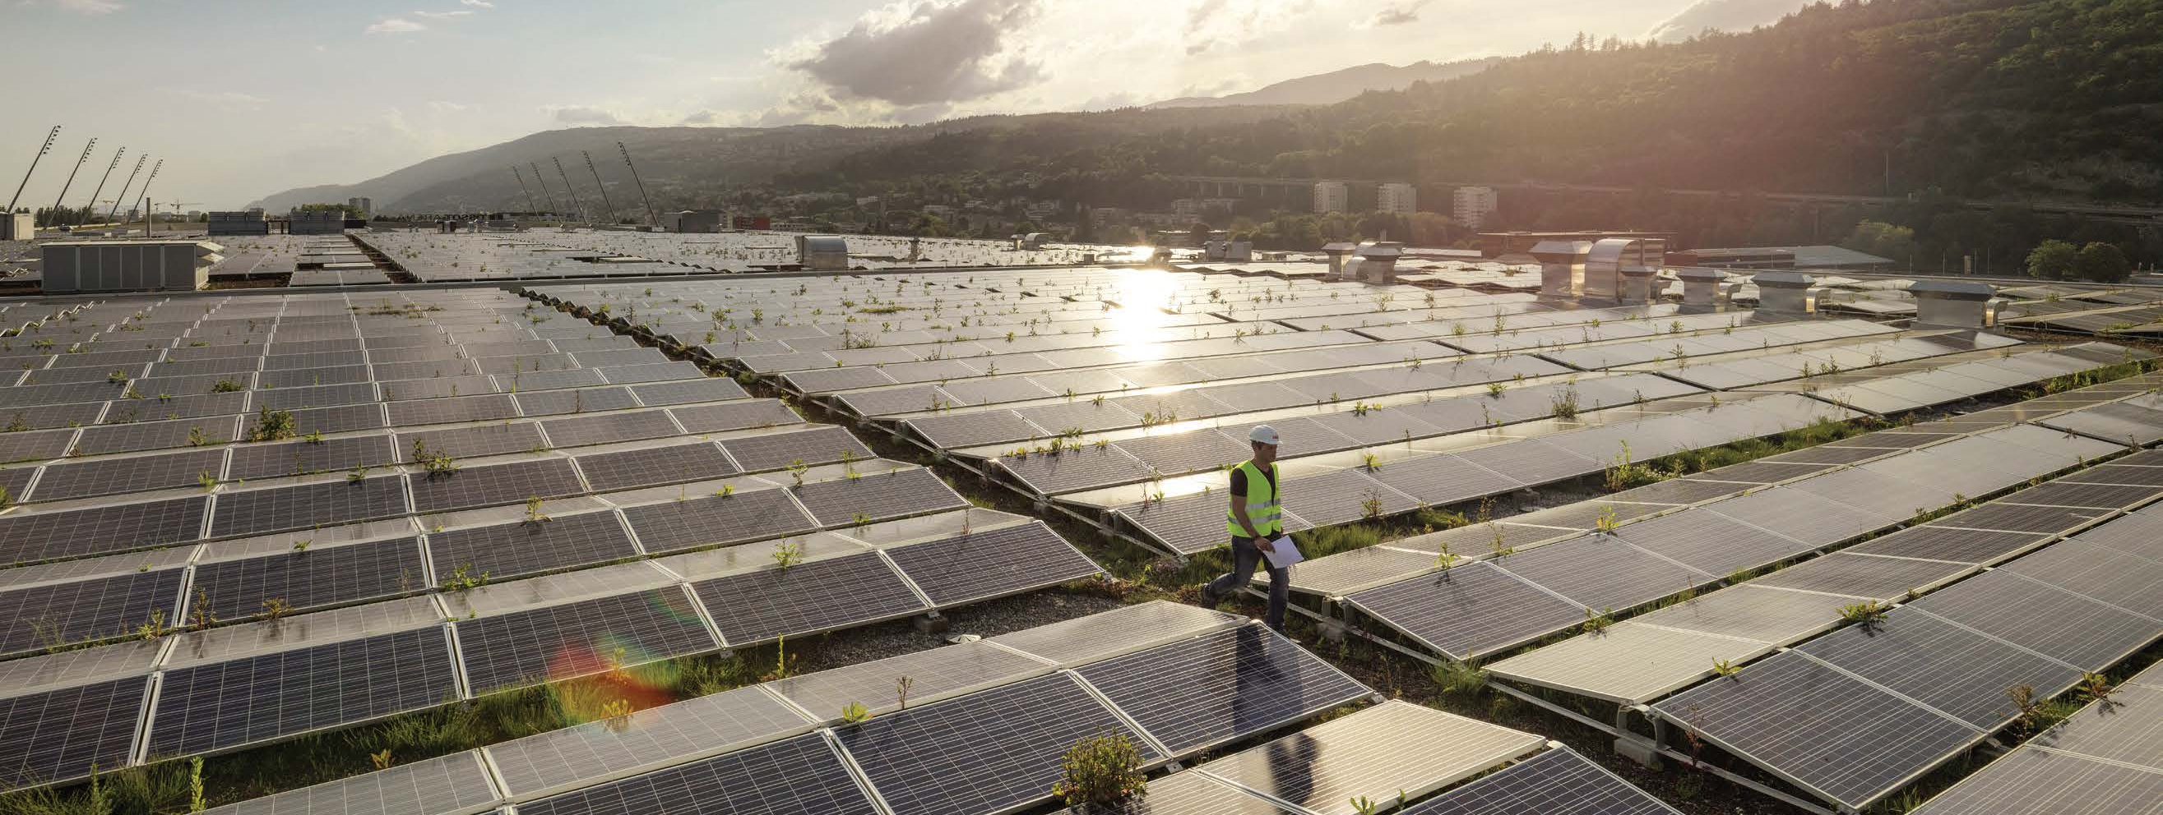
Renewable Energy Industry
Industry brochure
Installation Products Division
March 2021
2020

Slide 2
— Thomas & Betts is now part of ABB’s Installation Products Division, but our long legacy of quality products and innovation remains the same. From connectors that support wire buildings on Earth to cable ties that help put machines in space, we continue to work every day to make, market, design and sell products that provide a smarter, safer and more reliable flow of electricity, from source to socket.

Slide 3
Contents
04 Designed to perform
05 Challenge and commitment
08 Safety
09 Continuous operation & sustainability
12 Grounding & bonding
13 Power quality, efficiency & reliability
16 Corrosive & harsh environment protection
17 Extreme temperature protection
20 Space savings
21 Services & training
23 Product selection guide

Slide 4
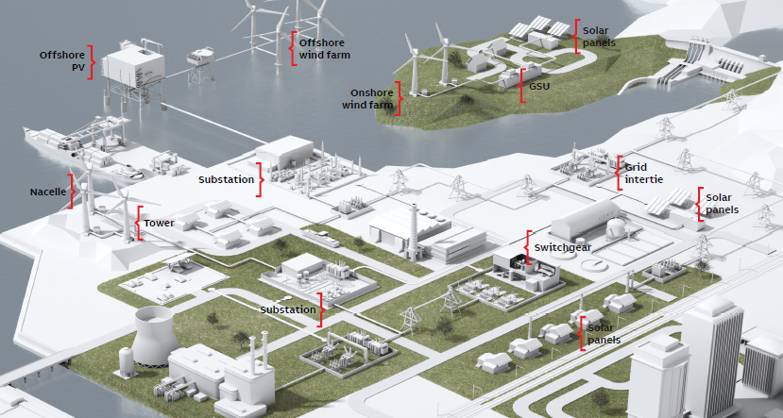
Designed to perform
Renewable energy industry
ABB understands the challenges faced in the renewable energy industry and is committed to providing innovative electrical solutions that not only reduce overall project costs, but also increase safety, promote sustainability and even improve cash flow.
Whether it’s labor-saving rough-in components, custom-designed electrical prefabrication systems, online cloud-based design tools or even our world-class logistics, ABB can help bring renewable energy projects in on time, within budget and profitably.

Slide 5
Challenge and commitment
Green energy solutions are driving the new energy economy. The world’s escalating demand for energy has driven heightened awareness of the need for clean, safe, renewable wind energy to supplement existing fossil and nuclear sources.
Renewable energy applications

Slide 6
— Generating electricity from renewable sources such as wind and solar is gaining momentum from the economics of grid parity as technology and demand become more sophisticated. Increasingly higher efficiencies and high-performance products will accelerate worldwide demand, making renewable wind power more cost-competitive with other conventional resources.

Slide 7
— Have you implemented both active and passive safety systems to ensure that your renewable power infrastructure is safe and reliable?

Slide 8
Safety
As with any electrical system, the wind and solar power generation infrastructure must be equipped to ensure safe operation and avoid product contamination.
The right products and controls provide the ability to:
Avoid burns and electrical shock
Protect against explosions and fire
Prevent premature product wear
Avert equipment failure
Reduce costly downtime
Arc flash hazards are a prominent concern in renewable power generation systems. All electrical terminations, lugs, connectors and other devices must protect against electrical shock and arc flashes. Vapors and other agents with deteriorating effects on conductors or equipment should not be in close proximity. Contamination of this nature is time consuming and expensive to clean.
You’ll find a thorough assortment of electrical system protection products from ABB, including solid-dielectric switchgear that uses no gas or oil, heat-shrink tubing to insulate exposed conductors and wiring and connectors with fault indicators.
Blackburn®
E-Z-Ground® compression, mechanical and exothermic grounding systems
Compression lugs and splices
Ergonomic compression tools
Ty-Rap® – Cable ties
UV resistant
“The Grip of Steel®” non-magnetic stainless steel locking device
Versatile nylon 6.6 material
With and without color and non-color UV-stabilizing additive
Smooth notchless body reduces stress concentration points under tension
Hi-Tech® – Current-limiting fuses
Greatly reduce energy let-through, minimizing the risk of catastrophic failures
Interrupting capabilities up to 50,000A
Used in molded fuses for underground junction boxes and switchgear for full-range load overcurrent protection
Address arc flash concerns and generate no external arcing or byproducts
EZCODE® – Safety labels, tags, signs and
barricade tapes
Help to ensure personnel and workplace safety
Conform to NEC® 2012 Section 110.3(A)(1)
Highly visible and long-lasting materials
Barricades and burial marking tapes in a variety of materials and colors
Custom labels, tags and signs

Slide 9
Continuous operation & sustainability
Photovoltaic and wind outputs are naturally constrained by wind availability. Proper engineering and product support are critical in keeping the systems operating at peak performance.
In order to satisfy the requirements of the Power Purchase Agreements (PPA), renewable power facilities must avoid downtime by applying processes and technology that:
Mitigate against meteorological forces
Assist in accurate product selection
Avoid inferior quality products
Prevent poor installations
Due to the remote nature of wind and solar farms, outages can be particularly costly. Long response times to critical conditions or failures intensify the costs. Wind turbine heights add to that cost if the problem is within the tower column or in the nacelle.
Downtime prevention is the key. ABB has the quality products, training, services and support needed to prevent outages and ensure sustained, low-maintenance solar and wind power operation.
T&B® Fittings – Type A liquidtight flexible
non-metallic conduit and fittings
Non-metallic, steel and stainless steel fittings
Ideal for continuous flexing or vibration applications
Create a liquid-, dust- and oil-tight seal
Suitable for operating temperatures from -20°C to 60°C
Blackburn®
E-Z-Ground® compression, mechanical and exothermic grounding systems
Compression lugs and splices
KUBE® power connectors and motor lead disconnects
Ergonomic compression tools
Sta-Kon®
Nylon-, vinyl- and non-insulated wire terminals
Heat-shrink terminals, ergonomic Comfort Crimp® tools and disconnect installation tool
Shrink-Kon® heat-shrink insulation for harnesses, wires or cables
T&B® Fittings
Liquidtight conduit and fittings (Type A stainless steel/non-metallic, Type B non-metallic, Type C stainless steel/aluminum)
Wire-mesh strain-relief cord and conduit grips

Slide 10
— Products that are designed to perform consistently and are able to withstand the forces of nature require less field service.

Slide 11
— Lightning produces currents of up to 200,000 amps within an extremely short period of time, testing the strength of the system’s grounding capability.
Are you prepared?

Slide 12
Grounding & bonding
Grounding and bonding are critical to any power generation facility, particularly wind turbines and solar farms, due to their exposure to lightning strikes.
Choosing the right product is necessary to:
Ensure employee safety
Prevent costly job interruptions
Ensure timely completion of the installation and project
Meet IEEE requirements with UL® and CSA application standards
Provide electrical continuity and reliability
Power generation facilities must ensure that their grounding and bonding meet the specified code requirements. With the right electrical product selection, you can reduce the number of conductors and terminations required.
ABB provides an extensive range of products and sizes to fit all grounding and bonding needs, including compression, mechanical and exothermic products for above-ground and direct-burial grounding applications. We also deliver comprehensive, onsite grounding and bonding training in addition to services to ensure that your installation continues to operate smoothly and safely.
Blackburn®
E-Z-Ground® compression connectors
High-conductivity copper and bronze connectors for direct-burial, OEM or telecomm applications
Featuring the Color-Keyed® Compression System that ensures proper connections
Mechanical grounding connectors
High-strength split-bolt connectors for copper-to-copper connections
Service post connectors for steel structures, fence posts or transformers using one or two cables
ViceLock® connectors for cable tray, channel and strut applications
Exothermic grounding system
Simple, self-contained system to form high-quality electrical connections
T&B® Fittings – Blackjack® grounding bushings
Innovative design makes installation quicker and easier
Design improves performance with superior continuity
Design secures grip forms for lasting bond
Sta-Kon®
Shield-Kon® coaxial grounding connectors and Dragon Tooth® insulation-piercing connectors

Slide 13
Power quality, efficiency & reliability
Reliability, efficiency and quality are primary goals of all energy generation utilities. Renewable power facilities depend on unique, advanced components that accommodate very specific tolerances and provide predictable, reliable performance and control.
These innovative electrical systems and tools are needed to:
Adapt to fluctuating wind and solar supply
Avoid damage from power quality disturbances
Eliminate underperformance
Minimize system losses and increase power output
ABB products are designed for energy efficiency and reliability. We offer monitoring and control solutions such as fault detection and overcurrent protection to enhance energy efficiency and system reliability. We use the right quality of raw materials to reduce voltage drops, increase usable power and boost the stakeholders’ ROI.
Our adherence to ISO and industry standards ensures consistent quality and safety in our products. ABB incorporates the latest technological advancements to meet the changing needs of our customers.
Elastimold®
Molded vacuum interrupters
Compact, lightweight, submersible protection
Predictable tripping for ease of coordination with upstream and/or downstream protection
Distribution switchgear
Solid EPDM insulating media makes it maintenance free and environmentally friendly – no oil, no gas
Compact and modular designs allow for smaller footprint and field assembly inside tight vaults
Joslyn® – Capacitor switches
Vacuum interruption and solid-dielectric insulation translate into maintenance-free and environmentally friendly designs – no oil, no gas
Exclusive Vacstat® vacuum interrupter monitoring
Long-life operating mechanisms
Available for applications in 15 to 230kV systems
Fisher Pierce® – Faulted current indicators
Adaptive trip reset reduces inventory and eliminates the need to replace devices as the load changes
Temporary fault detection option to help locate nuisance temporary faults
Highly visible strobe, LED and fluorescent orange flag indication options – and SCADA ready
Hi-Tech® – Current-limiting fuses
Greatly reduce energy let-through, minimizing the risk of catastrophic failures
Interrupting capabilities up to 50,000A
Address arc flash concerns and generate no external arcing or byproducts internal bonding strap for rigid conduit
XJG conduit expansion coupling with internal bonding strap

Slide 14
— Are you generating enough power to satisfy demand? Are weaknesses in your systems reducing your energy output?

Slide 15
— Unless properly mitigated, harsh environmental conditions can prove costly to renewable power generation facilities.

Slide 16
Corrosive & harsh environment protection
Solar and wind farms are, by their nature, continually exposed to the elements.
Environmental risks to renewable power generation infrastructure include:
High moisture and high winds
Lightning
Salt spray, sand and dust
Ice accumulations
Corrosion caused by these factors is among the greatest threats to safe and reliable operations. Uncontrolled dew point or moisture can cause corrosion and rust, and the pairing of dissimilar metals enhances the corrosive atmosphere. Extreme weather conditions should not compromise performance sustainability. With proper planning and selection, your electrical systems and devices will survive the elements. For example, you can reduce the occurrence of dissimilar metals to avoid corrosion and protect exposed wiring and conductors by insulating with heat-shrink.
ABB offers these solutions and others to protect against challenging environments. Our extensive electrical product suite is designed, manufactured and tested to meet all NEMA, UL®, NEC®, IEEE and other specified code requirements.
Kindorf® – Stainless steel modular framing channel, pipe hangers, beam clamps and accessories
Available in 316 stainless steel, aluminum, PVC-coated, non-metallic and standard Galv-Krom® finish
T&B® Fittings – BlueKote® conduit bodies
Multi-layer protection with epoxy external finish for superior corrosion control
Tapered NPT threads for integrated bushing
BlueKote® internal finish for faster, easier wire pulling
Ty-Rap® – Cable ties
Polypropylene ties engineered for harsh environments, especially for corrosion resistance
Stainless steel ties for enhanced, not infinite, corrosion protection
Ocal® – PVC-coated conduit
Industry leading thread protection through a hot-dipped galvanizing process, and industry leading UL® Listed Type 4X PVC-coated conduit bodies
Meets the requirements of NEMA RN-1 without exception
UL® Listed with both the zinc coating and the PVC coating investigated and listed per UL6
UL® Listed including UV resistance testing
PVC-Coated Conduit System provides superior corrosion protection against many harmful elements
Interior blue urethane provides corrosion protection around copper wire or fiber optics
T&B® Fittings
Stainless steel form 8 and BlueKote® conduit bodies
Xtra Flex® non-metallic liquidtight conduit, tubing and Bullet® Fittings

Slide 17
Extreme temperature protection
Wind and solar power generation facilities may be subject to extreme temperatures and temperature swings. Electrical systems in these environments must be robust enough to withstand the elements and ensure continuous delivery of quality power.
Otherwise, the owner/operator will face degraded operational capacity and the risk of costly downtime. For example:
Hotter temperatures reduce the power output of photovoltaic modules
Prolonged heat causes materials to age more rapidly
Frost heave occurs when materials contract and expand due to ground frost
Hail can cause physical damage to the systems
To help manage renewable power electrical systems installed in freezing or high-heat climates, ABB offers a broad array of electrical products that can withstand or insulate against extreme temperatures. Durable materials, insulated products, resilient fasteners, heating and cooling elements and temperature controls are among the solutions available.
Ty-Rap® – Stainless steel cable ties
Stainless steel alloys available for enhanced corrosion protection
Quick, easy installation and secure locking
Kopex-Ex™
Stainless steel flexible conduit systems for hazardous locations
T&B® Fittings – ATX liquidtight flexible metalconduit and fittings
Construction utilizes the flexibility of a standard cable core
Engineered with the advantage of a thermoplastic rubber jacket
Virtually unaffected by temperature extremes
Contain no halogens
Flammability rating of UL94-HB
52® Series High-Temperature Liquidtight Fittings rated UL94V-2
Sta-Kon® – High-temperature wire terminals
Tefzel® insulated terminations for high temperatures
Braised and overlapped seams eliminate chances for lost wire strands, poor resistance, wire pullout and electrical failure
Selective annealing to strengthen materials and reduce fatigue
Anti-rotational tongue prevents shorting by keeping terminal secure within the block
Kopex®
High-temperature conduit systems

Slide 18
— ABB designs and tests its products to deliver high performance in extreme high and low operating temperatures.

Slide 20
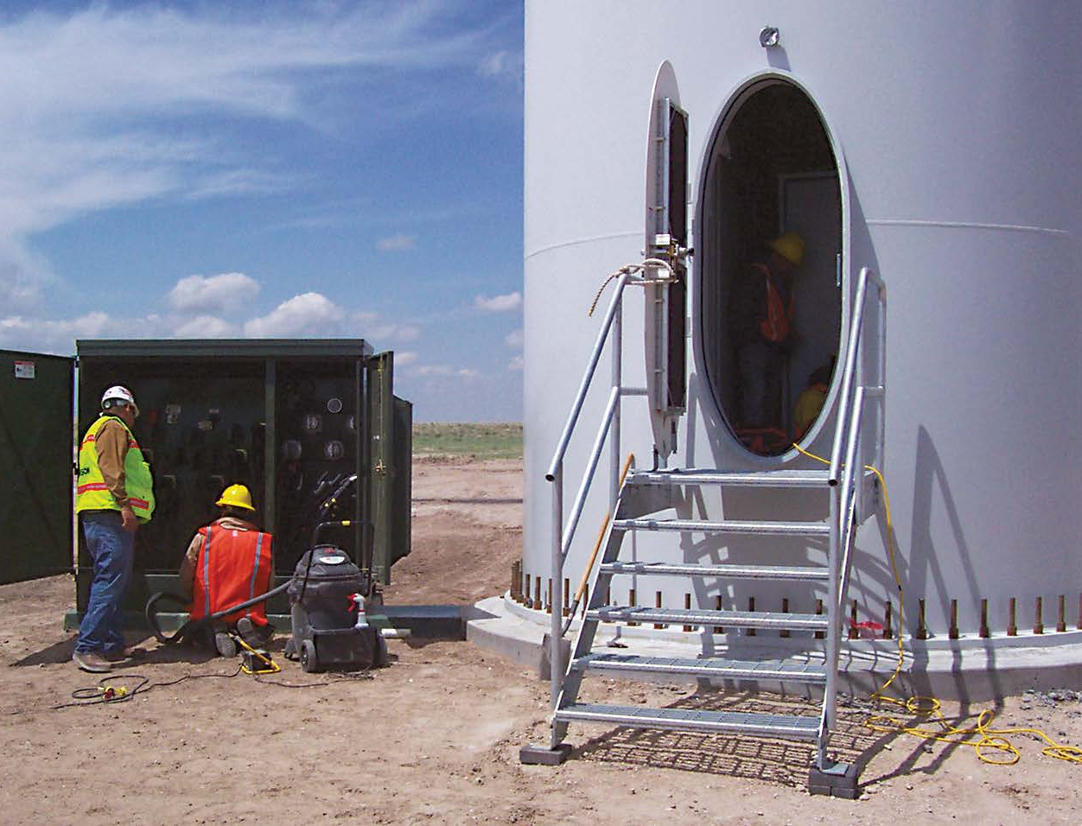
Space savings
Adapting electrical devices and systems to fit in small or confined spaces requires innovative technology.
ABB delivers space-saving solutions designed to:
Pack more power into a smaller footprint
Ensure sufficient operating clearance
Allow retrofits without altering the surrounding infrastructure
Accommodate load growth within the existing available space
Reduce construction and maintenance costs
Provide engineering and 3D CAD for equipment placement
Tall, narrow wind towers present unique challenges. Smaller footprint products are needed to fit the smaller space without sacrificing efficiency, reliability or safety. Wind power utilities need electrical products that can handle the same current ratio in smaller packages, such as narrow lugs that handle the same current as a conventional lug. Switchgear, fusing and surge arresters for wind applications also need to be engineered for confined spaces.
Solar power utilities may also be subject to space constraints. In these circumstances, the racks, inverters, switchgear and other technologies that make up the solar power electrical system need to be designed to fit.
Elastimold® – Molded vacuum interrupters
Compact, lightweight submersible overcurrent protection
TCC curves provide predictable tripping for ease of coordination with upstream and/or downstream protection
Enable radial feeders or loops to be reconfigured, either manually or via SCADA
Ty-Rap®
Low-profile nylon 6.6 cable ties
Blackburn® – Narrow-tongue lugs
Engineered for 90°, up to 35kV
Designed for quick, positive compression
Low compression areas ensure complete contact
Filled with high-temperature oxide inhibitor compound
Only seven dies handle all 14 lug sizes
11/2" wide tongues save vertical space on tie bar
Can be directly substituted for equipment mechanical lugs in most applications
Featuring the Color-Keyed® Compression System that ensures proper connections

Slide 21
Services & training
The renewable energy industry is extremely dynamic, making it difficult to develop in-house expertise.
—
Our services
Wind and photovoltaic developers must reconcile these key challenges:
New and emerging technologies
Evolving regulations and standards
Workforce skills gap
Wind and solar electrical infrastructure continues to evolve as designers and engineers improve existing technologies and increase reliability, efficiency and safety. Specialized training is often required.
Blackburn®
The QTP program provides a guaranteed two-week shipment of Blackburn® products
Configurator enables special connectors to be designed with a guaranteed two-week shipment
Product specification specialists and Mobile Technical Specialists are available nationwide to train in the proper use and installation of Blackburn® products
Inside Tech Support group provides 24/7/365 expertise for Blackburn® products
Hi-Tech®
Field training on current-limiting fuses
Joslyn Hi-Voltage®/Elastimold®
Power & High Voltage Field Service group provides field maintenance for Joslyn Hi-Voltage® and Elastimold® equipment
Ocal®
Onsite installation training provides a review and hands-on practice of clamping, cutting, threading, assembling and repairing the Ocal® PVC-coated conduit system
Training also extends warranty from two to five years on a system installed by a certified contractor
Additional services & training
NEC® Update Training provides an overview of the latest changes to the National Electrical Code®
Grounding & Bonding Training covers design, layout and connections
T&B Tool Services, tool loaner and tool leasing programs

Slide 22
— How will you keep up with the rapid pace of innovation in wind power electrical systems?

Slide 23
Product selection guide
Renewable energy industry
Product description | Safety | Total project cost reduction | Continuous operation & sustainability | Grounding & bonding | Power quality, efficiency & reliability | Corrosive & harsh environment protection | Extreme temperature protection | Space savings | Services & training
Blackburn®
E-Z-Ground® compression, mechanical and exothermic grounding systems | • |  | • | • |  |  |  |  | •
Compression lugs and splices | • | • | • | • |  |  |  |  | •
KUBE® power connectors and motor lead disconnects |  |  | •
Narrow-tongue lugs |  |  |  |  |  |  |  | •
Ergonomic compression tools | • | • | • | • |  |  |  |  | •
Color-Keyed® system training |  |  |  |  |  |  |  |  | •
Elastimold®
Fused loadbreak elbows | • |  |  |  | •
Separable connectors | • | • |  |  |  |  |  | •
Solid-dielectric switchgear, switchgear automation packages, molded vacuum interrupters and arresters | • | • |  |  | • |  |  | •
Field training on cable accessories and switchgear |  |  |  |  |  |  |  |  | •
EZCODE®
Danger/warning labels and signs, industrial/wire markers, barricade/burial tape | •
Fisher Pierce®
Faulted circuit indicators and voltage and current sensors |  |  |  |  | •
Hi-Tech®
Trans-Guard® fuses, molded current-limiting fuses, molded canister fuses | • |  |  |  | •
Field training on current-limiting fuses |  |  |  |  |  |  |  |  | •
Joslyn Hi-Voltage®
Capacitor switches, reclosers, air disconnect switches and interrupter attachments |  |  |  |  | •
Power & high-voltage field maintenance services |  |  |  |  |  |  |  |  | •

Slide 24
Product selection guide
Renewable energy industry
Product description | Safety | Total project cost reduction | Continuous operation & sustainability | Grounding & bonding | Power quality, efficiency & reliability | Corrosive & harsh environment protection | Extreme temperature protection | Space savings | Services & training
Kindorf®
Rooftop solar mounting systems, surface raceway, lighting support and cable mounting systems |  | •
316 stainless, aluminum, PVC-coated or non-metallic channel, hangers and clamps | • | • | • |  |  | •
Seismic bracing system | • |  | • |  |  | •
Kopex®
High-temperature conduit systems |  |  |  |  |  |  | •
Kopex-Ex™
Stainless steel flexible conduit systems for hazardous locations |  |  |  |  |  | • | •
Ocal®
PVC-coated conduit systems |  |  | • |  |  | •
Ocal-Blue® type 4X form 8 conduit bodies |  |  |  |  |  | •
Installation certification training |  |  |  |  |  |  |  |  | •
Red•Dot®
Code Keeper® weatherproof while-in-use covers |  |  |  |  |  | •
Russellstoll®
MaxGard® pin-and-sleeve connectors and explosion-proof interlocked receptacles | • |  |  |  |  | •
GSUL ground indicator system | •
Sta-Kon®
Nylon-, vinyl- and non-insulated wire terminals |  |  | •
High-temperature wire joints and terminals |  |  |  |  |  |  | •
Corrosion-resistant, nickel-plated wire terminals |  |  |  |  |  | •
Heat-shrink terminals, ergonomic Comfort Crimp® tools and disconnect installation tool |  | • | •
Shrink-Kon® heat-shrink insulation for harnesses, wires or cables |  |  | • |  |  | •
Shrink-Kon® self-fusing insulation tape |  |  |  |  |  | •
Shield-Kon® coaxial grounding connectors and Dragon Tooth® insulation-piercing connectors |  |  |  | • |  |  |  |  | •

Slide 25
Product selection guide
Renewable energy industry
Product description | Safety | Total project cost reduction | Continuous operation & sustainability | Grounding & bonding | Power quality, efficiency & reliability | Corrosive & harsh environment protection | Extreme temperature protection | Space savings | Services & training
T&B® Cable Tray
Aluminum, stainless steel and fiberglass support and wire management systems |  |  | • |  |  | •
T&B® Fittings
Liquidtight conduit and fittings (Type A stainless steel/non-metallic, |  |  | •
ATX high-/low-temperature liquidtight conduit and fittings |  |  |  |  |  |  | •
Stainless steel form 8 and BlueKote® conduit bodies |  | • |  |  |  | •
Xtra Flex® non-metallic liquidtight conduit, tubing and Bullet® fittings
Ranger® series liquidtight cord connectors |  | • |  |  |  | •
Blackjack® grounding bushings |  | • |  | • |  | •
Wire-mesh strain-relief cord and conduit grips |  |  | •
Ty-Rap®
Coated and uncoated stainless steel, extra-high temperature and flame-retardant UL94V-0 nylon cable ties | • |  |  |  |  | • | •
Ty-Rap Tote® cable tie dispensers and ergonomic installation tools | •
Low-profile nylon 6.6 cable ties |  |  |  |  |  |  |  | •
Services & training
Onsite NEC® update training and onsite grounding & bonding training |  |  |  |  |  |  |  |  | •
T&B tool services, tool loaner and tool leasing programs |  |  |  |  |  |  |  |  | •

