Slide 1
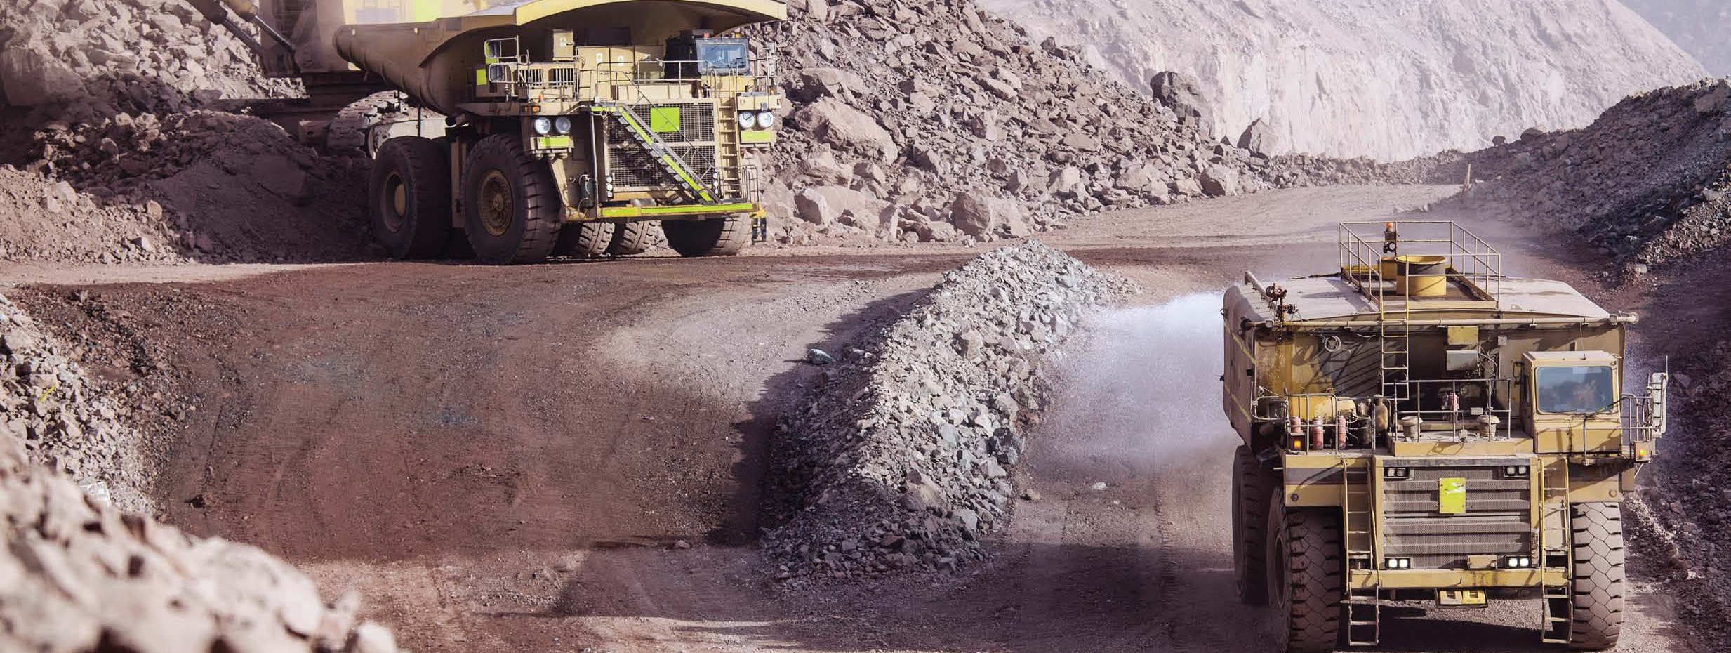
Metals and Mining Industry
Industry brochure
Installation Products Division
January 2021
2020

Slide 2
— Thomas & Betts is now part of ABB’s Installation Products Division, but our long legacy of quality products and innovation remains the same. From connectors that support wire buildings on Earth to cable ties that help put machines in space, we continue to work every day to make, market, design and sell products that provide a smarter, safer and more reliable flow of electricity, from source to socket.

Slide 3
Contents
04 Designed to perform
05 Challenge and commitment
08 Continuous operation & sustainability
09 Corrosive & harsh environment protection
12 Liquid ingress protection
13 Safety
16 Extreme temperature protection
17 Hazardous location protection
20 Power, quality, efficiency and reliability
21 Grounding & bonding
24 Product selection guide

Slide 4
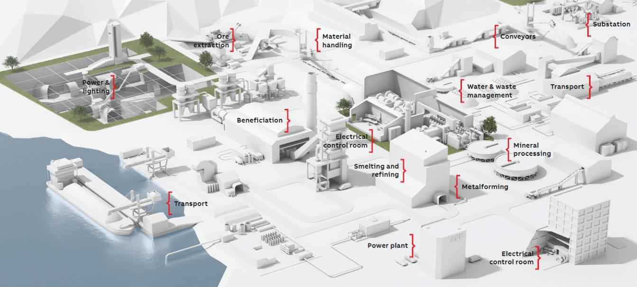
Designed to perform
Metals and mining industry
ABB understands the challenges faced in the metal and mining industry and is committed to providing innovative electrical solutions that not only reduce overall project costs, but also increase safety, promote sustainability and even improve cash flow.

Slide 5
Challenge and commitment
As new mining, processing and metallurgical equipment with complex and sensitive electrical systems controls and automation replaces older equipment, MRO expenses are rising with increasing maintenance time, technical support and power costs.
Metals & mining applications

Slide 6
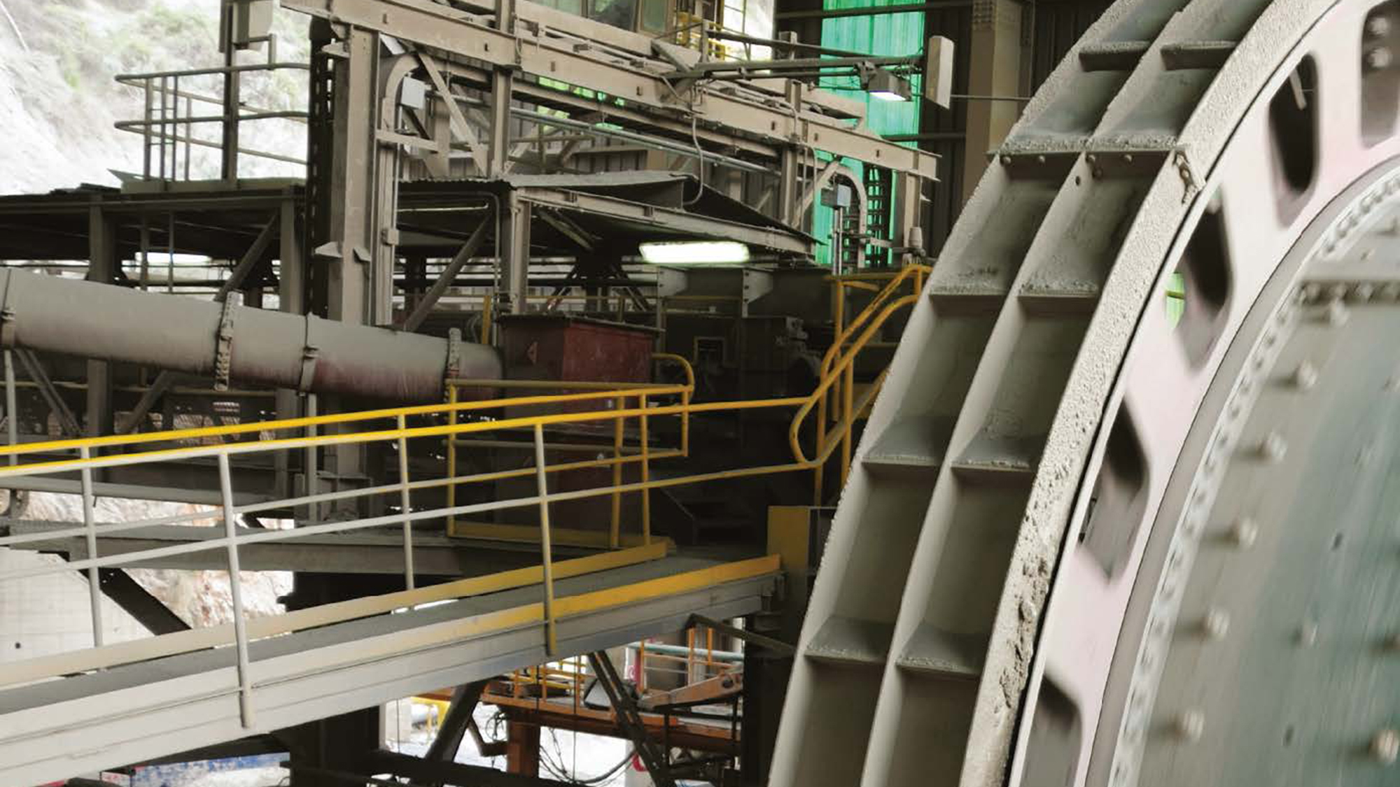
— Key metals and mining business drivers include; minimizing operation and maintenance costs, maximizing plant availability and throughput, ensuring safety for personnel, machinery, materials and property,
conserving natural resources and reducing
emissions and energy saving.

Slide 7
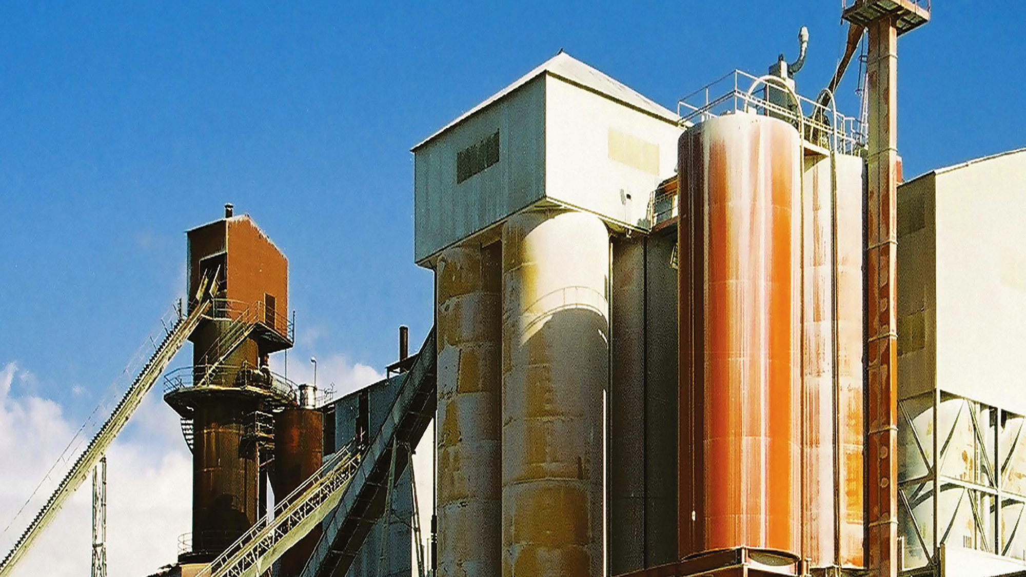
— ABB electrical packages deliver
significant capital and operating
cost efficiencies while shrinking the
project’s development footprint
and environmental impact.

Slide 8
Continuous operation & sustainability
Mining and metallurgy plants need skilled operators and good maintenance management to produce at sustainable yields. But costs associated with unscheduled downtime – replacement of ruined equipment, idle manpower, late-penalty fees, rental equipment expenses and intangibles for dissatisfied customers – can add up quickly.
To avoid cost-prohibitive unscheduled downtime and to enforce safe and environmentally friendly production, most metals and mining facilities choose higher performing electrical materials and products to boost plant availability. ABB offers the following solutions to sustain continuous operation safely and at high yields:
Long-lasting electrical systems to optimize lifecycle costs and capital expenditures
High-performance electrical systems to withstand harsh environments and increase operational equipment effectiveness (OEE)
Installation training certification to help ensure plant sustainability
Qualified technicians to assist you in quickly getting your plant back online
Product solutions to standardize your electrical system and ensure that you have the required products available at your local supplier when you need them
To avoid cost-prohibitive unscheduled downtime and to enforce safe and environmentally friendly production, most metals and mining facilities choose higher performing electrical materials and products to boost plant availability. ABB offers the following solutions to sustain continuous operation safely and at high yields:
Long-lasting electrical systems to optimize lifecycle costs and capital expenditures
High-performance electrical systems to withstand harsh environments and increase operational equipment effectiveness (OEE)
Installation training certification to help ensure plant sustainability
Qualified technicians to assist you in quickly getting your plant back online
Product solutions to standardize your electrical system and ensure that you have the required products available at your local supplier when you need them
Sta-Kon® – Crimped wire termination systems
Metal insulation grip sleeve included on all nylon terminals for strain relief
Long barrel selectively annealed
UL® Listed and CSA Certified
Carlon®
PVC fittings and Snap-Loc® Spacers
P&C® Flex Conduit
Kopex-Ex™
Explosion-proof conduit and coupling systems
T&B® Fittings – Type A liquidtight flexible non-metallic conduit with non-metallic or stainless steel fittings
Ideal for continuous flexing or vibration applications
Creates a liquid-, dust- and oil-tight seal
Suitable for operating temperatures from -4° to 140°F (-20° to 60°C)
Blackburn® – Motor lead disconnects
Quick and easy change-out of electric motors – with no bolting, taping or loose connections
UL® Listed to 600V, 125°C
Available for wire sizes up to 500 kcmil
Featuring the Color-Keyed® compression system that ensures proper connections

Slide 9
Corrosive & harsh environment protection
Corrosion – the enemy of electrical systems – costs an estimated $2.1 billion annually in lost equipment, plus labor and downtime.
Problems caused by corrosion include:
Equipment failure and shortened life
Poor electrical system reliability caused by high-resistance connections
Long maintenance repair time due to corroded parts
Safety hazards and product contamination
Harsh environmental factors inherent in mining and metallurgy applications – such as liquid and dirt ingress, heat, vibration and shock – can greatly accelerate corrosion and cause failures in the electrical and automation systems if not properly addressed. ABB solutions are made with corrosion-resistant materials to extend the life and reliability of your electrical system. Our aluminum, stainless steel, specialty alloy, and PVC or PVC coated products are the solutions to your corrosion issues.
T&B® Fittings
Stainless steel form 8 and BlueKote® conduit bodies
Marine-grade Type 316 stainless steel construction
in rugged Form 8 design in sizes to 2" and LB, T, TB and LU® shapes
Ferrous Form 7 and Form 8 designs in all popular sizes and shapes with triple-layer, corrosion resistant BlueKote® finish
Sand Cast Aluminum Form 7 and Form 9
Stainless steel liquidtight conduit connectors
Type 304 stainless steel body and gland nut resist corrosion far better than other metallic fittings
Rated for temperatures up to 105°C
Ocal® – OCAL-BLUE® PVC-coated conduit
PVC-coated, hot-dipped galvanized conduit and threads
Provides superior corrosion protection against many harmful elements
Interior blue polyurethane provides corrosion protection around cables
T&B® Cable Tray – Stainless steel cable tray
Does not channel moisture to electrical equipment, preventing corrosion and failure
Does not channel corrosive, explosive or toxic gases
Adaptaflex®
Cable protection systems – conduit and connectors
Ty-Rap® – Stainless steel cable ties
Strong, fireproof and easy to apply – for safe cable bundling
Resist corrosion and UV light, with the ability to withstand temperature extremes
Provide a strong, safe installation with a unique dual-locking mechanism
Carlon®
PVC fittings and Snap-Loc® spacers
P&C® Flex Conduit
Homac®
Copper Flood-Seal® compression splice kits
Kopex-Ex™
Explosion-proof conduit and coupling systems

Slide 10
— At a typical mineral processing plant, energy and operations represent approximately 50% of all costs, followed by maintenance and lost production due to downtime. At ABB, we understand miners seek to extend periods of operation and still be able to plan for maintenance downtime.

Slide 11
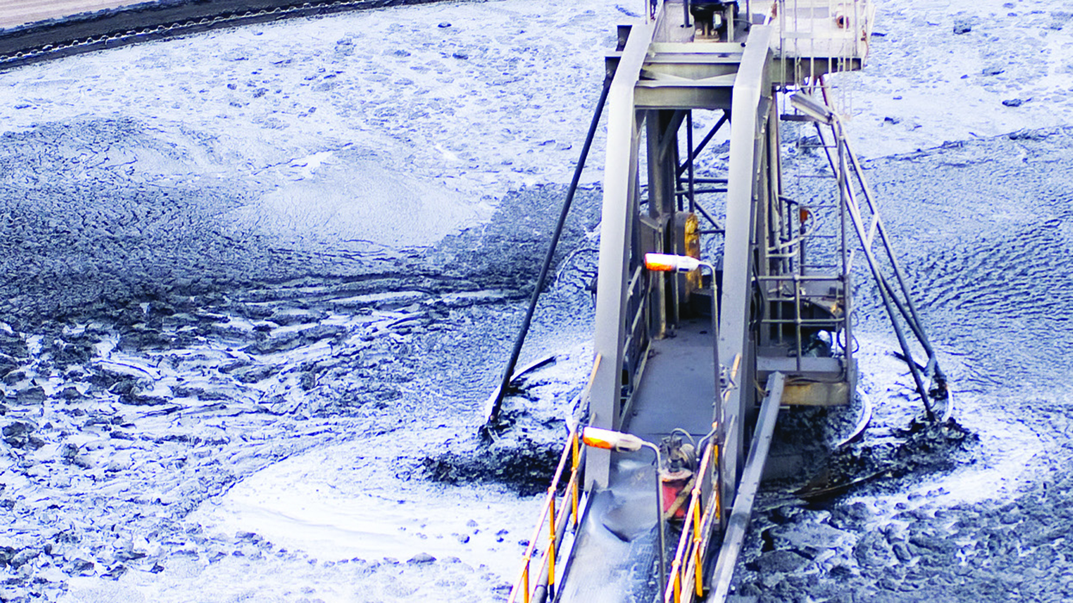
— Metals and mining electrical systems are often directly exposed to liquid, dirt, dust and chemicals. ABB offers thousands of high-performing products to protect these systems from liquid and dust ingress.

Slide 12
Liquid ingress protection
Liquid ingress protection is a critical element to keeping electrical systems operational. Exposure to water in indoor or outdoor applications, dust in suspension, condensation and accidental spills of machine oils and lubricants can all shorten the life of your electrical system.
One drop can be enough to ruin your production, so when specifying electrical components for mining and mineral processing applications, consider the following issues related to liquid ingress:
Liquid exposure can cause deterioration of electrical connections or short circuits
Electrical system components designed with round surfaces help to shed contaminants, rather than creating a shelf where they can collect
Abrasive and corrosive mine waters combined with moisture present extra challenges for liquidtight electrical components in mining and metal applications
Appropriate product design, materials and labor skills are required to ensure reliability, maintainability and safety of electrical connections subject to liquid and dust ingress
ABB electrical solutions offer protection against liquid, moisture and dust ingress.
Russellstoll® – DuraGard® pin-and sleeve connectors
Not just watertight, but waterproof, mated or unmated
Tested to 1000 psi for washdown applications
Full line of 20–60A (600VAC/250VDC max.) connectors, plugs and receptacles in UL94V-0 flammability-rated, corrosion-resistant, non-metallic housings
Hazlux®
Explosion-proof lighting fixtures for hazardous locations
Strobe lighting fixtures
Ocal® – OCAL-BLUE® PVC-Coated NEMA type 4X form 8 conduit bodies
Double coated inside and out for corrosion protection
Stainless steel encapsulated cover screws can behand- tightened – using only 15 in.-lbs. of torque –to achieve the UL® Listed Type 4X watertight rating
T&B® Fittings – Stainless steel liquidtight conduit and cord fittings
Stainless steel construction resists corrosion
Rounded gland nut deflects water from connector
Continuous sealing ring ensures a liquidtight seal
Red•Dot – Code Keeper® weatherproof covers
Rugged aluminum construction resists corrosion
Cover wet location receptacles to ensure personnel safety
Adaptaflex®
Cable protection systems – Conduit and connectors
Carlon®
PVC fittings and Snap-Loc® spacers
P&C® flex conduit

Slide 13
Safety
During the years 2000–2009, electrical accidents were the leading cause of fatalities in the U.S. mining industry, accounting for 6% of all deaths. Electrical injuries in mining are also disproportionately deadly, with 1 out of every 22 such injuries a fatality compared with an average of 1 out of every 203 for all other types of injuries.*
Safety in metal and mining industries encompasses personnel, vehicles, machinery, the material and also the mine, with issues such as roofing and ground sustainability. Common hazards requiring preventive safety measures in these industries include:
Fire or explosion
Electrical shock from exposed wiring, lightning or improper grounding
Release of toxic materials
Temperature extremes
Heavy vehicles and projection of debris
Large equipment and bulk conveyor systems
Drilling, climbing, hoisting and excavation machinery
ABB products address safety concerns in mining and metal processing workplaces.
Ty-Rap® – Flame-retardant cable ties
Perfect for low-smoke applications
UL94V-0 flammability rating
For use in temperatures ranging from -46°C to 140°C
EZCODE® – Safety labels, tags, signs and barricade tapes
Help to ensure personnel and workplace safety, as well as regulatory compliance
Highly visible and long-lasting materials
Custom labels, tags and signs available
Barricade and burial marking tapes in a variety of materials and colors
DTS®
Hazardous location lighting, junction boxes and controls
Russellstoll®
GSUL safe ground indicator system
Prevents operation of pumps without a safe ground
Lights indicate the establishment of a safe ground
Safety interlocks
30A and 50A ranges and polarizations to 480VAC
22kA interrupt capacity breaker
UL94V-0, NEMA Type 4X
Blackburn®
E-Z-Ground® compression, mechanical and exothermic grounding systems
Compression lugs and splices
Ergonomic compression tools
Color-Keyed® system training
T&B® Fittings
XTRA FLEX® non-metallic liquidtight conduit, tubing and BULLET® fittings
Steel, stainless steel, aluminum and non-metallic liquidtight flexible conduit fittings and cord connectors

Slide 14
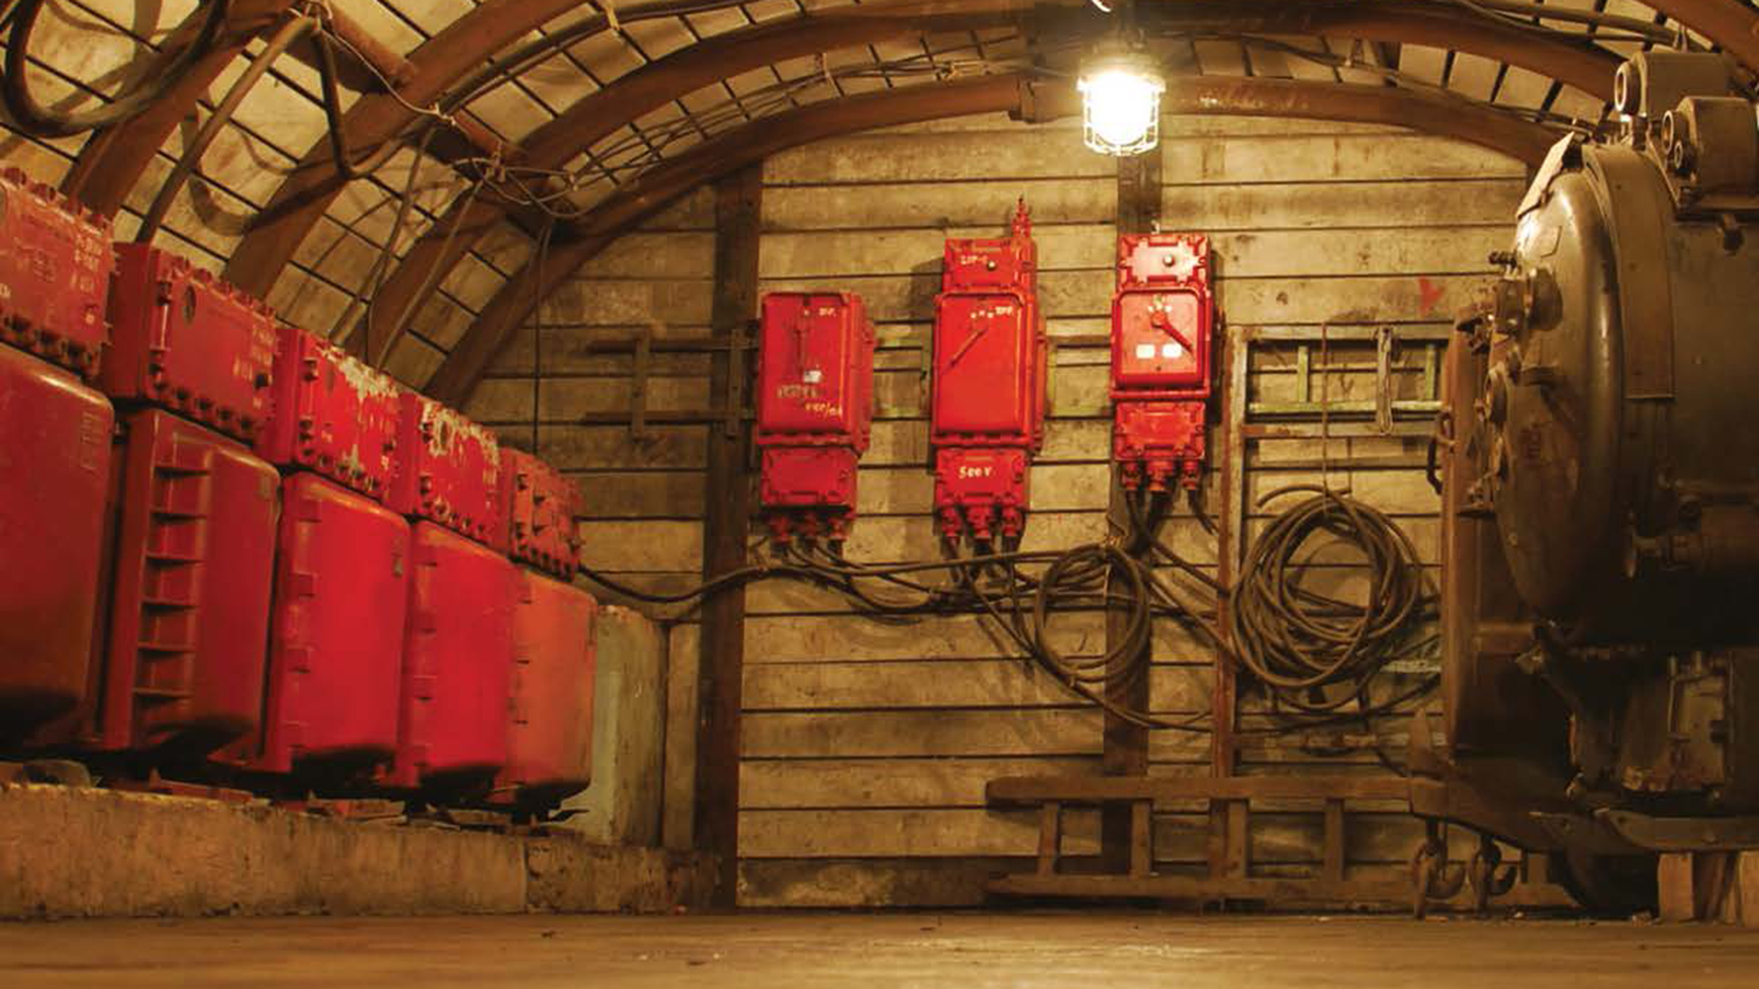
— The number of total injuries in metal, nonmetal and coal mining operations in the U.S. has greatly decreased from 30,986 cases in 1990 to 8,525 cases in 2010. Fatalities also decreased, from 122 deaths in 1990 to 71 lives lost in 2010.*
* Source: U.S. Occupational Safety and Health, http://www.cdc.gov/niosh/mining/topicspage1.htm

Slide 15
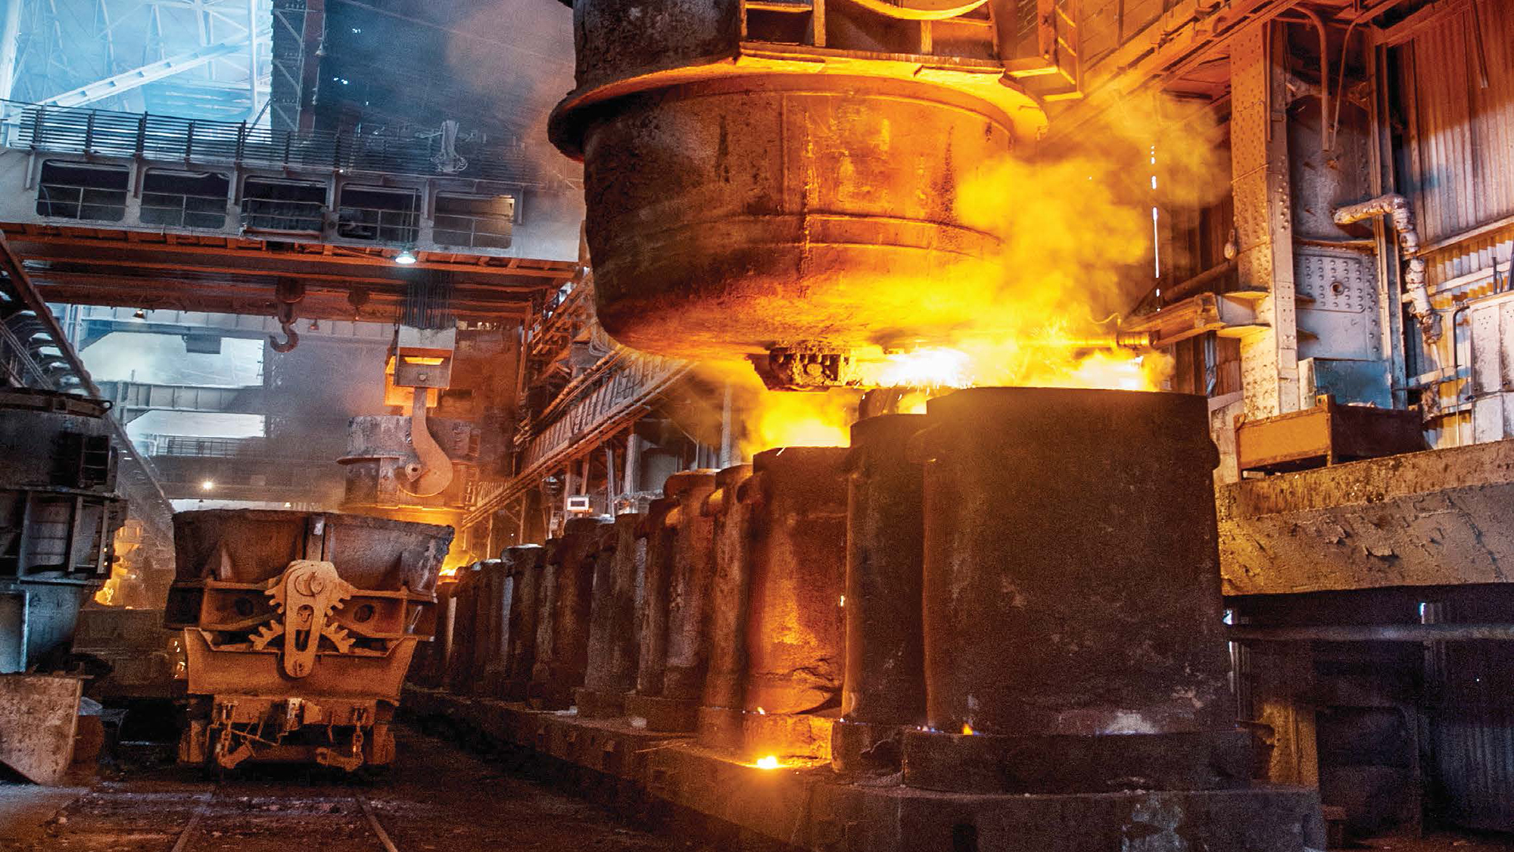
— ABB products provide equipment installed in remote areas and in extreme temperatures a high degree of production safety over a long service life. Our product technology helps avoid downtime to the greatest possible extent.

Slide 16
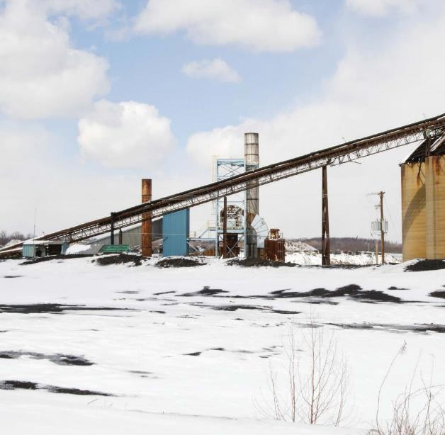
Extreme temperature protection
Outdoor and indoor machinery and process equipment at metal processing, coal and cement plants must stand up to extreme temperatures, UV radiation, humidity and corrosive substances.
Electrical systems must perform in these harsh conditions and be protected against condensation, water and sludge. Whether you’re operating a conveyor belt in snowy longitudes or in tropical zones, a high-temperature slurry pump or a furnace application, ABB electrical solutions address issues that can result from extreme temperatures, including:
Repeated thermal expansion and contraction damaging conduit systems and electrical connections
Components softening and failing due to high temperatures
Components melting and destroying other nearby equipment
Components near flames catching fire and burning
Components becoming brittle and failing at low temperatures
Condensation occurring due to rapid temperature changes, stressing electrical systems
Ty-Rap®
Extra-high temperature nylon cable ties
For use in temperatures from -40°C to 150°C
Feature “The Grip of Steel®” stainless steel locking device and offer infinite adjustability
Heavy-duty stainless steel cable ties
For use in temperatures from -80° to 538°C
Available in both Type 304 and Type 316 stainless steel
Quick, easy installation and secure locking
Sta-Kon® – High-temperature wire joints
and terminals
Rated for temperatures up to 150°C, 600V maximum
Molded, one-piece nylon construction for electrical insulation, rated UL94V-2
PMA® – High-temperature nylon conduit
and fittings
Offer good fire protection (flammability and smoke generation)
Provide high impact strength even at low temperatures
• Also resistant to weather

Slide 17
Hazardous location protection
During the years 1990–2001, more than 975 reported fires occurred in the U.S. mining industry, causing over 470 injuries, 6 fatalities and the temporary closing of several mines.* Many metals and mining processing personnel are in danger of being killed or permanently disabled because of exposure to many different hazardous sources inherent in these industries.
The National Electrical Code® (NEC®) defines hazardous locations as areas where the possibility of explosion and fire is created by the presence of flammable gases, vapors, dust, fibers or flyings. In metals and mining facilities, hazardous locations include areas where substances in suspension, mine gases or fuels and chemicals may be present.
To protect both your facility and your employees, ABB offers a wide variety of high performance, explosion-proof solutions designed to prevent or contain an explosion in classified hazardous locations.
Hazlux® – Hazardous location lighting
Explosion-proof fixtures for Class I, II and III hazardous locations
Enclosed, gasketed and rated NEMA 4X, IP66 and UL1598 for wet and marine locations
Russellstoll® – MaxGard® explosion-proof interlocked receptacles
Copper-free, cast-aluminum, epoxy-coated housing
O-ring-sealed interior components ensure watertight protection whether connections are mated or not
Explosion-proof systems for 30A, 60A and 100A
T&B® Fittings
GUP explosion-proof enclosure
Compact design is ideal for fuel pumps
Constructed of ductile iron for superior strength
Dust-ignition-proof, raintight and listed for wet locations
XP explosion-proof flexible couplings
Explosion proof and corrosion resistant for use in hazardous and wet locations
Ideal for making tight bends in conduit systems or for applications subject to movement or vibration
DTS®
Hazardous location lighting, junction boxes and controls
EZCODE®
Danger/warning labels and signs, industrial/wire markers, barricade/burial tape
Kopex-Ex™
Explosion-proof conduit and coupling systems

Slide 18
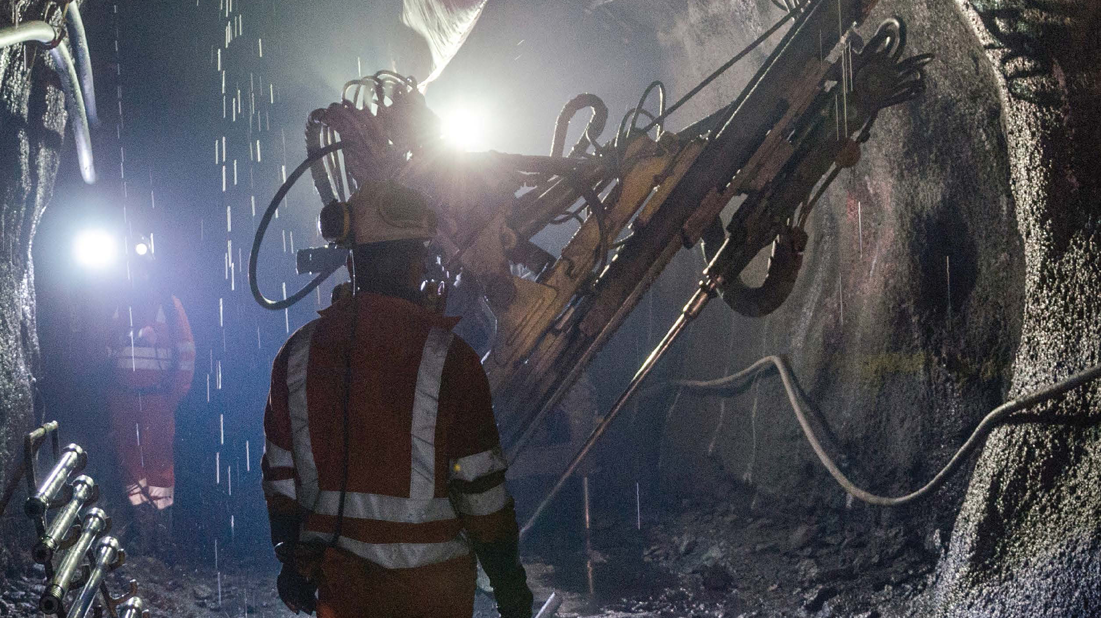
— Miners often work in the presence of gases, heat sources and machinery. That is why we engineer our products for faster service, additional longevity and reliability in hazardous locations.

Slide 19
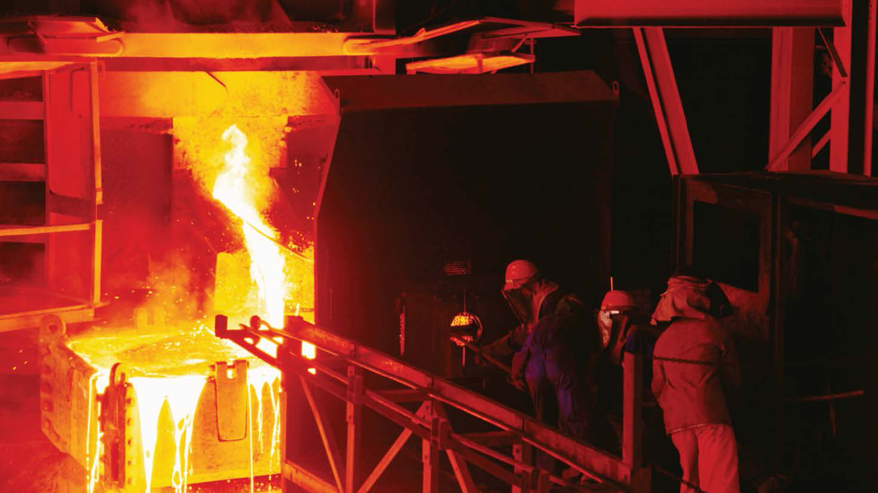
— Power is prone to sags, spikes and surges. But ABB power solutions provide clean, dependable electric power to facilities – and they keep your equipment and data safe.

Slide 20
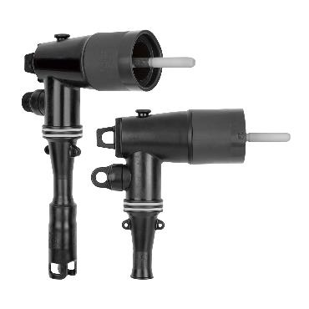
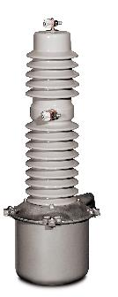
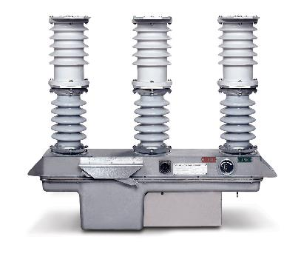
Power quality, efficiency & reliability
Separable connectors and solid-dielectric switchgear
When the reliable connection and intelligent control of electrical power are necessities, the ABB Power Connection and Control range offers a wide selection of products.
From 120V to 230kV, our products are specified worldwide in the industrial, construction and utility markets.
Elastimold® – Cable accessories
A full line of loadbreak and deadbreak separable connectors, cable joints and cable terminations
Developed for 5 to 35kV distribution systems
Fisher Pierce®
Faulted circuit indicators
Homac®
Copper Flood-Seal® compression splice kits
Substation connectors
Joslyn Hi-Voltage®
Capacitor switches & controllers and air break switches
Kopex-Ex™
Explosion-proof conduit and coupling systems
Capacitor switches & controllers and air break switches

Slide 21
Grounding & bonding
Grounding and bonding are achieved in many ways. ABB provides Grounding & Bonding products that can meet exothermic, compression and mechanical requirements.
A ground is a critical part of an electrical system. In some cases, redundant grounds are used to ensure operations are not interrupted.
Blackburn® – High-quality flexible connectors
A wide variety of grounding straps and accessories for grounding applications
Extra-flexible links for heavy-duty applications up to 3600A
Standard flexible links for medium-voltage
Blackburn®
E-Z-Ground® compression, mechanical and exothermic grounding systems
KUBE® power connectors and motor lead disconnects
Compression lugs and splices
Ergonomic compression tools
Color-Keyed® system training
High-quality flexible connectors
EZCODE®
Danger/warning labels and signs, industrial/wire markers, barricade/burial tape
Furse®
Lightning protection
Fisher Pierce®
Faulted circuit indicators
Homac®
Copper Flood-Seal® compression splice kits
Substation connectors
Kopex-Ex™
Explosion-proof conduit and coupling systems
Russellstoll®
GSUL ground indicator system
T&B® Fittings – Grounding fittings
Malleable iron construction with tapered hub threads
Many include Revolver® ground ring
Straight, 45° angle and 90° angle versions available
T&B® Fittings
XD expansion/deflection coupling for rigid conduit
STAR TECK® and STAR TECK XP® fittings for jacketed metal-clad and teck cables

Slide 22
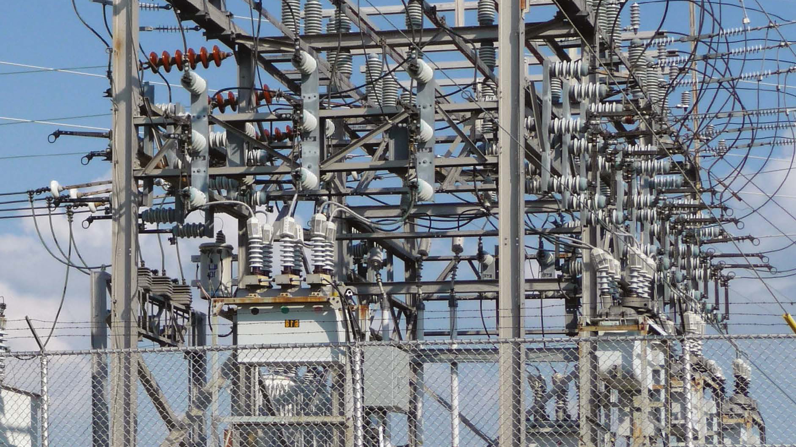
— ABB experience in the utility, construction and industrial markets gives you peace of mind when you need quality, highly available electrical power operating safely at the most efficient cost levels.

Slide 23
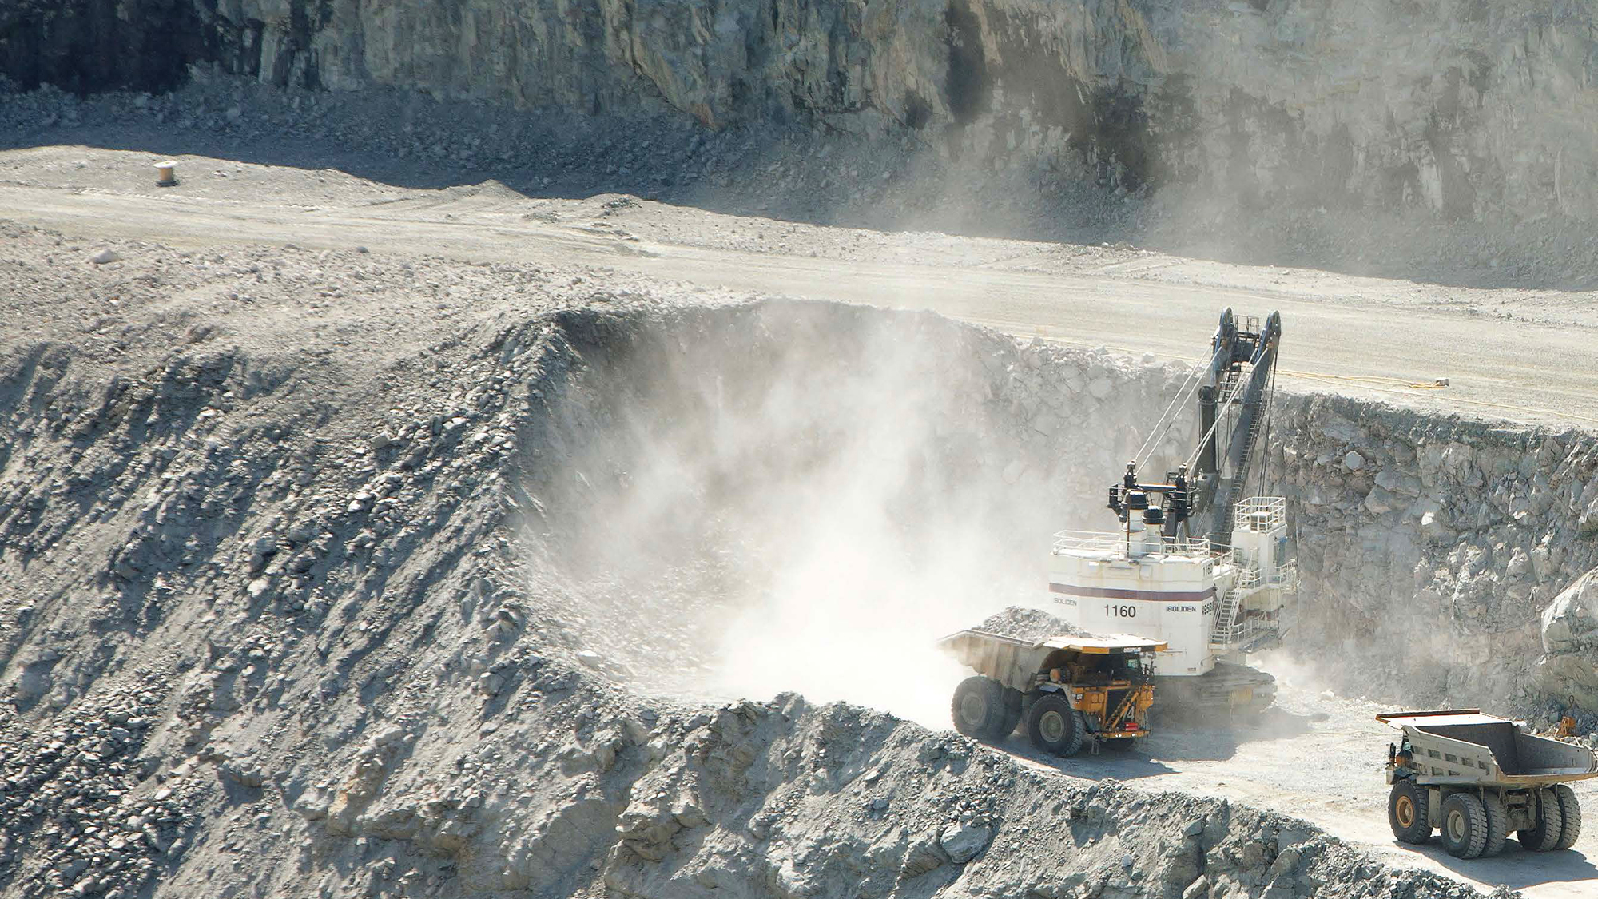
— ABB understands the challenges faced in the metal and mining industry and is committed to providing innovative electrical solutions that not only reduce overall project costs, but also increase safety, promote sustainability and even improve cash flow.

Slide 24
Product selection guide
Metals and mining industry
Product description | Continuous operation & sustainability | Corrosive & harsh environment protection | Liquid ingress protection | Safety | Extreme temperature protection | Hazardous location protection | Power quality, efficiency & reliability | Grounding & bonding
Adaptaflex®
Cable protection systems – Conduit and connectors | • | • | • | • | •
Blackburn®
E-Z-Ground® compression, mechanical and exothermic grounding systems |  |  |  | • |  |  |  | •
KUBE® power connectors and motor lead disconnects | • |  |  |  |  |  |  | •
Compression lugs and splices |  |  |  | • |  |  |  | •
Ergonomic compression tools |  |  |  | • |  |  |  | •
Color-Keyed® system training |  |  |  | • |  |  |  | •
DTS®
Hazardous location lighting, junction boxes and controls | • |  | • | • |  | • |  | •
Elastimold®
High-voltage separable connectors and solid-dielectric switchgear |  |  |  |  |  |  | • | •
EZCODE®
Danger/warning labels and signs, industrial/wire markers, barricade/burial tape |  |  |  | • | • | • |  | •
Fisher Pierce®
Faulted circuit indicators |  |  |  | • |  |  | • | •
Homac®
Copper Flood-Seal® compression splice kits | • | • | • | • |  |  | • | •
Substation connectors | • |  |  |  |  |  | • | •
Joslyn Hi-Voltage®
Capacitor switches and air disconnect switches |  |  |  | • |  |  | •
Kindorf®
Electro-galvanized, aluminum, and 316 stainless steel channel, hangers and clamps | • | •

Slide 25
Product selection guide
Metals and mining industry
Product description | Continuous operation & sustainability | Corrosive & harsh environment protection | Liquid ingress protection | Safety | Extreme temperature protection | Hazardous location protection | Power quality, efficiency & reliability | Grounding & bonding
Kopex-Ex™
Explosion-proof conduit and coupling systems | • | • | • | • | • | • | • | •
Ocal®
PVC-Coated Conduit and Fittings |  | • | •
OCAL-BLUE® NEMA Type 4X Form 8 conduit bodies |  | • | •
Ocal installation certification training |  | • | •
PMA®
Nylon cable protection systems | • | • | • | • | •
Red•Dot®
Code Keeper® weatherproof while-in-use covers | • | • | • | •
Russellstoll®
Pin-and-sleeve connectors and explosion-proof interlocked receptacles |  | • |  |  | •
GSUL ground indicator system |  |  | • |  | • |  | •
Sta-Kon®
Nylon-, vinyl- and non-insulated wire terminals | •
High-temperature wire joints and terminals |  |  |  |  | •
Luminaire disconnects |  |  |  | •
Corrosion-resistant, nickel-plated wire terminals |  | •
Heat-shrink terminals, comfort crimp® tools and disconnect installation tool
Shrink-Kon® wire and connector insulation products |  |  | •
Superstrut®
Electro-galvanized, aluminum, and 316 stainless steel channel, hangers and clamps | •
T&B® Cable Tray
Aluminum, steel, stainless steel and fiberglass support/wire management systems |  | • |  |  |  | •

Slide 26
Product selection guide
Metals and mining industry
Product description | Continuous operation & sustainability | Corrosive & harsh environment protection | Liquid ingress protection | Safety | Extreme temperature protection | Hazardous location protection | Power quality, efficiency & reliability | Grounding & bonding
T&B Fittings®
Type A liquidtight flexible conduit and fittings | • | • | •
ATX high-/Low-temperature liquidtight conduit and fittings | • | • | • |  | •
Form 8 conduit bodies - stainless steel and BlueKote® |  | • | •
XTRA FLEX® non-metallic liquidtight conduit, tubing and BULLET® fittings | • | • | • | •
Hubs - stainless steel and aluminum |  | •
Steel, stainless steel, aluminum and non-metallic liquidtight flexible conduit fittings | • | • | • | •
Steel, stainless steel, aluminum and non-metallic cord connectors | • | • | • | •
Explosion-proof boxes, elbows, fittings and xp explosion-proof flexible couplings |  | • |  |  |  | •
Silver Grip® tray cord fittings | • | • | •
Wire-mesh strain-relief cord and conduit grips | • | • | •
CorroStall® aluminum conduit boxes |  | • | •
XD Expansion/Deflection coupling for rigid conduit | • | • |  |  |  |  |  | •
BlueKote® and stainless steel LU® conduit bodies | • | •
STAR TECK® and STAR TECK XP® fittings for jacketed metal-clad and teck cables | • | • | • |  |  | • |  | •
Ty-Rap®
Coated and uncoated stainless steel cable ties |  | • |  |  | •
Extra-high temperature and flame-retardant UL94V-0 nylon cable ties |  |  |  | • | •
Ty-Rap Tote® cable tie dispensers and ergonomic installation tools |  | • |  | •
Deltec® outdoor fastening system |  | • |  | •

