Slide 1
SACE® Tmax® XT and Emax 2
OCTOber 2021
Ekip™ Touch trip unit power supply options

Slide 2
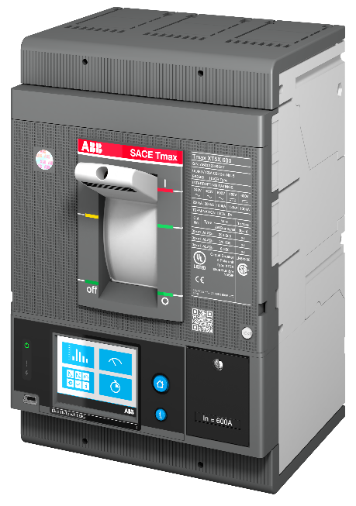
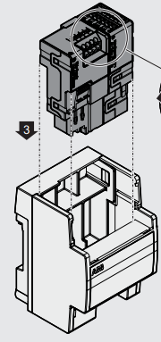
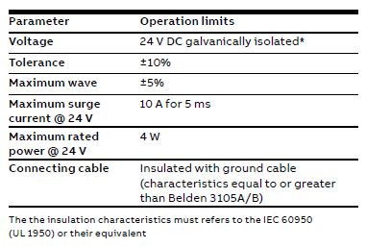
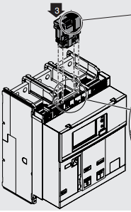
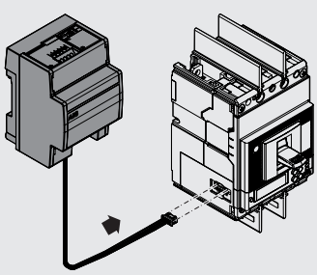
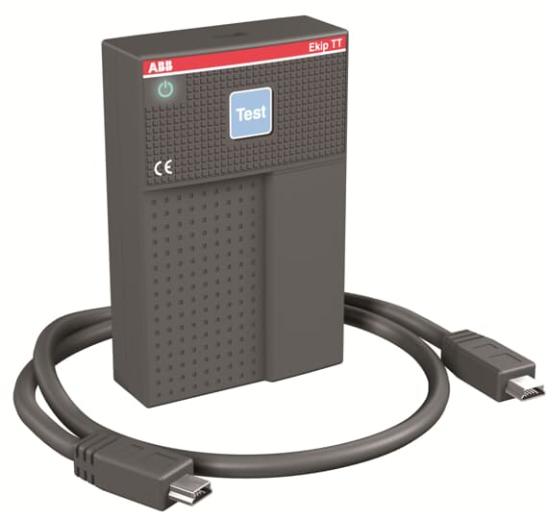
SACE® Tmax XT
Ekip™ Touch trip units – power supply options
Self-supplied
Auxiliary supply
Ekip Supply module
Ekip TT/T&P
Self-supplied through the current sensors with minimum of 0.2 x In*.
*0.3 x In for XT2 and XT4 with In≤100A
Must be galvanically isolated 24V DC auxiliary voltage with the following characteristics:
Two versions available:
24-48V DC
120-240V AC/DC
These devices can be connected to the front test connector of the trip unit:
Ekip TT supplies temporarily power to the trip unit when breaker is off/tripped
Ekip T&P is used for programming trip unit via Ekip Connect 3 software

Slide 3
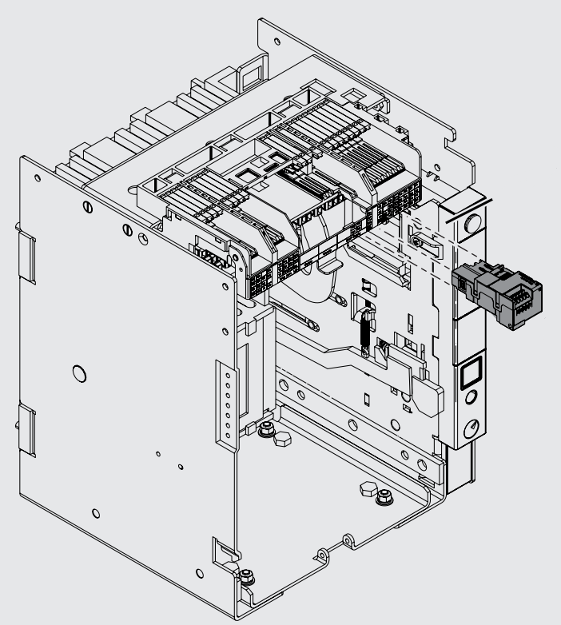
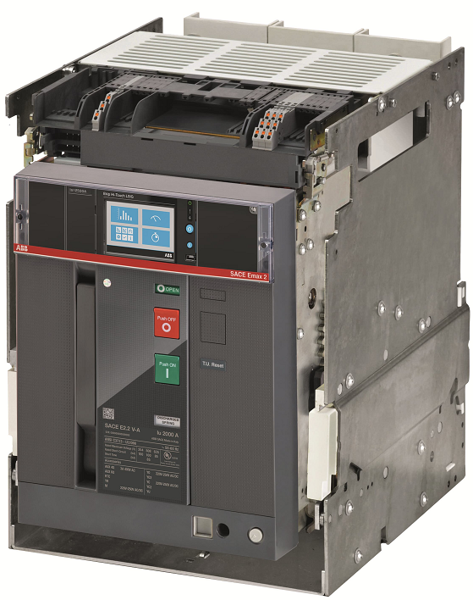
SACE® Emax 2
Ekip™ Touch trip units – power supply options
Self-supplied
Auxiliary supply
Ekip Supply module
Ekip TT/T&P
Power from internal current sensors
E1.2 – E4.2 requires a minimum 3 phase current of 80A to power trip unit
E6.2 requires a minimum 3 phase current of 160A to power trip unit
Direct supply using provided ABB terminal blocks (using K1 and K2)
Typically used when no additional modules are present
Two versions available:
24-48V DC
120-240V AC/DC
These devices can be connected to the front test connector of the trip unit:
Ekip TT supplies temporarily power to the trip unit when breaker is off/tripped
Ekip T&P is used for programming & powering trip unit via Ekip Connect 3 software and laptop

