Slide 1
ABB ESCo System Program Energize Your Business

Slide 2
Give your projects a boost: Energize Your Business
… reach more end-users thanks to the additional customers coming from the ABB customer base?
Energy consultants
… create project opportunities?
… hit the road together to increase the business leveraging a joint value proposition: ABB HW + SW & ESCO/SI Service ?
…benefit from an additional business coming from ABB ?
Energy services companies (ESCOs)
System Integrators

Slide 3
Why should I participate in the program?
—
A complete&effective approach
Countless advantages
A network of professionals
International lead sharing
Having worked with ESCos for many years, ABB has a comprehensive approach to energy efficiency that makes a difference because this program is specific and targeted to the needs and challenges of international ESCos and SIs.
Professional updates and industry-specific information on energy management.
Masterclasses,
webinars, offering previews, and events.
Dashboard and latest insights.
Exclusive access to an international community of professionals.
Get support in a confidential environment with data protection as a priority.
Hit the road together to increase the business by leveraging a joint value proposition.
Reach more end-users thanks to the additional opportunities coming from the ABB customer base.

Slide 4
The ESCo System Program Overview
ABB ESCo System Program is a new engagement program for ABB Electrification energy management offering dedicated to Energy Service Companies (ESCos), Energy Consultants, and System Integrators (SIs). It is based on a partner referral agreement that enables energy management experts to connect each other in one special global club of professional experts.
The light agreement does not require neither strong commitments neither exclusivity, and gives the possibility for energy consultants, ESCOs and SIs to be independent influencer of ABB offering “ABB Ability™ Energy Manager , software solutions and digitally-enabled products.”
The partners have access to an international community of professionals to get support in a confidential environment with data protection as a priority and receive professional updates and industry-specific information on energy management with masterclasses, offering and latest insights.
More Information: ABB ESCo System Program

Slide 5
We understood ESCOs and SIs are a key accelerator for our business
Leveraging existing relationships with key ESCOs and SIs in Europe we understood how we can do biz. together
Prospect coming from
the ESCO/SI
Prospect coming
from ABB
New Prospect
for the ESCO/SI and ABB
The ESCO/SI propose our SW and HW on top to their traditional Biz. Model
ABB proposes the ESCO/SI to its customer base in order to address needs that are not covered by ABB portfolio
ABB and ESCO hit the road together in order to increase their business leveraging a joint value proposition: ABB HW + SW & ESCO/SI Service
WHAT
FOR ESCO/SI
ESCO/SI can benefit from an additional business coming from ABB
(e.g. reselling margin or one-off fee for bringing the customer to ABB)
ESCO/SI can benefit from additional customers coming from the ABB customer base
ESCO/SI can do business with a strong biz partner (ABB heritage and brand to support the ESCO/SI go to market)
ESCO System Program is based on a Mutual Referral Agreement
Notes:
ABB Electrification energy management offering dedicated to Energy Service Companies (ESCos) and System Integrators (Sis).
ABB ESCo System Program is based on a partner referral agreement that enables energy management experts to connect each other in one special global club of professional experts. The light agreement, which does not require neither strong commitments neither exclusivity, gives the possibility for energy consultants, ESCOs and SIs to be independent influencer of ABB offering with the different editions of ABB AbilityTM Energy Managersuch as Matching, the portfolio of software solutions and digitally enabled products.

Slide 6
— Discover the world of ABB and find out how to participate

Slide 7
Become Our partner
ESCos, Energy Consultants and SIs can join it in the dedicated area of ABB Connect Partner Hub by following steps.
Registering own ABB account Compiling and uploading the downloadable agreement
You’ll find dedicated news, technical papers, articles, and webinars on the dashboard!
Join the program here: ABB Connect PartnerHub

Slide 8
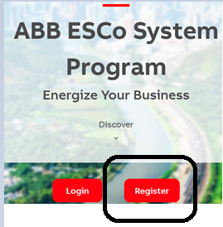
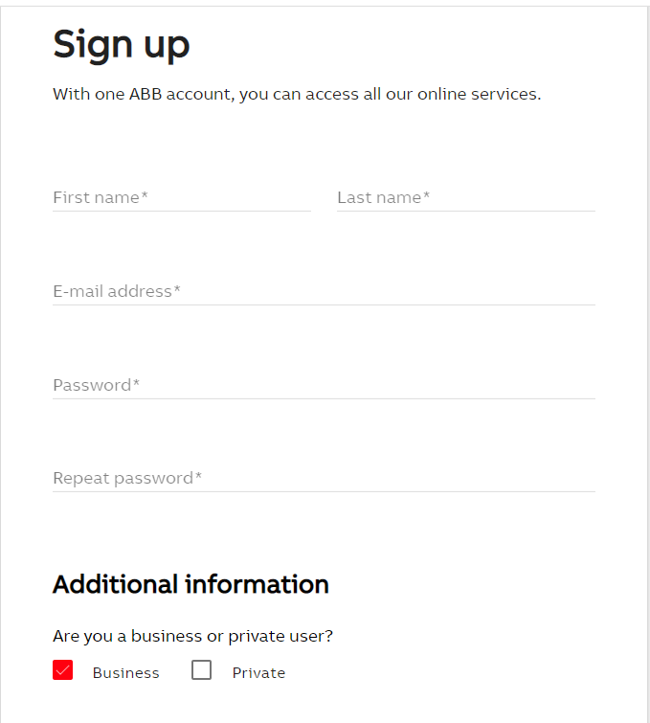
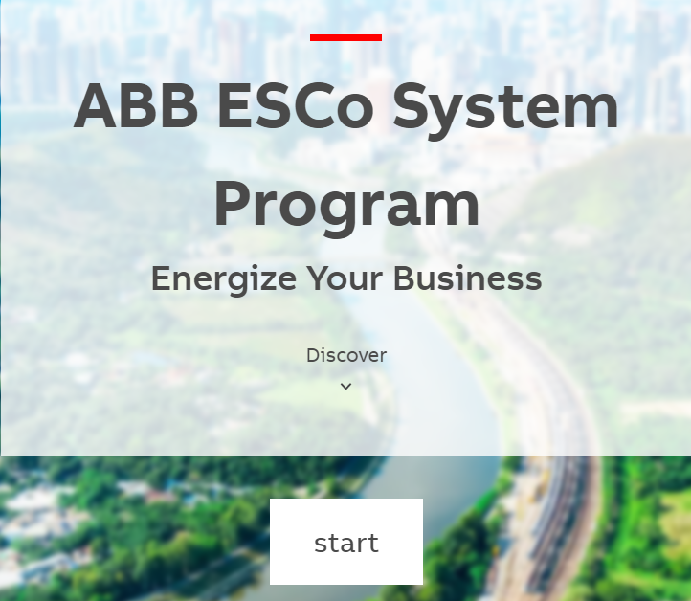
How to register
Once you register your own ABB account, you’ll be able to start and see the agreement.

Slide 9
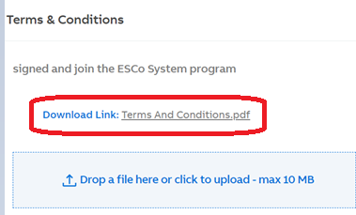
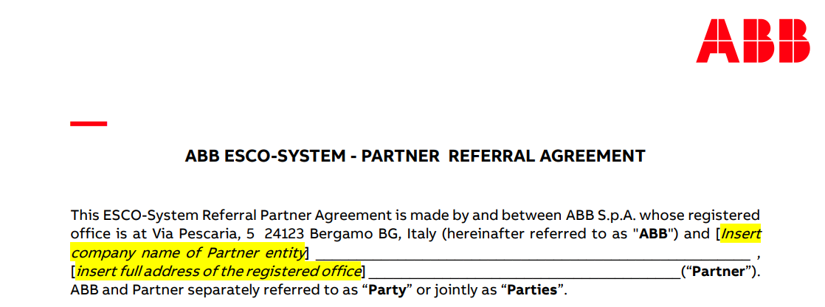
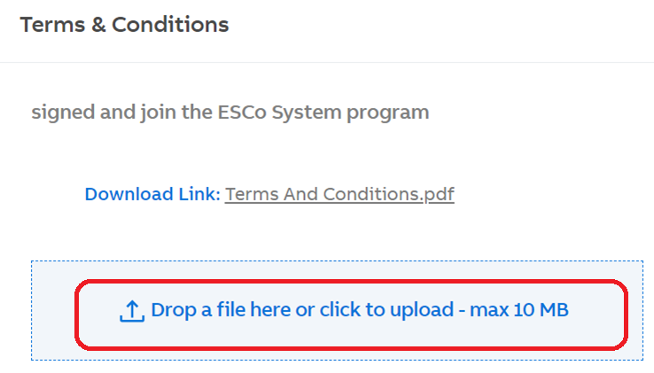
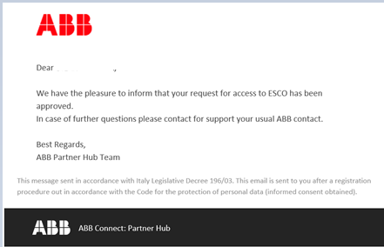
How to register
After you fill yellow (mandatory) fields, and upload your agreement, the team will approve your request and you’ll receive a confirmation email.

Slide 10
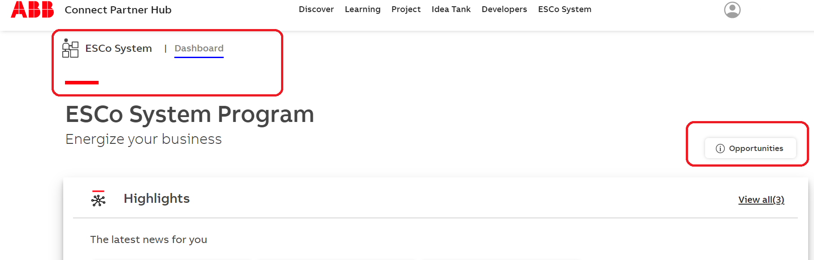
Dashboard
Under dashboard, you have all the material prepared for you!
To receive/share the opportunity, there’s an opportunity tab on the right.
To see this page, the salesforce registration has to be done by ABB global team. It may take up to 14days.

Slide 11
How to Share an Opportunity
Whenever you log in, you’ll see the dashboard: ABB Connect PartnerHub. On the right-hand side at the top of the page, you need to click on opportunities. You’ll see that it’s written: «go to salesforce». Then you’ll redirect to another page .
Click on the “opportunities”tab and then “new opportunity”

Slide 12
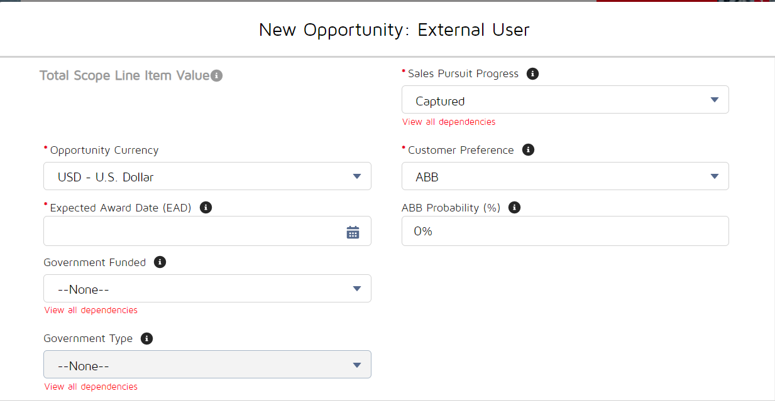
Required Opportunity Basics
Please fill in the mandatory areas. *

Slide 13
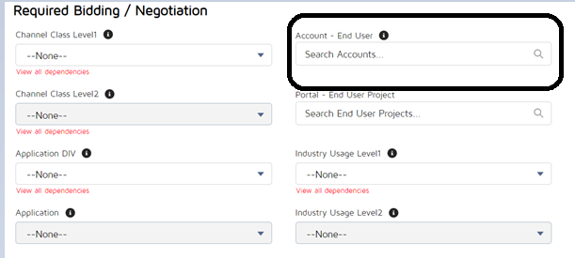
Necessary Information
Please search for the account – end user (the name of the company you want to share with us).
If you couldn’t find the company name, please share the name and address of the company(full address), contact person’s name , surname, email address/phone number from the company. -> in the description field*
Fill in the other information if you have one, otherwise please share all the details at the end of the page “description” section and save it.
After saving the opportunity, ABB global team will be able to see it.(The other companies cannot see it.)

Slide 14
Contact
Resources
ABB Connect Partner Hub
ESCo System Program web page
ABB Ability Energy Manager brochure
ABB Ability Energy Manager web page
Dilara Sengul
Digital Front End Specialist
dilara.sengul@it.abb.com
+39 3665769287
Laura Moscatelli
Global Communications Specialist
laura.moscatelli@it.abb.com
+39 3385366607

