Slide 1
Emax 2 All-in-one innovation
Ekip Power Controller

Slide 2
Agenda
Introduction
Cost saving on electricity billing
Type of loads managed
Application examples
Industry
Hotel
Building
Algorithm
Description of operation
Settings

Slide 3
Introduction
SACE Emax 2 with Ekip Power Controller is the ideal solution for load management and provides the optimum balance between reliability, simplicity and cost-effectiveness
Its features and advantages include:
Integration in the trip unit for simplicity of use and quick commissioning
Patented calculation algorithm to avoid penalties and reduce overall power consumption
One circuit-breaker controls up to 15 loads to eliminate the need for additional systems and software
Non-controllable generator
Non-controllable load
Controllable generator
Controllable load
Control circuit
Emax 2 with Power Controller
Transformer
Energy Meter
Notes:
The target of the Ekip Power Controller is to regulate the use of electric energy and remain below contractual power limits through coordinated load operations.
Neither complex control systems nor the implementation of dedicated software programs are necessary.
The algorithm, which provides precise monitoring and control of average power without instantaneous based shut downs, is based on a foreseen average power absorption which can be set by the User over a determined time interval; whenever this value exceeds the contract power, Ekip Power Controller function intervenes to bring it back within the limits.
To realize the system, it is enough that, in the installation, there is a single circuit-breaker provided with this function, installed as main circuit-breaker on the LV plant of the user: it is this circuit-breaker that decides, according to the set parameters and to the total energy absorbed by the network, when and which load must be disconnected.
The circuit breaker equipped with the function Ekip Power Controller shall not only command the switching devices of the passive loads, but, if necessary, it shall also be able to command the reserve generator device too.
- Economical advantages: energetic optimization of consumption, focused on the control of the costs linked, in particular, to the penalties that are due when the contractual power is exceeded or when the contractual power is increased by the Distribution System Operator (DSO) as a consequence of exceeding the limit repeatedly
- Technical advantages: possibility of power absorption over the contractual limits for short periods and, on the other side, the management and the control of the power consumption which lasts for a long time. Thus it is possible to reduce the likelihood of malfunctioning due to overloads which could involve, in the worst cases, the inefficiency of the whole plant because of tripping of the LV main circuit-breaker.

Slide 4
Introduction
Cost saving on electricity billing
The tariff structure generally includes
Maximum Demand Charges
Charges related to the maximum power demand registered during a billing period and its corresponding rate of utility
This is NOT instantaneous based, but based on averages and will typically be set at the highest demand value recorded over the month
Energy Charges
Charges related to the energy consumed during the billing period and their corresponding rates
Ekip Power Controller allows savings on Maximum Demand Charges
Ekip Power Controller is a powerful means of efficiency improvement for both Users and Utilities
Notes:
The tariff structure generally includes mainly the following components:
Maximum Demand Charges - These charges relate to maximum power demand (kW) registered during month/billing period and corresponding rate of utility.
Energy Charges - These charges relate to energy (kWh) consumed during month / billing period and corresponding rates. Some utilities now charge on the basis of apparent energy (kVAh), the vector sum of active (kWh) and reactive (kvarh) energy.
It is important to note that the Maximum Demand Charge recorded is not the instantaneous demand drawn, but the average value of power obtained by the ratio between the energy absorbed during the predefined time interval and the time interval itself.
The smart meter registers only if the value exceeds the previous maximum demand value and thus, also when average maximum demand is low, the User has to pay the maximum demand charges for the highest value registered during the month, even if it has occurred for just one recording cycle duration (e.g. 30 minutes).
The Utilities can use power tariff structure to influence end Users through measures like time of use tariffs, penalties on exceeding allowed maximum demand or contract demand, night tariffs and concessions. Besides, as already mentioned, since the demand charges constitute a portion of the electricity bill, from the User’s side too there is a need for integrated load management to effectively control the maximum demand in the billing cycle.

Slide 5
Introduction
Type of loads managed
Ekip Power Controller works by managing the loads to limit average power use.
The types of loads that can be managed include:
Thermal and refrigerating loads
Lighting apparatus
Delayed start loads
Charging systems for electric vehicles
Generators
Notes:
thermal and refrigerating loads – such loads can usually work in a certain temperature range and can tolerate some deviations from the optimum value. This makes it possible to reduce or increase the energy consumption whenever necessary, with limited impact on the performances. Another characteristic of this type of loads is their storing capacity, which grants a further flexibility when the working cycle varies, without altering the process. Examples of thermal electric users are furnaces and ovens (induction, resistance, arc type, etc.), water heaters, stoves, refrigerators, freezers and air conditioners
lighting apparatus – it is possible to reduce the light flow of a group of lamps and maintain at the same time the minimum lighting defined in the design phase (e.g. groups of lamps for outdoor environments or garages)
delayed start loads – in some installations the starting up of the motors connected to pumps for particular fluids can be deferred in the short time (e.g. storage air compressors for production cycles or swimming pool circulation pumps)
charging systems for electric vehicles – recharging of electric vehicles can be managed by modulating the power absorbed by the batteries over short periods
- generators – diesel/electrical generators or generators connected to renewable sources can be inserted in the event of a particular energy demand; such generators can be considered from the point of view of Ekip Power Controller as loads with negative power.

Slide 6
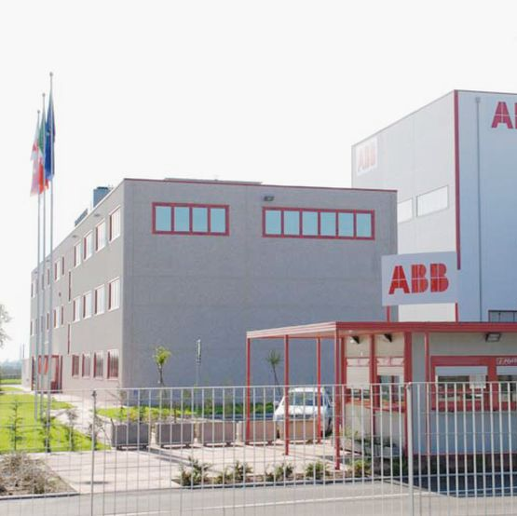
Application examples
Industry
Hotel
Building

Slide 7
Industry
Manufacturing industry
Maximum power absorption 1200kW
GEN SET
3~
Average power absorption with
Ekip Power Controller 1000kW
Line 1
Offices
Line 2
Warehouse
Power factor Correction
-17% Power absorption
Asynch- ronous motor
Asynch- ronous motor
Asynch- ronous motor
Lighting
Sockets
Lighting
[HMC]
M
3~
M
3~
M
3~
Notes:
The maximum total power absorption of about 1200 kW has been detected. Therefore, in order to reduce the maximum contractual power greed upon with the DSO, through Ekip Power Controller function the aim is to decrease the maximum power absorption at 1000 kW. Then, it is the task of Ekip Power Controller function of SACE Emax 2 to disconnect/reconnect the defined loads (inside the orange circles) in order not to exceed the contractual power.
The manufacturing industry has 2 production lines: one of them can be managed by Ekip Power Controller by means of contactors open/closed, which are installed on the power circuit of the corresponding asynchronous motors. To supply additional power, the Gen Set can be started-up and managed.
A power factor correction plant is installed to keep the monthly average power factor equal to or higher than 0.9.

Slide 8
Industry
Controlled loads
Priority | Load | Power | Nominal current | Controlled device
1 | Air compressor | 30kW | 55A | A63
2 | Crusher | 160kW | 280A | A300
3 | Conveyor belt | 160kW | 280A | A300
4 | Gen Set | 700kVA | 1010A | E1.2 1250 Ekip G LSIG
Notes:
The selected loads could be disconnected for some minutes and therefore managed by Ekip Power Controller according to the priority list defined by the User

Slide 9
Industry
Wired connections, 4 controlled loads
In the same switchboard, it’s convenient to use Ekip Signalling 2K-4K modules
1 digital input for clock tick synchronization with the smart meter of the DSO (optional)
Energy meter clock
110-240 Vac
Ekip Signaling 2K
Ekip Signaling 2K
Ekip Supply
Ekip Signaling 4k
Emax 2.2
Ekip power controller
A63
A300
A300
Emax 1.2 Ekip G LSIG
Ekip
Notes:
With SACE Emax 2.2, 4.2 or 6.2 it is possible to command up to 5 switching devices through Ekip Signalling 2K-4K modules
With SACE Emax 1.2 it is possible to command 2 switching devices through Ekip Signalling 2K modules

Slide 10
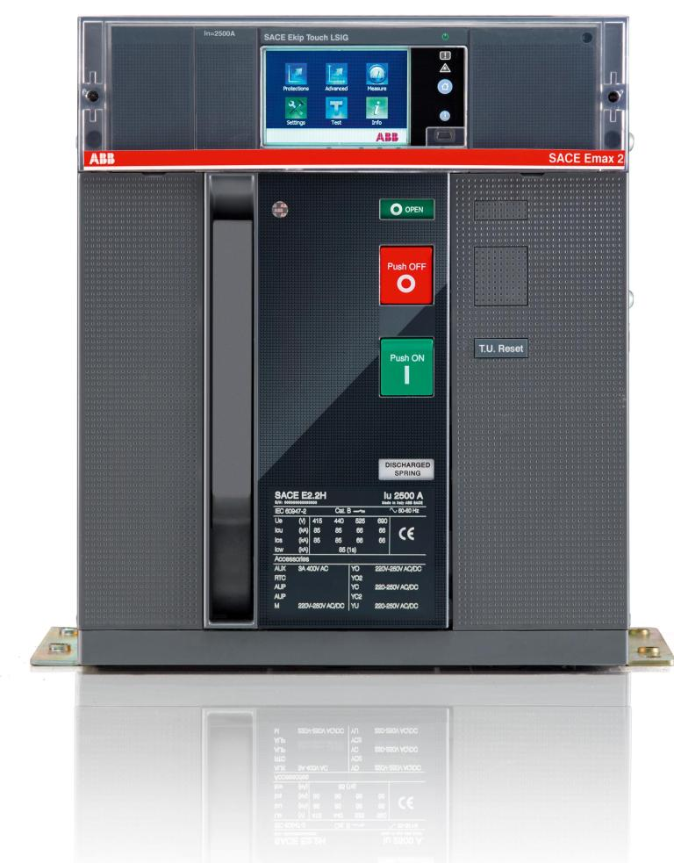
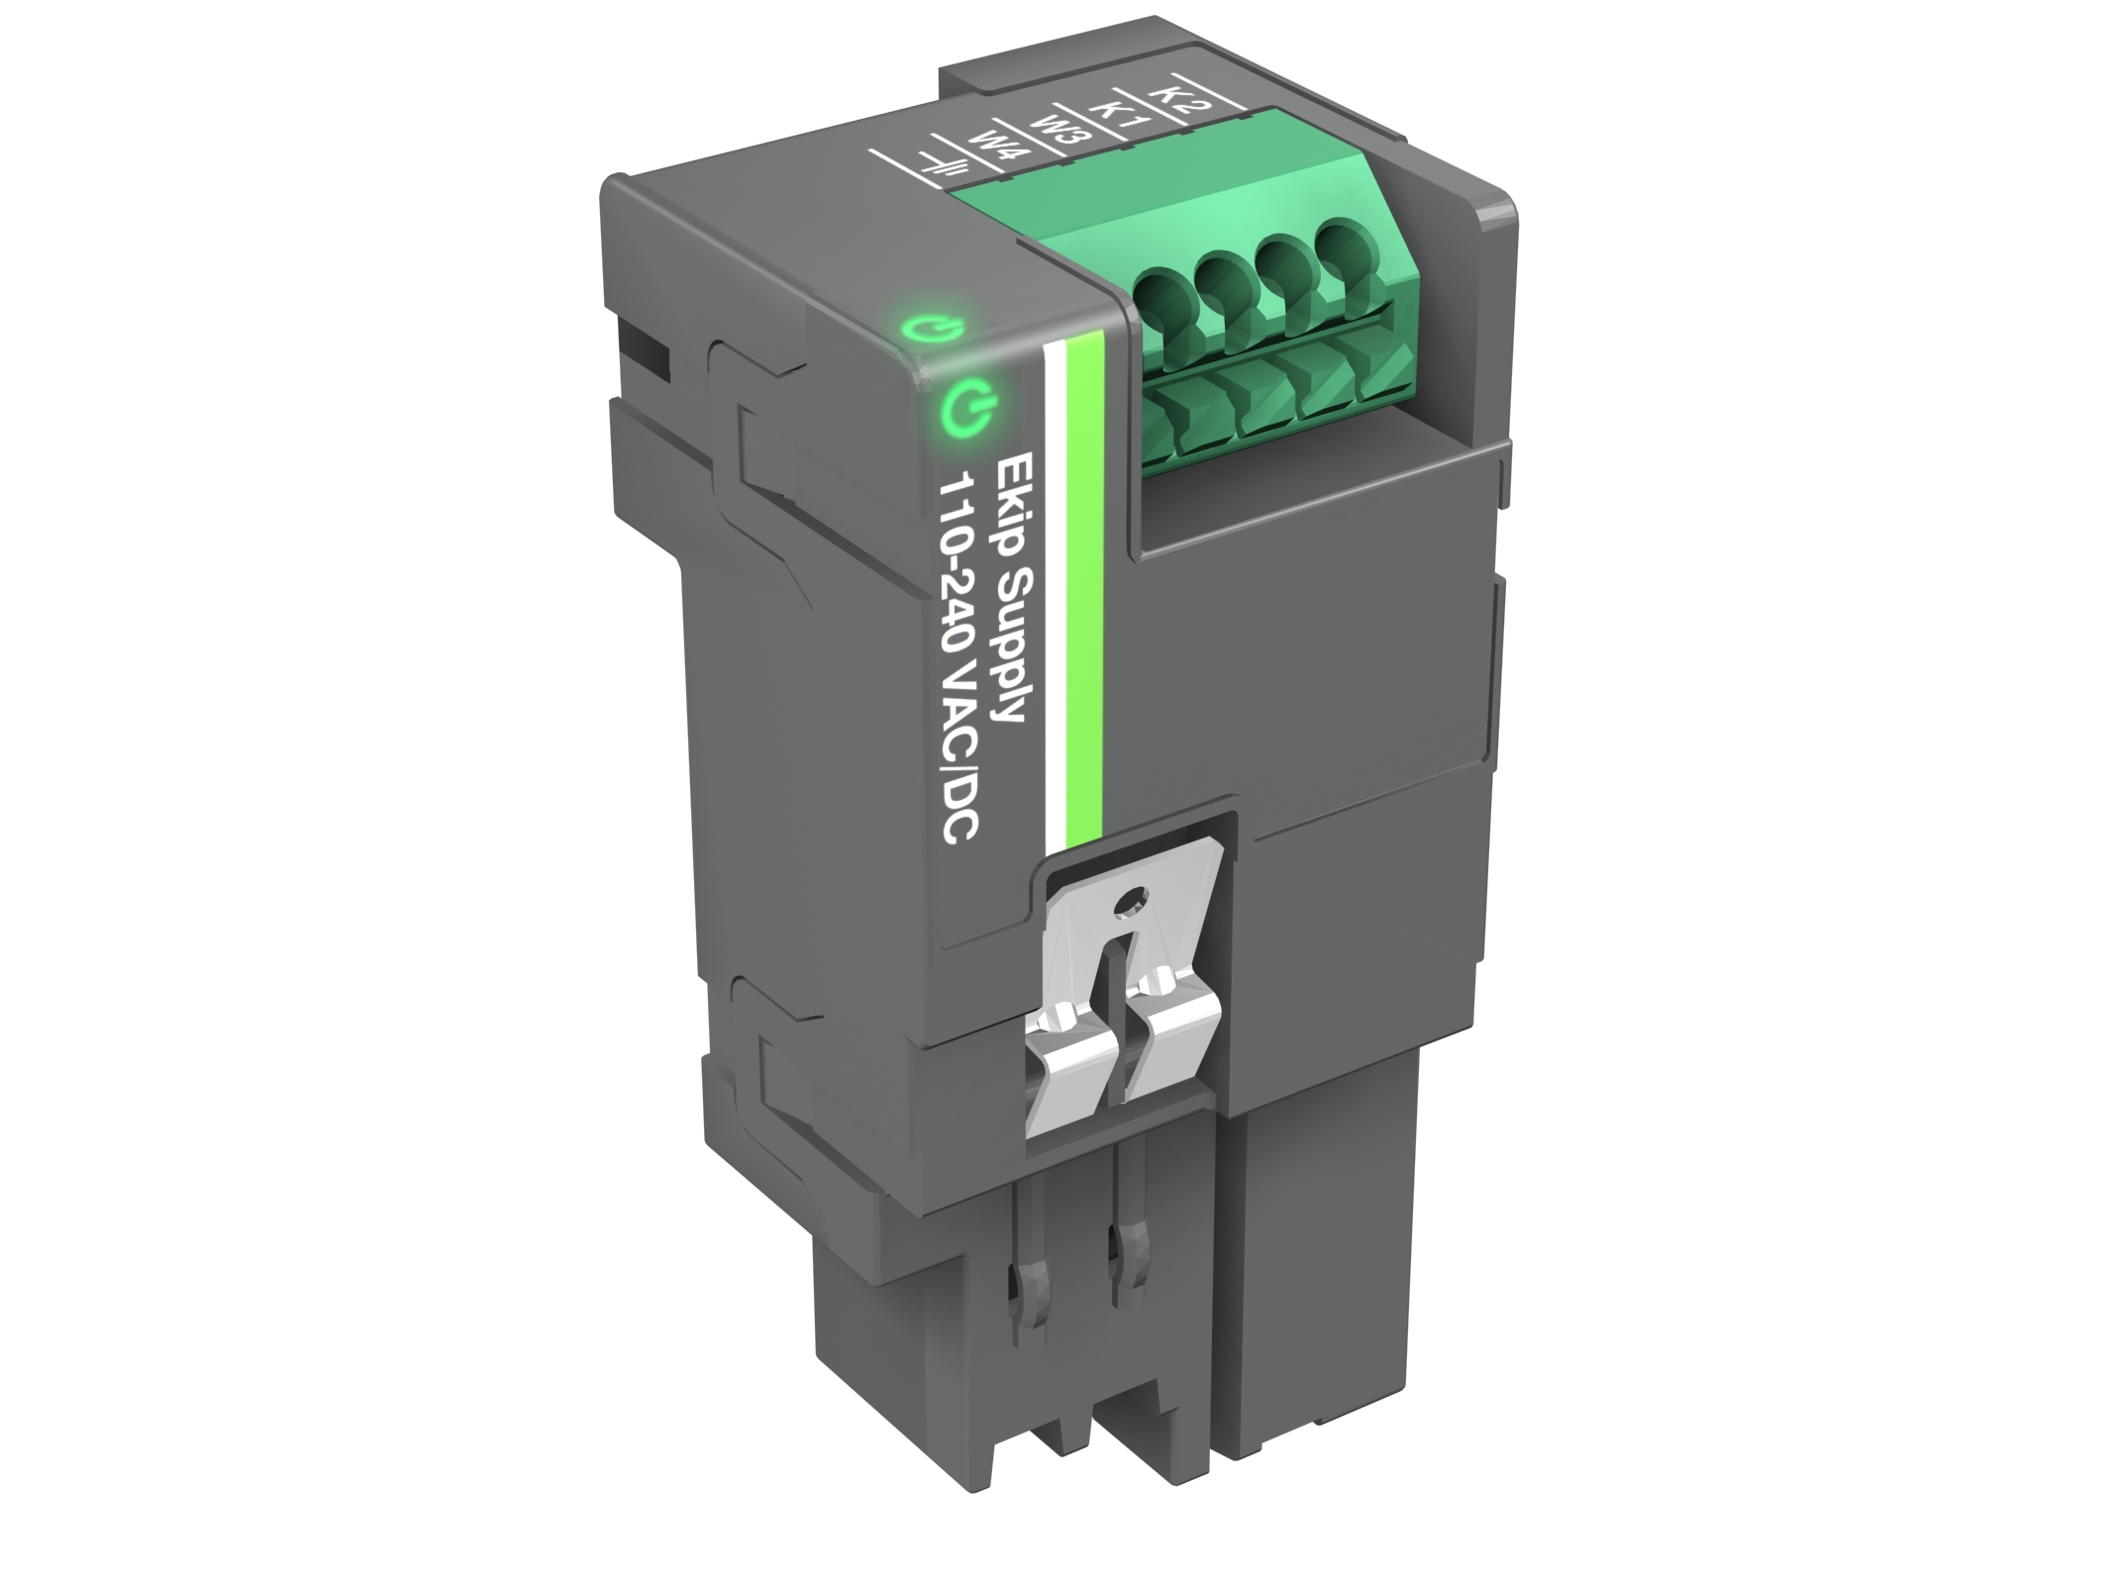
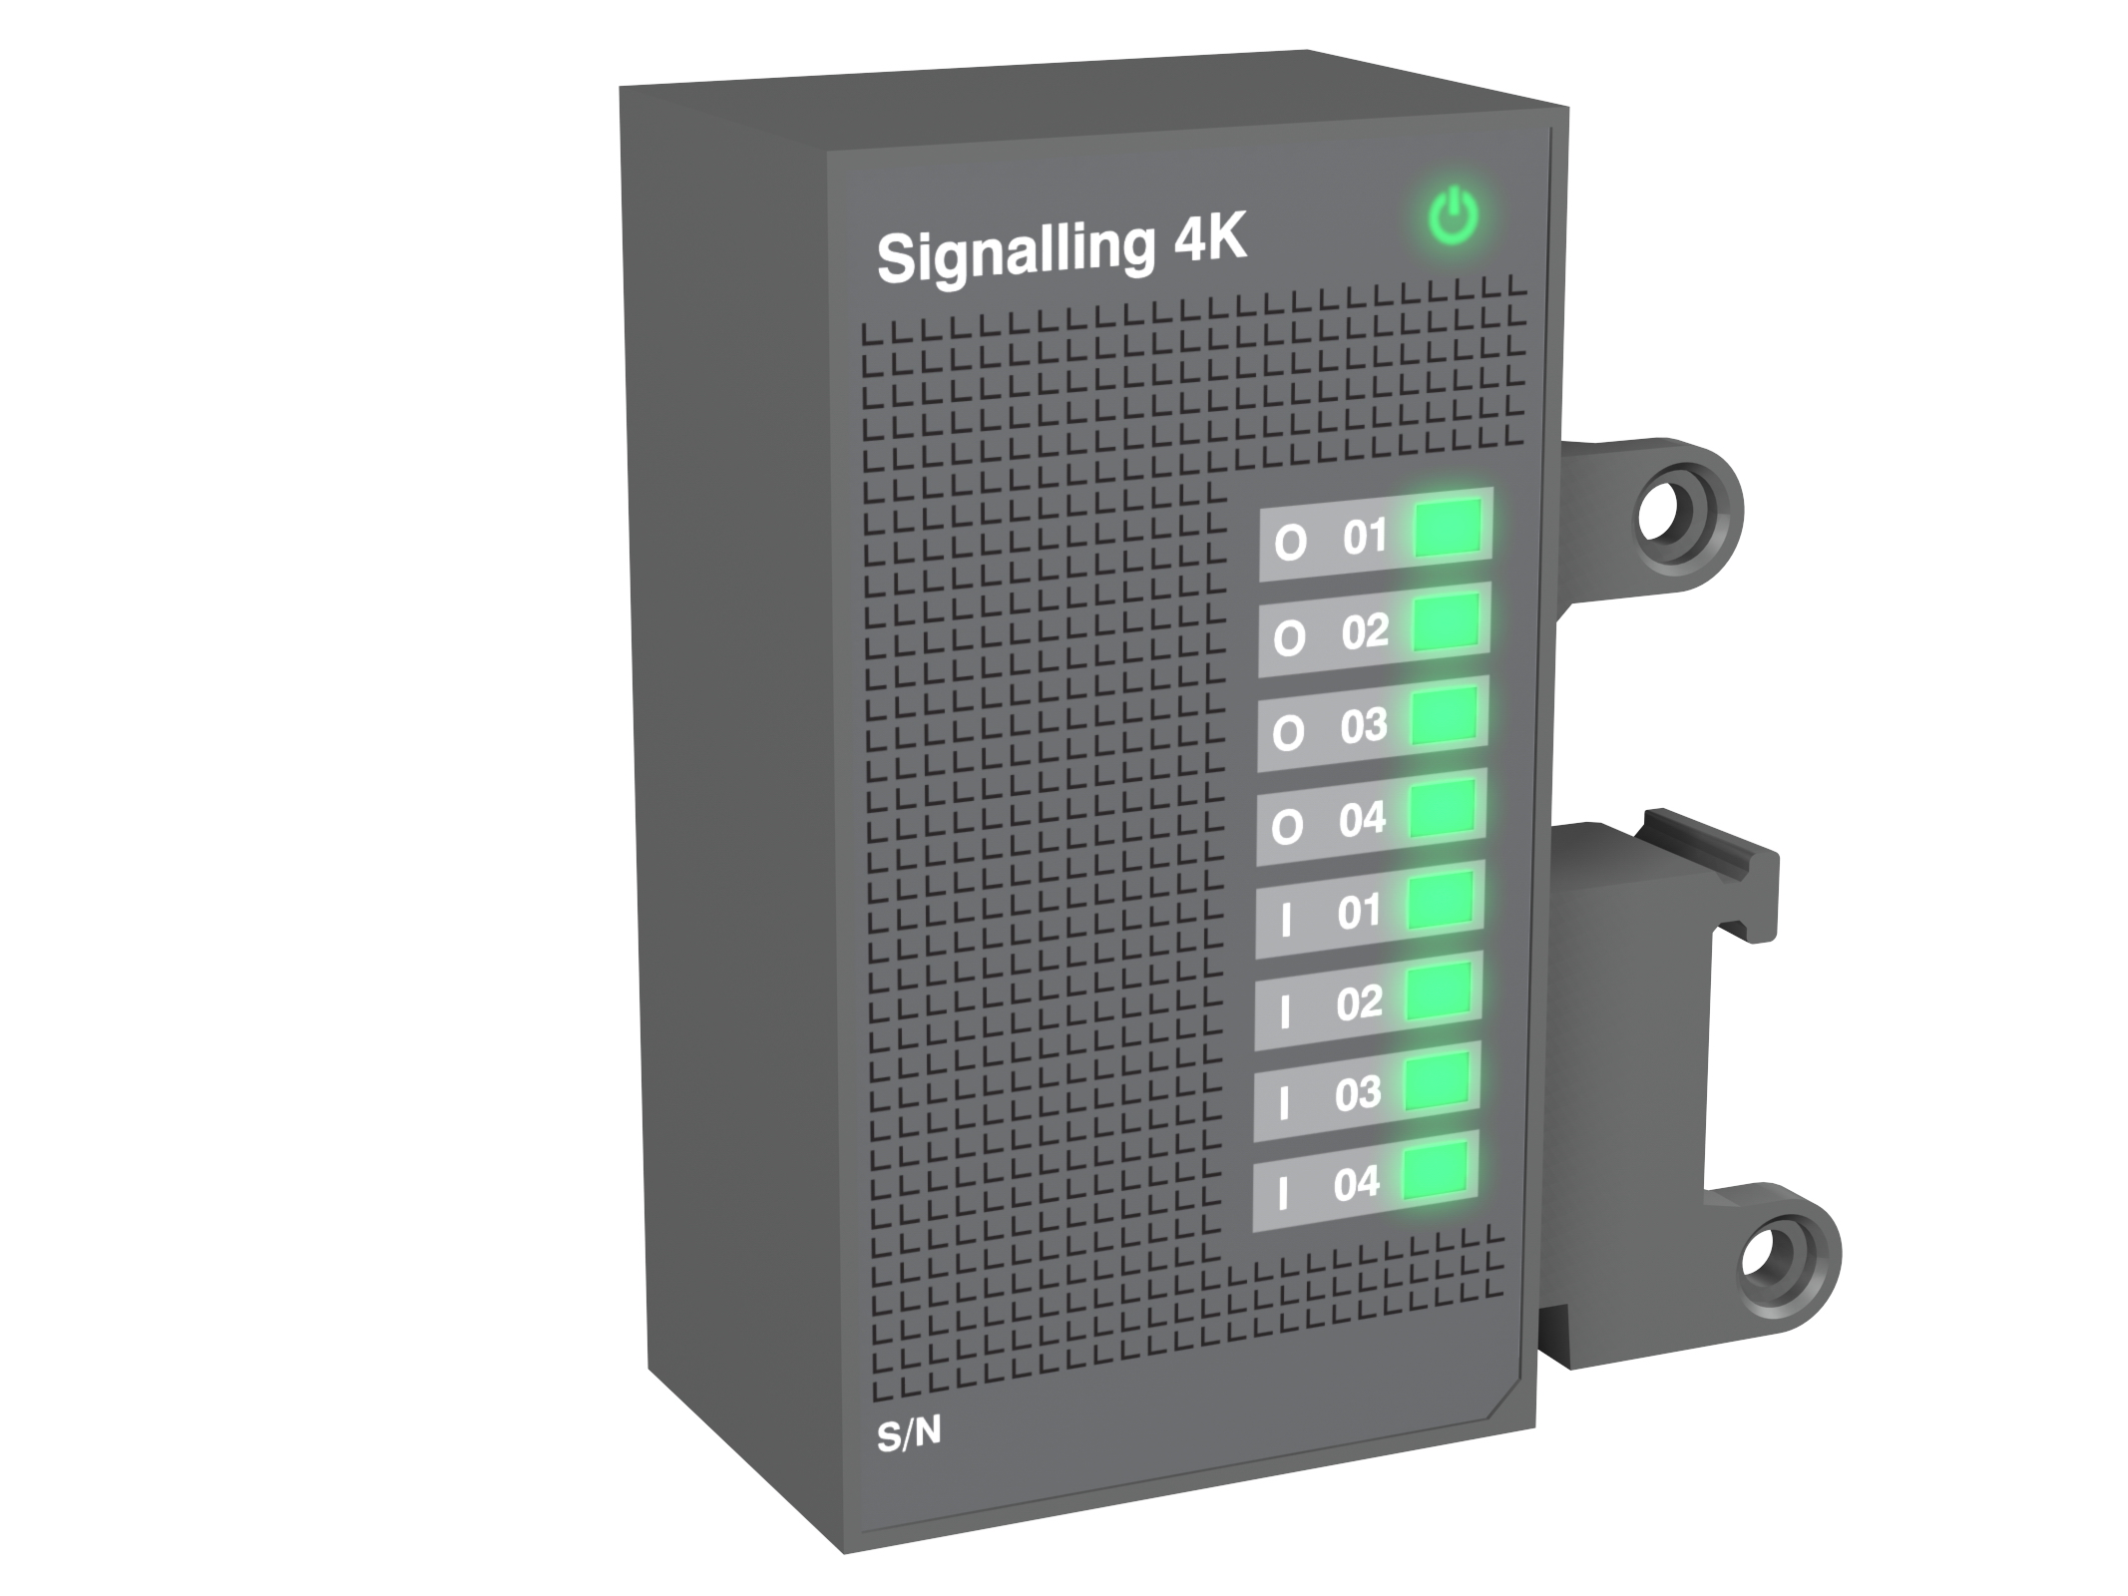
Industry
Shopping list
The main SACE Emax E2.2 equipped with:
Ekip Touch LSIG + Measuring Pro
Ekip Power Controller function
Ekip Supply module
2 x Ekip Signalling 2K modules
Ekip Signalling 4K module
2x
+
+
+
+
+

Slide 11
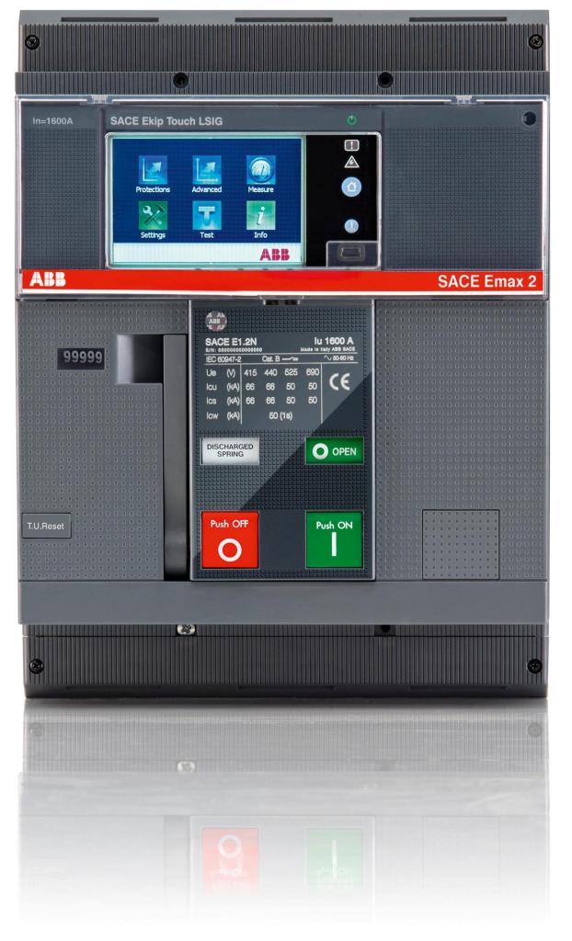
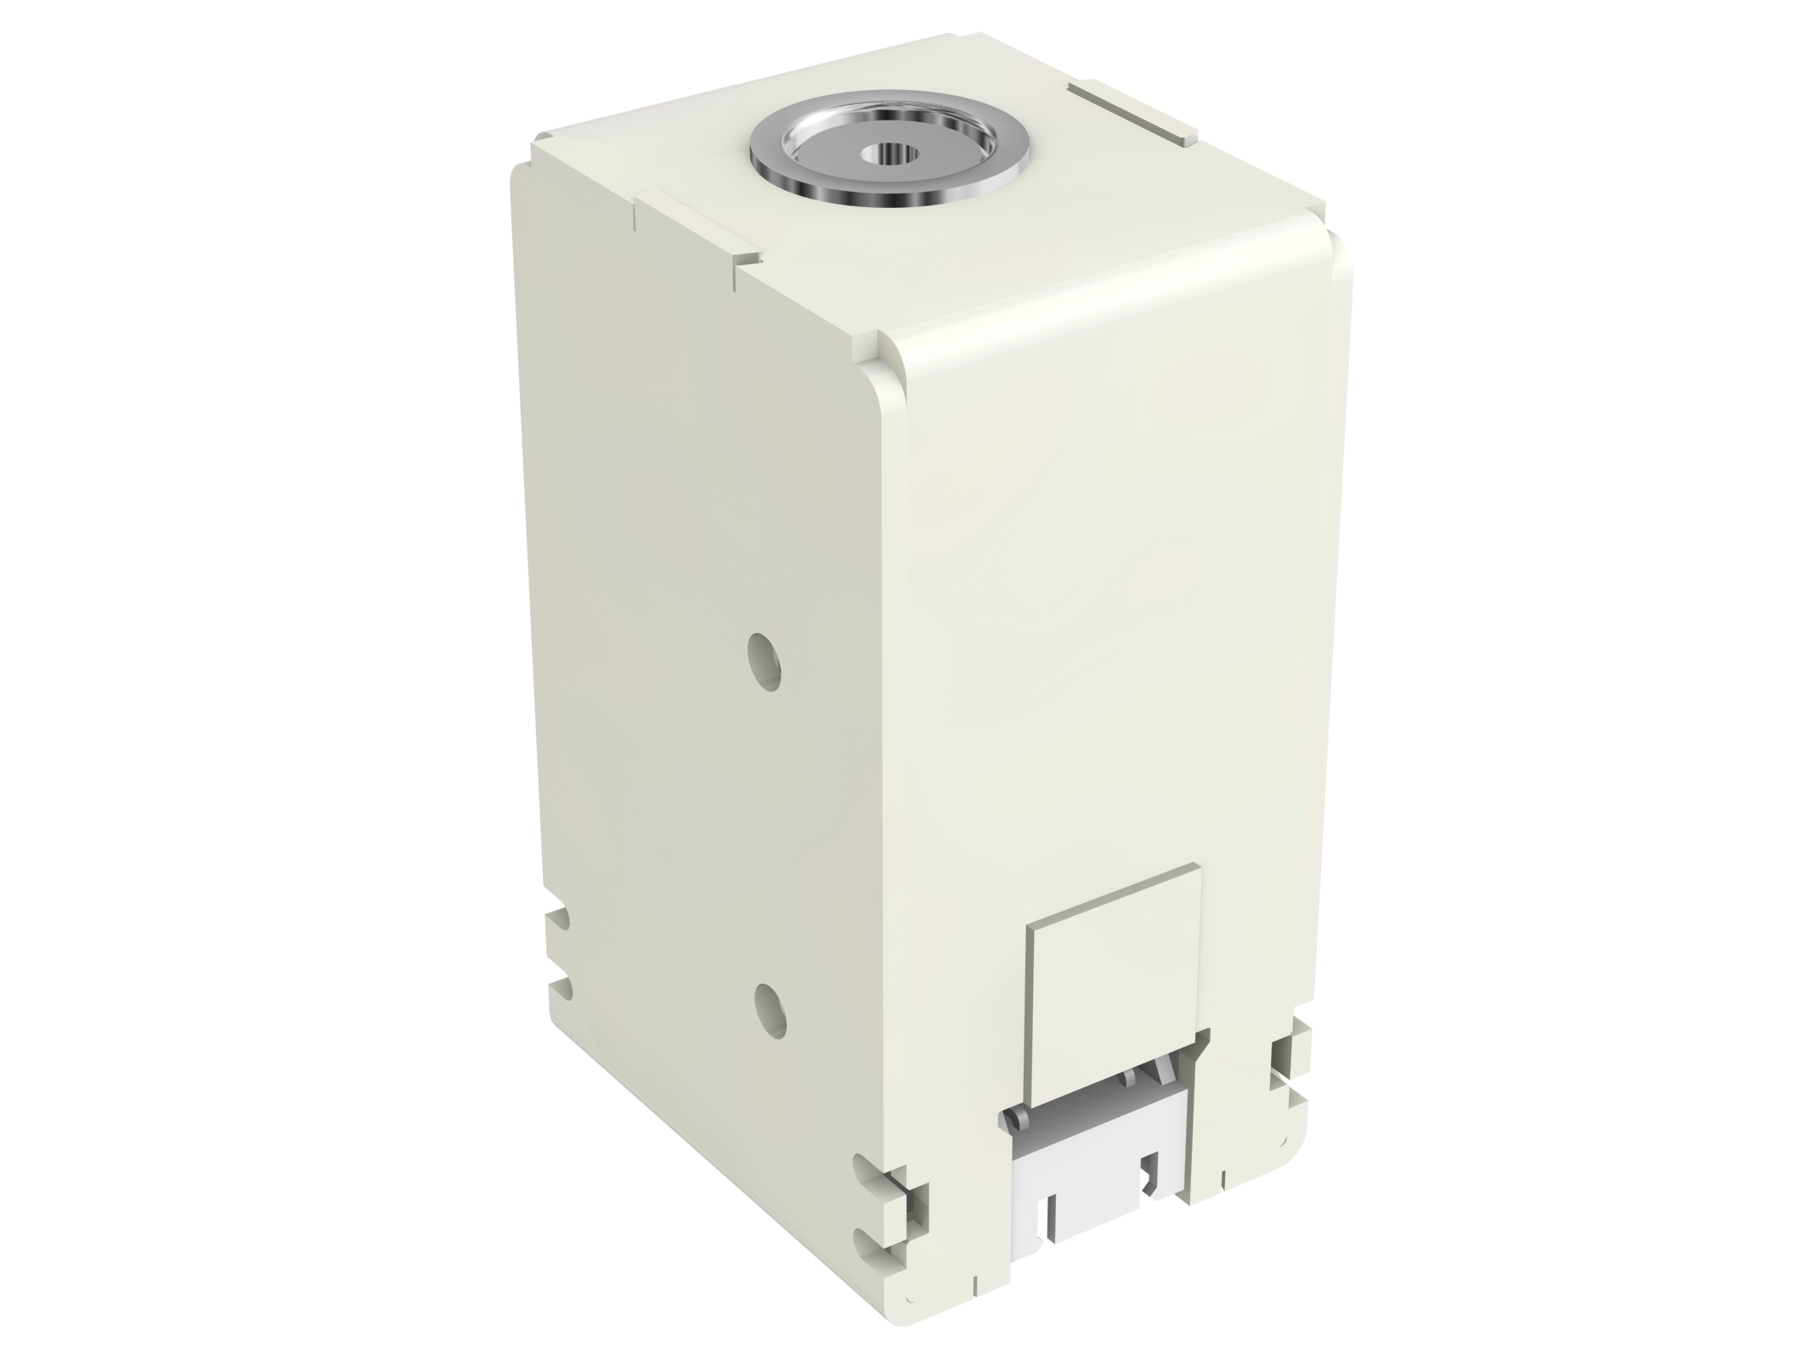
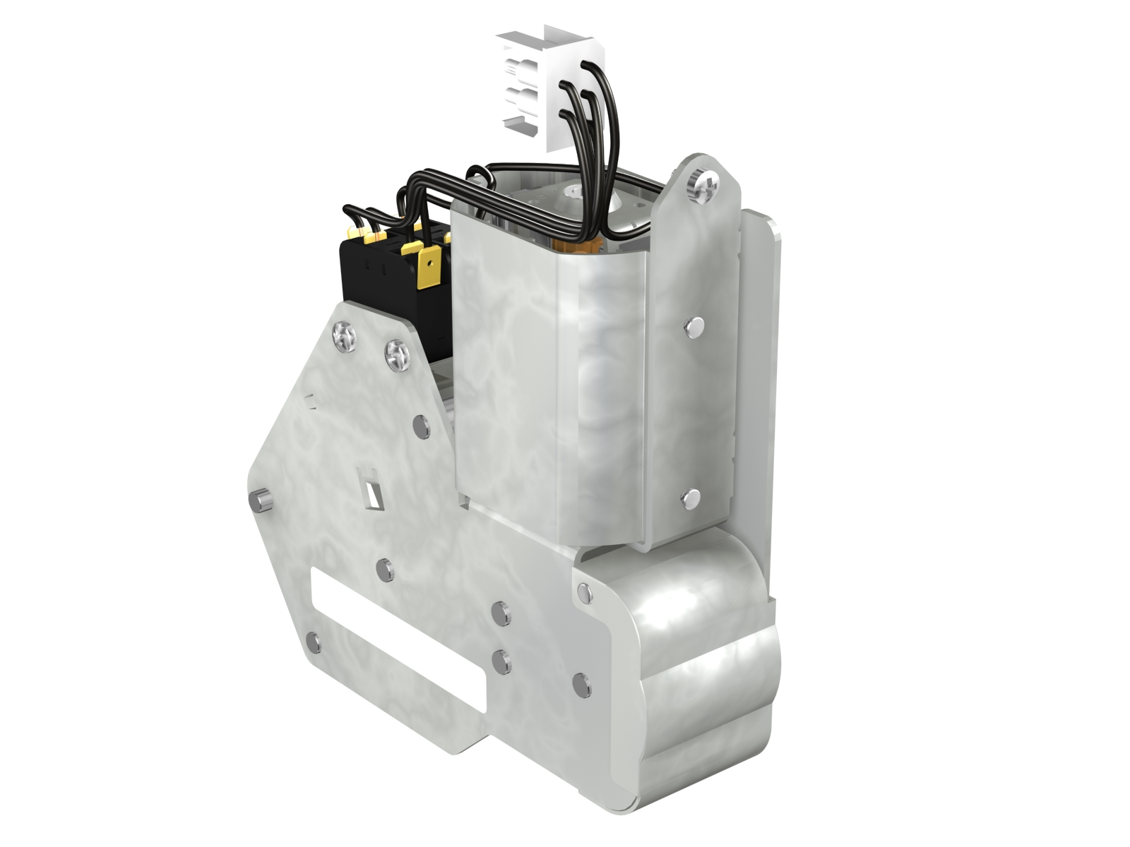
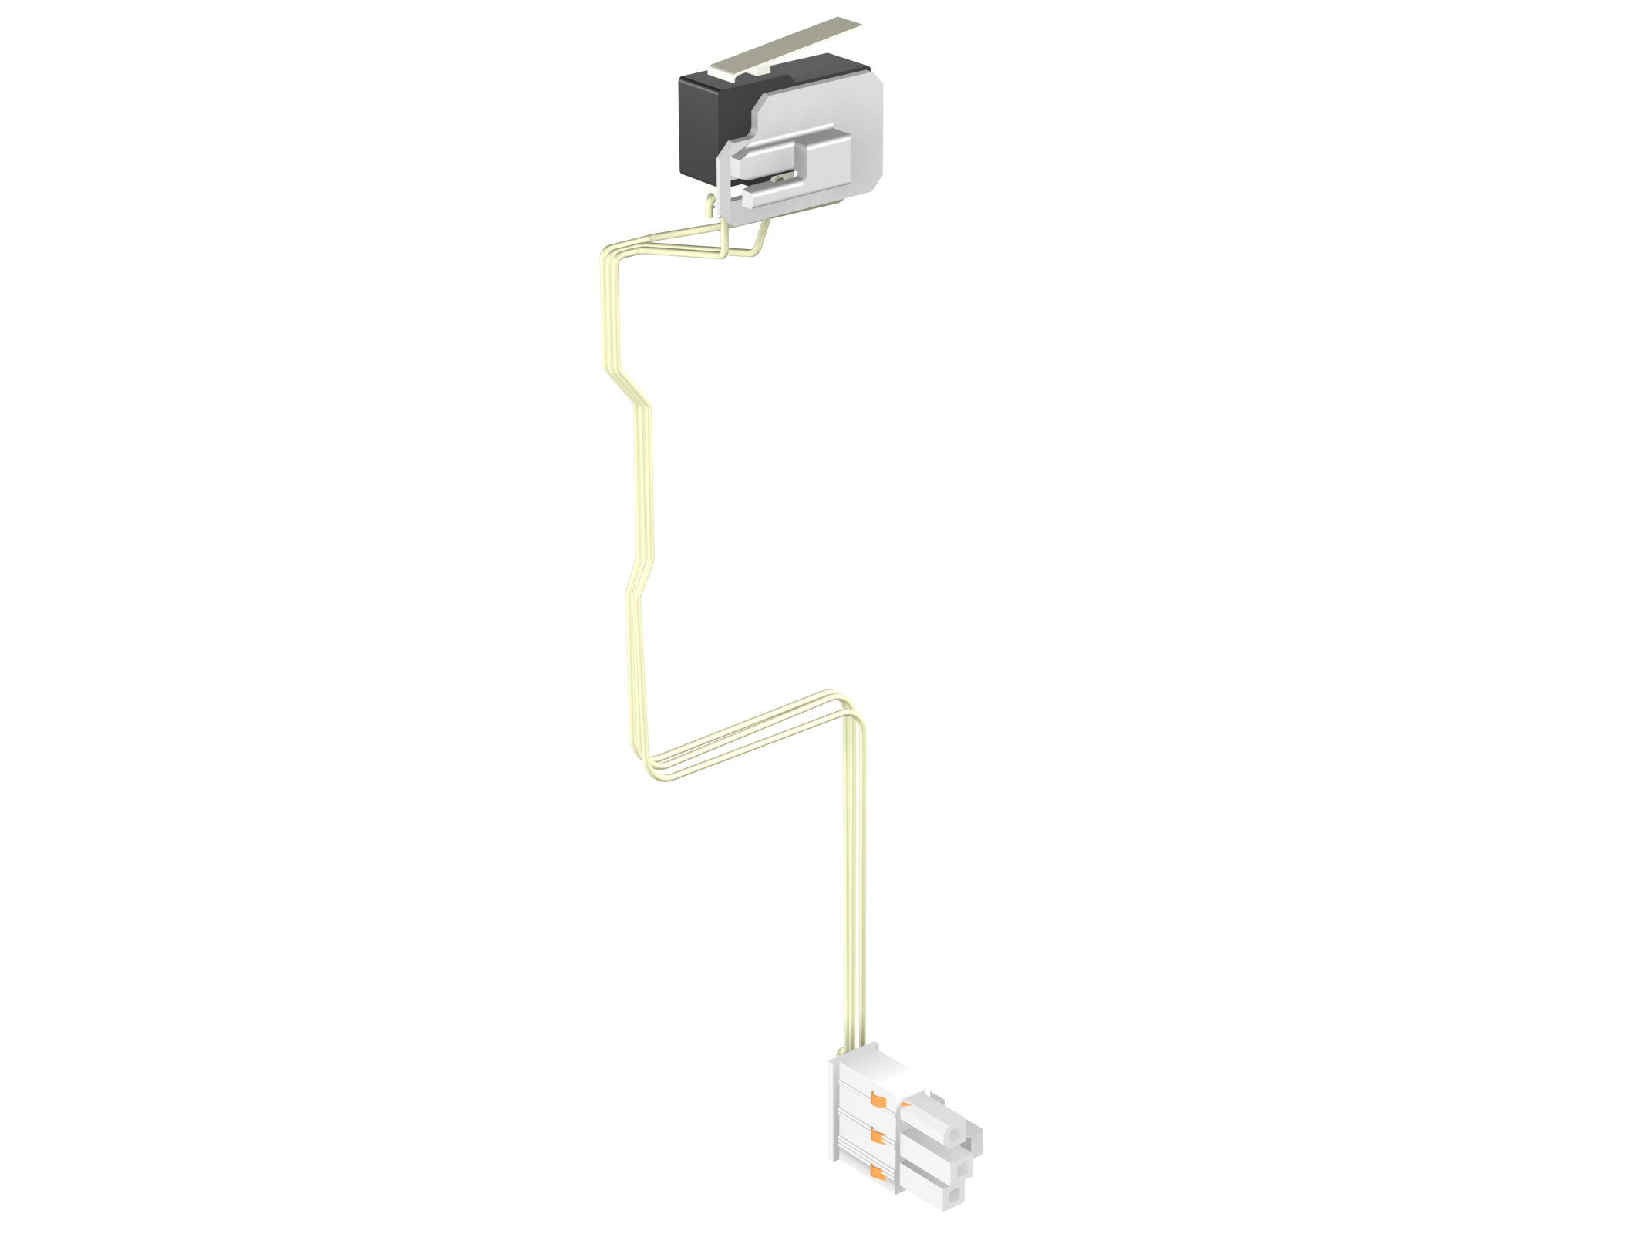
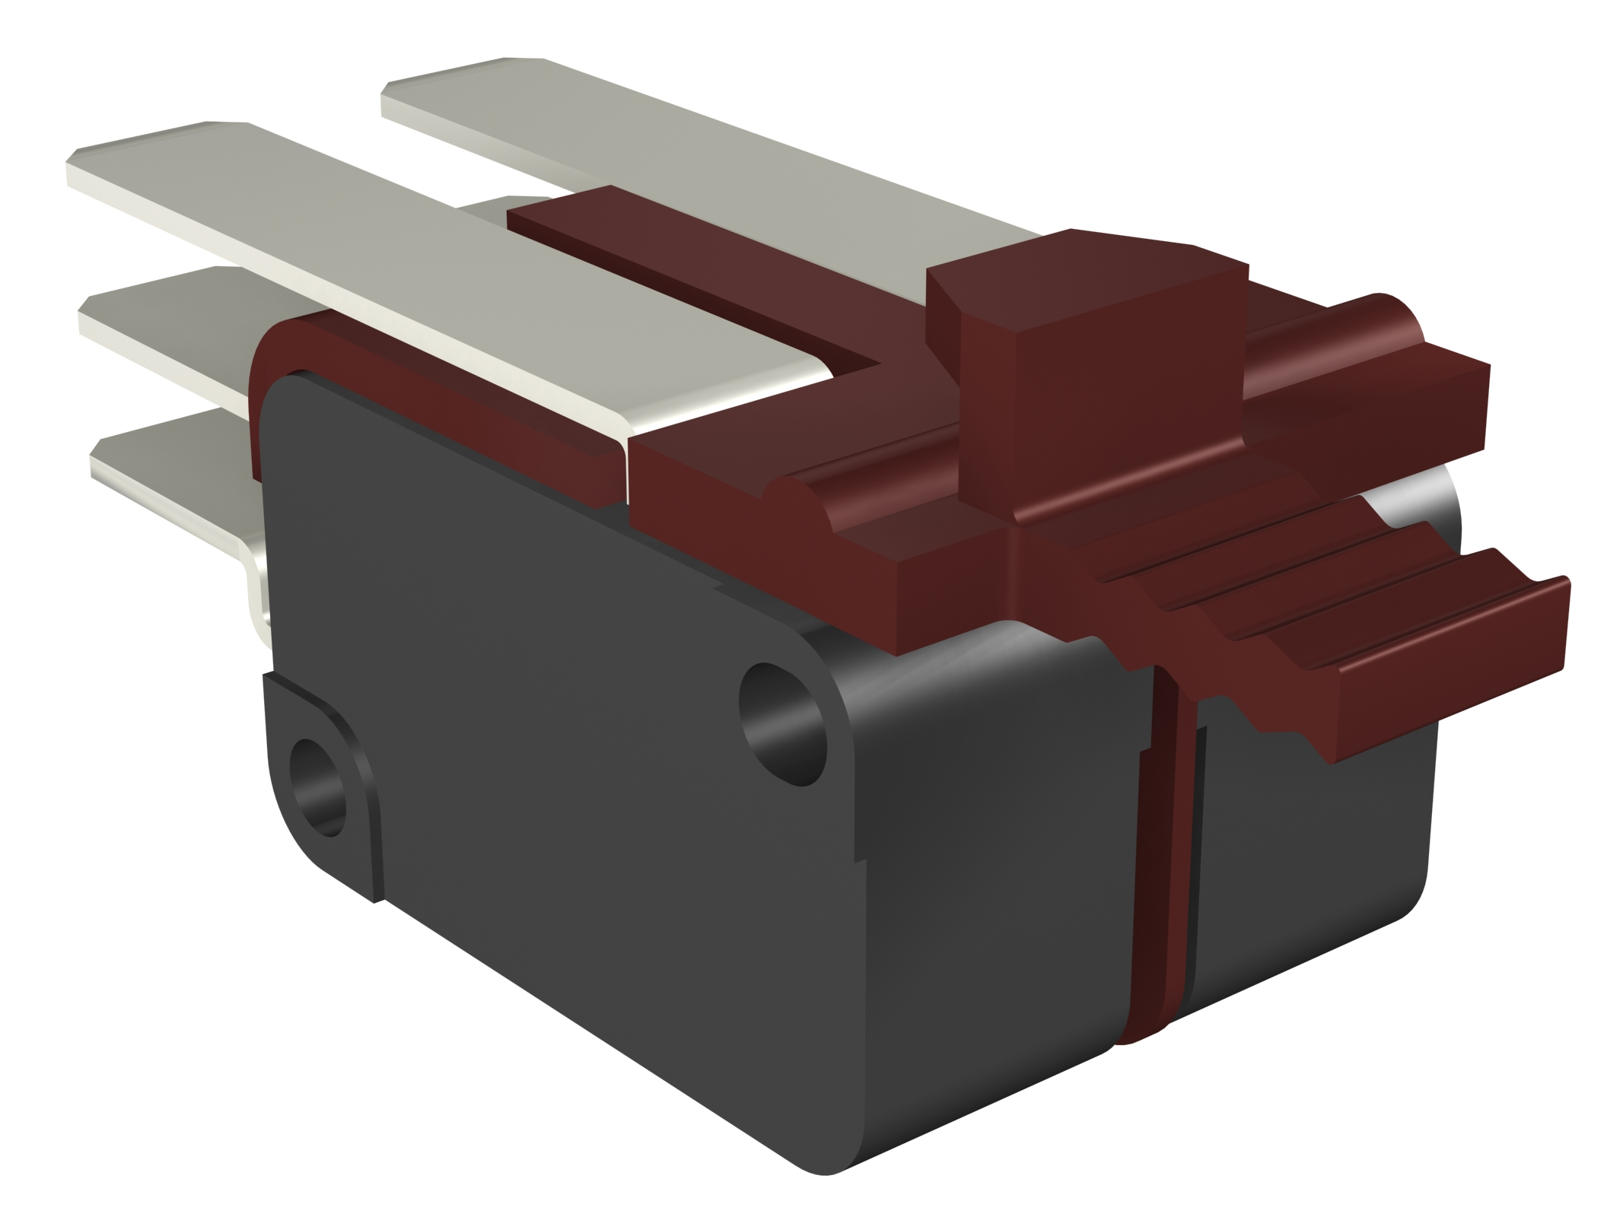
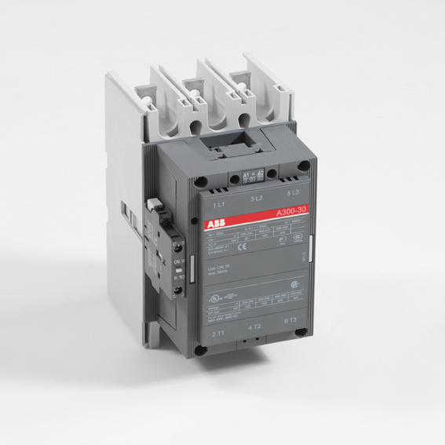
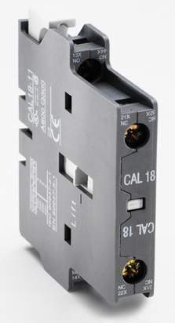
Industry
Shopping list
The controlled SACE Emax 1.2 (Gen Set) equipped with:
Ekip G Touch LSIG
Shunt opening release (YO)
Shunt closing release (YC)
Geared motor device (M)
Contact for signaling of CB open due to overcurrent (S51)
Open/closed auxiliary contact (Q/1)
+
+
+
+
+
Each controlled contactor equipped with an auxiliary contact
+
Notes:
A connection must be provided to an auxiliary voltage (110... 240Vac) for the supply of the shunt opening/closing releases and of the geared motor device

Slide 12
Hotel
-14% Power absorption
4 star hotel with 80 rooms
Maximum power absorption 580kW
Average power absorption with
Ekip Power Controller 500kW
Ground floor
Floor-1
Air conditioning
Congress room
Restaurant
Kitchen
Hall
Bar
Laundry
Car parking
Various [facilities] storage room
Tennis court
Outdoor lighting
Stairs
Elevators
Floor 5
Floor 4
Floor 3
Floor 2
Floor 1
Air conditioning
Wellness Spa
Swimming pool
Air conditioning
Corridors
Rooms
Air conditioning
Corridors
Rooms
Air conditioning
Corridors
Rooms
Air conditioning
Corridors
Rooms
Freezer
Electric ovens
Notes:
The maximum total power absorption of about 580 kW has been detected. Therefore, in order to reduce the maximum contractual power greed upon with the DSO, through Ekip Power Controller function the aim is to decrease the maximum power absorption at 500 kW. Then, it is the task of Ekip Power Controller function of SACE Emax 2 to disconnect/reconnect the defined loads (inside the orange circles) in order not to exceed the contractual power.
The hotel consists of 4 room floors and of a fifth floor where SPA and swimming pool are located.
A power factor correction plant is installed to keep the monthly average power factor equal to or higher than 0.9.

Slide 13
Hotel
Controlled loads
Priority | Load | Power | Nominal current | Controlled device
1 | SPA | 32kW | 51A | XT2 160 Ekip LS/I 63A
2 | Swimming pool | 32kW | 51A | XT2 160 Ekip LS/I 63A
3 | Air-conditioning per floor | 35kW | 56A | XT2 160 Ekip LS/I 63A
4 | Kitchen (refrigerators) | 8kW | 13A | XT2 160 TMD 16A
5 | Laundry | 8.4kW | 13.5A | XT2 160 TMD 16A
Notes:
The selected loads could be disconnected for some minutes and therefore managed by Ekip Power Controller according to the priority list defined by the User

Slide 14
Hotel
Wired connections, 10 controlled loads
To manage more than 5 loads, it is possible to use up to 3 Ekip Signalling 10K units
Ekip Signalling 10K is mounted on DIN rail and interfaced with the main Emax 2 through the internal bus connection
Same configuration for the other 5 loads
110-240 Vac
Local BUS
Ekip Supply
Ekip signaling 10K
Emax 1.2
O/1
S51
O/1
S51
O/1
S51
O/1
S51
O/1
S51
Ekip
Ekip
Ekip
TM
TM
Tmax XT2 160 Ekip LS/I
Tmax XT2 160 Ekip LS/I
Tmax XT2 160 Ekip LS/I
Tmax XT2 160 TMD
Tmax XT2 160 TMD
Notes:
Connection to the terminals W3, W4 of SACE Emax 2
Each Ekip Signalling 10K unit shall be addressed through the dip switch configuration provided on the module itself.
Cabling is provided for the circuit-breakers to make it possible to command the shunt opening/closing releases and the motor operators.
The cable to be used is a Shielded Twisted Pair (STP), 15 m maximum length. ABB SACE specifies a cable type Belden 3105A, but the use of other types of cable with the same characteristics is allowed. The shield of the cable must be connected to earth on the CB side.
The synchronization signal can be delivered to one input of Ekip Signalling 10K.

Slide 15
Hotel
Shopping list
The main SACE Emax E1.2 equipped with:
Ekip Hi-Touch LSIG
Ekip Power Controller function
Ekip Supply module
+
+

Slide 16
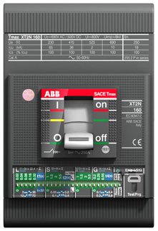
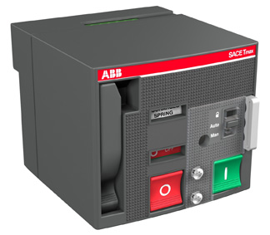
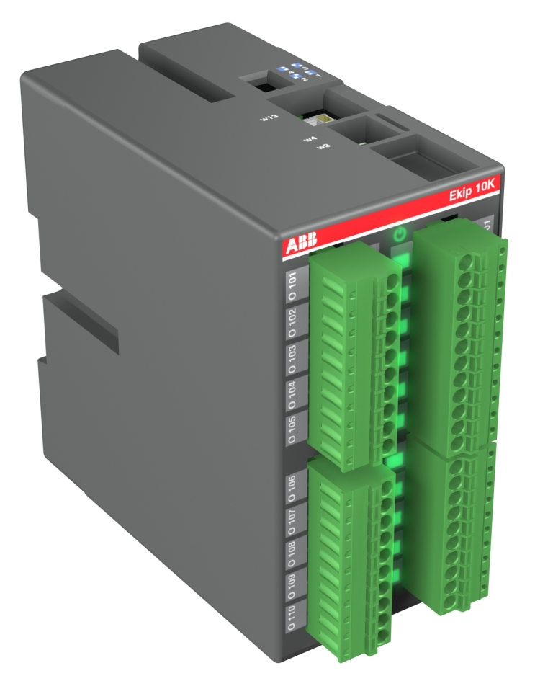
Hotel
Back
Shopping list
Each controlled SACE XT2 equipped with:
Stored energy motor operator (MOE)
Contact for signaling of CB open due to overcurrent (S51)
Open/closed auxiliary contact Q/1
+
+
+
+
2x
2x Ekip Signalling 10K (on DIN rail)
Notes:
A connection must be provided to an auxiliary voltage (110... 240Vac) for the supply of the motor operators MOE

Slide 17
Building
-20% Power absorption
Office building
Maximum power absorption 1000kW
Average power absorption with
Ekip Power Controller 800kW
~
PV Plant
Priority loads
Wastewater pumps
Clean-water pumps
HVAC 1
HVAC 2
Priority loads
Offices
Power factor correction
The PV plant is a “priority load” as renewable energy source
M
3~
M
3~
NO DISCONNECTION
Notes:
The maximum total power absorption of about 1000 kW has been detected. Therefore, in order to reduce the maximum contractual power greed upon with the DSO, through Ekip Power Controller function the aim is to decrease the maximum power absorption at 800 kW. Then, it is the task of Ekip Power Controller function of SACE Emax 2 to disconnect/reconnect the defined loads (inside the orange circles) in order not to exceed the contractual power.
The office building is supplied by 2 MV/lv transformers. The HVAC and water pumps can be managed by Ekip Power Controller. In particular, the pumps, by means of open/closed contactors, which are installed on the power circuit of the corresponding asynchronous motors.
The PV plant is a “priority load”; in fact, it is a renewable energy source connected to the Utility and it cannot be disconnected in order not to reduce the feed-in tariff obtained through the energy produced.
A power factor correction plant is installed to keep the monthly average power factor equal to or higher than 0.9.

Slide 18
Building
Controlled loads
Priority | Load | Power | Nominal current | Controlled device
1 | Clean-water pumps | 37kW | 66A | A75
2 | Wastewater pumps | 37kW | 66A | A75
3 | HVAC1 | 360kW | 578A | T5 630 PR222 DS-LSI 630A
4 | HVAC2 | 360kW | 578A | T5 630 PR222 DS-LSI 630A
Notes:
The selected loads could be disconnected for some minutes and therefore managed by Ekip Power Controller according to the priority list defined by the User

Slide 19
Building
Connection through Ekip Link
It is possible to install only 1 Emax 2 equipped with Ekip Power Controller, without having to duplicate wiring
The first circuit-breaker will carry out the analysis (and the consequent load management) of the total energy consumed in the plant
The total energy is the sum of the 2 energy profiles detected by the two measure modules
MV Breaker
Energy meter
Energy meter clock
110 – 240 Vac
110-240 Vac
Ekip link
Ekip Signaling 2K
Ekip Supply
Ekip signaling 10K
Ekip link
Ekip Supply
Ekip Signaling 4k
Ekip power controller
Emax 2.2
Emax 2.2
Ekip
Ekip link
???
???
[???]
[???]
???
???
???
???
[Tmax ???]
[Tmax ???]
Notes:
As for the second circuit-breaker, it will be enough to connect it to Ekip Link and to mount Ekip Supply and Ekip Measuring modules, whereas on the first circuit-breaker equipped with Ekip Power Controller it will be enough to add the IP address of the second circuit-breaker in Ekip Connect so that it is possible to read the quota of the absorbed energy passing through it.
In particular, if the two transformers operate in an alternate way, when the second transformer is put into service, the first circuit-breaker carries out the analysis of the energy which has been absorbed by the plant and which, in this case, flows exclusively through the second circuit-breaker.
1 digital input for clock tick synchronization with the smart meter of the DSO (optional)
Customers must guarantee the presence of an Ethernet Switch with a number of outputs depending on the number of circuit-breakers/switch-disconnectors to be controlled.

Slide 20
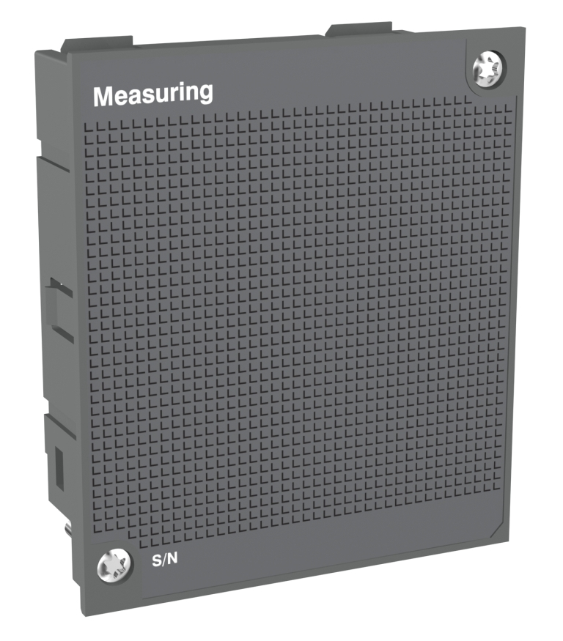
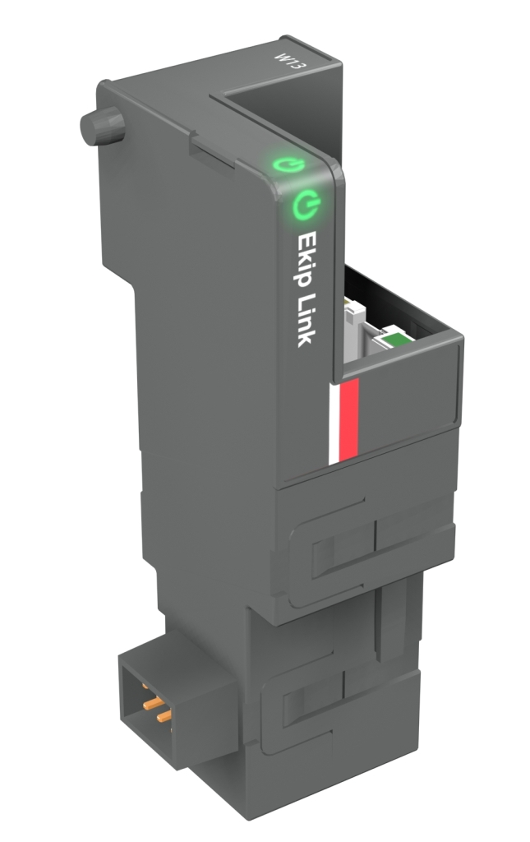
Building
Shopping list
1 of the 2 main SACE Emax 2.2 equipped with:
Ekip Touch LSIG + Ekip Measuring
Ekip Power Controller function
Ekip Supply module
Ekip Link module
+
+
+
+
The other main SACE Emax 2.2 equipped with:
Ekip Touch LSIG + Ekip Measuring
Ekip Supply module
Ekip Link module
+
+
+

Slide 21
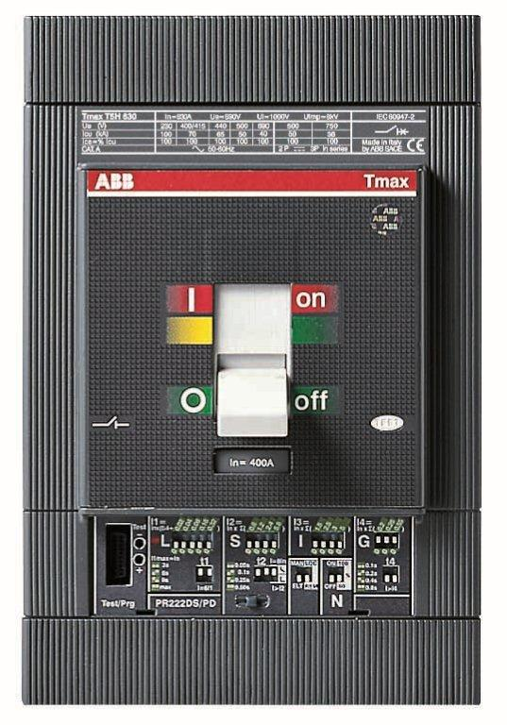
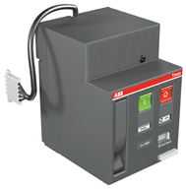
Building
Agenda
Back
Shopping list
Each controlled Tmax T5 equipped with:
Stored energy motor (MOE)
Contact for signaling of CB open due to Overcurrent (S51)
Open/closed auxiliary contact Q/1
+
+
+
Each controlled contactor equipped with an auxiliary contact
+
+
Ekip Signalling 10K (on DIN rail)
Notes:
A connection must be provided to an auxiliary voltage (110... 240Vac) for the supply of the motor operators MOE

Slide 22
Algorithm
The algorithm consists of 4 steps
Algorithm
Measure: measures the total power flow through the SACE Emax 2 which implements the function
Synchronization: defines the time intervals in which the average power demand is measured
Evaluation: evaluates whether the demand is too high, whether it is within the normal limits or whether it is significantly lower
Load management: decides which are the loads to be disconnected/reconnected, in compliance with:
Priority
Respect times
Reordering
Measure
Synchronization
Evaluation
Load Management
Notes:
Measure: this value is integrated to obtain the total energy. When each reference time interval has elapsed, the energy is set to zero. In such way, the evaluation modulus of the algorithm has always at its disposal the value of the energy measured in the current interval of time at its disposal.
2. Synchronization: on the base of the clock inside the trip unit, the algorithm defines the time intervals in which the average power demand is measured (a typical value in is 15 minutes) . During each reference period, at regular intervals (e.g. every minute), it starts the evaluation module. As an option, it can be synchronized by an external signal given by the smart meter of the DSO distribution system operator.
3. Evaluation: based on the energy measured and on the time elapsed from the beginning of the reference period, one of the three following results is generated:
- if the absorbed energy is within the limits, the decision is to keep the existing load configuration (number of connected loads)
- if the absorbed energy is too much, the decision is to decrease the existing load configuration
if the absorbed energy is remarkably lower, the decision is to increase the existing load configuration.
4. Load management:
- priority – if it is necessary to disconnect a load, and when more than one load can be chosen for this operation, the indication and the order given by the User in the list of the controllable loads is followed: the load at the first place of the list is typically the least important for the application or that for which a temporary period of disconnection can be accepted. The load at the second place is that which immediately follows for importance and so on. On the contrary, when a load must be reconnected, the algorithm follows the set list in the reverse order (starting from the last load in the list), that is starting with the reconnection of the load with the utmost priority for the plant. The algorithm complies with the priority order set by the User, in compliance with the respect times mentioned below and with the opening of a circuit-breaker due to tripping of the relevant trip unit or due to the voluntary manual operation of the User himself;
- respect times – every load may have minimum times in which it must remain connected (or disconnected) to avoid damage. Therefore, at the moment of choosing the load to be connected or disconnected, the algorithm takes into consideration only the loads which have not been just switched by jumping to the following one of the list if that is the case;
- reordering – when a load becomes available again because its respect time is over, it is connected or disconnected according to its position in the list.

Slide 23
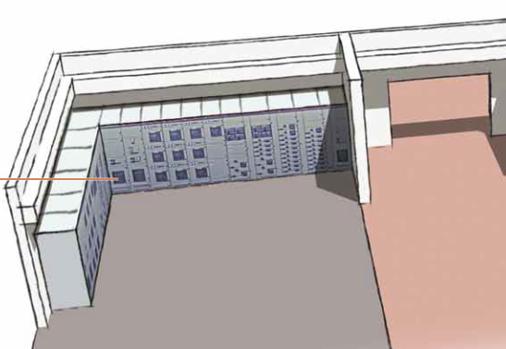
Description of operation
Connection details
Each load is controlled in one of the following ways
Ekip Power Controller is able to automatically manage the following situations, allowing integration with the selectivity of the protection devices in the plant:
Tripping of protection trip units
Manual operation
1 - Wired control
1 digital input (mandatory) to get information about the open/closed state of the downstream device
1 digital input (optional) to get information about the enabled/disabled state of the downstream device (or tripped state or redundant contact state)
2 digital outputs to give the opening/closing command to the downstream device when it is a circuit breaker or switch disconnector
2 - Ekip Link control
Using Ethernet cable with Ekip Link module
Notes:
Tripping of protection trip units - if one of the controlled circuit-breakers opens due to protection tripping, for safety reasons (in particular not to reclose on a short-circuit) it cannot be managed anymore and consequently the algorithm considers it as "not available" for control, until the operator has restored it manually and made it available again. More specifically, if a controlled circuit-breaker is tripped due to the overcurrent release, the algorithm, after three attempts to command opening, gives an alarm signal and temporarily excludes that circuit-breaker from the priority list as long as the trip state has been reset: the reset operation can be carried out through local manual command from display or through Ekip Connect from remote
Manual operation – the loads are considered “not available” also when the operator acts manually on the relevant circuit-breakers. Such loads will remain in that condition until reactivation is commanded by the operator
1. wired control, through shunt opening/closing releases (YO / YC) or motor operator and applicable to any circuit breaker (moulded, air or miniature circuit-breakers), switch-disconnector, contactor or through the control/start circuit
2. Ekip Link control, through Ethernet cable and applicable to any circuit-breaker or switch-disconnector of the new series SACE Emax 2 equipped with Ekip Link module.
A digital input can be optionally used by SACE Emax 2 for time synchronization with the smart meter of the DSO.

Slide 24
Description of operation
Example of operating logic
Load – P1
Emax 2
P₁
P₂
P₃
Load – P2
Load – P3
Notes:
Supposing we have an electrical plant which consists of three big loads, one priority load (P3) and two non priority ones (P1 and P2).
P1 and P2 can be managed through the Ekip Power Controller logic and the time interval of action of the algorithm is set by the User to 15 minutes.
At the moment the synchronization signal is sent from the DSO meter, the three loads are all connected with a total power lower than the limit contractual power (Pc =1500 kW).

Slide 25
Description of operation
Agenda
Example of operating logic
Total load
Emax 2
t₅
t₆
t₁
t₂
t₃
Limit contractual power P_{c}
P₁
P₂
P₃
t₇
Average power P_{m}
t₄
Notes:
At the instant t1 there is a peak of power absorption of load P3, but its duration does not make it exceeds the set limit for power demand in 15 minutes (Ea = Pc*0.4 [kWh]) according to the evaluation of Ekip Power Controller algorithm. As a consequence, none of the non-priority loads are disconnected.
At the instant t2 the power absorption of P3 increases so that the sum of the three power demands exceeds the contractual power and with such duration that the result of the algorithm forecast is a value exceeding the absorbable energy. As a consequence, Ekip Power Controller disconnects the load P1, which comes before P2 in the priority list for disconnection. The load P2 must stay disconnected for a minimum time t1min_off (i.e. up to the instant t4). This minimum time is necessary to avoid too frequent switching operations which can affect life of the switching devices and proper load operation.
At t3 the power absorption of P2 increases, but since the sum of P2 and P3 is lower than the contractual power Pc the algorithm does not intervene.
At t4 Ekip Power Controller consents to reclose P1, also because the load P3 has reduced the absorbed power and therefore the total absorption of the three loads is lower than Pc.
At t5 there is a further increase in the power absorbed by P3 such that the sum of P3 and P2 is already higher than the contractual one and the duration is such that Ekip Power Controller detects the risk of exceeding the absorbable energy.
As a consequence, the algorithm disconnects firstly the load P1 in t6 (in compliance with the minimum time t1min_on), but by evaluating the possibility of exceeding the absorbable energy, in t7 it disconnects also P2.
After the minimum times t1min_off and t2min_off of P1 and P2 respectively, since the power absorbed by P3 has decreased, the algorithm reconnects the loads according to their connection priority (times t1min_off and t2min_off permitting) and the operation logic repeats indefinitely for each time interval defined by the User.
As can be noticed in the diagram which represents the total load, in the considered interval of 15 minutes there can be some power absorptions exceeding the contractual power limit Pc, but, thanks to the algorithm of Ekip Power Controller, the average power Pm absorbed always remains under the limit contractual power Pc.

Slide 26
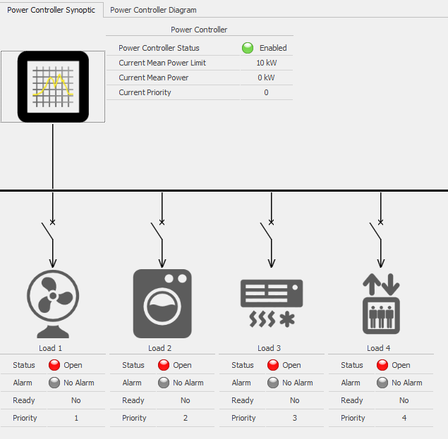
Settings
Ekip connect 2- Power Controller Wizard
To initiate the Power Controller, the user may set a list of parameters:
Enable/ disable
Power limits
Week scheduling
Saturday scheduling
Sunday scheduling
Synch configuration
Start-up behavior
Notes:
The User may set a list of parameters for SACE Emax 2 circuit-breaker equipped with Ekip Power Controller function.
Such parameters are the following:
- enable/disable – enabling or disabling Ekip Power Controller function
- power limits – showing which is the average power (Pm) absorption not to be exceeded; setting this value is mandatory, whereas the others are optional and are needed to differentiate the power consumed in the various daily tariff bands
- week scheduling – indicating the four tariff bands in which week days (Monday to Friday) are divided
- Saturday scheduling – indicating the four tariff bands in which Saturday is divided
- Sunday scheduling – indicating the four tariff bands in which Sunday is divided
- synch configuration – indicating the presence and the reception channel for the synchronization signal of the smart meter
- start-up behavior – indicating which loads must be inserted in the list of the loads that can be managed at startup.

Slide 27
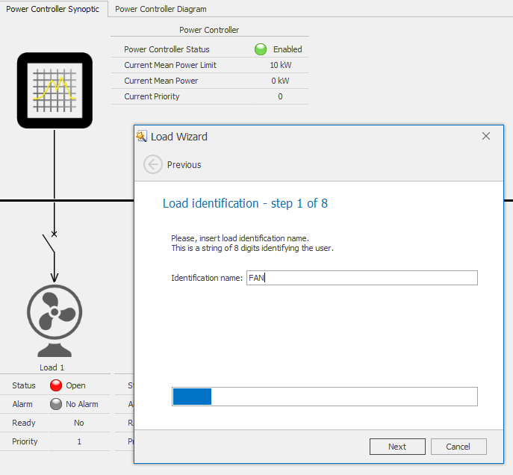
Settings
Ekip connect 2- Power Controller Wizard
For each load, the following parameters may be set:
Connection type
Open/closed input
Optional input
Enable/disable
Shed priority
Ton_min
Toff_min
Toff_max
User type
Nickname
Notes:
- connection type - selecting the number of input for each load
- open/closed input – indicating to which contacts (either Ekip Signalling or Ekip Link) the inputs for the open/closed state of the switching device are connected
- optional input – indicating to which contacts (either Ekip Signalling or Ekip Link) the auxiliary input is connected
- enable/disable – allowing load control to be disabled through Ekip Power Controller when the User does not wish that a given load is controlled by the algorithm for a certain time period. In such case, the algorithm by-passes that load and jumps to the following one in the priority list. For example this parameter can be useful when a load is undergoing maintenance
- shed priority – defining the priority with which the related load must be managed; it is represented by a number from 1 to 15 with decreasing priority of disconnection. There may also be more loads with the same priority: in that event, the algorithm proceeds to disconnect them alternately
- ton_min – minimum time during which the load/generator must remain connected in order to protect it against too frequent start/stop operations; it is possible to set a null time or a time in the range from 1 to 360 minutes with 1-minute step
- toff_min – minimum time during which the load/generator must remain disconnected in order to protect it against too frequent start/stop operations (e.g. gas-discharge lamps which need a minimum time to elapse between each switching-on operations); it is possible to set a null time or a time in the range from 1 to 360 minutes with 1-minute step
- toff_max – maximum time during which the load can remain disconnected in order to protect the process managed (e.g. cold rooms, electric ovens) against the damages caused by a prolonged lack of supply; it is possible to set a null time or a time in the range from 1 to 360 minutes with 1-minute step
- time window – time window in the space of the day during which the load cannot be disconnected; for example, this can be useful when there is a generator that can be started up and kept working in the daytime only to avoid noise pollution in the nighttime; it is possible to set a time interval from 1 to 24 hours with 1-hour step
- user type – type of user (load/generator)
- nickname – a string of 8 digits identifying the user.

