Slide 1
Product selection tool
Emergency Lighting
PROJECTS
FUNCTIONS
PRODUCTS

Slide 2
Select your project
Home
ARCHITECTURAL
COMMERCIAL
INDUSTRIAL
DISTRIBUTOR SELECT

Slide 3
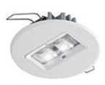
Architectural
collection
Home
Projects
Modularity & harmonious design
GUIDEWAY
Innovative & stylish
Clearly visible in daylight
Uniform light distribution
In harmony with interior spaces
SERENGA 2
Project covering & stylish
Up to 12m height
Harmonizing with interior spaces
Long or wide beam + wall version

Slide 4
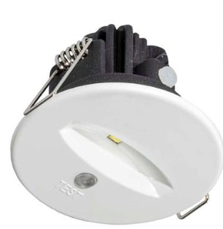
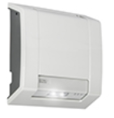
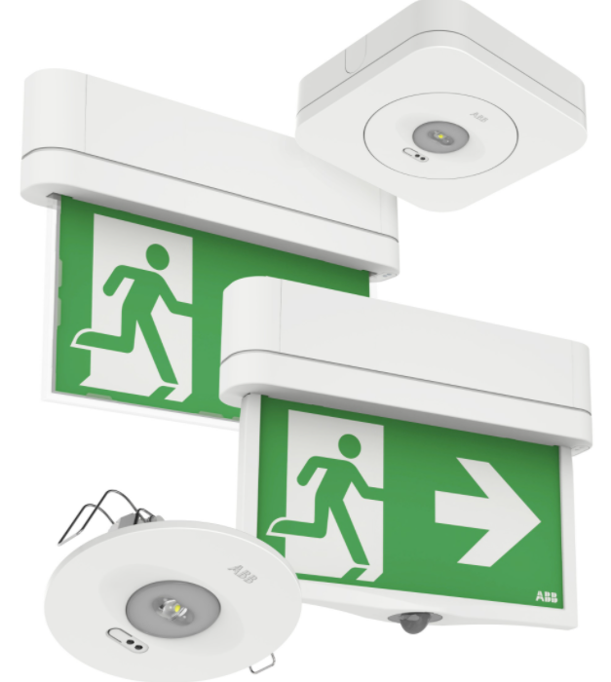
Commercial
collection
Home
Projects
Modularity & harmonious design
Industrial Reliability
OVANO
Productivity & Reliability
Compatible with DALI control unit
Plug and play, maintained and non-maintained
LUTIA
Reliable & robust
First-fix and loop-in, loop-out systems minimalize installation time
One product concept for both wall and ceiling mounted
Robust design developed for outdoor applications
MOVION
Modular and versatile
One version available for wall and ceiling mount
Strong light distribution with 500 cd/m²
Light track mountable with 3C adapter included
Recess kit for flush mounting available

Slide 5
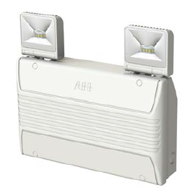
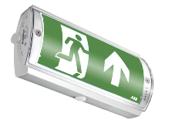
Industrial
collection
Home
Projects
Industrial reliabilty
LUTIA
Reliable & robust
First-fix and loop-in, loop-out systems minimalize installation time
One product concept for both wall and ceiling mounted
Robust design developed for outdoor applications
MIREVO TWINSPOT
Compact & reliable
Full adjustable heads with 140] beam angle
Available with Lithium Ferro phosphate battery technology for a longer service life
AQUALUX
Durable & high performance
Waterproof enclosures to IP65 & 67
Ease of maintenance with in-built Self-Test

Slide 6
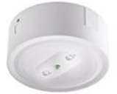
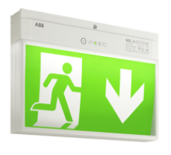
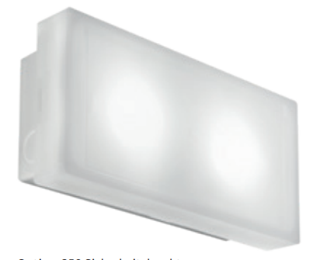
Distributor select
collection
Home
Projects
Easy installation & maintenance
PRIMEVO
Productivity & reliability
Available at your local wholesaler
Designed for escape route and open area lighting
Plug and play, maintained and non-maintained
Full LED range with best price / performance ratio
NEL-3
Productivity & Reliability
Exit sign with 25 m recognition distance
One single version for wall and ceiling
Automatic Self Test
IP54
OPTIMA
All-rounder for every application
Robust with a high degree of Protection
Flexible, rotatable pictogram for wall mounting
Universally applicable as an escape sign and as an escape route

Slide 7
GUIDEWAY
Innovative and stylish
Clearly visible in daylight
Uniform light distribution
In harmony with interior spaces
TECHNOLOGIES
Self test
DALI
Naveo®Pro
FUNCTIONS
Exit sign
SOLUTION TYPE
Self contained
PROJECT TYPE
GUIDEWAY web page
MOUNTING METHOD
Recessed
Surface
VIEWING DISTANCE
22 m
32 m
Architectural
GENERAL

Slide 8
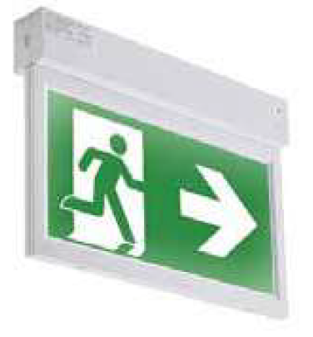
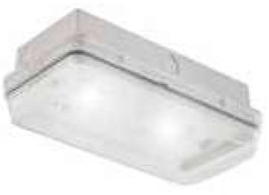
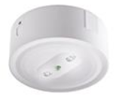
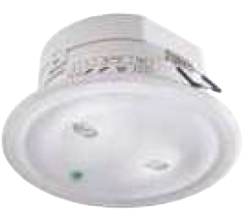
PRIMEVO
Productivity & reliability
Available at your local wholesaler
Plug and play, maintained and non-maintained in one
Full LED range with best price/performance ratio
TECHNOLOGIES
Self Test
FUNCTIONS
Exit sign
Escape route
SOLUTION TYPE
Self contained
MOUNTING METHOD
Recessed
Surface
PHOTOMETRY
Access files
PROJECT TYPE
PrimEvo Webpage XT100ST
Distributor select
GENERAL
PrimEvo Webpage XT200ST
VIEWING DISTANCE
20 m
24 m
PrimEvo Webpage RS100ST & SM100ST

Slide 9
MirEvo Twinspot
Compact & reliable
Full adjustable heads with 140° beam angle
Available with Lithium Ferro phosphate (LiFePO4) battery technology for a longer service life
Suitable for commercial and industrial environments
TECHNOLOGIES
DALI
Naveo®Pro
FUNCTIONS
Escape route
SOLUTION TYPE
Self contained
MOUNTING METHOD
Surface
PHOTOMETRY
Access files
PROJECT TYPE
GENERAL
Industrial
MirEvo Twinspot Webpage

Slide 10
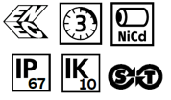
AQUALUX
Durable & high performance
Waterproof enclosures to IP65 & IP67
Optimal LED performance
Ease of maintenance with in-built Self-Test
FUNCTIONS
Exit sign
SOLUTION TYPE
Self contained
TECHNOLOGIES
DALI
Naveo®Pro
MOUNTING METHOD
Surface
VIEWING DISTANCE
24 m
PROJECT TYPE
Industrial
GENERAL
AQUALUX Webpage

Slide 11
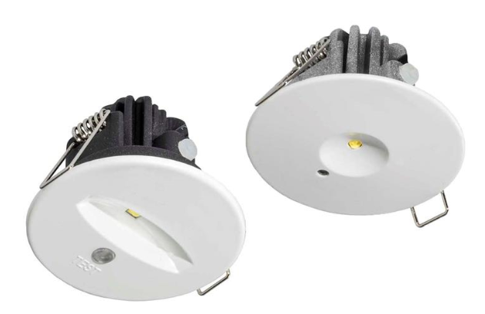
OVANO
Productivity & reliability
Compatible with DALI control unit to control, test & monitor emergency lighting
Plug & play, maintained and non-maintained in one
Compact and decorative
TECHNOLOGIES
DALI
FUNCTIONS
Exit sign
Escape route
SOLUTION TYPE
Self contained
PHOTOMETRY
Access files
PROJECT TYPE
MOUNTING METHOD
Recessed
Surface
GENERAL
Ovano Webpage
Commercial
VIEWING DISTANCE
24 m
30 m

Slide 12
MOVION
Modular and Versatile
One version available for wall and ceiling mount
Strong light distribution with 500 cd/m²
Light track mountable with 3C adapter included
Recess kit for flush mounting available
SOLUTION TYPE
Self contained
Slave
FUNCTIONS
Exit sign
Escape route
Hybrid
TECHNOLOGIES
Naveo®Pro
DALI
Self Test
Standard
FLX
Emex test
PROJECT TYPE
MOUNTING METHOD
Surface
Recessed
PHOTOMETRY
Access files
GENERAL
Naveo®Pro Smart Monitoring System
MOVION Web page
Commercial
GENERAL

Slide 13
MOVION
Naveo®Pro
Home
Function
Click on any item to access product sheet
Reference | Product ID | Type | Technology
Exit sign
411013311/50 | 7TCA305020R0068 | XT800S-M3/COM 22M | NaveoPro WIRED | Self contained
411013411/50BT | 7TCA305020R0144 | XT800S-M3/BT 22M | NaveoPro WIRELESS | Self contained
Hybrid
411113311/50 | 7TCA305020R0074 | XTH800S-M3/COM 22M | NaveoPro WIRED | Self contained
411113411/50BT | 7TCA305020R0145 | XTH800S-M3/BT 22M | NaveoPro WIRELESS | Self contained
Lighting – Square shape
511013311/50 | 7TCA305020R0094 | EL800S-M3/COM ER | NaveoPro WIRED | Self contained
511013312/50 | 7TCA305020R0100 | EL800S-M3/COM OA | NaveoPro WIRED | Self contained
511013411/50BT | 7TCA305020R0148 | EL800S-M3/BT ER | NaveoPro WIRELESS | Self contained
511013412/50BT | 7TCA305020R0149 | EL800S-M3/BT OA | NaveoPro WIRELESS | Self contained
Lighting – Round shape
511013321/50 | 7TCA305020R0106 | EL800R-M3/COM ER | NaveoPro WIRED | Self contained
511013322/50 | 7TCA305020R0112 | EL800R-M3/COM OA | NaveoPro WIRED | Self contained
511013421/50BT | 7TCA305020R0150 | EL800R-M3/BT ER | NaveoPro WIRELESS | Self contained
511013422/50BT | 7TCA305020R0151 | EL800R-M3/BT OA | NaveoPro WIRELESS | Self contained
Movion
Product Page
More information on
Naveo®Pro technology

Slide 14
MOVION
DALI
Home
Function
Click on any item to access product sheet
Reference | Product ID | Type | Technology
411013211/50 | 7TCA305020R0066 | XT800S-M3/DALI 22M | DALI | Self contained
411113211/50 | 7TCA305020R0073 | XTH800S-M3/DALI 22M | DALI | Self contained
511013211/50 | 7TCA305020R0093 | EL800S-M3/DALI ER | DALI | Self contained
511013212/50 | 7TCA305020R0099 | EL800S-M3/DALI OA | DALI | Self contained
511013221/50 | 7TCA305020R0105 | EL800R-M3/DALI ER | DALI | Self contained
511013222/50 | 7TCA305020R0111 | EL800R-M3/DALI OA | DALI | Self contained
Movion
Product Page

Slide 15
MOVION
Self test
Home
Function
Click on any item to access product sheet
Reference | Product ID | Type | Technology
411013111/50 | 7TCA305020R0067 | XT800S-M3/ST 22M | Self test | Self contained
411113111/50 | 7TCA305020R0072 | XTH800S-M3/ST 22M | Self test | Self contained
511013111/50 | 7TCA305020R0092 | EL800S-M3/ST ER | Self test | Self contained
511013112/50 | 7TCA305020R0098 | EL800S-M3/ST OA | Self test | Self contained
511013121/50 | 7TCA305020R0104 | EL800R-M3/ST ER | Self test | Self contained
511013122/50 | 7TCA305020R0110 | EL800R-M3/ST OA | Self test | Self contained
Movion
Product Page

Slide 16
MOVION
Standard
Home
Function
Click on any item to access product sheet
Reference | Product ID | Type | Technology
411012811/50 | 7TCA305020R0069 | XT800S-230 22M | Standard | Slave
411112811/50 | 7TCA305020R0075 | XTH800S-230 22M | Standard | Slave
511012811/50 | 7TCA305020R0095 | EL800S-230 ER | Standard | Slave
511012812/50 | 7TCA305020R0101 | EL800S-230 OA | Standard | Slave
511012821/50 | 7TCA305020R0107 | EL800R-230 ER | Standard | Slave
511012822/50 | 7TCA305020R0113 | EL800R-230 OA | Standard | Slave
Movion
Product Page

Slide 17
MOVION
FLX
Home
Function
Click on any item to access product sheet
Reference | Product ID | Type | Technology
411012711/50 | 7TCA305020R0070 | XT800S-230/FLX 22M | FLX | Slave
411112711/50 | 7TCA305020R0076 | XTH800S-230/FLX 22M | FLX | Slave
511012711/50 | 7TCA305020R0096 | EL800S-230/FLX ER | FLX | Slave
511012712/50 | 7TCA305020R0102 | EL800S-230/FLX OA | FLX | Slave
511012721/50 | 7TCA305020R0108 | EL800R-230/FLX ER | FLX | Slave
511012722/50 | 7TCA305020R0114 | EL800R-230/FLX OA | FLX | Slave
Movion
Product Page

Slide 18
MOVION
Emex test
Home
Function
Click on any item to access product sheet
Reference | Product ID | Type | Technology
411012611/50 | 7TCA305020R0071 | XT800S-230/LTC 22M | Emex test | Slave
411112611/50 | 7TCA305020R0077 | XTH800S-230/LTC 22M | Emex test | Slave
511012611/50 | 7TCA305020R0097 | EL800S-230/LTC ER | Emex test | Slave
511012612/50 | 7TCA305020R0103 | EL800S-230/LTC OA | Emex test | Slave
511012621/50 | 7TCA305020R0109 | EL800R-230/LTC ER | Emex test | Slave
511012622/50 | 7TCA305020R0115 | EL800R-230/LTC OA | Emex test | Slave
Movion
Product Page

Slide 19
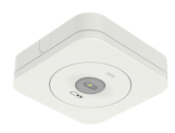
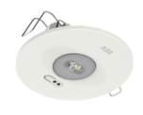
MOVION
Escape route
Home
Function
Click on any item to access product sheet
Reference | Product ID | Type | Technology
Lighting – Square shape
511013311/50 | 7TCA305020R0094 | EL800S-M3/COM ER | NaveoPro WIRED | Self contained
511013312/50 | 7TCA305020R0100 | EL800S-M3/COM OA | NaveoPro WIRED | Self contained
511013411/50BT | 7TCA305020R0148 | EL800S-M3/BT ER | NaveoPro WIRELESS | Self contained
511013412/50BT | 7TCA305020R0149 | EL800S-M3/BT OA | NaveoPro WIRELESS | Self contained
511013211/50 | 7TCA305020R0093 | EL800S-M3/DALI ER | DALI | Self contained
511013212/50 | 7TCA305020R0099 | EL800S-M3/DALI OA | DALI | Self contained
Lighting – Round shape
511013321/50 | 7TCA305020R0106 | EL800R-M3/COM ER | NaveoPro WIRED | Self contained
511013322/50 | 7TCA305020R0112 | EL800R-M3/COM OA | NaveoPro WIRED | Self contained
511013421/50BT | 7TCA305020R0150 | EL800R-M3/BT ER | NaveoPro WIRELESS | Self contained
511013422/50BT | 7TCA305020R0151 | EL800R-M3/BT OA | NaveoPro WIRELESS | Self contained
511013221/50 | 7TCA305020R0105 | EL800R-M3/DALI ER | DALI | Self contained
511013222/50 | 7TCA305020R0111 | EL800R-M3/DALI OA | DALI | Self contained
Movion
Product Page

Slide 20
MOVION
Escape route
Home
Function
Reference | Product ID | Type | Technology
Square shape
511013111/50 | 7TCA305020R0092 | EL800S-M3/ST ER | Self test | Self contained
511013112/50 | 7TCA305020R0098 | EL800S-M3/ST OA | Self test | Self contained
511012811/50 | 7TCA305020R0095 | EL800S-230 ER | Standard | Slave
511012812/50 | 7TCA305020R0101 | EL800S-230 OA | Standard | Slave
511012711/50 | 7TCA305020R0096 | EL800S-230/FLX ER | FLX | Slave
511012712/50 | 7TCA305020R0102 | EL800S-230/FLX OA | FLX | Slave
511012611/50 | 7TCA305020R0097 | EL800S-230/LTC ER | Emex test | Slave
511012612/50 | 7TCA305020R0103 | EL800S-230/LTC OA | Emex test | Slave
Round shape
511013121/50 | 7TCA305020R0104 | EL800R-M3/ST ER | Self test | Self contained
511013122/50 | 7TCA305020R0110 | EL800R-M3/ST OA | Self test | Self contained
511012821/50 | 7TCA305020R0107 | EL800R-230 ER | Standard | Slave
511012822/50 | 7TCA305020R0113 | EL800R-230 OA | Standard | Slave
511012721/50 | 7TCA305020R0108 | EL800R-230/FLX ER | FLX | Slave
511012722/50 | 7TCA305020R0114 | EL800R-230/FLX OA | FLX | Slave
511012621/50 | 7TCA305020R0109 | EL800R-230/LTC ER | Emex test | Slave
511012622/50 | 7TCA305020R0115 | EL800R-230/LTC OA | Emex test | Slave
Click on any item to access product sheet
Movion
Product Page

Slide 21
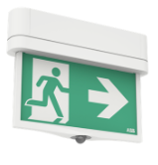
MOVION
Hybrid
Home
Function
Click on any item to access product sheet
Reference | Product ID | Type | Technology
411113311/50 | 7TCA305020R0074 | XTH800S-M3/COM 22M | NaveoPro WIRED | Self contained
411113411/50BT | 7TCA305020R0145 | XTH800S-M3/BT 22M | NaveoPro WIRELESS | Self contained
411113211/50 | 7TCA305020R0073 | XTH800S-M3/DALI 22M | DALI | Self contained
411113111/50 | 7TCA305020R0072 | XTH800S-M3/ST 22M | Self test | Self contained
411112811/50 | 7TCA305020R0075 | XTH800S-230 22M | Standard | Slave
411112711/50 | 7TCA305020R0076 | XTH800S-230/FLX 22M | FLX | Slave
411112611/50 | 7TCA305020R0077 | XTH800S-230/LTC 22M | Emex test | Slave
Movion
Product Page

Slide 22
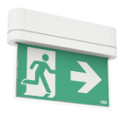
MOVION
Exit sign
Home
Function
Click on any item to access product sheet
Reference | Product ID | Type | Technology
411013311/50 | 7TCA305020R0068 | XT800S-M3/COM 22M | NaveoPro WIRED | Self contained
411013411/50BT | 7TCA305020R0144 | XT800S-M3/BT 22M | NaveoPro WIRELESS | Self contained
411013211/50 | 7TCA305020R0066 | XT800S-M3/DALI 22M | DALI | Self contained
411013111/50 | 7TCA305020R0067 | XT800S-M3/ST 22M | Self test | Self contained
411012811/50 | 7TCA305020R0069 | XT800S-230 22M | Standard | Slave
411012711/50 | 7TCA305020R0070 | XT800S-230/FLX 22M | FLX | Slave
411012611/50 | 7TCA305020R0071 | XT800S-230/LTC 22M | Emex test | Slave
Movion
Product Page

Slide 23
MOVION
Surface
Home
Function
Click on any item to access product sheet
Reference | Product ID | Type | Technology
Exit sign
411013311/50 | 7TCA305020R0068 | XT800S-M3/COM 22M | NaveoPro WIRED | Self contained
411013411/50BT | 7TCA305020R0144 | XT800S-M3/BT 22M | NaveoPro WIRELESS | Self contained
411013211/50 | 7TCA305020R0066 | XT800S-M3/DALI 22M | DALI | Self contained
411013111/50 | 7TCA305020R0067 | XT800S-M3/ST 22M | Self test | Self contained
411012811/50 | 7TCA305020R0069 | XT800S-230 22M | Standard | Slave
411012711/50 | 7TCA305020R0070 | XT800S-230/FLX 22M | FLX | Slave
411012611/50 | 7TCA305020R0071 | XT800S-230/LTC 22M | Emex test | Slave
Hybrid
411113311/50 | 7TCA305020R0074 | XTH800S-M3/COM 22M | NaveoPro WIRED | Self contained
411113411/50BT | 7TCA305020R0145 | XTH800S-M3/BT 22M | NaveoPro WIRELESS | Self contained
411113211/50 | 7TCA305020R0073 | XTH800S-M3/DALI 22M | DALI | Self contained
411113111/50 | 7TCA305020R0072 | XTH800S-M3/ST 22M | Self test | Self contained
411112811/50 | 7TCA305020R0075 | XTH800S-230 22M | Standard | Slave
411112711/50 | 7TCA305020R0076 | XTH800S-230/FLX 22M | FLX | Slave
411112611/50 | 7TCA305020R0077 | XTH800S-230/LTC 22M | Emex test | Slave
Movion
Product Page

Slide 24
MOVION
Recessed
Home
Function
Reference | Product ID | Type | Technology
Lighting – Square shape
511013311/50 | 7TCA305020R0094 | EL800S-M3/COM ER | NaveoPro WIRED | Self contained
511013312/50 | 7TCA305020R0100 | EL800S-M3/COM OA | NaveoPro WIRED | Self contained
511013411/50BT | 7TCA305020R0148 | EL800S-M3/BT ER | NaveoPro WIRELESS | Self contained
511013412/50BT | 7TCA305020R0149 | EL800S-M3/BT OA | NaveoPro WIRELESS | Self contained
511013211/50 | 7TCA305020R0093 | EL800S-M3/DALI ER | DALI | Self contained
511013212/50 | 7TCA305020R0099 | EL800S-M3/DALI OA | DALI | Self contained
511013111/50 | 7TCA305020R0092 | EL800S-M3/ST ER | Self test | Self contained
511013112/50 | 7TCA305020R0098 | EL800S-M3/ST OA | Self test | Self contained
Lighting – Round shape
511013321/50 | 7TCA305020R0106 | EL800R-M3/COM ER | NaveoPro WIRED | Self contained
511013322/50 | 7TCA305020R0112 | EL800R-M3/COM OA | NaveoPro WIRED | Self contained
511013421/50BT | 7TCA305020R0150 | EL800R-M3/BT ER | NaveoPro WIRELESS | Self contained
511013422/50BT | 7TCA305020R0151 | EL800R-M3/BT OA | NaveoPro WIRELESS | Self contained
511013221/50 | 7TCA305020R0105 | EL800R-M3/DALI ER | DALI | Self contained
511013222/50 | 7TCA305020R0111 | EL800R-M3/DALI OA | DALI | Self contained
511013121/50 | 7TCA305020R0104 | EL800R-M3/ST ER | Self test | Self contained
511013122/50 | 7TCA305020R0110 | EL800R-M3/ST OA | Self test | Self contained
Click on any item to access product sheet
Movion
Product Page

Slide 25
MOVION
Recessed
Home
Function
Click on any item to access product sheet
Reference | Product ID | Type | Technology
Recessed – Square shape
511012811/50 | 7TCA305020R0095 | EL800S-230 ER | Standard | Slave
511012812/50 | 7TCA305020R0101 | EL800S-230 OA | Standard | Slave
511012711/50 | 7TCA305020R0096 | EL800S-230/FLX ER | FLX | Slave
511012712/50 | 7TCA305020R0102 | EL800S-230/FLX OA | FLX | Slave
511012611/50 | 7TCA305020R0097 | EL800S-230/LTC ER | Emex test | Slave
511012612/50 | 7TCA305020R0103 | EL800S-230/LTC OA | Emex test | Slave
Recessed – Round shape
511012821/50 | 7TCA305020R0107 | EL800R-230 ER | Standard | Slave
511012822/50 | 7TCA305020R0113 | EL800R-230 OA | Standard | Slave
511012721/50 | 7TCA305020R0108 | EL800R-230/FLX ER | FLX | Slave
511012722/50 | 7TCA305020R0114 | EL800R-230/FLX OA | FLX | Slave
511012621/50 | 7TCA305020R0109 | EL800R-230/LTC ER | Emex test | Slave
511012622/50 | 7TCA305020R0115 | EL800R-230/LTC OA | Emex test | Slave
Movion
Product Page

Slide 26
MOVION
Self contained
Home
Function
Click on any item to access product sheet
Reference | Product ID | Type | Technology
Exit sign
411013311/50 | 7TCA305020R0068 | XT800S-M3/COM 22M | NaveoPro WIRED | Self contained
411013411/50BT | 7TCA305020R0144 | XT800S-M3/BT 22M | NaveoPro WIRELESS | Self contained
411013211/50 | 7TCA305020R0066 | XT800S-M3/DALI 22M | DALI | Self contained
411013111/50 | 7TCA305020R0067 | XT800S-M3/ST 22M | Self test | Self contained
Hybrid
411113311/50 | 7TCA305020R0074 | XTH800S-M3/COM 22M | NaveoPro WIRED | Self contained
411113411/50BT | 7TCA305020R0145 | XTH800S-M3/BT 22M | NaveoPro WIRELESS | Self contained
411113211/50 | 7TCA305020R0073 | XTH800S-M3/DALI 22M | DALI | Self contained
411113111/50 | 7TCA305020R0072 | XTH800S-M3/ST 22M | Self test | Self contained
Movion
Product Page

Slide 27
MOVION
Self contained
Home
Function
Reference | Product ID | Type | Technology
Lighting – Square shape
511013311/50 | 7TCA305020R0094 | EL800S-M3/COM ER | NaveoPro WIRED | Self contained
511013312/50 | 7TCA305020R0100 | EL800S-M3/COM OA | NaveoPro WIRED | Self contained
511013411/50BT | 7TCA305020R0148 | EL800S-M3/BT ER | NaveoPro WIRELESS | Self contained
511013412/50BT | 7TCA305020R0149 | EL800S-M3/BT OA | NaveoPro WIRELESS | Self contained
511013211/50 | 7TCA305020R0093 | EL800S-M3/DALI ER | DALI | Self contained
511013212/50 | 7TCA305020R0099 | EL800S-M3/DALI OA | DALI | Self contained
511013111/50 | 7TCA305020R0092 | EL800S-M3/ST ER | Self test | Self contained
511013112/50 | 7TCA305020R0098 | EL800S-M3/ST OA | Self test | Self contained
Lighting – Round shape
511013321/50 | 7TCA305020R0106 | EL800R-M3/COM ER | NaveoPro WIRED | Self contained
511013322/50 | 7TCA305020R0112 | EL800R-M3/COM OA | NaveoPro WIRED | Self contained
511013421/50BT | 7TCA305020R0150 | EL800R-M3/BT ER | NaveoPro WIRELESS | Self contained
511013422/50BT | 7TCA305020R0151 | EL800R-M3/BT OA | NaveoPro WIRELESS | Self contained
511013221/50 | 7TCA305020R0105 | EL800R-M3/DALI ER | DALI | Self contained
511013222/50 | 7TCA305020R0111 | EL800R-M3/DALI OA | DALI | Self contained
511013121/50 | 7TCA305020R0104 | EL800R-M3/ST ER | Self test | Self contained
511013122/50 | 7TCA305020R0110 | EL800R-M3/ST OA | Self test | Self contained
Click on any item to access product sheet
Movion
Product Page

Slide 28
MOVION
Slave
Home
Function
Click on any item to access product sheet
Reference | Product ID | Type | Technology
Exit sign
411012811/50 | 7TCA305020R0069 | XT800S-230 22M | Standard | Slave
411012711/50 | 7TCA305020R0070 | XT800S-230/FLX 22M | FLX | Slave
411012611/50 | 7TCA305020R0071 | XT800S-230/LTC 22M | Emex test | Slave
Hybrid
411112811/50 | 7TCA305020R0075 | XTH800S-230 22M | Standard | Slave
411112711/50 | 7TCA305020R0076 | XTH800S-230/FLX 22M | FLX | Slave
411112611/50 | 7TCA305020R0077 | XTH800S-230/LTC 22M | Emex test | Slave
Movion
Product Page

Slide 29
MOVION
Slave
Home
Function
Click on any item to access product sheet
Reference | Product ID | Type | Technology
Recessed – Square shape
511012811/50 | 7TCA305020R0095 | EL800S-230 ER | Standard | Slave
511012812/50 | 7TCA305020R0101 | EL800S-230 OA | Standard | Slave
511012711/50 | 7TCA305020R0096 | EL800S-230/FLX ER | FLX | Slave
511012712/50 | 7TCA305020R0102 | EL800S-230/FLX OA | FLX | Slave
511012611/50 | 7TCA305020R0097 | EL800S-230/LTC ER | Emex test | Slave
511012612/50 | 7TCA305020R0103 | EL800S-230/LTC OA | Emex test | Slave
Recessed – Round shape
511012821/50 | 7TCA305020R0107 | EL800R-230 ER | Standard | Slave
511012822/50 | 7TCA305020R0113 | EL800R-230 OA | Standard | Slave
511012721/50 | 7TCA305020R0108 | EL800R-230/FLX ER | FLX | Slave
511012722/50 | 7TCA305020R0114 | EL800R-230/FLX OA | FLX | Slave
511012621/50 | 7TCA305020R0109 | EL800R-230/LTC ER | Emex test | Slave
511012622/50 | 7TCA305020R0115 | EL800R-230/LTC OA | Emex test | Slave
Movion
Product Page

Slide 30
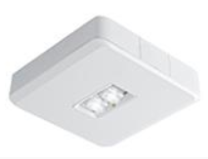
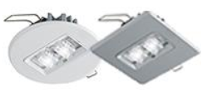
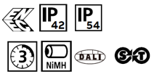
SERENGA 2
Project covering & stylish
Up to 12m high
3m ceiling height: 23m spacing
Harmonizing with interior spaces
Long or wide beam + version
FUNCTIONS
Escape route
SOLUTION TYPE
Self contained
TECHNOLOGIES
Self test
DALI
Naveo®Pro
PROJECT TYPE
MOUNTING METHOD
Recessed
Surface
PHOTOMETRY
Access files
GENERAL
Architectural
Serenga 2 Webpage

Slide 31
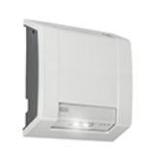
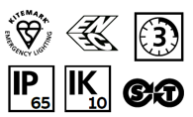
LUTIA
Reliable & robust
First-fix and loop-in, loop-out systems minimalize installation time
One product concept for both wall and ceiling mounted
Robust design developed for outdoor applications
FUNCTIONS
Escape route
SOLUTION TYPE
Self contained
TECHNOLOGIES
Self test
DALI
Naveo®Pro
PROJECT TYPE
MOUNTING METHOD
Surface
PHOTOMETRY
Access files
GENERAL
Lutia Webpage
Industrial

Slide 32
NEL-3
Productivity & Reliability
Exit sign with 25 m recognition distance
One single version for wall and ceiling
Automatic Self Test
IP54
TECHNOLOGIES
Self Test
FUNCTIONS
Exit sign
SOLUTION TYPE
Self contained
PROJECT TYPE
MOUNTING METHOD
Surface
VIEWING DISTANCE
25 m
Distributor Select
GENERAL
NEL-3 Webpage

Slide 33
OPTIMA 350
All-rounder for every application
Robust with a high degree of Protection
Flexible, rotatable pictogram for wall mounting
Universally applicable as an escape sign and as an escape route
TECHNOLOGIES
Self Test
FUNCTIONS
Exit sign
Escape route
SOLUTION TYPE
Self contained
PROJECT TYPE
MOUNTING METHOD
Surface
VIEWING DISTANCE
20 m
Distributor Select
GENERAL
Optima Webpage

Slide 34
GUIDEWAY
Exit sign
Home
Function
Click on any item to access product sheet
Reference | Product ID | Type | Technology
Surface
XT3300S-M3/COM 22M ALU | 7TCA305020R0156 | 4510236152/50 | Naveo®Pro WIRED | Self Contained
XT3300S-M3/COM 32M ALU | 7TCA305020R0158 | 4510236153/50 | Naveo®Pro WIRED | Self Contained
XT3300S-M3/BT 22M ALU | 7TCA305020R0293 | 4510236152/50BT | Naveo®Pro WIRELESS | Self Contained
XT3300S-M3/BT 32M ALU | 7TCA305020R0307 | 4513216153/50BT | Naveo®Pro WIRELESS | Self Contained
XT3300S-M3/DALI 22M ALU | 7TCA305020R0032 | 4510236952/50 | DALI | Self Contained
XT3300S-M3/DALI 32M ALU | 7TCA305020R0034 | 4513216953/50 | DALI | Self Contained
XT3300S-M8/ST 22M ALU | 7TCA309010R0042 | 4510286052/50 | Self Test | Self Contained
Recessed
XT3300R-M3/COM 22M ALU | 7TCA305020R0157 | 4510236162/50 | Naveo®Pro WIRED | Self Contained
XT3300R-M3/BT 22M ALU | 7TCA305020R0210 | 4510236162/50BT | Naveo®Pro WIRELESS | Self Contained
XT3300R-M3/COM 32M ALU | 7TCA305020R0159 | 4510236163/50 | Naveo®Pro WIRED | Self Contained
XT3300R-M3/BT 32M ALU | 7TCA305020R0211 | 4510236163/50BT | Naveo®Pro WIRELESS | Self Contained
XT3300R-M3/DALI 22M ALU | 7TCA305020R0033 | 4510236962/50 | DALI | Self Contained
XT3300R-M3/DALI 32M ALU | 7TCA305020R0035 | 4510236963/50 | DALI | Self Contained
XT3300R-M8/ST 22M ALU | 7TCA309010R0043 | 4510286062/50 | Self Test | Self Contained
Guideway
Product Page

Slide 35
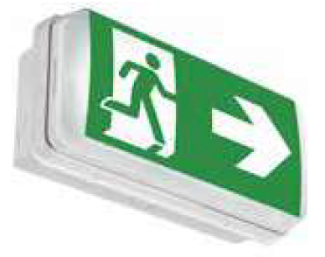
PRIMEVO
Exit sign
Home
Function
Click on any item to access product sheet
Reference | Product ID | Type | Technology
XT200ST | 7TCA091720R0192 | PRIMEVO EXIT SIGN 200 ST | Self test | Self contained
XT100ST | 7TCA091160R0583 | PRIMEVO EXIT SIGN 100 ST | Self test | Self contained
Primevo
Product Page

Slide 36
PRIMEVO
Escape route
Home
Function
Click on any item to access product sheet
Reference | Product ID | Type | Technology
XT100ST | 7TCA091160R0583 | PRIMEVO EXIT SIGN 100 ST | Self test | Self contained
SM100ST | 7TCA091720R0193 | PRIMEVO ESC R. S. MT 100 ST | Self test | Self contained
RS100ST | 7TCA091720R0191 | PRIMEVO ESC R. REC 100 ST | Self test | Self contained
Primevo
Product Page

Slide 37
MIREVO TWINSPOT
Escape route
Home
Function
Click on any item to access product sheet
Reference | Product ID | Type | Technology
TW500BT | 7TCA305060R0009 | Mirevo Twin | Naveo®Pro WIRELESS | Self contained
TW500DA | 7TCA305020R0023 | MIREVO TWIN SP DALI 500LM NM3HR | DALI | Self contained
MIREVO TWINSPOT
Product Page

Slide 38
AQUALUX
Exit sign
Home
Function
Click on any item to access product sheet
Reference | Product ID | Type | Technology
XTE9100S-M3/DALI | 7TCA305020R0045 | 7339055/50 | DALI | Self Contained
XTE9100S-M3/DALI FR | 7TCA305020R0046 | 7339955/50 | DALI | Self Contained
7341955/50 | 7TCA305020R0182 | XTE9100S-M3/COM FR | Naveo®Pro WIRED | Self Contained
7341055/50 | 7TCA305020R0181 | XTE9100S-M3/COM | Naveo®Pro WIRED | Self Contained
7339055/50BT | 7TCA305020R0224 | XTE9100S-M3/BT | Naveo®Pro WIRELESS | Self Contained
7339955/50BT | 7TCA305020R0225 | XTE9100S-M3/BT FR | Naveo®Pro WIRELESS | Self Contained
Aqualux
Product Page

Slide 39
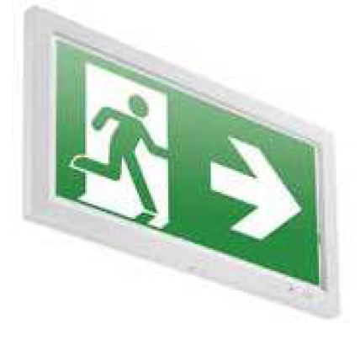
OVANO
Exit sign
Home
Function
Click on any item to access product sheet
Reference | Product ID | Type | Technology
XT230RS/DALI | 7TCA091720R0155 | DALI LED EXIT SIGN 30M | DALI | Self contained
XT224SM/DALI | 7TCA091720R0156 | DALI LED EXIT SIGN 24M | DALI | Self contained
XT230H/DALI | 7TCA091720R0154 | DALI LED SUSP EXIT SIGN 30M | DALI | Self contained
Ovano
Product Page

Slide 40
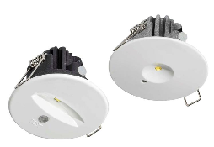
OVANO
Escape route
Home
Function
Click on any item to access product sheet
Reference | Product ID | Type | Technology
XT200M3H/DALI | 7TCA091720R0153 | DALI LED ESCAPE DOWN AUTO TEST 3HR | DALI | Self contained
XT201M3H/DALI | 7TCA091720R0152 | DALI LED ESC DOWN MAN AUTO TEST 3HR | DALI | Self contained
Ovano
Product Page

Slide 41
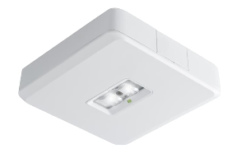
SERENGA 2
Escape route
Home
Function
Click on any item to access product sheet
Reference | Product ID | Type | Technology
EL2200W-M8/ST S | 7TCA309010R0044 | 5523287057/50 | Self Test | Self Contained
EL2200S-M8/ST HE | 7TCA309010R0047 | 5520287052/50 | Self Test | Self Contained
EL2200S-M8/ST HO | 7TCA309010R0048 | 5520287059/50 | Self Test | Self Contained
EL2200S-M8/ST OA | 7TCA309010R0051 | 5520287054/50 | Self Test | Self Contained
EL2200W-M3/DALI S | 7TCA305020R0036 | 5523237957/50 | DALI | Self contained
EL2200S-M3/DALI HE | 7TCA305020R0037 | 5520237958/50 | DALI | Self contained
EL2200S-M3/DALI HO | 7TCA305020R0038 | 5520237959/50 | DALI | Self contained
EL2200S-M3/DALI OA | 7TCA305020R0041 | 5520237954/50 | DALI | Self contained
EL2200S-M3/DALI ER | 7TCA305020R0042 | 5520237951/50 | DALI | Self contained
EL2200S-M3/COM HO | 7TCA305020R0164 | 5520237159/50 | Naveo®Pro WIRED | Self contained
EL2200S-M3/COM HE | 7TCA305020R0163 | 5520237158/50 | Naveo®Pro WIRED | Self contained
EL2200W-M3/COM S | 7TCA305020R0162 | 5523237157/50 | Naveo®Pro WIRED | Self contained
EL2200S-M3/COM ER | 7TCA305020R0168 | 5520237151/50 | Naveo®Pro WIRED | Self contained
EL2200S-M3/COM OA | 7TCA305020R0167 | 5520237154/50 | Naveo®Pro WIRED | Self contained
EL2200S-M3/BT HO | 7TCA305020R0244 | 5520237159/50BT | Naveo®Pro WIRELESS | Self contained
EL2200S-M3/BT HE | 7TCA305020R0243 | 5520237158/50BT | Naveo®Pro WIRELESS | Self contained
EL2200W-M3/BT S | 7TCA305020R0246 | 5523237157/50BT | Naveo®Pro WIRELESS | Self contained
EL2200S-M3/BT ER | 7TCA305020R0242 | 5520237151/50BT | Naveo®Pro WIRELESS | Self contained
EL2200S-M3/BT OA | 7TCA305020R0245 | 5520237154/50BT | Naveo®Pro WIRELESS | Self contained
Serenga 2
Product Page

Slide 42
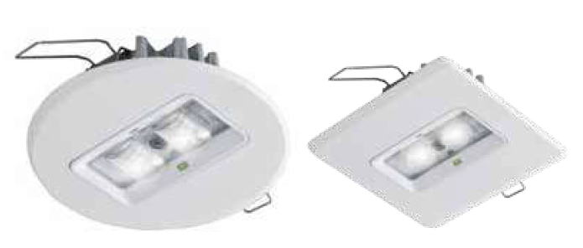
SERENGA 2
Escape route
Home
Function
Reference | Product ID | Type | Technology
Recessed – Round shaped
EL2200R-M8/ST HE | 7TCA309010R0045 | 5520287062/50 | Self Test | Self Contained
EL2200R-M8/ST OA | 7TCA309010R0049 | 5520287064/50 | Self Test | Self Contained
EL2200R-M3/DALI OA | 7TCA305020R0039 | 5520237964/50 | DALI | Self contained
EL2200R-M3/DALI ER | 7TCA305020R0043 | 5520237961/50 | DALI | Self contained
EL2200R-M3/COM ER | 7TCA305020R0169 | 5520237161/50 | Naveo®Pro WIRED | Self contained
EL2200R-M3/COM OA | 7TCA305020R0165 | 5520237164/50 | Naveo®Pro WIRED | Self contained
EL2200R-M3/BT ER | 7TCA305020R0213 | 5520237161/50BT | Naveo®Pro WIRELESS | Self contained
EL2200R-M3/BT OA | 7TCA305020R0214 | 5520237164/50BT | Naveo®Pro WIRELESS | Self contained
Recessed – Square shaped
EL2200RQ-M8/ST HE | 7TCA309010R0046 | 5520287072/50 | Self Test | Self Contained
EL2200RQ-M8/ST OA | 7TCA309010R0050 | 5520287074/50 | Self Test | Self Contained
EL2200RQ-M3/DALI OA | 7TCA305020R0040 | 5520237974/50 | DALI | Self contained
EL2200RQ-M3/DALI ER | 7TCA305020R0044 | 5520237971/50 | DALI | Self contained
EL2200RQ-M3/COM ER | 7TCA305020R0170 | 5520237171/50 | Naveo®Pro WIRED | Self contained
EL2200RQ-M3/COM OA | 7TCA305020R0166 | 5520237174/50 | Naveo®Pro WIRED | Self contained
EL2200RQ-M3/BT ER | 7TCA305020R0215 | 5520237171/50BT | Naveo®Pro WIRELESS | Self contained
EL2200RQ-M3/BT OA | 7TCA305020R0216 | 5520237174/50BT | Naveo®Pro WIRELESS | Self contained
Click on any item to access product sheet
Serenga 2
Product Page

Slide 43
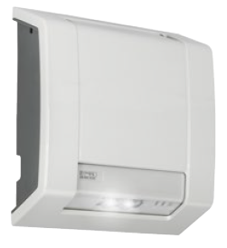
LUTIA
Escape route
Home
Function
Click on any item to access product sheet
Reference | Product ID | Type | Technology
65760230/50BT | 7TCA309010R0071 | EL9400S-M3/BT ER | Naveo®Pro WIRELESS | Self contained
EL9400S-M3/ST ER | 7TCA309010R0052 | 65760230/50 | Self test | Self contained
EL9400S-M8/ST ER | 7TCA309010R0053 | 65760280/50 | Self test | Self contained
EL9400S-M3/DALI ER | 7TCA305020R0064 | 65790239/50 | DALI | Self contained
Lutia
Product Page

Slide 44
GUIDEWAY
Self Contained
Home
Function
Click on any item to access product sheet
Reference | Product ID | Type | Technology
Surface
XT3300S-M3/COM 22M ALU | 7TCA305020R0156 | 4510236152/50 | Naveo®Pro WIRED | Self Contained
XT3300S-M3/COM 32M ALU | 7TCA305020R0158 | 4510236153/50 | Naveo®Pro WIRED | Self Contained
XT3300S-M3/BT 22M ALU | 7TCA305020R0293 | 4510236152/50BT | Naveo®Pro WIRELESS | Self Contained
XT3300S-M3/BT 32M ALU | 7TCA305020R0307 | 4513216153/50BT | Naveo®Pro WIRELESS | Self Contained
XT3300S-M3/DALI 22M ALU | 7TCA305020R0032 | 4510236952/50 | DALI | Self Contained
XT3300S-M3/DALI 32M ALU | 7TCA305020R0034 | 4513216953/50 | DALI | Self Contained
XT3300S-M8/ST 22M ALU | 7TCA309010R0042 | 4510286052/50 | Self Test | Self Contained
Recessed
XT3300R-M3/COM 22M ALU | 7TCA305020R0157 | 4510236162/50 | Naveo®Pro WIRED | Self Contained
XT3300R-M3/BT 22M ALU | 7TCA305020R0210 | 4510236162/50BT | Naveo®Pro WIRELESS | Self Contained
XT3300R-M3/COM 32M ALU | 7TCA305020R0159 | 4510236163/50 | Naveo®Pro WIRED | Self Contained
XT3300R-M3/BT 32M ALU | 7TCA305020R0211 | 4510236163/50BT | Naveo®Pro WIRELESS | Self Contained
XT3300R-M3/DALI 22M ALU | 7TCA305020R0033 | 4510236962/50 | DALI | Self Contained
XT3300R-M3/DALI 32M ALU | 7TCA305020R0035 | 4510236963/50 | DALI | Self Contained
XT3300R-M8/ST 22M ALU | 7TCA309010R0043 | 4510286062/50 | Self Test | Self Contained
Guideway
Product Page

Slide 45
PRIMEVO
Self contained
Home
Function
Click on any item to access product sheet
Reference | Product ID | Type | Technology
XT200ST | 7TCA091720R0192 | PRIMEVO EXIT SIGN 200 ST | Self test | Self contained
XT100ST | 7TCA091160R0583 | PRIMEVO EXIT SIGN 100 ST | Self test | Self contained
SM100ST | 7TCA091720R0193 | PRIMEVO ESC R. S. MT 100 ST | Self test | Self contained
RS100ST | 7TCA091720R0191 | PRIMEVO ESC R. REC 100 ST | Self test | Self contained
Primevo
Product Page

Slide 46
MIREVO TWINSPOT
Self contained
Home
Function
Click on any item to access product sheet
Reference | Product ID | Type | Technology
TW500BT | 7TCA305060R0009 | Mirevo Twin | Naveo®Pro WIRELESS | Self contained
TW500DA | 7TCA305020R0023 | MIREVO TWIN SP DALI 500LM NM3HR | DALI | Self contained
MIREVO TWINSPOT
Product Page

Slide 47
AQUALUX
Self contained
Home
Function
Click on any item to access product sheet
Reference | Product ID | Type | Technology
XTE9100S-M3/DALI | 7TCA305020R0045 | 7339055/50 | DALI | Self Contained
XTE9100S-M3/DALI FR | 7TCA305020R0046 | 7339955/50 | DALI | Self Contained
7341955/50 | 7TCA305020R0182 | XTE9100S-M3/COM FR | Naveo®Pro WIRED | Self Contained
7341055/50 | 7TCA305020R0181 | XTE9100S-M3/COM | Naveo®Pro WIRED | Self Contained
7339055/50BT | 7TCA305020R0224 | XTE9100S-M3/BT | Naveo®Pro WIRELESS | Self Contained
7339955/50BT | 7TCA305020R0225 | XTE9100S-M3/BT FR | Naveo®Pro WIRELESS | Self Contained
Aqualux
Product Page

Slide 48
OVANO
Self contained
Home
Function
Click on any item to access product sheet
Reference | Product ID | Type | Technology
Exit sign
XT230RS/DALI | 7TCA091720R0155 | DALI LED EXIT SIGN 30M | DALI | Self contained
XT224SM/DALI | 7TCA091720R0156 | DALI LED EXIT SIGN 24M | DALI | Self contained
XT230H/DALI | 7TCA091720R0154 | DALI LED SUSP EXIT SIGN 30M | DALI | Self contained
Escape route
XT200M3H/DALI | 7TCA091720R0153 | DALI LED ESCAPE DOWN AUTO TEST 3HR | DALI | Self contained
XT201M3H/DALI | 7TCA091720R0152 | DALI LED ESC DOWN MAN AUTO TEST 3HR | DALI | Self contained
Ovano
Product Page

Slide 49
LUTIA
Self contained
Home
Function
Click on any item to access product sheet
Reference | Product ID | Type | Technology
65760230/50BT | 7TCA309010R0071 | EL9400S-M3/BT ER | Naveo®Pro WIRELESS | Self contained
EL9400S-M3/ST ER | 7TCA309010R0052 | 65760230/50 | Self test | Self contained
EL9400S-M8/ST ER | 7TCA309010R0053 | 65760280/50 | Self test | Self contained
EL9400S-M3/DALI ER | 7TCA305020R0064 | 65790239/50 | DALI | Self contained
Lutia
Product Page

Slide 50
GUIDEWAY
Recessed
Home
Function
Click on any item to access product sheet
Reference | Product ID | Type | Technology
XT3300R-M3/DALI 22M ALU | 7TCA305020R0033 | 4510236962/50 | DALI | Self Contained
XT3300R-M3/DALI 32M ALU | 7TCA305020R0035 | 4510236963/50 | DALI | Self Contained
XT3300R-M8/ST 22M ALU | 7TCA309010R0043 | 4510286062/50 | Self Test | Self Contained
XT3300R-M3/COM 22M ALU | 7TCA305020R0157 | 4510236162/50 | Naveo®Pro WIRED | Self Contained
XT3300R-M3/BT 22M ALU | 7TCA305020R0210 | 4510236162/50BT | Naveo®Pro WIRELESS | Self Contained
XT3300R-M3/COM 32M ALU | 7TCA305020R0159 | 4510236163/50 | Naveo®Pro WIRED | Self Contained
XT3300R-M3/BT 32M ALU | 7TCA305020R0211 | 4510236163/50BT | Naveo®Pro WIRELESS | Self Contained
Guideway
Product Page

Slide 51
GUIDEWAY
Surface
Home
Function
Click on any item to access product sheet
Reference | Product ID | Type | Technology
XT3300S-M3/DALI 22M ALU | 7TCA305020R0032 | 4510236952/50 | DALI | Self Contained
XT3300S-M3/DALI 32M ALU | 7TCA305020R0034 | 4513216953/50 | DALI | Self Contained
XT3300S-M8/ST 22M ALU | 7TCA309010R0042 | 4510286052/50 | Self Test | Self Contained
XT3300S-M3/COM 22M ALU | 7TCA305020R0156 | 4510236152/50 | Naveo®Pro WIRED | Self Contained
XT3300S-M3/COM 32M ALU | 7TCA305020R0158 | 4510236153/50 | Naveo®Pro WIRED | Self Contained
XT3300S-M3/BT 22M ALU | 7TCA305020R0293 | 4510236152/50BT | Naveo®Pro WIRELESS | Self Contained
XT3300S-M3/BT 32M ALU | 7TCA305020R0307 | 4513216153/50BT | Naveo®Pro WIRELESS | Self Contained
Guideway
Product Page

Slide 52
GUIDEWAY
22 m
Home
Function
Click on any item to access product sheet
Reference | Product ID | Type | Technology
XT3300S-M3/DALI 22M ALU | 7TCA305020R0032 | 4510236952/50 | DALI | Self Contained
XT3300R-M3/DALI 22M ALU | 7TCA305020R0033 | 4510236962/50 | DALI | Self Contained
XT3300S-M8/ST 22M ALU | 7TCA309010R0042 | 4510286052/50 | Self Test | Self Contained
XT3300R-M8/ST 22M ALU | 7TCA309010R0043 | 4510286062/50 | Self Test | Self Contained
XT3300S-M3/COM 22M ALU | 7TCA305020R0156 | 4510236152/50 | Naveo®Pro WIRED | Self Contained
XT3300R-M3/COM 22M ALU | 7TCA305020R0157 | 4510236162/50 | Naveo®Pro WIRED | Self Contained
XT3300R-M3/BT 22M ALU | 7TCA305020R0210 | 4510236162/50BT | Naveo®Pro WIRELESS | Self Contained
XT3300S-M3/BT 22M ALU | 7TCA305020R0293 | 4510236152/50BT | Naveo®Pro WIRELESS | Self Contained
Guideway
Product Page

Slide 53
GUIDEWAY
32 m
Home
Function
Click on any item to access product sheet
Reference | Product ID | Type | Technology
XT3300S-M3/DALI 32M ALU | 7TCA305020R0034 | 4513216953/50 | DALI | Self Contained
XT3300R-M3/DALI 32M ALU | 7TCA305020R0035 | 4510236963/50 | DALI | Self Contained
XT3300S-M3/COM 32M ALU | 7TCA305020R0158 | 4510236153/50 | Naveo®Pro WIRED | Self Contained
XT3300R-M3/COM 32M ALU | 7TCA305020R0159 | 4510236163/50 | Naveo®Pro WIRED | Self Contained
XT3300R-M3/BT 32M ALU | 7TCA305020R0211 | 4510236163/50BT | Naveo®Pro WIRELESS | Self Contained
XT3300S-M3/BT 32M ALU | 7TCA305020R0307 | 4513216153/50BT | Naveo®Pro WIRELESS | Self Contained
Guideway
Product Page

Slide 54
PRIMEVO
Recessed
Home
Function
Click on any item to access product sheet
Reference | Product ID | Type | Technology
RS100ST | 7TCA091720R0191 | PRIMEVO ESC R. REC 100 ST | Self test | Self contained
Primevo
Product Page

Slide 55
PRIMEVO
Surface
Home
Function
Click on any item to access product sheet
Reference | Product ID | Type | Technology
XT200ST | 7TCA091720R0192 | PRIMEVO EXIT SIGN 200 ST | Self test | Self contained
XT100ST | 7TCA091160R0583 | PRIMEVO EXIT SIGN 100 ST | Self test | Self contained
SM100ST | 7TCA091720R0193 | PRIMEVO ESC R. S. MT 100 ST | Self test | Self contained
Primevo
Product Page

Slide 56
PRIMEVO
20 m
Home
Function
Click on any item to access product sheet
Reference | Product ID | Type | Technology
XT100ST | 7TCA091160R0583 | PRIMEVO EXIT SIGN 100 ST | Self test | Self contained
Primevo
Product Page

Slide 57
PRIMEVO
24 m
Home
Function
Click on any item to access product sheet
Reference | Product ID | Type | Technology
XT200ST | 7TCA091720R0192 | PRIMEVO EXIT SIGN 200 ST | Self test | Self contained
Primevo
Product Page

Slide 58
OVANO
Recessed
Home
Function
Click on any item to access product sheet
Reference | Product ID | Type | Technology
XT200M3H/DALI | 7TCA091720R0153 | DALI LED ESCAPE DOWN AUTO TEST 3HR | DALI | Self contained
XT201M3H/DALI | 7TCA091720R0152 | DALI LED ESC DOWN MAN AUTO TEST 3HR | DALI | Self contained
Ovano
Product Page

Slide 59
OVANO
Surface
Home
Function
Click on any item to access product sheet
Reference | Product ID | Type | Technology
XT230RS/DALI | 7TCA091720R0155 | DALI LED EXIT SIGN 30M | DALI | Self contained
XT224SM/DALI | 7TCA091720R0156 | DALI LED EXIT SIGN 24M | DALI | Self contained
XT230H/DALI | 7TCA091720R0154 | DALI LED SUSP EXIT SIGN 30M | DALI | Self contained
Ovano
Product Page

Slide 60
OVANO
24 m
Home
Function
Click on any item to access product sheet
Reference | Product ID | Type | Technology
XT224SM/DALI | 7TCA091720R0156 | DALI LED EXIT SIGN 24M | DALI | Self contained
Ovano
Product Page

Slide 61
OVANO
30 m
Home
Function
Click on any item to access product sheet
Reference | Product ID | Type | Technology
XT230RS/DALI | 7TCA091720R0155 | DALI LED EXIT SIGN 30M | DALI | Self contained
XT230H/DALI | 7TCA091720R0154 | DALI LED SUSP EXIT SIGN 30M | DALI | Self contained
Ovano
Product Page

Slide 62
SERENGA 2
Recessed
Home
Function
Reference | Product ID | Type | Technology
Recessed – Round shaped
EL2200R-M8/ST HE | 7TCA309010R0045 | 5520287062/50 | Self Test | Self Contained
EL2200R-M8/ST OA | 7TCA309010R0049 | 5520287064/50 | Self Test | Self Contained
EL2200R-M3/DALI OA | 7TCA305020R0039 | 5520237964/50 | DALI | Self contained
EL2200R-M3/DALI ER | 7TCA305020R0043 | 5520237961/50 | DALI | Self contained
EL2200R-M3/COM ER | 7TCA305020R0169 | 5520237161/50 | Naveo®Pro WIRED | Self contained
EL2200R-M3/COM OA | 7TCA305020R0165 | 5520237164/50 | Naveo®Pro WIRED | Self contained
EL2200R-M3/BT ER | 7TCA305020R0213 | 5520237161/50BT | Naveo®Pro WIRELESS | Self contained
EL2200R-M3/BT OA | 7TCA305020R0214 | 5520237164/50BT | Naveo®Pro WIRELESS | Self contained
Recessed – Square shaped
EL2200RQ-M8/ST HE | 7TCA309010R0046 | 5520287072/50 | Self Test | Self Contained
EL2200RQ-M8/ST OA | 7TCA309010R0050 | 5520287074/50 | Self Test | Self Contained
EL2200RQ-M3/DALI OA | 7TCA305020R0040 | 5520237974/50 | DALI | Self contained
EL2200RQ-M3/DALI ER | 7TCA305020R0044 | 5520237971/50 | DALI | Self contained
EL2200RQ-M3/COM ER | 7TCA305020R0170 | 5520237171/50 | Naveo®Pro WIRED | Self contained
EL2200RQ-M3/COM OA | 7TCA305020R0166 | 5520237174/50 | Naveo®Pro WIRED | Self contained
EL2200RQ-M3/BT ER | 7TCA305020R0215 | 5520237171/50BT | Naveo®Pro WIRELESS | Self contained
EL2200RQ-M3/BT OA | 7TCA305020R0216 | 5520237174/50BT | Naveo®Pro WIRELESS | Self contained
Click on any item to access product sheet
Serenga 2
Product Page

Slide 63
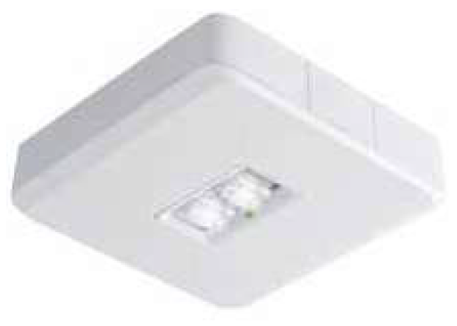
SERENGA 2
Surface
Home
Function
Click on any item to access product sheet
Reference | Product ID | Type | Technology
EL2200W-M8/ST S | 7TCA309010R0044 | 5523287057/50 | Self Test | Self Contained
EL2200S-M8/ST HE | 7TCA309010R0047 | 5520287052/50 | Self Test | Self Contained
EL2200S-M8/ST HO | 7TCA309010R0048 | 5520287059/50 | Self Test | Self Contained
EL2200S-M8/ST OA | 7TCA309010R0051 | 5520287054/50 | Self Test | Self Contained
EL2200W-M3/DALI S | 7TCA305020R0036 | 5523237957/50 | DALI | Self contained
EL2200S-M3/DALI HE | 7TCA305020R0037 | 5520237958/50 | DALI | Self contained
EL2200S-M3/DALI HO | 7TCA305020R0038 | 5520237959/50 | DALI | Self contained
EL2200S-M3/DALI OA | 7TCA305020R0041 | 5520237954/50 | DALI | Self contained
EL2200S-M3/DALI ER | 7TCA305020R0042 | 5520237951/50 | DALI | Self contained
EL2200S-M3/COM HO | 7TCA305020R0164 | 5520237159/50 | Naveo®Pro WIRED | Self contained
EL2200S-M3/COM HE | 7TCA305020R0163 | 5520237158/50 | Naveo®Pro WIRED | Self contained
EL2200W-M3/COM S | 7TCA305020R0162 | 5523237157/50 | Naveo®Pro WIRED | Self contained
EL2200S-M3/COM ER | 7TCA305020R0168 | 5520237151/50 | Naveo®Pro WIRED | Self contained
EL2200S-M3/COM OA | 7TCA305020R0167 | 5520237154/50 | Naveo®Pro WIRED | Self contained
EL2200S-M3/BT HO | 7TCA305020R0244 | 5520237159/50BT | Naveo®Pro WIRELESS | Self contained
EL2200S-M3/BT HE | 7TCA305020R0243 | 5520237158/50BT | Naveo®Pro WIRELESS | Self contained
EL2200W-M3/BT S | 7TCA305020R0246 | 5523237157/50BT | Naveo®Pro WIRELESS | Self contained
EL2200S-M3/BT ER | 7TCA305020R0242 | 5520237151/50BT | Naveo®Pro WIRELESS | Self contained
EL2200S-M3/BT OA | 7TCA305020R0245 | 5520237154/50BT | Naveo®Pro WIRELESS | Self contained
Serenga 2
Product Page

Slide 64
GUIDEWAY
Self test
Home
Function
Click on any item to access product sheet
Reference | Product ID | Type | Technology
Surface
XT3300S-M8/ST 22M ALU | 7TCA309010R0042 | 4510286052/50 | Self test | Self Contained
Recessed
XT3300R-M8/ST 22M ALU | 7TCA309010R0043 | 4510286062/50 | Self test | Self Contained
Guideway
Product Page

Slide 65
GUIDEWAY
DALI
Home
Function
Click on any item to access product sheet
Reference | Product ID | Type | Technology
Recessed
XT3300R-M3/DALI 22M ALU | 7TCA305020R0033 | 4510236962/50 | DALI | Self Contained
XT3300R-M3/DALI 32M ALU | 7TCA305020R0035 | 4510236963/50 | DALI | Self Contained
Surface
XT3300S-M3/DALI 22M ALU | 7TCA305020R0032 | 4510236952/50 | DALI | Self Contained
XT3300S-M3/DALI 32M ALU | 7TCA305020R0034 | 4513216953/50 | DALI | Self Contained
Guideway
Product Page

Slide 66
GUIDEWAY
Naveo®Pro
Home
Function
Click on any item to access product sheet
Reference | Product ID | Type | Technology
Surface
4510236152/50 | 7TCA305020R0156 | XT3300S-M3/COM 22M ALU | Naveo®Pro WIRED | Self Contained
4510236153/50 | 7TCA305020R0158 | XT3300S-M3/COM 32M ALU | Naveo®Pro WIRED | Self Contained
4510236152/50BT | 7TCA305020R0293 | XT3300S-M3/BT 22M ALU | Naveo®Pro WIRELESS | Self Contained
4513216153/50BT | 7TCA305020R0307 | XT3300S-M3/BT 32M ALU | Naveo®Pro WIRELESS | Self Contained
Recessed
4510236162/50 | 7TCA305020R0157 | XT3300R-M3/COM 22M ALU | Naveo®Pro WIRED | Self Contained
4510236162/50BT | 7TCA305020R0210 | XT3300R-M3/BT 22M ALU | Naveo®Pro WIRELESS | Self Contained
4510236163/50 | 7TCA305020R0159 | XT3300R-M3/COM 32M ALU | Naveo®Pro WIRED | Self Contained
4510236163/50BT | 7TCA305020R0211 | XT3300R-M3/BT 32M ALU | Naveo®Pro WIRELESS | Self Contained
Guideway
Product Page

Slide 67
PRIMEVO
Self test
Home
Function
Click on any item to access product sheet
Reference | Product ID | Type | Technology
XT200ST | 7TCA091720R0192 | PRIMEVO EXIT SIGN 200 ST | Self test | Self contained
XT100ST | 7TCA091160R0583 | PRIMEVO EXIT SIGN 100 ST | Self test | Self contained
SM100ST | 7TCA091720R0193 | PRIMEVO ESC R. S. MT 100 ST | Self test | Self contained
RS100ST | 7TCA091720R0191 | PRIMEVO ESC R. REC 100 ST | Self test | Self contained
Primevo
Product Page

Slide 68
MIREVO TWINSPOT
DALI
Home
Function
Click on any item to access product sheet
Reference | Product ID | Type | Technology
TW500DA | 7TCA305020R0023 | MIREVO TWIN SP DALI 500LM NM3HR | DALI | Self contained
MIREVO TWINSPOT
Product Page

Slide 69
MIREVO TWINSPOT
Naveo®Pro
Home
Function
Click on any item to access product sheet
Reference | Product ID | Type | Technology
TW500BT | 7TCA305060R0009 | Mirevo Twin | Naveo®Pro WIRELESS | Self contained
MIREVO TWINSPOT
Product Page

Slide 70
AQUALUX
DALI
Home
Function
Click on any item to access product sheet
Reference | Product ID | Type | Technology
XTE9100S-M3/DALI | 7TCA305020R0045 | 7339055/50 | DALI | Self contained
XTE9100S-M3/DALI FR | 7TCA305020R0046 | 7339955/50 | DALI | Self contained
Aqualux
Product Page

Slide 71
AQUALUX
Naveo®Pro
Home
Function
Click on any item to access product sheet
Reference | Product ID | Type | Technology
7341955/50 | 7TCA305020R0182 | XTE9100S-M3/COM FR | Naveo®Pro WIRED | Self Contained
7341055/50 | 7TCA305020R0181 | XTE9100S-M3/COM | Naveo®Pro WIRED | Self Contained
7339055/50BT | 7TCA305020R0224 | XTE9100S-M3/BT | Naveo®Pro WIRELESS | Self Contained
7339955/50BT | 7TCA305020R0225 | XTE9100S-M3/BT FR | Naveo®Pro WIRELESS | Self Contained
Aqualux
Product Page

Slide 72
OVANO
DALI
Home
Function
Click on any item to access product sheet
Reference | Product ID | Type | Technology
XT230RS/DALI | 7TCA091720R0155 | DALI LED EXIT SIGN 30M | DALI | Self contained
XT224SM/DALI | 7TCA091720R0156 | DALI LED EXIT SIGN 24M | DALI | Self contained
XT230H/DALI | 7TCA091720R0154 | DALI LED SUSP EXIT SIGN 30M | DALI | Self contained
XT200M3H/DALI | 7TCA091720R0153 | DALI LED ESCAPE DOWN AUTO TEST 3HR | DALI | Self contained
XT201M3H/DALI | 7TCA091720R0152 | DALI LED ESC DOWN MAN AUTO TEST 3HR | DALI | Self contained
Ovano
Product Page

Slide 73
SERENGA 2
Self test
Home
Function
Click on any item to access product sheet
Reference | Product ID | Type | Technology
Surface
EL2200W-M8/ST S | 7TCA309010R0044 | 5523287057/50 | Self Test | Self Contained
EL2200S-M8/ST HE | 7TCA309010R0047 | 5520287052/50 | Self Test | Self Contained
EL2200S-M8/ST HO | 7TCA309010R0048 | 5520287059/50 | Self Test | Self Contained
EL2200S-M8/ST OA | 7TCA309010R0051 | 5520287054/50 | Self Test | Self Contained
Recessed – Round shaped
EL2200R-M8/ST HE | 7TCA309010R0045 | 5520287062/50 | Self Test | Self Contained
EL2200R-M8/ST OA | 7TCA309010R0049 | 5520287064/50 | Self Test | Self Contained
Recessed – Square shaped
EL2200RQ-M8/ST HE | 7TCA309010R0046 | 5520287072/50 | Self Test | Self Contained
EL2200RQ-M8/ST OA | 7TCA309010R0050 | 5520287074/50 | Self Test | Self Contained
Serenga 2
Product Page

Slide 74
SERENGA 2
DALI
Home
Function
Click on any item to access product sheet
Reference | Product ID | Type | Technology
Surface
EL2200W-M3/DALI S | 7TCA305020R0036 | 5523237957/50 | DALI | Self contained
EL2200S-M3/DALI HE | 7TCA305020R0037 | 5520237958/50 | DALI | Self contained
EL2200S-M3/DALI HO | 7TCA305020R0038 | 5520237959/50 | DALI | Self contained
EL2200S-M3/DALI OA | 7TCA305020R0041 | 5520237954/50 | DALI | Self contained
EL2200S-M3/DALI ER | 7TCA305020R0042 | 5520237951/50 | DALI | Self contained
Recessed – Square shape
EL2200RQ-M3/DALI OA | 7TCA305020R0040 | 5520237974/50 | DALI | Self contained
EL2200RQ-M3/DALI ER | 7TCA305020R0044 | 5520237971/50 | DALI | Self contained
Recessed – Round shape
EL2200R-M3/DALI OA | 7TCA305020R0039 | 5520237964/50 | DALI | Self contained
EL2200R-M3/DALI ER | 7TCA305020R0043 | 5520237961/50 | DALI | Self contained
Serenga 2
Product Page

Slide 75
SERENGA 2
Naveo®Pro
Home
Function
Click on any item to access product sheet
Reference | Product ID | Type | Technology
Surface
EL2200S-M3/COM HO | 7TCA305020R0164 | 5520237159/50 | Naveo®Pro WIRED | Self contained
EL2200S-M3/COM HE | 7TCA305020R0163 | 5520237158/50 | Naveo®Pro WIRED | Self contained
EL2200W-M3/COM S | 7TCA305020R0162 | 5523237157/50 | Naveo®Pro WIRED | Self contained
EL2200S-M3/COM ER | 7TCA305020R0168 | 5520237151/50 | Naveo®Pro WIRED | Self contained
EL2200S-M3/COM OA | 7TCA305020R0167 | 5520237154/50 | Naveo®Pro WIRED | Self contained
EL2200S-M3/BT HO | 7TCA305020R0244 | 5520237159/50BT | Naveo®Pro WIRELESS | Self contained
EL2200S-M3/BT HE | 7TCA305020R0243 | 5520237158/50BT | Naveo®Pro WIRELESS | Self contained
EL2200W-M3/BT S | 7TCA305020R0246 | 5523237157/50BT | Naveo®Pro WIRELESS | Self contained
EL2200S-M3/BT ER | 7TCA305020R0242 | 5520237151/50BT | Naveo®Pro WIRELESS | Self contained
EL2200S-M3/BT OA | 7TCA305020R0245 | 5520237154/50BT | Naveo®Pro WIRELESS | Self contained
Serenga 2
Product Page

Slide 76
SERENGA 2
Naveo®Pro
Home
Function
Click on any item to access product sheet
Reference | Product ID | Type | Technology
Recessed – Square shaped
EL2200RQ-M3/COM ER | 7TCA305020R0170 | 5520237171/50 | Naveo®Pro WIRED | Self contained
EL2200RQ-M3/COM OA | 7TCA305020R0166 | 5520237174/50 | Naveo®Pro WIRED | Self contained
EL2200RQ-M3/BT ER | 7TCA305020R0215 | 5520237171/50BT | Naveo®Pro WIRELESS | Self contained
EL2200RQ-M3/BT OA | 7TCA305020R0216 | 5520237174/50BT | Naveo®Pro WIRELESS | Self contained
Recessed – round shaped
EL2200R-M3/COM ER | 7TCA305020R0169 | 5520237161/50 | Naveo®Pro WIRED | Self contained
EL2200R-M3/COM OA | 7TCA305020R0165 | 5520237164/50 | Naveo®Pro WIRED | Self contained
EL2200R-M3/BT ER | 7TCA305020R0213 | 5520237161/50BT | Naveo®Pro WIRELESS | Self contained
EL2200R-M3/BT OA | 7TCA305020R0214 | 5520237164/50BT | Naveo®Pro WIRELESS | Self contained
Serenga 2
Product Page

Slide 77
LUTIA
Self test
Home
Function
Click on any item to access product sheet
Reference | Product ID | Type | Technology
EL9400S-M3/ST ER | 7TCA309010R0052 | 65760230/50 | Self test | Self contained
EL9400S-M8/ST ER | 7TCA309010R0053 | 65760280/50 | Self test | Self contained
Lutia
Product Page

Slide 78
LUTIA
DALI
Home
Function
Click on any item to access product sheet
Reference | Product ID | Type | Technology
EL9400S-M3/DALI ER | 7TCA305020R0064 | 65790239/50 | DALI | Self contained
Lutia
Product Page

Slide 79
LUTIA
Naveo®Pro
Home
Function
Click on any item to access product sheet
Reference | Product ID | Type | Technology
65760230/50BT | 7TCA309010R0071 | EL9400S-M3/BT ER | Naveo®Pro WIRELESS | Self contained
Lutia
Product Page

Slide 80
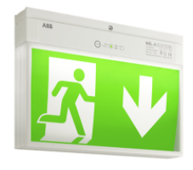
NEL-3
Self Test
Home
Function
Click on any item to access product sheet
Reference | Product ID | Type | Technology
NEL-3 Notleuchte | 7TCA091160R0265 | 6331031/50 | Self Test | Self Contained
Nel-3
Product Page

Slide 81
NEL-3
Self Contained
Home
Function
Click on any item to access product sheet
Reference | Product ID | Type | Technology
NEL-3 Notleuchte | 7TCA091160R0265 | 6331031/50 | Self Test | Self Contained
Nel-3
Product Page

Slide 82
NEL-3
Exit Sign
Home
Function
Click on any item to access product sheet
Reference | Product ID | Type | Technology
NEL-3 Notleuchte | 7TCA091160R0265 | 6331031/50 | Self Test | Self Contained
Nel-3
Product Page

Slide 83
NEL-3
Self Contained
Home
Function
Click on any item to access product sheet
Reference | Product ID | Type | Technology
NEL-3 Notleuchte | 7TCA091160R0265 | 6331031/50 | Self Test | Self Contained
Nel-3
Product Page

Slide 84
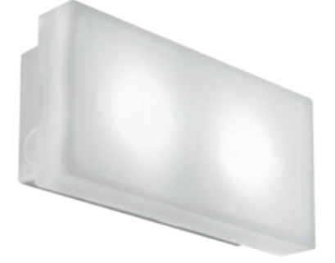
OPTIMA 350
Self Test
Home
Function
Click on any item to access product sheet
Reference | Product ID | Type | Technology
XTE350S-M3/ST | 7TCA309010R0041 | 6017618/50 | Self Test | Self Contained
XTE350S-M3/ST IP65 | 7TCA309010R0040 | 6017621/50 | Self Test | Self Contained
Optima 350
Product Page

Slide 85
OPTIMA 350
Exit Sign
Home
Function
Click on any item to access product sheet
Reference | Product ID | Type | Technology
XTE350S-M3/ST | 7TCA309010R0041 | 6017618/50 | Self Test | Self Contained
XTE350S-M3/ST IP65 | 7TCA309010R0040 | 6017621/50 | Self Test | Self Contained
Optima 350
Product Page

Slide 86
OPTIMA 350
Escape route
Home
Function
Click on any item to access product sheet
Reference | Product ID | Type | Technology
XTE350S-M3/ST | 7TCA309010R0041 | 6017618/50 | Self Test | Self Contained
XTE350S-M3/ST IP65 | 7TCA309010R0040 | 6017621/50 | Self Test | Self Contained
Optima 350
Product Page

Slide 87
OPTIMA 350
Self Contained
Home
Function
Click on any item to access product sheet
Reference | Product ID | Type | Technology
XTE350S-M3/ST | 7TCA309010R0041 | 6017618/50 | Self Test | Self Contained
XTE350S-M3/ST IP65 | 7TCA309010R0040 | 6017621/50 | Self Test | Self Contained
Optima 350
Product Page

Slide 88
Select your function
Home
Exit sign
Escape route
Intelligent products DALI Protocol

Slide 89
INTELLIGENT PRODUCTS
DALI
 | Reference | Product ID | Type | Technology
GUIDEWAY | Recessed
 | XT3300R-M3/DALI 22M ALU | 7TCA305020R0033 | 4510236962/50 | DALI | Self Contained
 | XT3300R-M3/DALI 32M ALU | 7TCA305020R0035 | 4510236963/50 | DALI | Self Contained
 | Surface
 | XT3300S-M3/DALI 22M ALU | 7TCA305020R0032 | 4510236952/50 | DALI | Self Contained
 | XT3300S-M3/DALI 32M ALU | 7TCA305020R0034 | 4513216953/50 | DALI | Self Contained
MIREVO TWINSPOT | TW500DA | 7TCA305020R0023 | MIREVO TWIN SP DALI 500LM NM3HR | DALI | Self Contained
AQUALUX | XTE9100S-M3/DALI | 7TCA305020R0045 | 7339055/50 | DALI | Self Contained
 | XTE9100S-M3/DALI FR | 7TCA305020R0046 | 7339955/50 | DALI | Self Contained
NEXT

Slide 90
INTELLIGENT PRODUCTS
DALI
 | Reference | Product ID | Type | Technology
OVANO | XT230RS/DALI | 7TCA091720R0155 | DALI LED EXIT SIGN 30M | DALI | Self contained
 | XT224SM/DALI | 7TCA091720R0156 | DALI LED EXIT SIGN 24M | DALI | Self contained
 | XT230H/DALI | 7TCA091720R0154 | DALI LED SUSP EXIT SIGN 30M | DALI | Self contained
 | XT200M3H/DALI | 7TCA091720R0153 | DALI LED ESCAPE DOWN AUTO TEST 3HR | DALI | Self contained
 | XT201M3H/DALI | 7TCA091720R0152 | DALI LED ESC DOWN MAN AUTO TEST 3HR | DALI | Self Contained
SERENGA 2 | EL2200W-M3/DALI S | 7TCA305020R0036 | 5523237957/50 | DALI | Self contained
 | EL2200S-M3/DALI HE | 7TCA305020R0037 | 5520237958/50 | DALI | Self contained
 | EL2200S-M3/DALI HO | 7TCA305020R0038 | 5520237959/50 | DALI | Self contained
 | EL2200R-M3/DALI OA | 7TCA305020R0039 | 5520237964/50 | DALI | Self contained
 | EL2200RQ-M3/DALI OA | 7TCA305020R0040 | 5520237974/50 | DALI | Self contained
 | EL2200S-M3/DALI OA | 7TCA305020R0041 | 5520237954/50 | DALI | Self contained
 | EL2200S-M3/DALI ER | 7TCA305020R0042 | 5520237951/50 | DALI | Self contained
 | EL2200R-M3/DALI ER | 7TCA305020R0043 | 5520237961/50 | DALI | Self contained
 | EL2200RQ-M3/DALI ER | 7TCA305020R0044 | 5520237971/50 | DALI | Self contained
PREVIOUS

Slide 91
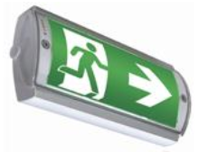
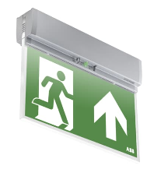
Exit sign
Home
Functions
Modularity & harmonious design
Easy installation & maintenance
Industrial reliability
GUIDEWAY
Innovative & stylish
Clearly visible in daylight
Uniform light distribution
In harmony with interior spaces
PRIMEVO
Productivity & reliability
Designed for escape route and open area lighting
Polycarbonate luminaire body
AQUALUX
Durable & high performance
Waterproof enclosures to IP65 & 67
Ease of maintenance with in-built Self-Test
NEL-3
Productivity & Reliability
Exit sign with 25m recognition distance
One single version for wall and ceiling
Automatic Self Test, IP54
OVANO
Productivity & Reliability
Compatible with DALI control unit
Plug and play, maintained and non-maintained
PHAROS
Productivity & Reliability
Edgelit exit sign, 25m recognition distance
One single version for wall and ceiling
Automatic Self Test, IP41
OPTIMA
All-rounder for every application
Robust with a high degree of Protection
Rotatable pictogram for wall mounting
Escape sign and escape route

Slide 92
Escape route
Home
Functions
Modularity & harmonious design
Easy installation & maintenance
Industrial reliability
LUTIA
Reliable & robust
One product concept for both wall & ceiling mounted
Robust design developed for outdoor applications
PRIMEVO
Productivity & reliability
Available at your local wholesaler
Plug and play, maintained and non-maintained
Full LED range with best price / performance ratio
MIREVO TWINSPOT
Compact & reliable
Full adjustable heads with 140] beam angle
Available with Lithium Ferro phosphate battery technology for a longer service life
SERENGA 2
Project covering & stylish
Up to 12m height
Long or wide beam + wall version
OPTIMA
All-rounder for every application
Robust with a high degree of Protection
Flexible, rotatable pictogram for wall mounting
Universally applicable as an escape sign and as an escape route
OVANO
Productivity & Reliability
Compatible with DALI control unit
Plug and play, maintained and non-maintained

Slide 93
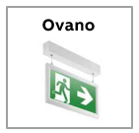
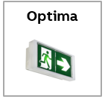
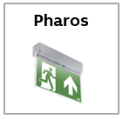
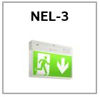
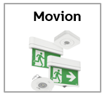
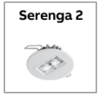
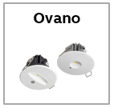
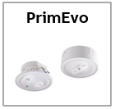
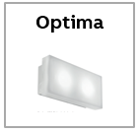
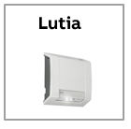
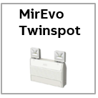
Select your product
Home

