Slide 1
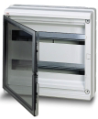
System Pro E Comfort
Consumer units EUROPA65
Solutions for photovoltaic systems
System Pro E Comfort
EUROPA65
NEW
The new serie of Consumer unit EUROPA65 is suitable for heavy duty applications such as photovoltaic systems. outdoor installations, etc.. The polycarbonate GWT 960 °C ensure unique mechanical performance (shock resistance IK10) and high resistance against UV rays.
The rated insulation voltages of 1000V AC and 1500 V DC make EUROPA65 the perfect enclosure for PV string combiner boxes
Technical characteristics
Protection degree IP65
Insulation class II
Color RAL7035
Self-extinguishing polycarbonate resistant to abnormal heat and fire up to 960°C (glow wire test), according to IEC 60695-2-11 Standard
Installaton temperature from -25°C to +60°C
Resistance to heat: ball thermopressure up to +125°C according to EN60695-10-2 Standard
Shock resistance 20 Joules (IK10 degree)
Conformity: IEC 60670 Starndard
Range
Description | ABB Code | Order code
8 modules with trnsparent smoky door | 1SL2748A01 | 1SL2748A01
12 modules with transparent smoky door | 1SL2752A01 | 1SL2752A01
18 modules with transparent smoky door | 1SL2753A01 | 1SL2753A01
24 modules with transparent smoky door (2x12 modules) | 1SL2754A01 | 1SL2754A01
36 modules with transparent smoky door (2x18 modules) | 1SL2755A01 | 1SL2755A01

Slide 2
System Pro E Comfort
Consumer units EUROPA65
Solutions for photovoltaic systems
EUROPA65 accessories
Modul covers
Description | ABB code | Order code
Modul cover 1 module RAL 7035 grey | 12861 | M128610000
Modul cover 4 modules RAL 7035 grey | 12863 | M128630000
Wall brackets
Description | ABB code | Order code
Wall bracket in insulation material RAL 7035 grey | 12858 | M128580000
Spare flanges
Description | ABB code | Order code
8 modules per row bi-material RAL 7035 grey | 12600 | M126000000
12 modules per row bi-material RAL 7035 grey | 12601 | M126010000
18 modules per row bi-material RAL 7035 grey | 12602 | M126020000
Rigid flange 8 modules per row RAL 7035 grey | 1SL0550A00 | 1SL0550A00
Rigid flange 12 modules per row RAL 7035 grey | 1SL0551A00 | 1SL0551A00
Rigid flange 18 modules per row RAL 7035 grey | 1SL0552A00 | 1SL0552A00
Lock with key
Description | ABB code | Order code
Coded type | 12865 | M128650000
Spare doors
Description | ABB code | Order code
Transparent door for 1SL2748A01 (8 modules) | 12579 | M125790000
Transparent door for 1SL2752A01 (12 modules) | 12580 | M125800000
Transparent door for 1SL2753A01 (18 modules) | 12586 | M125860000
Transparent door for 1SL2754A01 (24 modules) | 12581 | M125810000
Transparent door for 1SL2755A01 (36 modules) | 12587 | M125870000

Slide 3
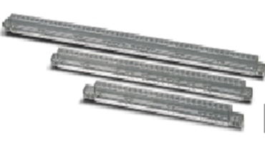
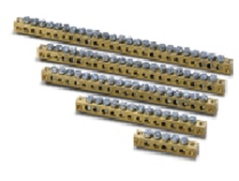
System Pro E Comfort
Consumer units EUROPA65
Solutions for photovoltaic systems
EUROPA65 accessories
Terminal block
Description | ABB code | Order code
for 8 moduls - composed of 12539x2 + 12531x2 | 12491 | M124910000
for 12 modules - composed of 12540x1 + 12531x1 + 12532x1 | 12492 | M124920000
for 18 modules - composed of 12543x1 + 12531x1 + 12535x1 | 12498 | M124980000
for 24 modules - composed of 12540x2 + 12533x2 | 12494 | M124940000
for 36 modules - composed of 12543x2 + 12534x2 | 12507 | M125070000
Terminal carrier
Description | For consumer unit (type) | ABB code | Order code
for 8 modules | 1SL2748A01 | 12539 | M125390000
for 12 modules per row | 1SL2752A01 1SL2754A01 | 12540 | M125400000
for 18 modules per row | 1SL2753A01 1SL2755A01 | 12543 | M125430000
Terminal bars
Description N° of holes x diam. holes (mm) + N° of holes x diam. holes (mm) | ABB code | Order code
5x4,5 | 12531 | M125310000
10x4,5 + 3x5,6 | 12532 | M125320000
16x4,5 + 3x5,6 | 12533 | M125330000
15x4,5 + 6x5,6 | 12534 | M125340000
19x4,5 + 6x5,6 | 12535 | M125350000

Slide 4
System Pro E Comfort
Consumer units EUROPA65
Solutions for photovoltaic systems
EUROPA65 - dimensions

Slide 5
System Pro E Comfort
Consumer units EUROPA65
Solutions for photovoltaic systems
EUROPA65 - dimensions

Slide 6
System Pro E Comfort
Consumer units EUROPA65
Solutions for photovoltaic systems
TERMINAL CARRIER - dimensions

Slide 7
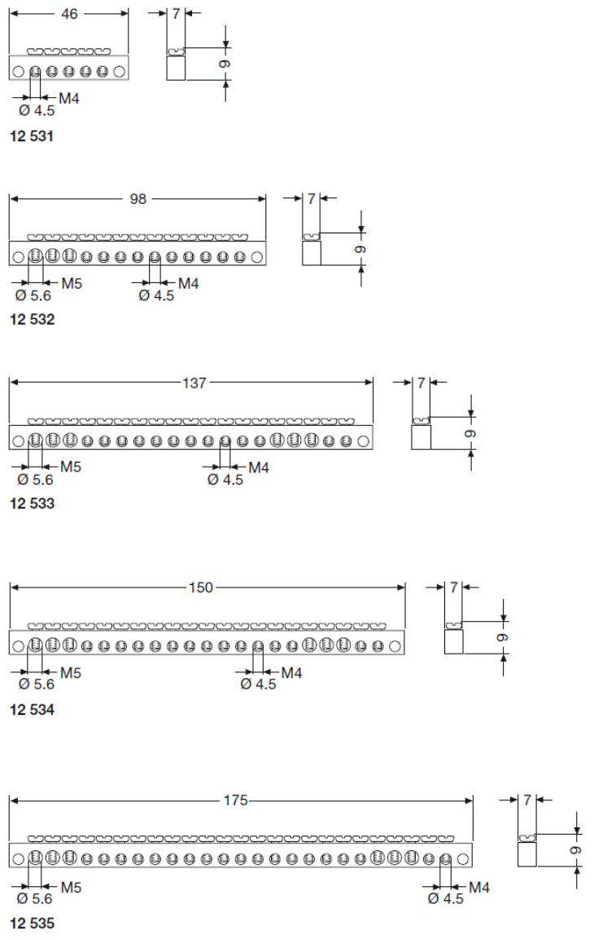
System Pro E Comfort
Consumer units EUROPA65
Solutions for photovoltaic systems
TERMINAL BARS - dimensions

Slide 8
System Pro E Comfort
Consumer units EUROPA65
Solutions for photovoltaic systems
TERMINAL BLOCK – assembly examples
TERMINAL CARRIER
1 | 2 | 3 | 4 | 5 | 6 | 7 | 8 | 9 | 10 | 11 | 12 | 13 | 14 | 15 | 16 | 17 | 18 | 19 | 20 | 21 | 22 | 23 | 24 | 25 | 26 | 27 | 28 | 29 | 30 | 31 | 32 | 33 | 34 | 35 | 36 | 37 | 38 | 39 | 40 | 41 | 42 | 43 | 44 | 45
12543
1 | 2 | 3 | 4 | 5 | 6 | 7 | 8 | 9 | 10 | 11 | 12 | 13 | 14 | 15 | 16 | 17 | 18 | 19 | 20 | 21 | 22 | 23 | 24 | 25
12540
1 | 2 | 3 | 4 | 5 | 6 | 7
12539
TERMINAL BARS
1 | 2 | 3 | 4 | 5 | 6 | 7 |  |  |  |  | 1 | 2 | 3 | 4 | 5 | 6 | 7 | 8 | 9 | 10 | 11 | 12 | 13 | 14 | 15 |  |  |  |  |  | 1 | 2 | 3 | 4 | 5 | 6 | 7 | 8 | 9 | 10 | 11 | 12 | 13 | 14 | 15 | 16 | 17 | 18 | 19 | 20 | 21
12531 |  |  |  |  |  |  |  |  |  |  | 12532 |  |  |  |  |  |  |  |  |  |  |  |  |  |  |  |  |  |  |  | 12533
1 | 2 | 3 | 4 | 5 | 6 | 7 | 8 | 9 | 10 | 11 | 12 | 13 | 14 | 15 | 16 | 17 | 18 | 19 | 20 | 21 | 22 | 23 |  |  | 1 | 2 | 3 | 4 | 5 | 6 | 7 | 8 | 9 | 10 | 11 | 12 | 13 | 14 | 15 | 16 | 17 | 18 | 19 | 20 | 21 | 22 | 23 | 24 | 25 | 26 | 27
12534 |  |  |  |  |  |  |  |  |  |  |  |  |  |  |  |  |  |  |  |  |  |  |  |  | 12535
ASSEMBLY EXAMPLES
1 | 2 | 3 | 4 | 5 | 6 | 7 | 8 | 9 | 10 | 11 | 12 | 13 | 14 | 15 | 16 | 17 | 18 | 19 | 20 | 21 | 22 | 23 | 24 | 25 | 26 | 27 | 28 | 29 | 30 | 31 | 32 | 33 | 34 | 35 | 36 | 37 | 38 | 39 | 40 | 41 | 42 | 43 | 44 | 45
1 | 2 | 3 | 4 | 5 | 6 | 7 | 8 | 9 | 10 | 11 | 12 | 13 | 14 | 15 |  | 1 | 2 | 3 | 4 | 5 | 6 | 7 | 8 | 9 | 10 | 11 | 12 | 13 | 14 | 15 | 16 | 17 | 18 | 19 | 20 | 21 |  | 1 | 2 | 3 | 4 | 5 | 6 | 7
1 | 2 | 3 | 4 | 5 | 6 | 7 | 8 | 9 | 10 | 11 | 12 | 13 | 14 | 15 | 16 | 17 | 18 | 19 | 20 | 21 | 22 | 23 | 24 | 25 |  |  |  |  |  |  |  |  | 1 | 2 | 3 | 4 | 5 | 6 | 7
 | 1 | 2 | 3 | 4 | 5 | 6 | 7 | 8 | 9 | 10 | 11 | 12 | 13 | 14 | 15 | 16 | 17 | 18 | 19 | 20 | 21 | 22 | 23 |  |  |  |  |  |  |  |  |  | 1 | 2 | 3 | 4 | 5 | 6 | 7
ABB S.p.A.
Viale Vicenza, 61
36063 Marostica (VI) - Italy
Tel.: +39 0424 478200
Fax: +39 0424 478305
www.abb.it/lowvoltage
www.abb.com
The data and illustrations are not binding. We reserve
the right to modify the contents of this document on
the basis of technical development of the products,
without prior notice.
Copyright 2016 ABB. All rights reserved.

