Slide 1
Extended Warranty
Service Product Management, December 2015
For Low Voltage Circuit Breakers

Slide 2
Extended Warranty
For Low Voltage Circuit Breakers
Protect the investment up to 5 years!
Low Voltage Breaker Standard warranty lasts for 1 year since production.
But ABB has defined multiple-year programs to extend the Active Low Voltage Breaker standard warranty up to 5 years:
+ 1 year → Free of Charge (with End users details)
+ 3 years → with an extra fee
+ 4 years → with an extra fee (with End users details)
Any accessory ordered mounted on the circuit breaker
is covered by the warranty

Slide 3
Extended Warranty
For Low Voltage Circuit Breakers
Access to extension warranty has never been so easy:
Just register yourself in the Warranty Extension tool and select the type of warranty you need for your active product.
An email is immediately sent to you with:
Part number(s)
Registration number to activate the extension of warranty
Both of them are required during Extended Warranty ordering phase

Slide 4
Extended Warranty Tool
For Low Voltage Circuit Breakers: Scenarios
only +3 year of extra warranty (tot=4 years) is available at a fee if end user’s details (Customer’s Name and ite details where the circuit breaker is or will be installed), are NOT specified:
With End User’s details (Customer’s Name and Site details where the circuit breaker is or will be installed), one extra year, free of charge, is offered:
+ 1year (tot= 2 years)
+ 4years (tot =5 years)
Delivery from Factory
End of Year 1
End of Year 2
End of Year 3
End of Year 4
End of Year 5
Standard factory warranty
3 years warranty
at a cost
Delivery from Factory
End of Year 1
End of Year 2
End of Year 3
End of Year 4
End of Year 5
Standard factory warranty
Free warranty with site details registered
Standard factory warranty
Free warranty with site details registered
3 years warranty at a cost

Slide 5
Extended Warranty
For Low Voltage Circuit Breakers
Access to Extended Warranty Tool → link
Available in ABB website: ww.abb.com
Offerings
LOW VOLTAGE PRODUCTS
SERVICE FOR LOW VOLTAGE PRODUCTS
SERVICE FOR BREAKERS AND SWITCHES
SPARES AND CONSUMABLES
Extended Warranty tool

Slide 6
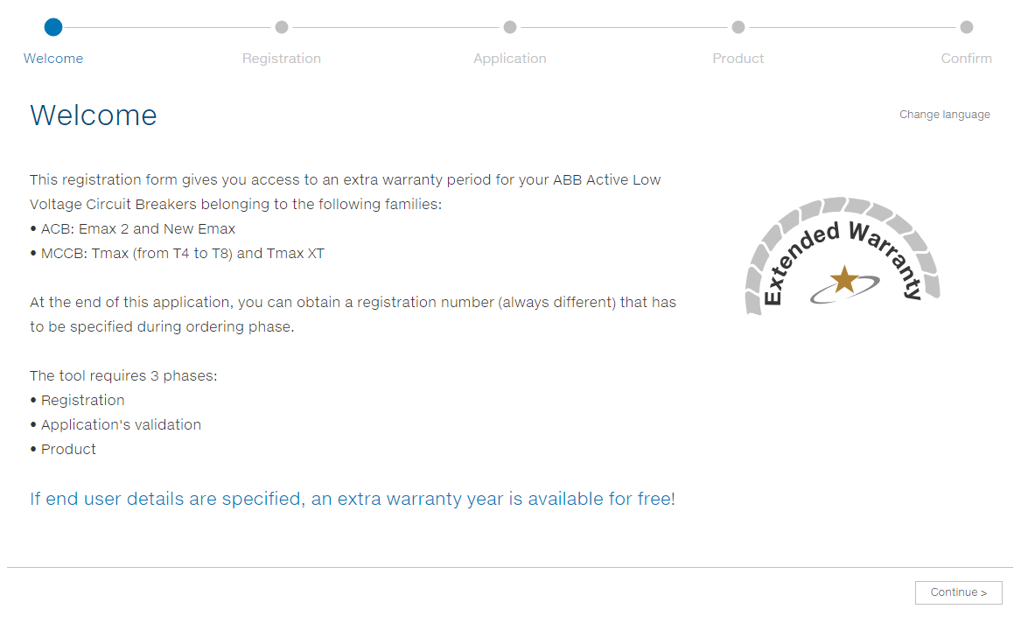
Extended Warranty
For Low Voltage Circuit Breakers

Slide 7
Extended Warranty
For Low Voltage Circuit Breakers
Registration
We need to profile you to offer the best solution:
For end user 1extra year is offered free of charge!

Slide 8
Extended Warranty
For Low Voltage Circuit Breakers
Application
Select from the list, the application where the circuit breaker is already or will be installed. Some critical applications, can require more checks

Slide 9
Extended Warranty
For Low Voltage Circuit Breakers
Product
Only the Active (according to LCM) low voltage breakers can have access to extension of warranty.
In 2016 the Active products are:
MCCB:
Tmax: T4, T5, T6, T7, T8
Tmax XT: XT1, XT2, XT3, XT4
ACB:
New Emax: E1, E2, E3, E4, E6
Emax 2: E1.2, E2.2, E4.2, E6.2

Slide 10
Extended Warranty
For Low Voltage Circuit Breakers
Product
Specify if you want to order:
a new circuit to be purchased with the warranty extension already included
only the warranty extension (as the circuit breaker has already been purchased) In this case, a check is requested: digit the circuit breaker’s serial number:

Slide 11
Extended Warranty
For Low Voltage Circuit Breakers
Confirm
A summary of what you have chosen:
Accept the standard and general conditions to complete the registration
USER

Slide 12
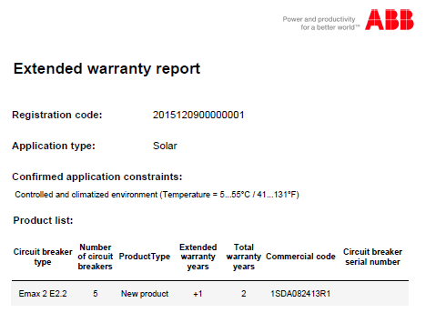
Extended Warranty
For Low Voltage Circuit Breakers
email
You will receive an email with:
Summary of the application checked
The list of the circuit breaker(s) involved in the Extension of warranty
The Extended Warranty Serial number(s) associated to the chosen circuit breaker(s)
The Registration code to activate the Extension of warranty

Slide 13
Extended Warranty
For Low Voltage Circuit Breakers
Order
You can now place an order with the Extended Warranty Part numbers indicated and the Registration code (as a note).

Slide 14
Extended Warranty
For Low Voltage Circuit Breakers
Benefits
Extend the warranty extension up to 5 years grants :
Protection of investment
Peace of mind
Partnership with ABB

