Slide 1
BU IS GIG Chemical, Oil & Gas
April 2014
Functional Safety Management Program

Slide 2
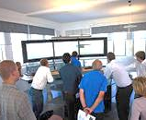
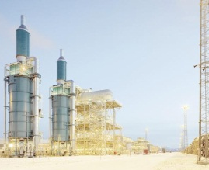
ABB in Oil and Gas Key facts
Over 50 years of experience in the Oil & Gas industry
1,000´s of successfully completed projects worldwide
Industrial solutions supplier of products, integrated automation and electrification systems, telecommunication, specialized EPC projects, consultancy and services
ABB 2011 sales in the Chemical, Oil and Gas market, in excess of $ 4.5 billion (systems and products)
#1 Upstream Oil and Gas DCS market share position
Over 7,500 dedicated oil and gas employees in 40 countries
Notes:
NAVIGATION INSTRUCTIONS
From slide 1- to 13 the presentation can be presented by scrolling down/up slides

Slide 3
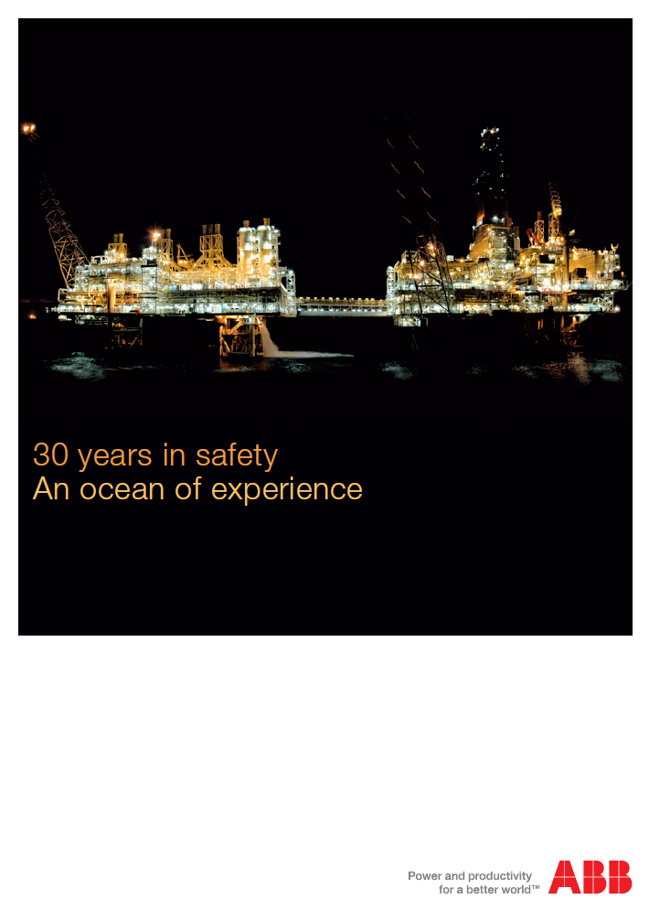
ABB in Oil and Gas 30 Years in Safety
Over 30 years of experience in the specification, design, implementation and installation of process safety systems
Over 3,000 800xA High Integrity systems installed globally since 2005
Developed and installed the original “integrated” safety system with the Safeguard platform
Global installations in over 55 countries including largest offshore installation on earth (Troll A)

Slide 4
ABB in Oil and Gas Committed to Functional Safety Management
Maintain the Functional Safety Management System (FSMS) in accordance with the IEC61508/11 standards
Promote a culture where everyone contributes to the Functional Safety of our customer’s installations
Ensure that everyone involved with safety related activities have the appropriate competencies
Maintain an understanding of all current industry standards, legislation, and guidelines associated with safety-related systems
Communicate and implement this policy throughout the organization

Slide 5
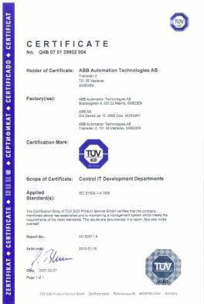
ABB in Oil and Gas Functional safety management – deployed globally
Objective: To ensure safety applications are implemented in accordance with the IEC61508 / IEC61511 standards
Strategy includes rollout via:
Safety Lead Competency Center (SLCC), tasked with:
Developing Functional Safety Management program
Defining / enforcing competency requirements
Creating assessment procedures for ABB OGP local project groups (SEC’s)
Local / Regional Safety Execution Centers (SEC)
Design, implement and deliver safety projects according the Functional Safety Management program and the customer’s Safety Requirement Specification
Providing TUV certified and competent safety engineers and experts
Offering safety consultancy and expert services
Achieve accredited TUV certification for Functional Safety Management delivery and project implementation

Slide 6
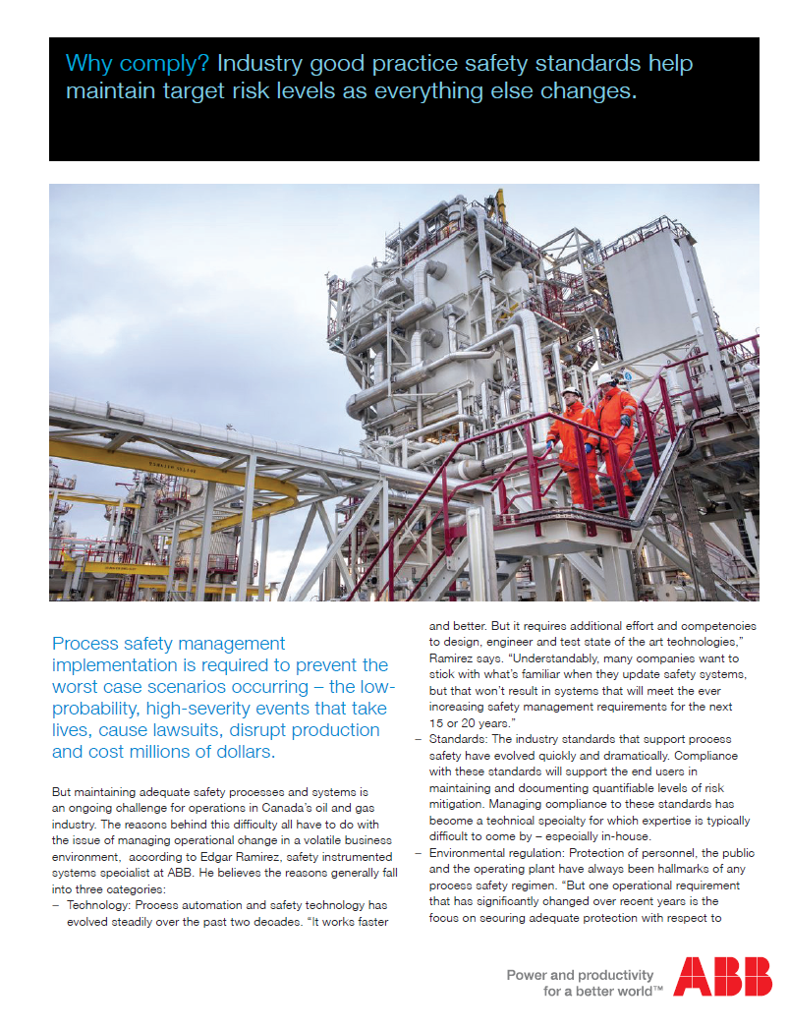
ABB in Oil and Gas Functional safety delivery – credible safety solutions
Challenges of safety in a volatile business environment:
Evolving technology
Managing compliance to the standards
Environmental regulations
Legacy protective systems
Why Comply with the standards?
“Good safety is good business”
Reduction of day to day operating costs as well as cost of future upgrades
Easier to deploy and maintain the desired level of risk reduction over time
Proof of compliance is available through documentation generated by following a Functional Safety Management System

Slide 7
Functional Safety Management
Driven by the standards

Slide 8
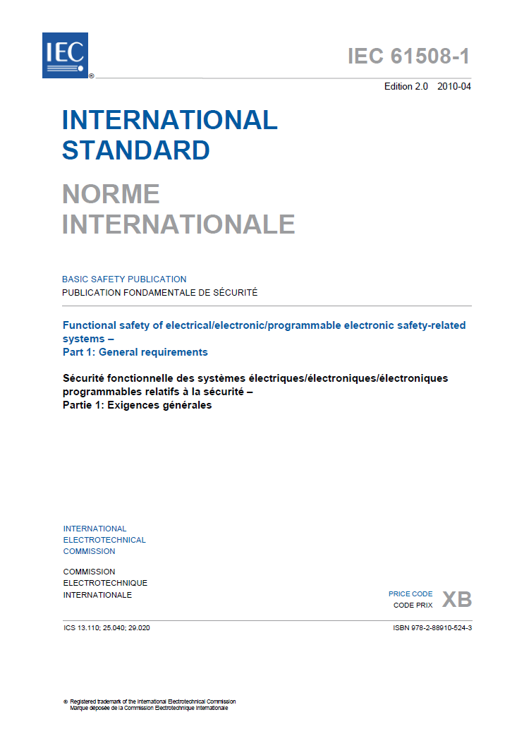
Functional Safety Management Industry Standard – IEC61508-1, 6.2.12
Those organizations or individuals who have responsibility for one or more phases of the overall, E/E/PE system or software safety lifecycles shall …specify all
management and technical activities that are necessary to ensure the achievement,
demonstration and maintenance of functional safety of the E/E/PE safety-related systems
In other words a functional safety management system

Slide 9
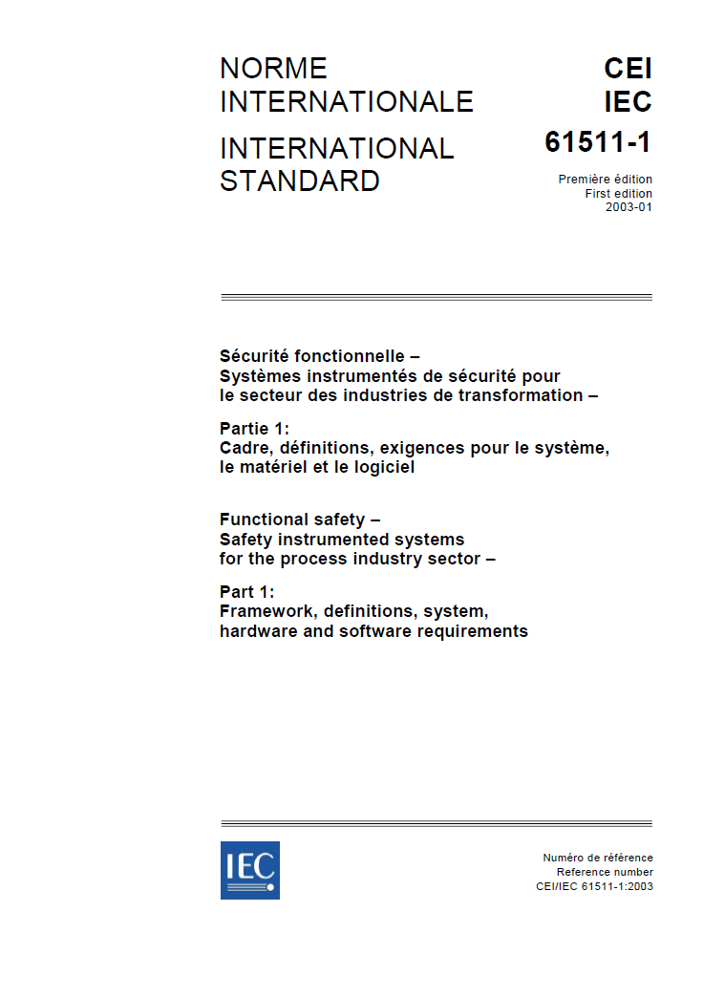
Functional Safety Management Driven by the Standards – IEC61511-1, 5.2.2.2
Competency Assurance
Persons, departments or organisations involved in safety lifecycle activities shall be competent to carry out the activities for which they are accountable….

Slide 10
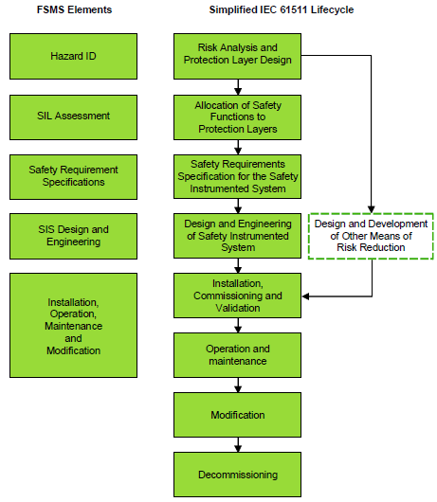
Functional Safety Management ABB’s Functional Safety Management System (FSMS)
Developed and maintained by ABB’s Consulting Group & Safety Lead Competency Center (SLCC)
Design & Engineering Capabilities Certified by TUV Rheinland
Common Design & Engineering FSMS Deployed at SEC’s
ABB’s Combined Procedures Cover:
Hazard Identification
SIL Assessment
Safety Requirements Specifications
SIS Design and Engineering
Installation, Operation, Maintenance and Modification

Slide 11
Functional Safety Management ABB’s SIS Implementation Strategy
Certified Products
Certified Development Teams
Certified Functional Safety Management System
Certified Safety Execution Centers
Certified Engineers
Technology Engineers 500+
TUV Function Safety Engineers 280+
TUV Functional Safety Experts 4
SLCC Functional Safety Assessors 36

Slide 12
Functional Safety Management
ABB’s Safety Execution Centers

Slide 13
ABB’s Safety Execution Centers Guiding principles
Architectural Design to meet target SIL requirements
PFD Calculations using appropriate reliability data for the desired loop configuration
SIL capability
SIS Design & Engineering
Hardware and Software Integration
Verification and Validation
SIL Achievement
Functional Safety Audits & Assessments
Information on operation and maintenance requirements - building on Manufacturers supplied data
Instructions for testing, operations & maintenance
Installation and commissioning
Accredited, TUV Certified Functional Safety Management Procedures for Design and Build activities
Source: IEC 61511

Slide 14
ABB’s Safety Execution Centers Delivery capabilities & expertise
SEC’s are engineering centers responsible for the execution of safety automation projects
Main function is as a system integrator
Scope is usually limited to the logic solver sub-system, but can include additional scope if required (i.e. end to end SIF’s)
All SEC’s are committed to ABB’s Functional Safety Management System and the TUV certification process
Using certified products developed according to the latest standards (IEC61508 Edition 2)
Implemented by a pool of certified engineers
Ability of offer complementary functional safety consultancy including:
Facilitation / Consulting
Technical or Standards Training
Independent Safety Requirements Specification Development
Independent Achieved SIL Assessments
Independent FS Assessments and Audits
Installation and commissioning Support

Slide 15
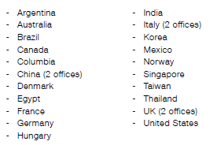
ABB’s Safety Execution Centers Over 24 locations globally
Safety Execution Center (SEC)
TUV Certified SEC

Slide 16
Functional Safety Management
Complementary Services

Slide 17
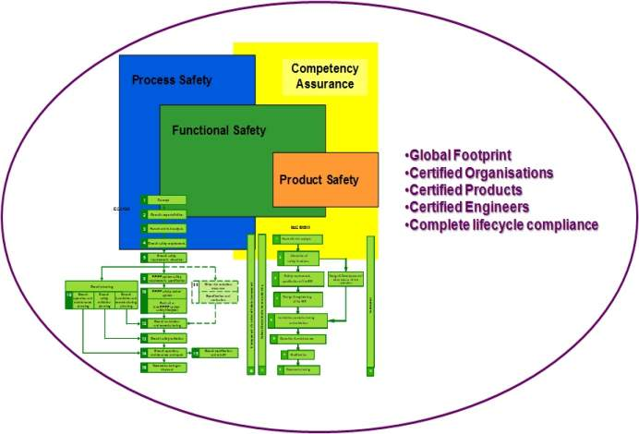
ABB’s Safety Execution Centers Safety Management Lifecycle Services
Seamless Integration of the key concepts to a best practice delivery model

Slide 18
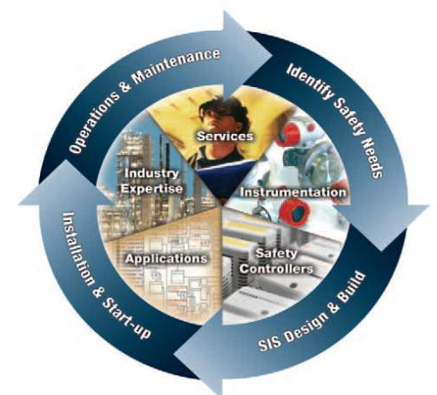
ABB’s Safety Execution Centers Complementary Functional Safety Services
Safety instrumented system (SIS) project design and engineering
Global implementation and delivery of integrated safety systems
Safety Lifecycle Consultancy:
Hazard Identification & Risk Management
Hazop, Hazan, SIL Assessments and Audits
TRAC LOPA and SIF Design Software Tool
Safety Requirements Specification development
Asset Benchmarking
Alarm Management
Proof Testing Support
Functional Safety Management System for end users
Full Service support
Complete Evolution Services – assured upgrade from earlier generation safety systems
SIL capable equipment - safety instrumentation, logic solvers and final elements

Slide 19
ABB Delivers Safety Assured Solutions Conclusion
ABB Methodology
Delivering the whole safety lifecycle on a global standardized approach
Certified Functional Safety Management program
Certified engineers
Traceable, auditable compliant systems and products
Competency assurance
ABB – Your Trusted Safety Partner
Meeting your regulatory and legal requirements
Supporting your ability to demonstrate duty of care and compliance
Facilitating your stakeholder confidence
Delivering “Fit for Purpose” technology, solutions and service support

