Slide 1
NERC CIP Version 5 webinar series “Baseline management”
10/22/2014

Slide 2
Housekeeping
All attendees are automatically in “Mute”.
If you have any questions, please type them into the questions panel.
This webinar is being recorded and can be found on http://new.abb.com/us/about/nerc-cip-education after the live event.
You will get a copy of this presentation in a follow-up email.
Please take a few moments at the end of the webinar to answer the survey questions.

Slide 3
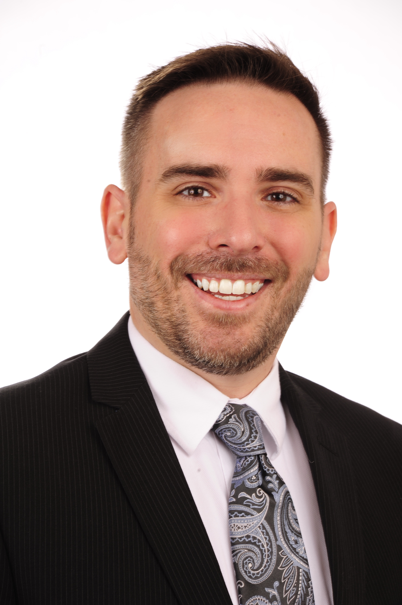
About the presenter(s)
Joseph Baxter CISSP/CISA/CISM/CGEIT/MCDBA/MCSE:S NERC CIP Lead – HVDC / FACTS joseph.baxter@us.abb.com (919) 807-5077
Before coming to ABB, Joseph Baxter completed several years as a NERC CIP Auditor for the SERC region, with special emphasis on the technical side of cyber security. He has both audited and been audited in the realm of CIP, and brings over fifteen years of Information Security experience gleaned from the Financial Sector to bear on the problems facing Grid Security today.

Slide 4
Quality evidence
Documentation is king
Record (get it down)
Retrieve (find it fast)
Reference (do it once)
Report (show it well)
Repeat (keep it up)

Slide 5
Managing risk
The four options (the T’s)
Tolerate (live with it)
Terminate (get rid of it)
Transfer (move it)
Treat (control it)

Slide 6
Audience question #1
Regional audits

Slide 7
Change management (over)simplified
Fitting baselines into the picture
Trigger
Impact CIP-002 R1
High
Medium
Baseline CIP-010 R1.1
Change
Change Impact CIP-010 R1.4
Impact CIP-002 R1
Medium
Low
No Change
High
Controls Test CIP-010 R1.5
Update Baseline Documentation CIP-010 R1.3
Accept
Authorize CIP-010 R1.2
Document
Deny

Slide 8
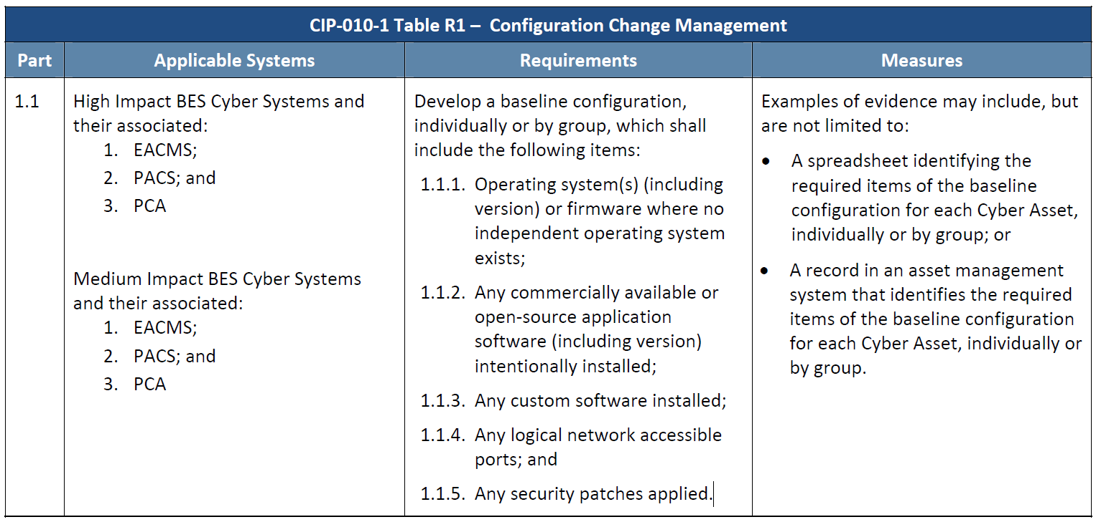
Basic baseline management
What makes up a baseline
OS or Firmware Version
Installed Software Version
Custom Software
Logical Network Ports
Security Patch Level

Slide 9
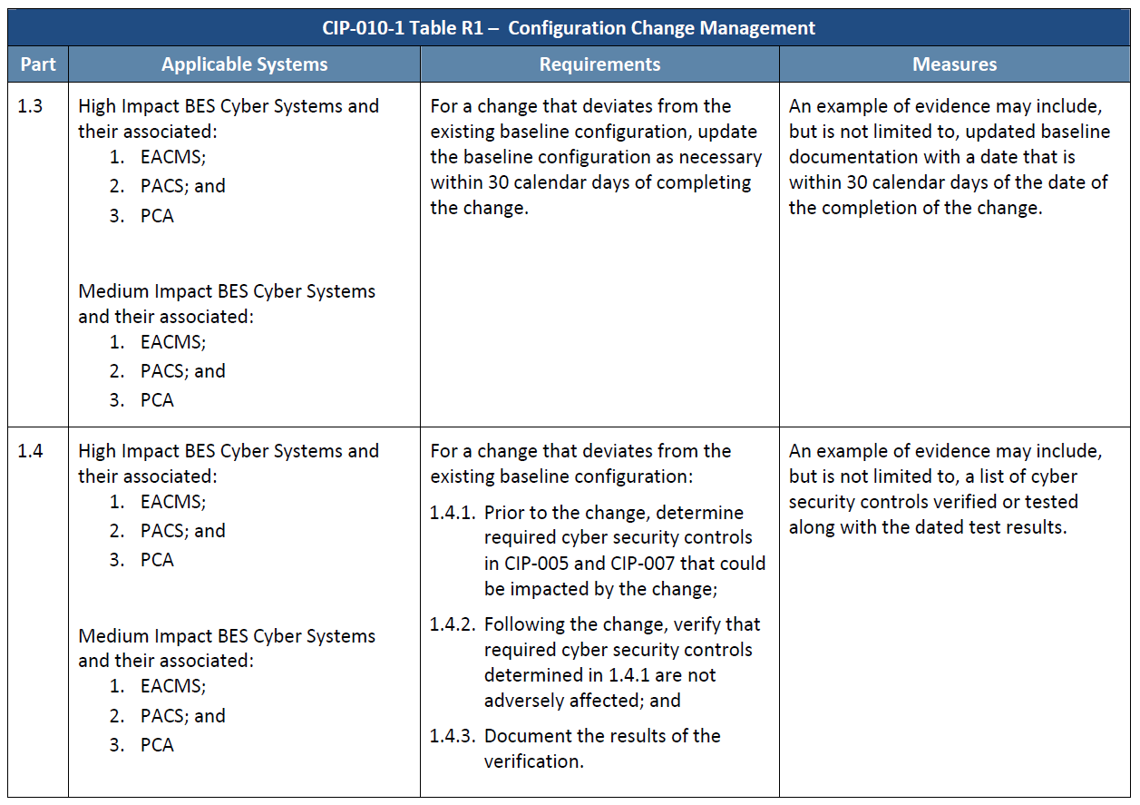
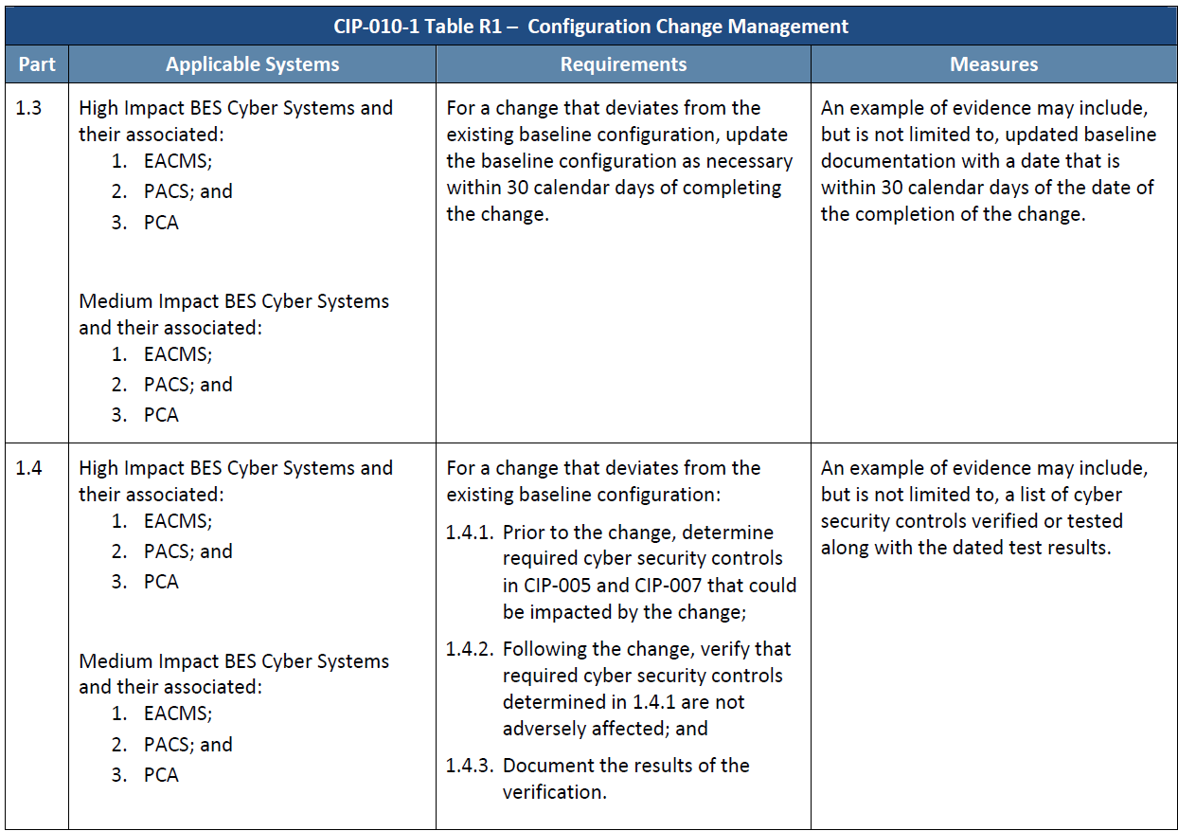
Security Controls
Baseline drives the process
Most of the requirements start with the same words
“For a change that deviates from the existing baseline…”
Presupposes extant evidence
Requires comparison

Slide 10
Detail required
The elements of a baseline
Regardless of the media
Each Cyber Asset
Individually or Group
Asset Management System
Not Likely Automated

Slide 11
Time machine
Data cube concept
Whether by spreadsheets
Or by database report
Be able to go backward in time and demonstrate a moment in time
Three years or from the last audit (or since V.3)
Data warehouse

Slide 12
Audience question #2
CIP consulting

Slide 13
Versioning systems
Programmatic tools to the rescue
Developers constantly change files when programming
They need the ability to fall back (and reference) previous versions
A few possibilities for versioning systems, many others available

Slide 14
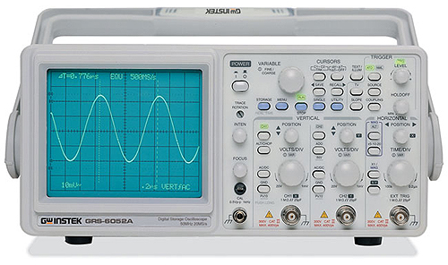
Baseline monitoring
Eternal vigilance
High Impact BES Cyber Systems only
Monitor at least once every 35 days
Document and Investigate
Show your work

Slide 15
Change management (over)simplified
Fitting baselines into the picture
Trigger
Impact CIP-002 R1
High
Medium
Baseline CIP-010 R1.1
Change
Change Impact CIP-010 R1.4
Impact CIP-002 R1
Medium
Low
No Change
High
Controls Test CIP-010 R1.5
Update Baseline Documentation CIP-010 R1.3
Accept
Authorize CIP-010 R1.2
Document
Deny

Slide 16
Additional NERC CIP educational webinars
(All webinars are Eastern Time)
Change management Wednesday, October 15, 2014 at 2:00 p.m. Learn about change management and the fact that this will be the largest area of recurring effort. You will gain understanding of why Patch Management is not a solution to meet your NERC CIP updates and why Version 3 no longer applies. Register now: https://www1.gotomeeting.com/register/567897657
Baseline management Wednesday, October 22, 2014 at 2:00 p.m. Learn what a baseline and testing are, why automation is key and what is required to meet Version 5 compliance. Register now: https://www1.gotomeeting.com/register/937111497
Cyber asset grouping Thursday, October 23, 2014 at 12:00 p.m. (Power generation specific) Learn process approaches to CIP-002-5.1 R1 as it pertains to BES cyber asset categorization. Register now: https://www1.gotomeeting.com/register/774616816

Slide 17
Additional NERC CIP educational webinars
(All webinars are Eastern Time)
Access management and malicious software controls Wednesday, October 29, 2014 at 2:00 p.m. Learn how to access control fits with CIP-004-5 and why account management is not effortless. Register now: https://www1.gotomeeting.com/register/448008129
Low assets and future CIP versions Wednesday, November 5, 2014 at 2:00 p.m. (Power generation specific) Learn the compliance requirements for entities with low assets and audit worksheets as well as future standard activities. Register now: https://www1.gotomeeting.com/register/872327665
Identification and review of critical transmission assets Wednesday, November 12, 2014 at 2:00 p.m. Learn how to approach the guidelines and criteria highlighted by NERC to fulfill the risk assessment goal. Register now: https://www1.gotomeeting.com/register/639963169

Slide 18
Automation & Power World (APW)
Power SmartStream Digital Conference
Theme: Preparing for the power evolution
Date: November 6, 2014 – 11 a.m. – 6 p.m. EST
Why should you attend? 25 educational webinars, dozens of scheduled chats and interviews and more than 100 white papers available for download from knowledgeable subject matter experts.
Earn Professional Development Hours (PDH) Download an official attendance certificate for every live webinar session you attend to get credit for your learning time
No travel or registration costs!
Can’t attend the day of? That’s fine. All webinars will be recorded and will be available for on-demand viewing after the live event.
Register now: http://bit.ly/SmartStreamPower

Slide 19
Automation & Power World (APW)
LIVE conference – APW 2015
Theme: Harnessing the power of change
Date: March 2-5, 2015 in Houston, Texas
Location: George R. Brown Convention Center
Why should you attend?
Listen to interesting and topical keynote presentations
Chose from over 300 industry and solution-focused educational sessions and panel discussions
Network with ABB experts and your peers
Earn Professional Development Hours (PDH)
Completely free!
Check the website for updates: http://new.abb.com/apw

Slide 20
Questions?
This is the point to review and answer any questions in the panel. If you have a question, please type your question in now.

Slide 21
Survey
Please take a few moments to answer the survey questions.
Thank you.

