Slide 1
Cyber Security Fingerprint Secure systems, protect production
Advanced Services

Slide 2
Cyber Security Fingerprint What does the fingerprint do?
Provides a comprehensive view of your site’s cyber security status
Identifies strengths and weaknesses for defending against an attack within your plant’s control systems
Reduces potential for system and plant disruptions
Increases plant and community protection
Supplies a solid foundation from which to build a sustainable cyber security strategy
It does NOT make the system completely secure.

Slide 3
Cyber Security Fingerprint Service with a defined scope
Benefits:
Consistent – same everywhere
High and even quality
Repeatable
Based on best practicies
Data
Collect
Store
View
Analyze
Interpret
Report

Slide 4
Cyber Security Fingerprint Diagnose, implement and sustain
4
Track
2
3
Manage Performance Gap
Hands-on
Scan
System Potential
1
Fingerprint
Diagnose
Implement
Sustain
Time

Slide 5
Cyber Security Fingerprint
Principles
Principle of least function
Principle of least privilege

Slide 6
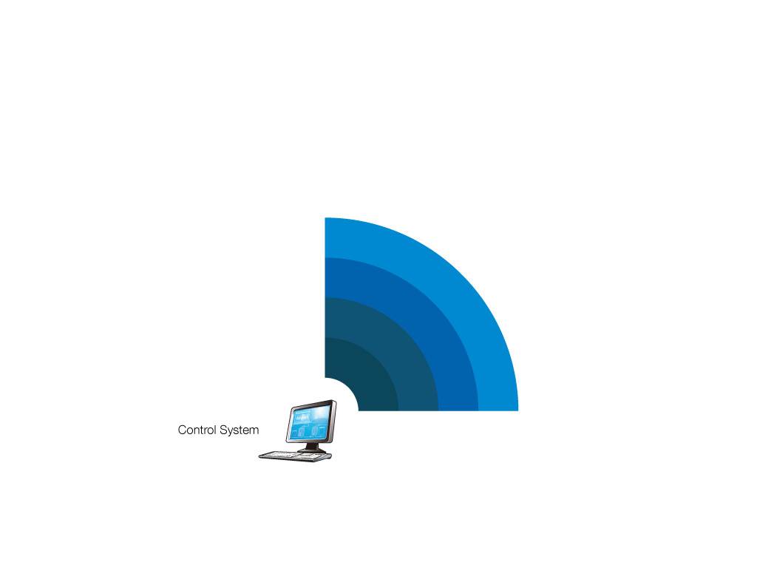
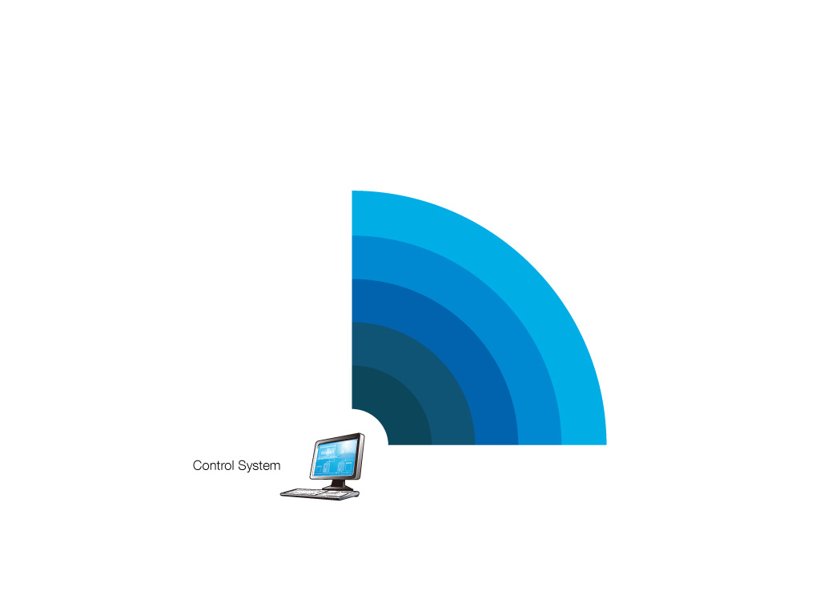
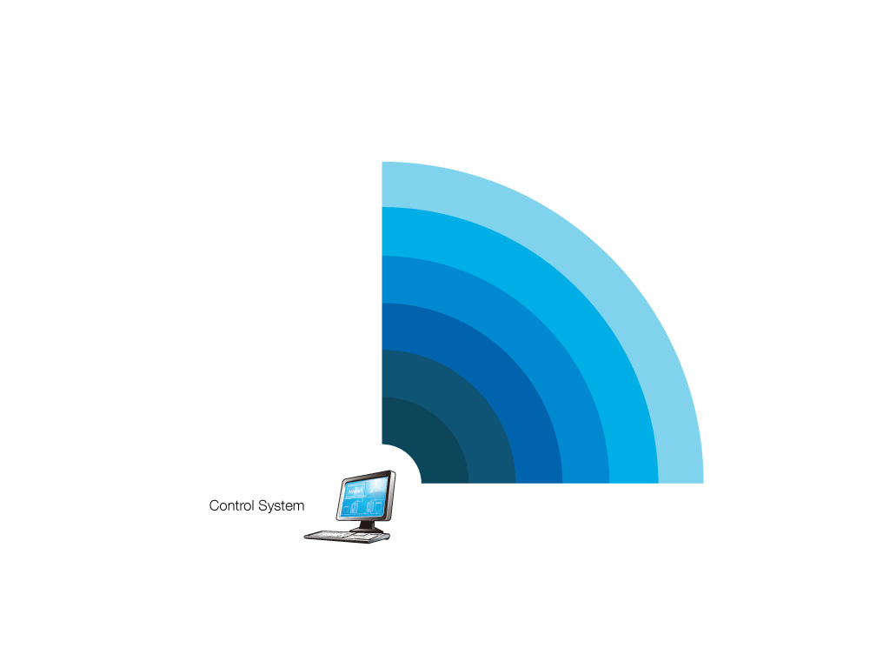
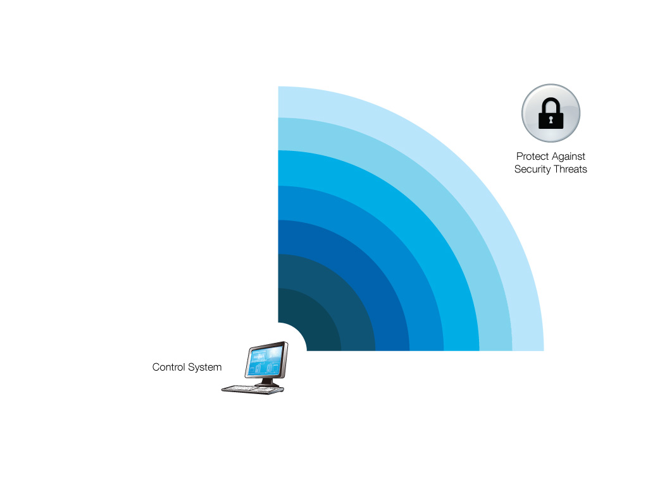
Cyber Security Fingerprint Security in depth
Physical Security
Procedures and Policies
Microsoft Firewall
Computer Policies
Account Management
Security Updates
Antivirus Solutions

Slide 7
Cyber Security Fingerprint Service with a defined scope
Energy
Design Details
Industrial Automation
IT
IEC 62351
Technical
Aspects
ISA 99*
NIST 800-53
IEEE P 1686
NERC CIP
Details of
Operations
Relevance
for Manufacturers
ISO 27K
CPNI
Operator
Manufacturer
Completeness
* Since the closing of the ESCoRTS project, ISA decided to relabel the ISA 99 standard to ISA 62443 to make the alignment with the IEC 62443 series more explicit and obvious.

Slide 8
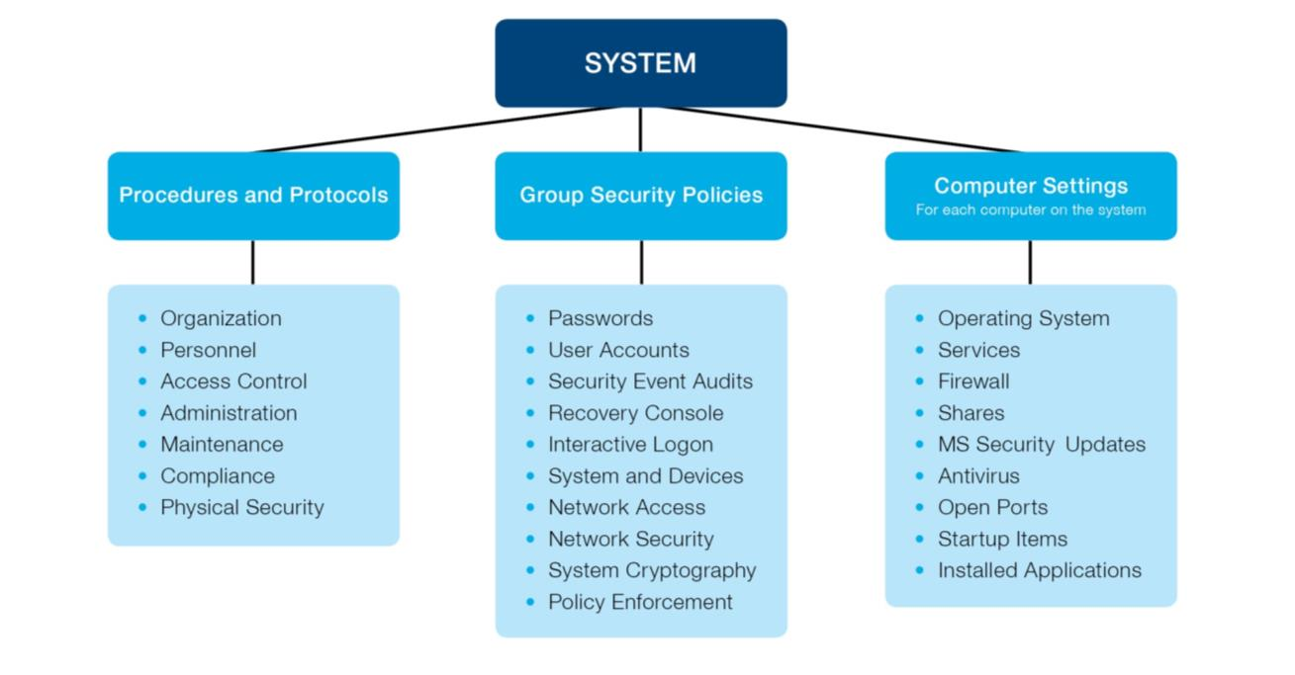
Cyber Security Fingerprint Key Performance Indicators

Slide 9
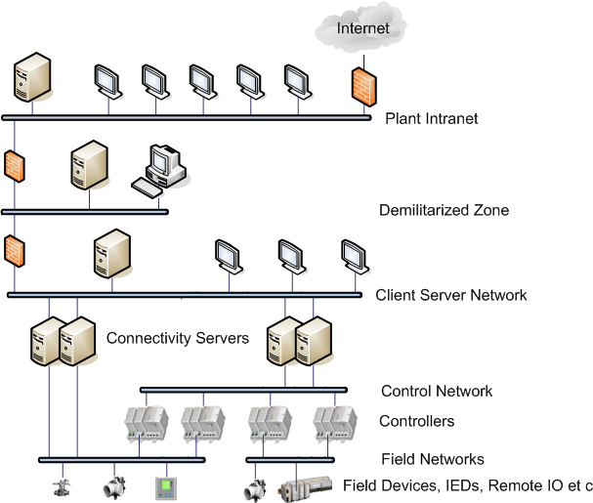
Cyber Security Fingerprint Control System Architecture - what to protect

Slide 10
Cyber Security Fingerprint Security Logger Data Collection Tool
Collects data without affecting the production
No installation
Only collects data
The collected data is saved as an encrypted file
Serves as support during interviews with key plant personnel
Over 90% timesaving compared to manual data collection

Slide 11
Cyber Security Fingerprint Interview
Notes:
______________________________________________________________________________________________________________________________________________________________________________________________________________________________________________________________________________________________________________________________________________________________________________________________________________________________________________________________________________________________________________________________________________________________________________________________________________________________________________________________________________________________________________________________________________________________________________________________________________________________________________________________________________________________________________________________________________________________________________________________________________________________________________________________________________________________________________________________________________________________________________________________________________________________________________________________________________________________________________________________________________________________________________________________________________________________________________________________________________________________________________________________________________________________________________________________________________________________________________________________________________________________________________________________________________________________________________________________________________________________________________________________________________________

Slide 12
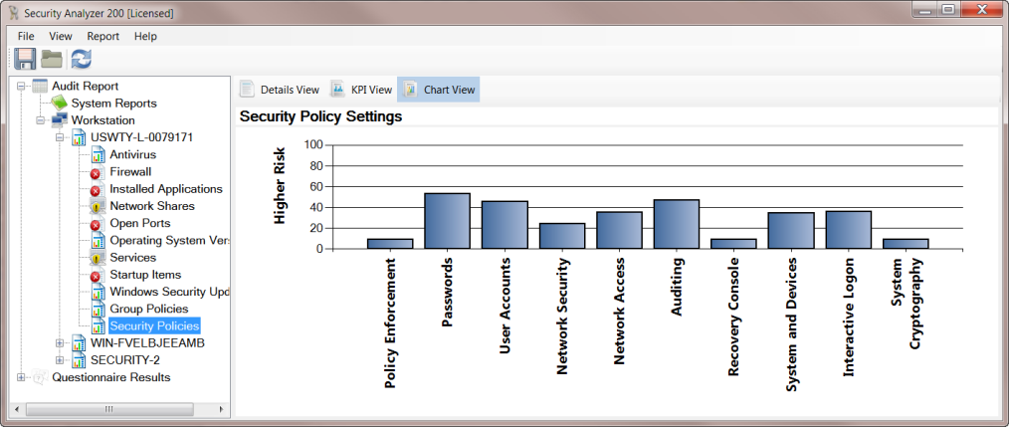
Cyber Security Fingerprint Security Analyzer Tool
Analyze the collected data
The only tool that can read the encrypted file
Apply different profiles

Slide 13
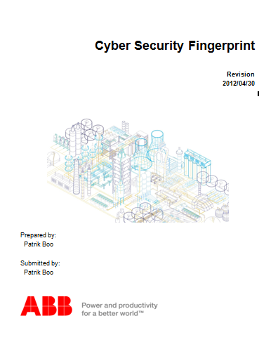
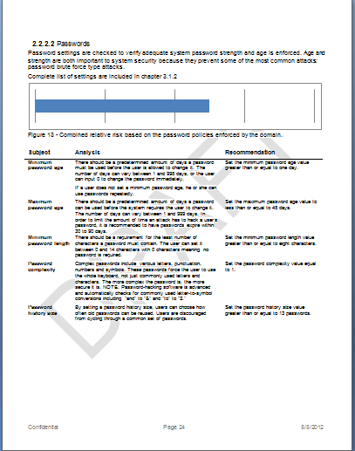
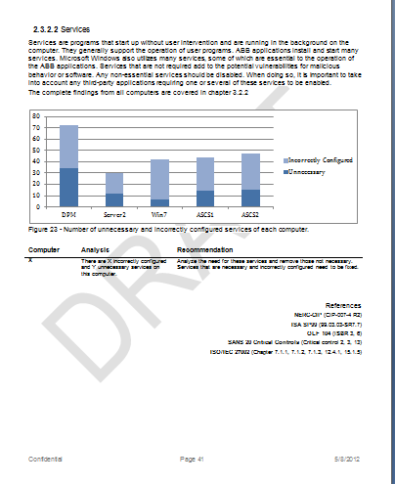
Cyber Security Fingerprint
Report with recommendations and action plan

Slide 14
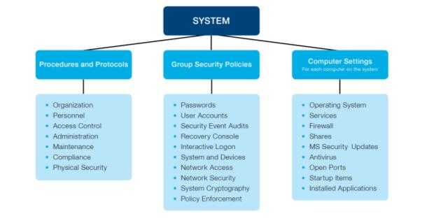
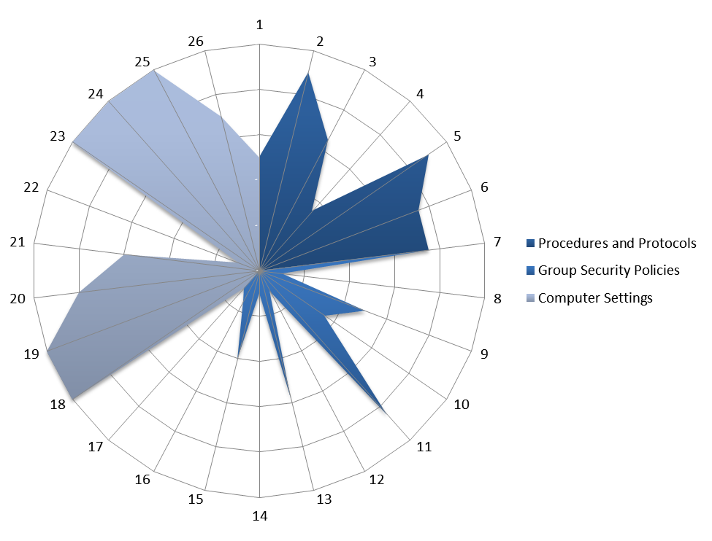
Cyber Security Fingerprint
Report: Risk Profile
High risk
Low risk
While the Fingerprint is an indicator of your security status at a given time, any system, no matter how many precautions are taken, can be compromised.

Slide 15
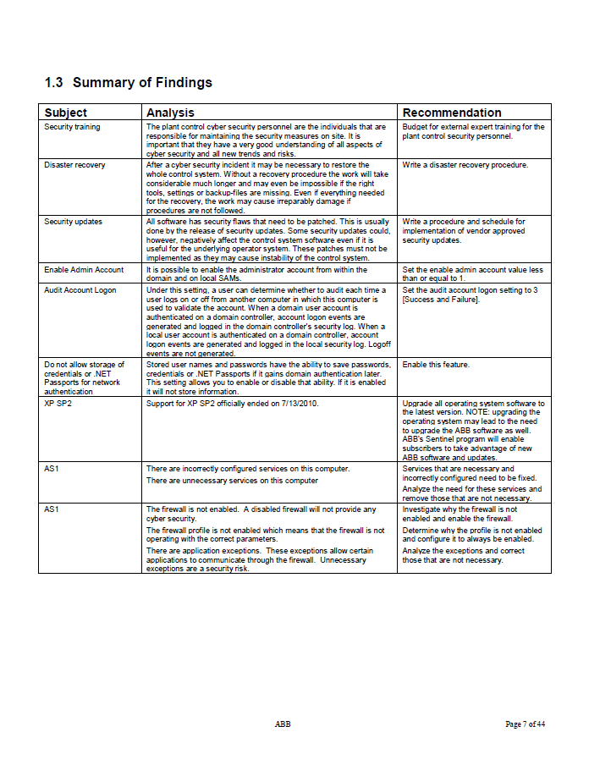
Cyber Security Fingerprint Recommendations

Slide 16
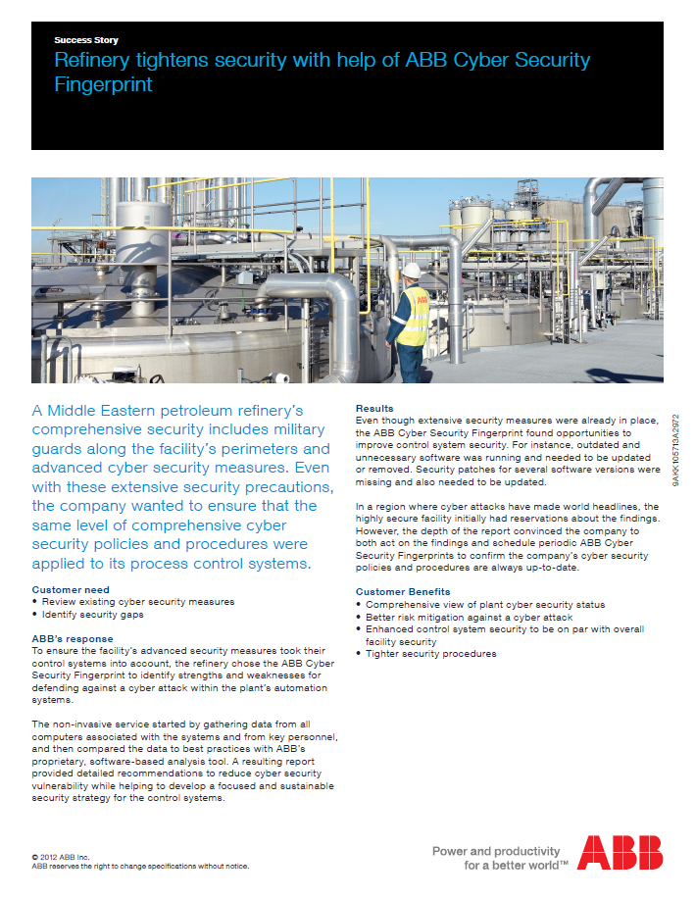
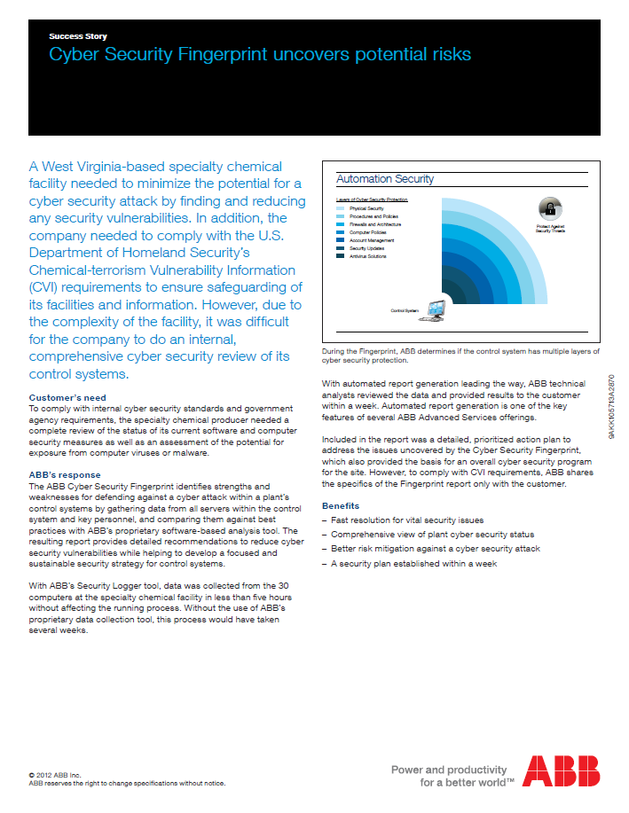
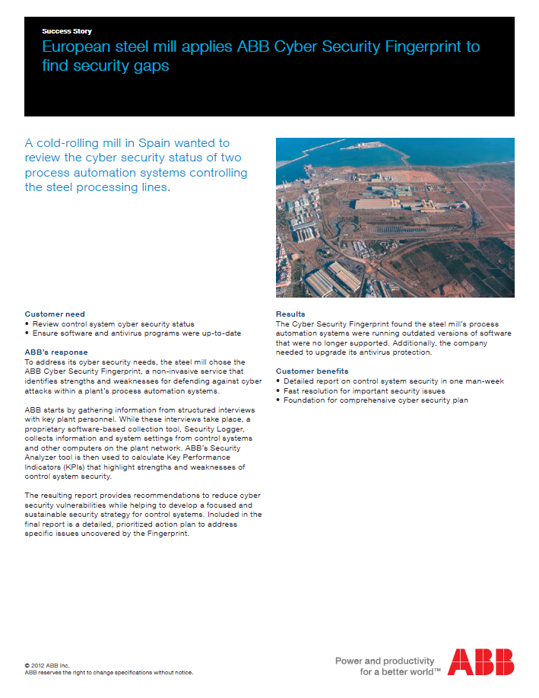
Cyber Security Fingerprint Success Stories

Slide 17
Cyber Security Fingerprint Pilot results

Slide 18
Cyber Security Monitoring Service (powered by ServicePort)

Slide 19
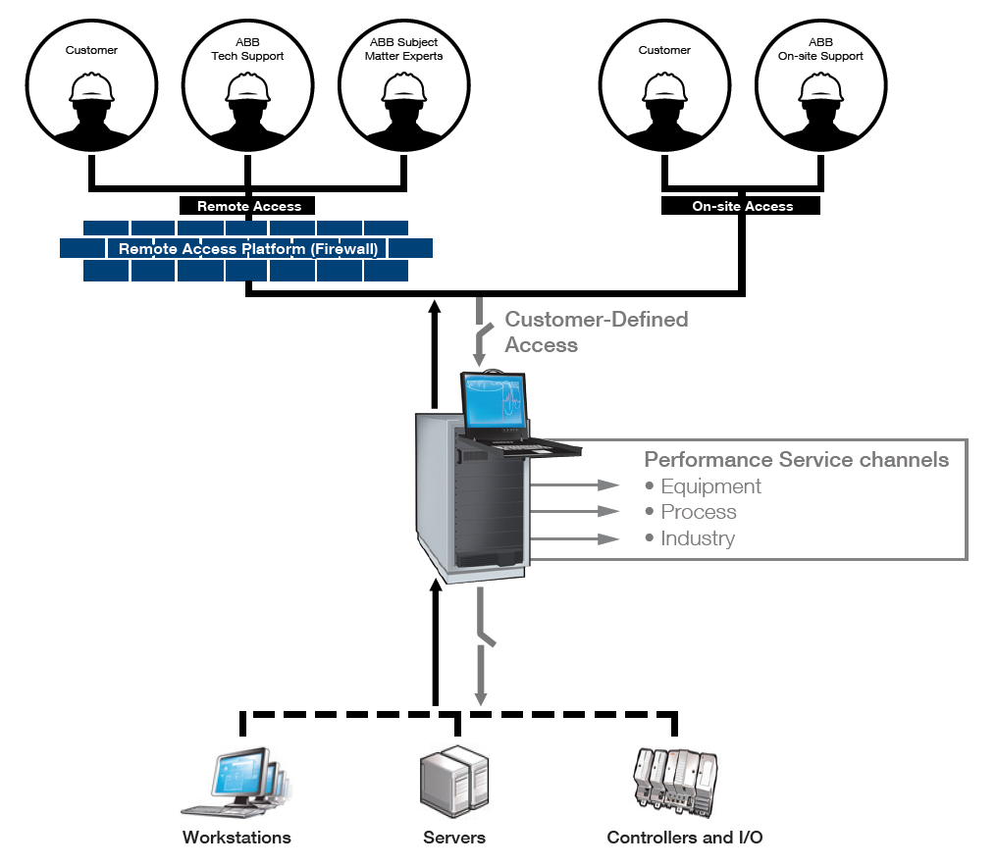
ServicePort Leverage the experts and reduce cost

Slide 20
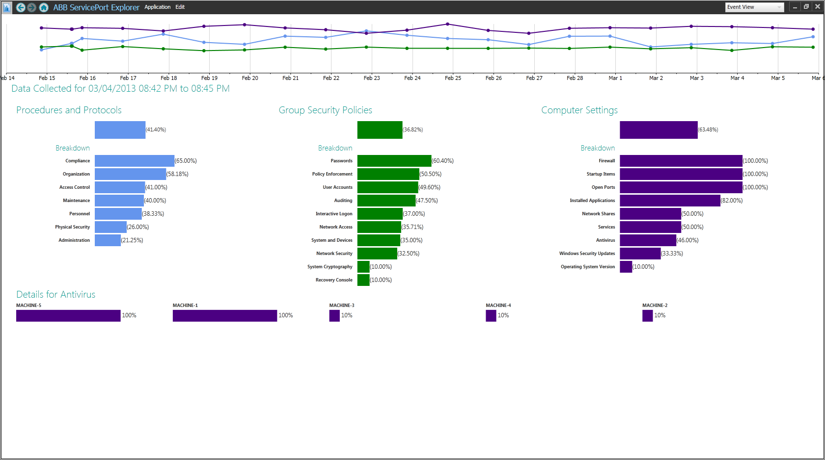
ServicePort Cyber Security Monitoring Service
9AKK105713A6279 A

